Slide 1



Annual meeting of the SEQ and ESC
20 - 23 october 2024
Quebec

Slide 2

What is a Sector Table
Association whose mandate is to ensure the sustainability and notoriety of an agrifood sector on the markets by promoting synergy between the various links in the sector with the common goal of meeting the demands of consumers and society in terms of food safety, the environment, product quality, farming conditions and economic benefits.

Slide 3
Our strategy, our values
Mission | Contributing to the recognition and innovation of the sector, the development of the industry, and the positioning of edible insects in the biofood system.
Vision | To be the place of consultation for the various links in the sector and implement a sustainable development strategy for the entire industry.
To commit to working collaboratively with stakeholders, focusing on finding common positions and objectives. Direct efforts towards bringing together complementary skills and leveraging different expertise. Establish a work environment conducive to dialogue and open to change.
To seek accuracy, objectivity, and reliability. Utilize one's knowledge, skills, and professional experience to achieve the desired results. Demonstrate consistency in one's positions to ensure continuity and alignment between decisions and actions of the Table.
To act in a fair and transparent manner towards all members and partners. Ensure fair and integral information sharing.
To mobilize partners proactively and agilely to foster the development and realization of innovative ideas in order to fulfill the mission of the table.
Consultation
Rigor
Transparency
Leadership & Innovation
Notes:
Traduire

Slide 4
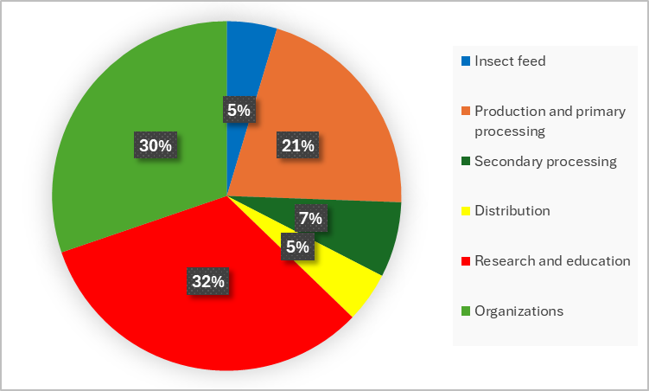
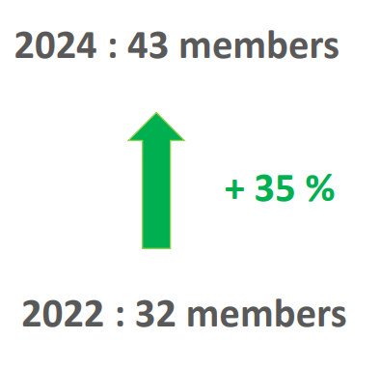
43
Members
Distribution of the members of the Table Filière des Insectes Comestibles (2024)
Notes:
Mettre les nouveaux chiffres

Slide 5
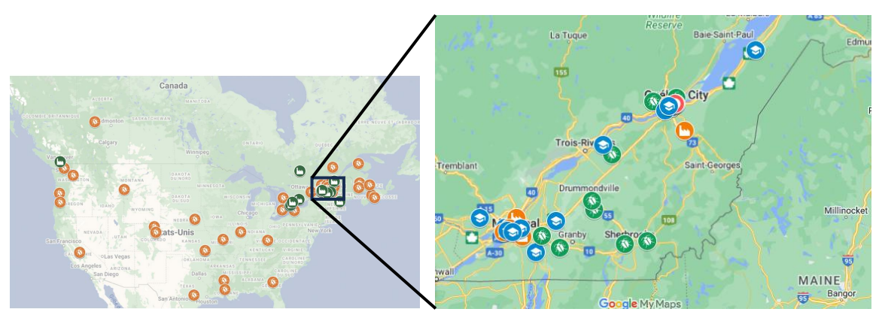
Insect companies in Quebec in 2024
https://insectescomestibles.ca/cartographie
Notes:
Carte des compagnies à jours

Slide 6
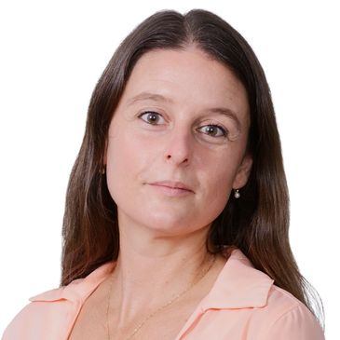


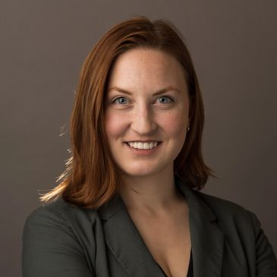
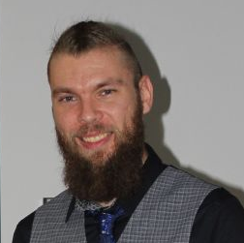
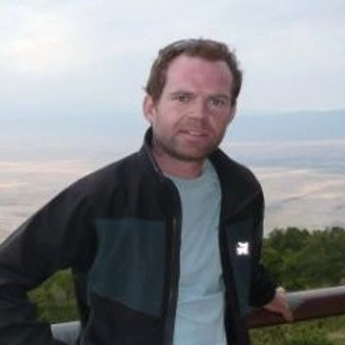



Who are we?
Marie-Hélène Deschamps, President
Marc-André Hébert-Briand, Vice-President
Christopher Warburton, Administrator
Jennifer Larouche, Administrator
Université Laval
Entologik & AETIQ
Entosystem
Ribozome
Florent Pechereau,
Development agent
TFIC
Yan Martel-Kennes, Administrator
Yves Fournier, Administrator
Benoit Choquet, agr. Administrator
Judith Lavoie,
Observer
Sollio Agriculture
CDBQ
Hagen Industries
MAPAQ
Notes:
Traduire

Slide 7
Strategic planification
Coordination of the TFIC
Sustainability of the TFIC
Coordination & consultation
Market development
Supply and accessibility of insect-based products
Industry notoriety
Networking
Integration of insect ingredients
Business development
Production volume
Legal framework
Business support (financing and mentoring)
Innovation, research & development
Communication
Legal aspect
Supply chain
Workforce & worker health

Slide 8
Strategic planification
Coordination of the TFIC
Sustainability of the TFIC
Coordination & consultation
Market development
Supply and accessibility of insect-based products
Industry notoriety
Networking
Integration of insect ingredients
Business development
Production volume
Legal framework
Business support (financing and mentoring)
Innovation, research & development
Communication
Legal aspect
Supply chain
Workforce & worker health

Slide 9
Strategic planification
Coordination of the TFIC
Sustainability of the TFIC
Coordination & consultation
Market development
Supply and accessibility of insect-based products
Industry notoriety
Networking
Integration of insect ingredients
Business development
Production volume
Legal framework
Business support (financing and mentoring)
Innovation, research & development
Communication
Legal aspect
Supply chain
Workforce & worker health

Slide 10
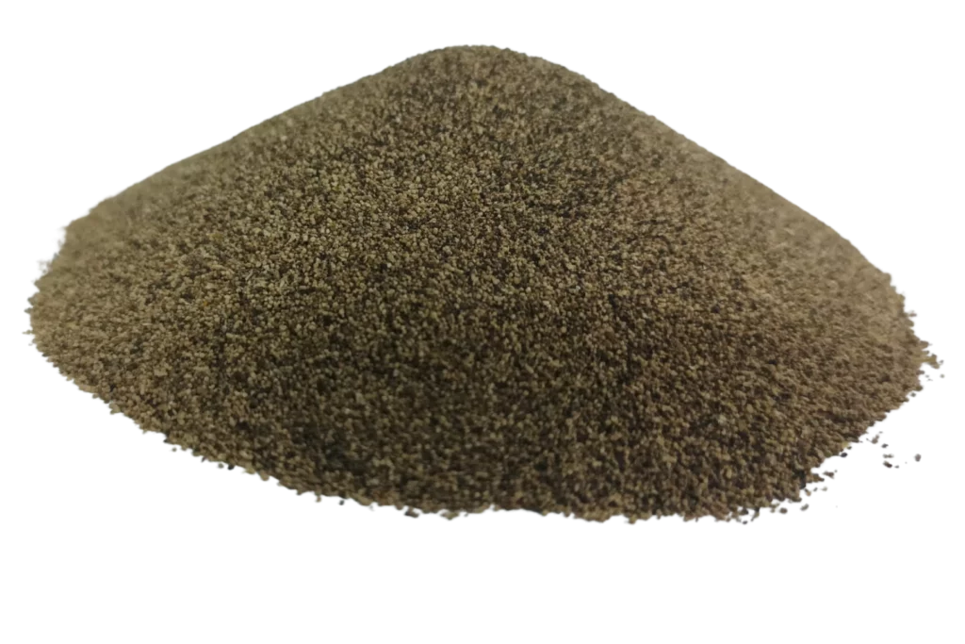
Working group
-
Frass

Slide 11
Mandate
Establish a definition of frass enabling its integration into federal and provincial regulatory frameworks
Summarize the current regulatory situation of frass at the provincial and federal levels
Issue a recommendation for the classification of frass based on species, inputs used, target market, risks associated with its commercialization, and potential valorization pathways
Make proposals for regulatory framework identification for each category of frass or specific regulation
Provide recommendations for analyses for frass categories based on regulatory criteria and risks to be addressed
Identify potential certification pathways for frass and provide recommendations on the need for such an approach

Slide 12
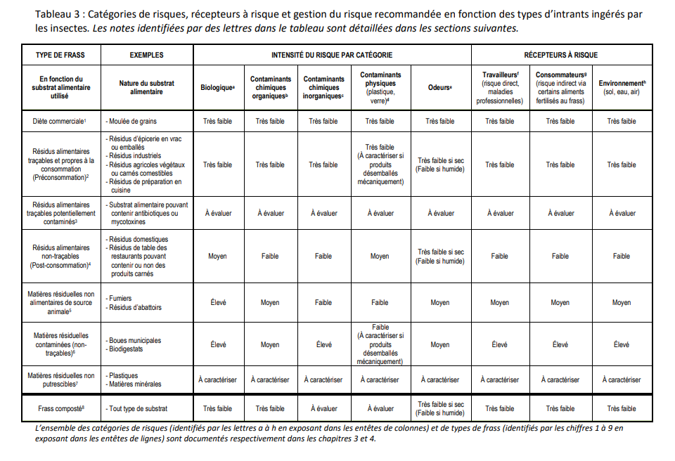
Document on the definition of frass
Update on current legislation
Expert recommendations
Definitions
Suggested citation : Table Filière des Insectes Comestibles (TFIC). Document de réflexion sur la définition et les bonnes pratiques de gestion des risques du frass, 2023, Québec, Canada.
Notes:
Frass (capture d’écran du tableau)

Slide 13

Working group
-
Communications
&
Media Relations

Slide 14
Mandate
Ensure the reputation of the table within the sector.
Ensure the research and transfer of relevant information to the entire sector.
Ensure consultation of sector members and transfer of relevant information between links.
Ensure the reputation of the Table internationally.
Ensure networking among TFIC members.

Slide 15
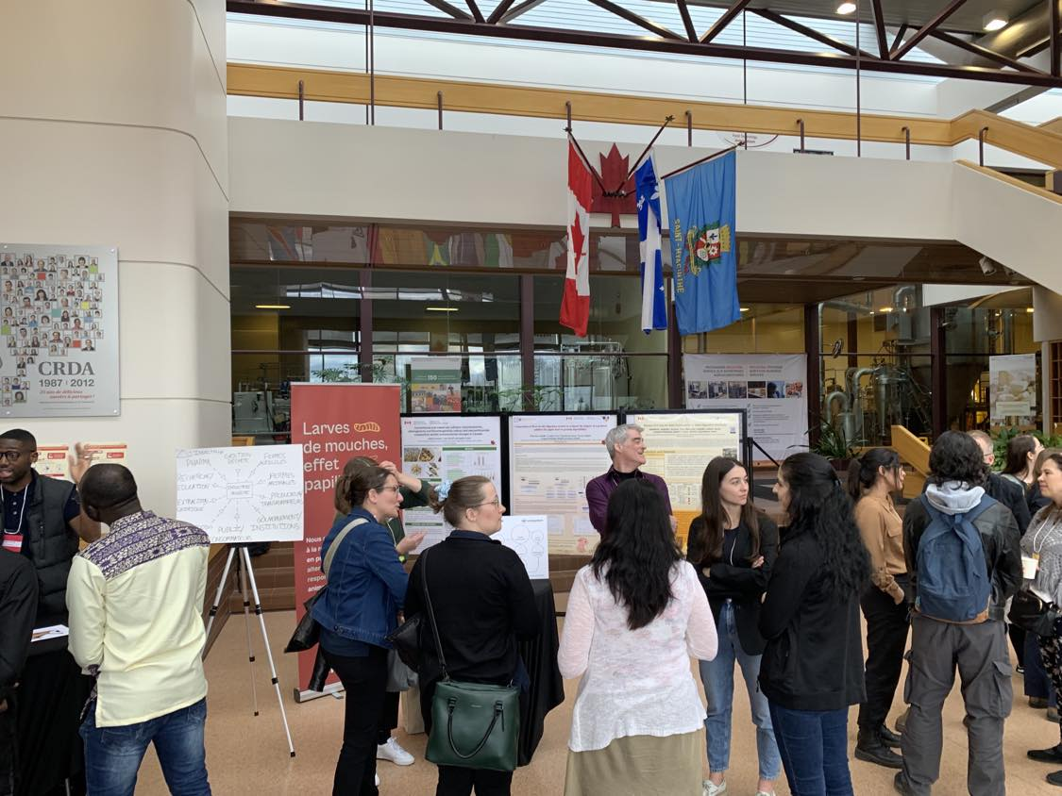
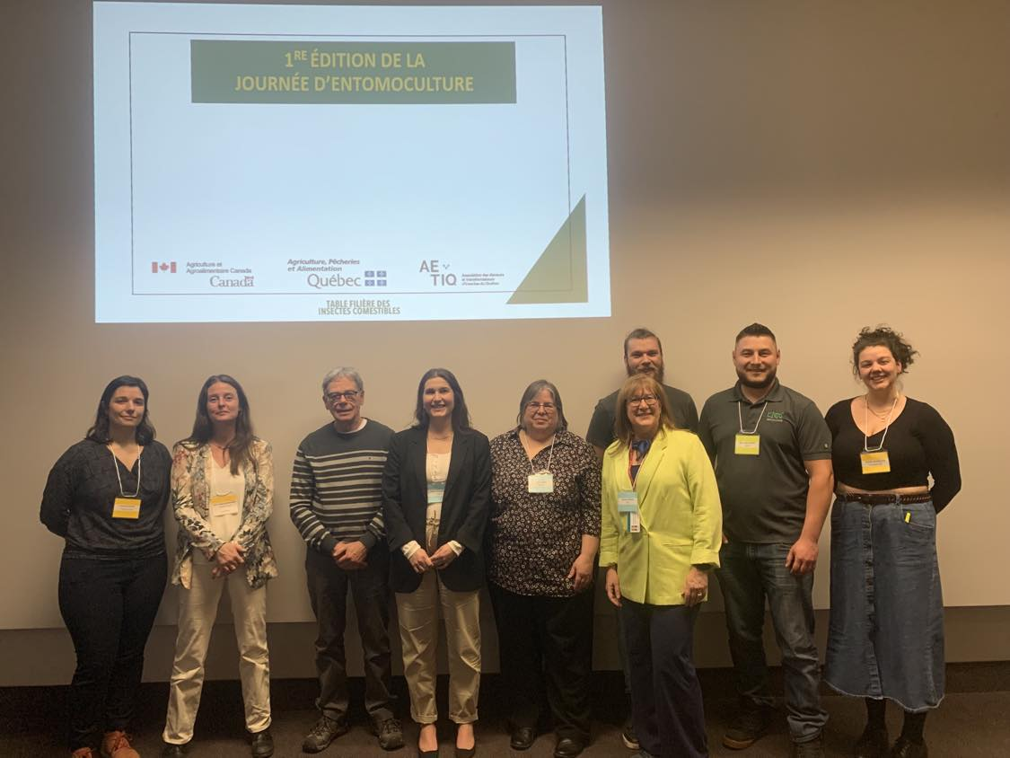
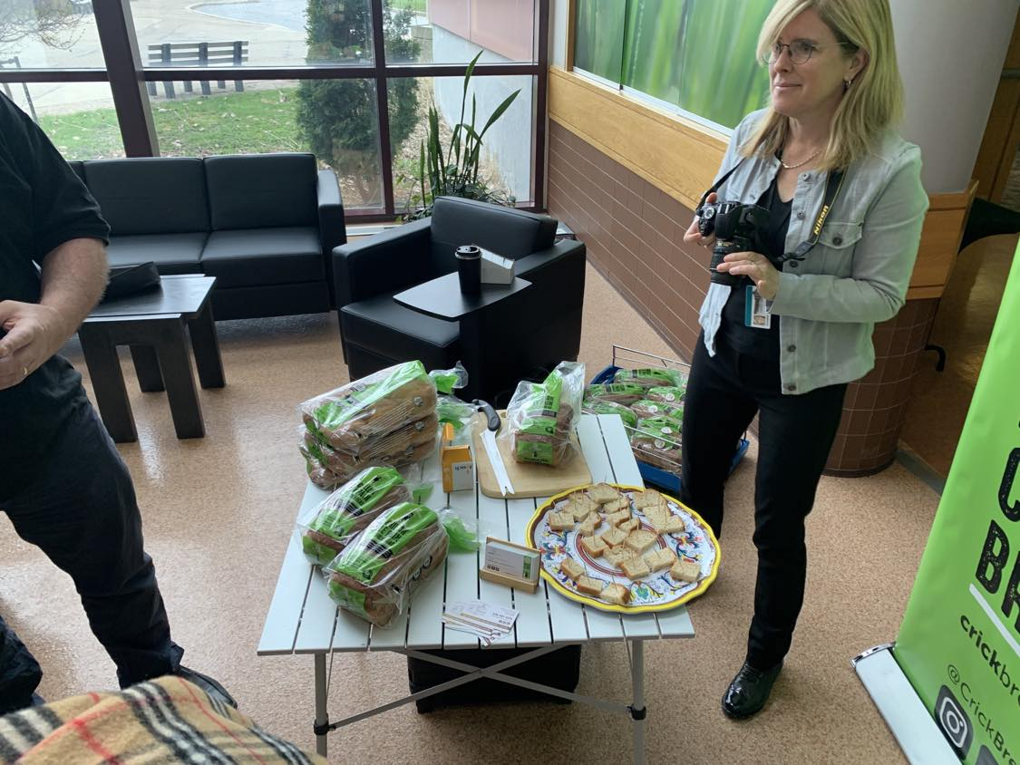
Day of Entomoculture – 1st edition
90 participants representing all links in the sector
8 hours of presentations and discussions
4 networking activities
Notes:
JE

Slide 16

Working group
-
Sectoral development

Slide 17
Mandate
Prioritize the different projects supported by the TFIC.
Stimulate an increase in the volumes of insect production in Quebec.
Promote a legal framework for the production of edible insects in Quebec.
Contribute to the development of suitable financing options for insect producers and processors.
Ensure support for highly skilled workforce.

Slide 18
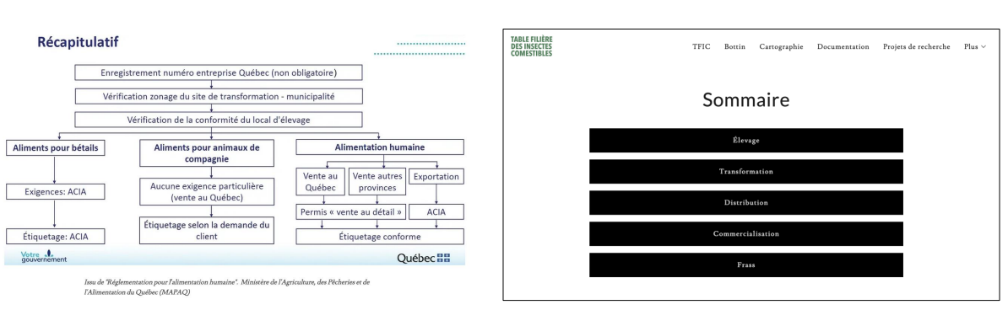
Updating regulatory frameworks
Available for free consultation on the website
Notes:
FAQ

Slide 19

Working group
-
Quality Assurance
&
Transformation

Slide 20
Mandate
Standardize and enhance the quality of insects to meet different markets.
Contribute to the automation and integration of information technologies in insect production.
Develop standardized analysis methods.
Study the variation of insect ingredients.
Analyze industry problems related to food allergies.
Clarify labeling requirements.

Slide 21
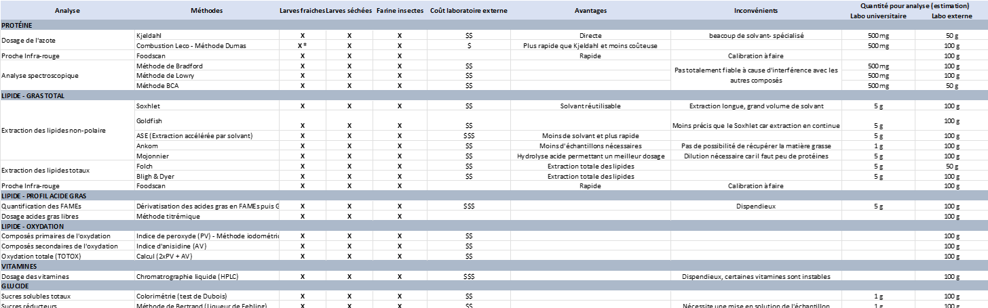
Various types of analyses for insect products
Expert recommendations
Industry support
Notes:
Tableau Méthode (AQ)

Slide 22
Recent work
December 2023
Industry support for the sector
(2 years)
March 2024
Publication of the document on the definition of frass
(available on TFIC web site)
April 2024
Day of Entomoculture
(1st edition)
June 2024
TFIC Annual Meeting 2024
Summer 2024
1) FAQ
2) Collaborative table on
analysis methods

Slide 23





DON'T MISS ANY OF OUR NEWS
https://www.facebook.com/TFInsectesComestibles
https://insectescomestibles.ca/tfic
https://www.linkedin.com/company/table-filière-des-insectes-comestibles/

