Slide 1
Business Advisory Council Webinar
Michelle Washington
September 10, 2021

Slide 2
Business Advisory Council Overview
Ohio law requires every school district and Educational Service Center to have a Business Advisory Council. This law was amended on March 2, 2020, to allow Joint Vocational School Districts to represent school districts as Business Advisory Councils.

Slide 3
Business Advisory Councils
Business-Education partnerships locally focused on providing experiential learning for students while developing a skilled talent pipeline.

Slide 4
Quality Practices
Developing Professional Skills for Future Careers​ Identify professional skills needed for future jobs. Develop curriculum that aligns to these skills. Advise on changes in the economy and market.​
Building Partnerships​ Develop working relationships among businesses, labor and education personnel.​
Coordinating Career-Related Experiences​ Create environments that allow students to demonstrate critical professional and specialized skills that aid in future employment.​
Notes:
CASSIE

Slide 5
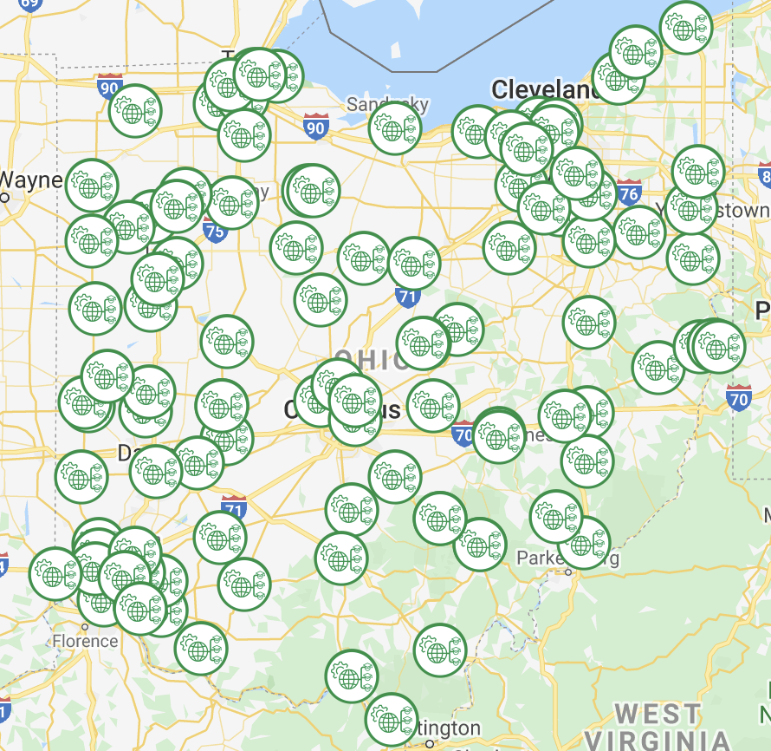
Business Advisory Councils in Ohio
Find the councils and which school districts they serve here.

Slide 6
Tips for Improving Effectiveness of Business Advisory Councils
Increase Involvement with Business Partners
Co-design initiatives to address workforce gaps while enhancing opportunities for students
Establish new partnerships on your Business Advisory Councils reflective of industries in your district
Increase communications to your business partners outside of meetings
Be open to feedback from your business partners

Slide 7
Strengthening Partnerships through Data
College and Career Readiness Data Dashboards
Ohio’s Top Jobs List
Survey Business Partners
Notes:
Ohio’s strategic plan for education, Each Child, Our Future, recognizes the importance of giving students access to practical, real-world work settings, so they can gain valuable exposure to the skills and knowledge necessary for their future career goals. When districts and schools connect with local business and industry partners, students can participate in innovative approaches to learning that strengthen the linkages between academics and preparation for future success and career readiness.
-The Department is committed to fostering positive relationships with stakeholders, including the business community, through Business Advisory Councils.
- We are working on the best ways to support these councils through state level partnerships with the Ohio Educational Service Center Association, OACTS, state board members, and our Business Association Leaders that we will discuss later in this presentation.

Slide 8
Strengthening Partnerships through Membership Expansion
Ohio Chamber of Commerce Member Directory
Jobs and Family Services Employer List
Small Businesses in your Region
Notes:
Ohio’s strategic plan for education, Each Child, Our Future, recognizes the importance of giving students access to practical, real-world work settings, so they can gain valuable exposure to the skills and knowledge necessary for their future career goals. When districts and schools connect with local business and industry partners, students can participate in innovative approaches to learning that strengthen the linkages between academics and preparation for future success and career readiness.
-The Department is committed to fostering positive relationships with stakeholders, including the business community, through Business Advisory Councils.
- We are working on the best ways to support these councils through state level partnerships with the Ohio Educational Service Center Association, OACTS, state board members, and our Business Association Leaders that we will discuss later in this presentation.

Slide 9
Sample Meeting Agenda and Protocol
Welcome
Updates and Events
Employer share-out:
Professional Development opportunities
Workforce needs
Internship/apprenticeship opportunities
Job shadowing opportunities
New Items:
Co-design opportunities
Workgroups
Goals and Priorities Progress report
Additional items
Q & A
Closing

Slide 10
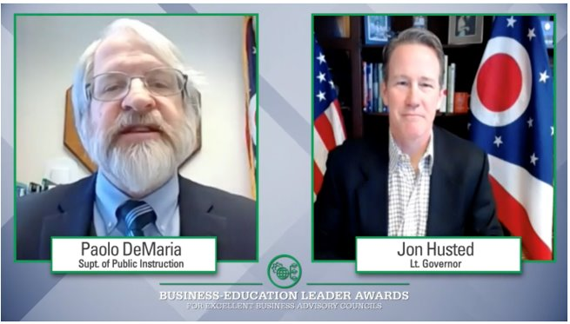
Awards for Excellent Business Advisory Councils
Find the announcement of the 2021 award winners here!​
Four-Star Councils:​
Cincinnati Public Schools​
Columbiana County Business Advisory Council​
Three-Star Councils:​
Building Bridges to Careers​
ESC of Central Ohio​
ESC of Northeast Ohio​
Marion Area Workforce Acceleration Collaborative​
Montgomery County ESC​
Muskingum Valley ESC​
Noble Local School District​
North Point ESC​
Piqua Business Advisory Council​
Tri-County ESC
Notes:
MICHELLE

Slide 11
Important Dates
Business Advisory Councils are required to submit an annual plan to the Ohio Department of Education by September 30th each year.
Optional Addendums should be submitted to be considered for Award for Excellent Business Advisory Councils by September 30th.
Find a planning template and instructions on where to upload your plan on our webpage: education.ohio.gov/bac
Joint statements, summarizing the work of the council, should be published on the council’s webpage by March 1st.
Find examples by searching the internet for:
“Ohio Business Advisory Council Joint Statements”
Notes:
MICHELLE

Slide 12
Resources
Directory of Business Advisory Councils throughout Ohio.
Business Advisory Councils are steered by established quality practices.
Business Advisory Council Awards
Highlight Report

Slide 13
Questions?
Notes:
CASSIE

Slide 14
@OHEducation

