Slide 1
Western Buckeye ESC
Paulding County, Ohio

Slide 2
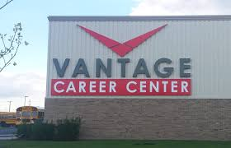
How we started:
Meet with Senior students: Career Booklets
Meet with Junior students: College Booklets
Meet with Student Councils for opinion
Host Seniors for Career Day
Attended both HR Managers Meeting &
Western Buckeye ESC Meeting
Combined HR Managers/WBESC Meetings into Business Advisory Council

Slide 3
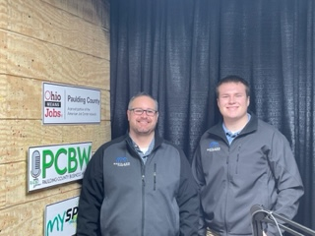
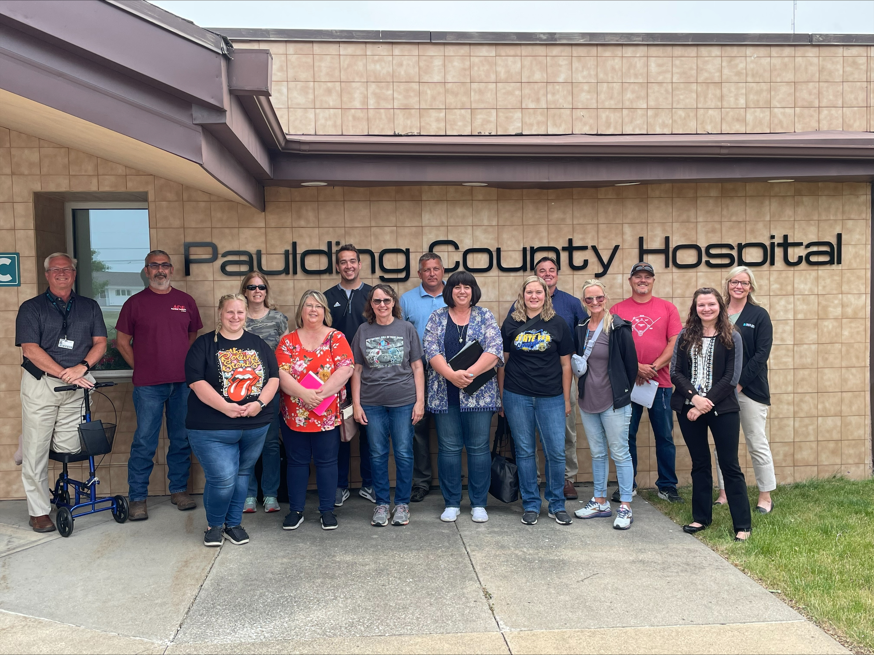
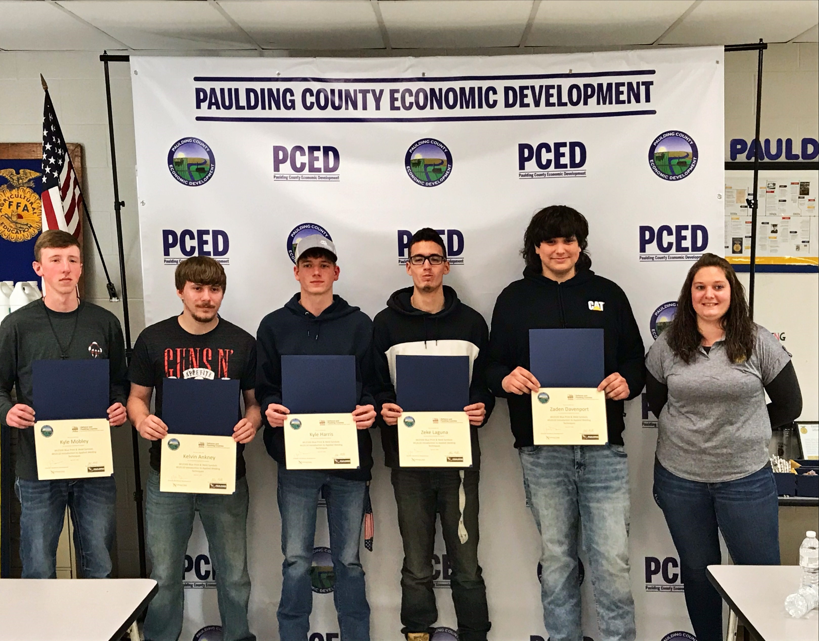
Discussions led to new opportunities:
Paulding County Business Weekly
Expanded Career Day
Now includes Seniors, Juniors & Career Center students
After school welding class for struggling students or those not attending career center
Teacher Boot Camp
More Business & Industry Discussions Lead to:
Welding Class Credentials
Carpentry Class Credentials

Slide 4
Business Advisory Council Steering Committee
Developed 2023
Involved in BAC Template
Meets quarterly before each quarterly BAC meeting
Sets Agenda for BAC meeting
College Survey
Student Testimonials

Slide 5
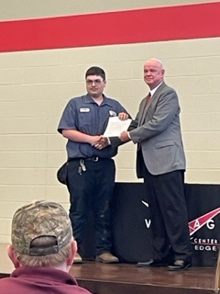
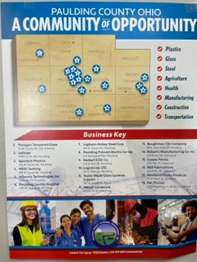
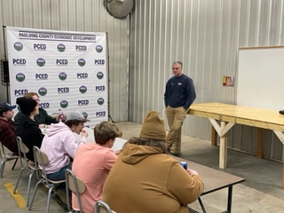
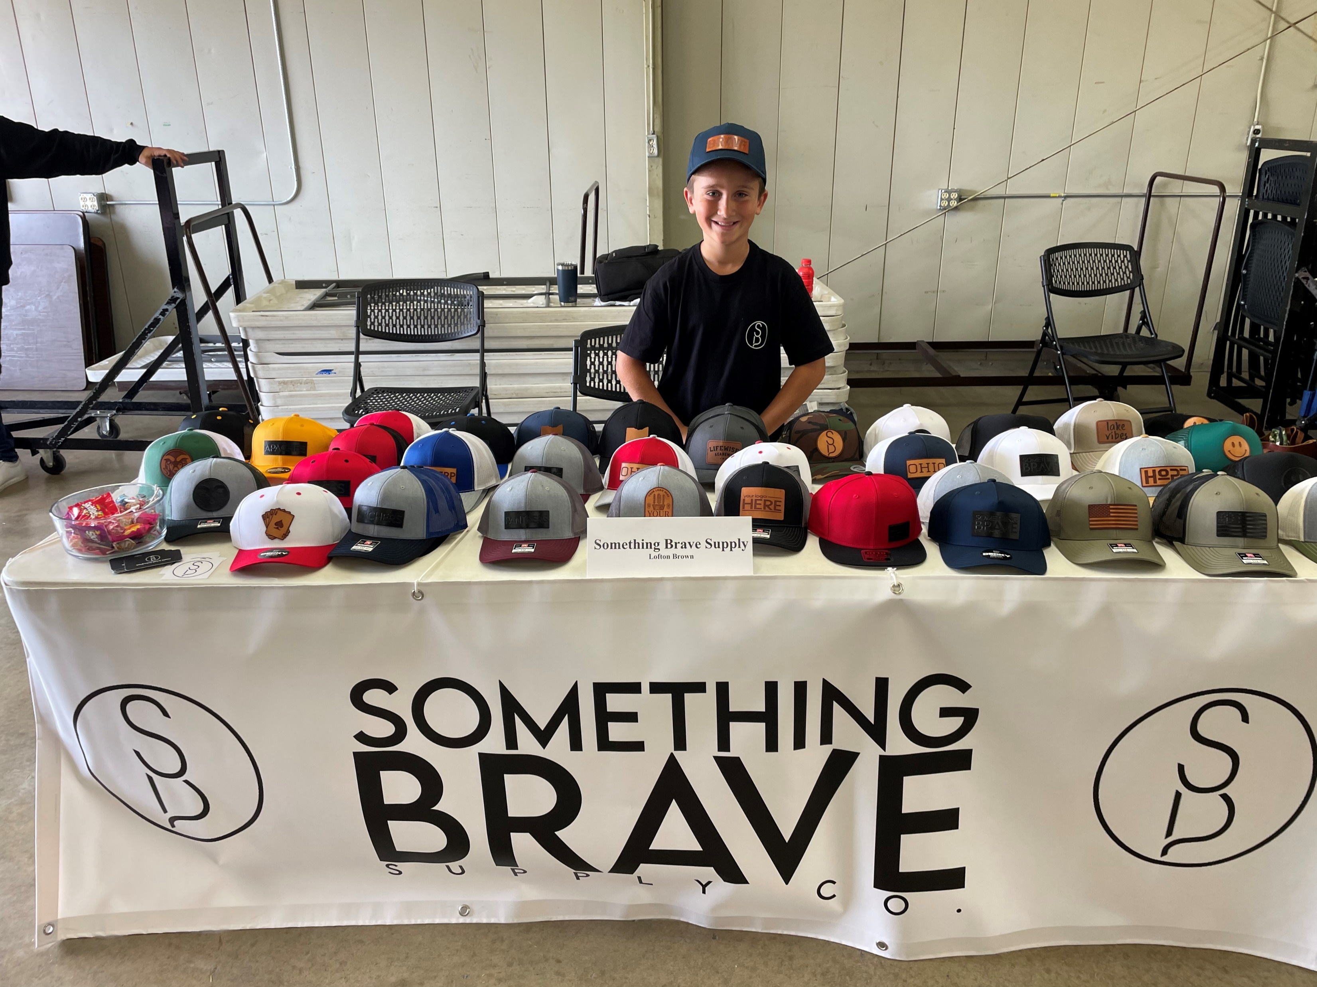
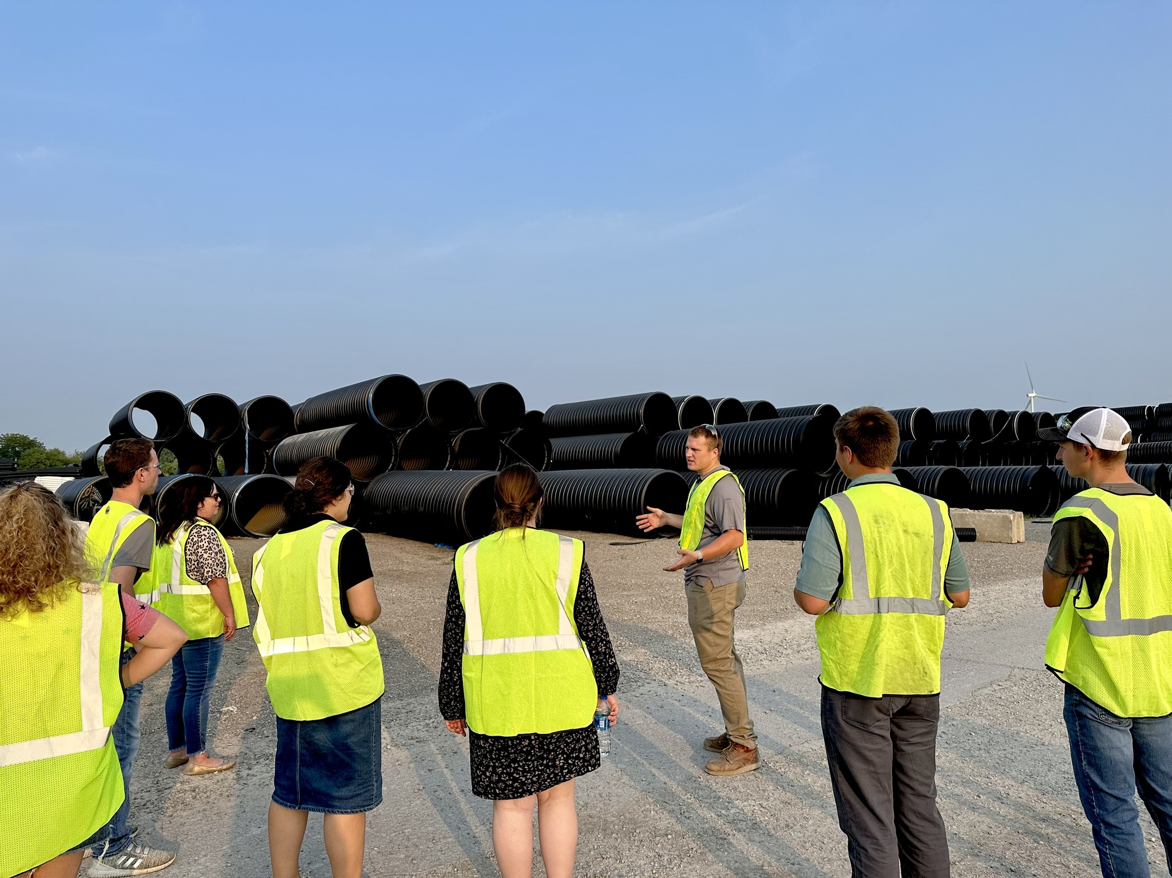
New Opportunities
New Credentials – STNA? Other STEM?
New Carpentry Class
Counting towards graduation credits
Lower grade levels
Entrepreneurship
Young Professionals

Slide 6
PAULDING COUNTY BUSINESS ADVIOSRY COUNCIL
Tim Copsey, Director
Paulding County Economic Development
director@pced.net
Fahyth Griner, Human Resource Manager
Haviland Companies
FGriner@haviland-drainage.com

