Slide 1
State of the Region: Job Growth and Opportunity in Northwest Ohio
TechPrep Ohio-Success Bound Conference Russell W. Mills, Ph.D., Senior Director, CRD April 16, 2021

Slide 2
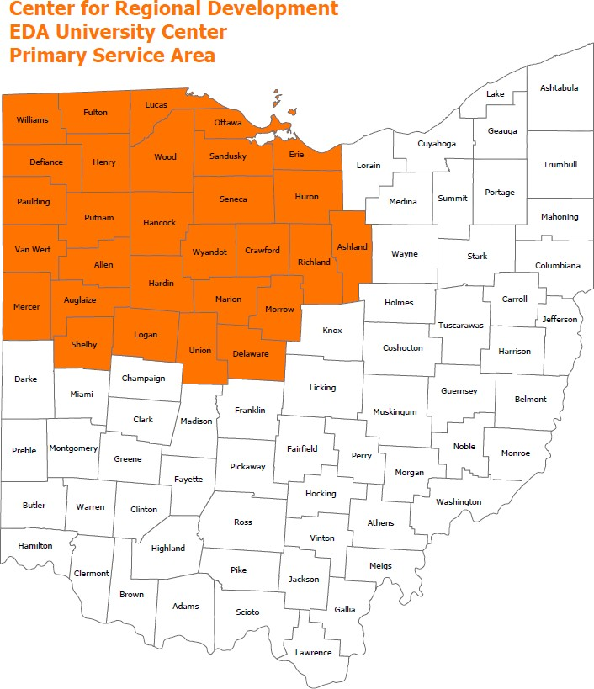
About CRD
The Center for Regional Development at BGSU is a community asset with expertise in regional economic, workforce, and community development.
CRD is a capacity builder and trusted partner:
Cutting-edge economic and demographic data analysis and visualization
Economic and community development project and grant development
Neutral and well-respected convener of planning processes
Social service and education program evaluation
Applied research including original survey research
Thought-leadership through annual State of the Region Conference
CRD partners with local governments, economic development organizations, social service agencies, private companies, and non-profit organizations across 29-counties in Northwest Ohio.

Slide 3
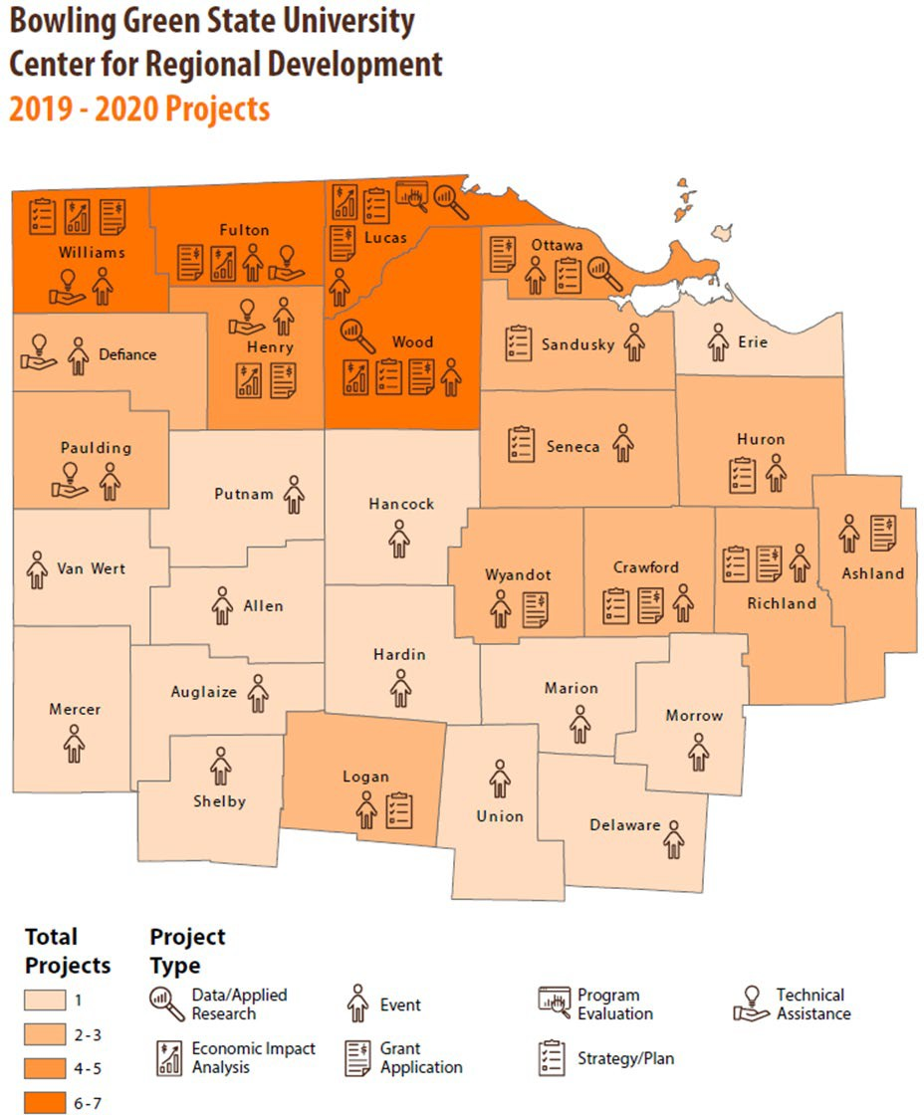
About CRD
EDA University Center Program
Partnership with Ohio University (Rural University Consortium)
Provide technical assistance for economic and workforce development projects across 29 counties in northwest Ohio.
CRD focus on supporting job attraction and retention projects in northwest Ohio, foreign-direct investment, and workforce development efforts.

Slide 4
Ohio Rural Universities Program

Slide 5
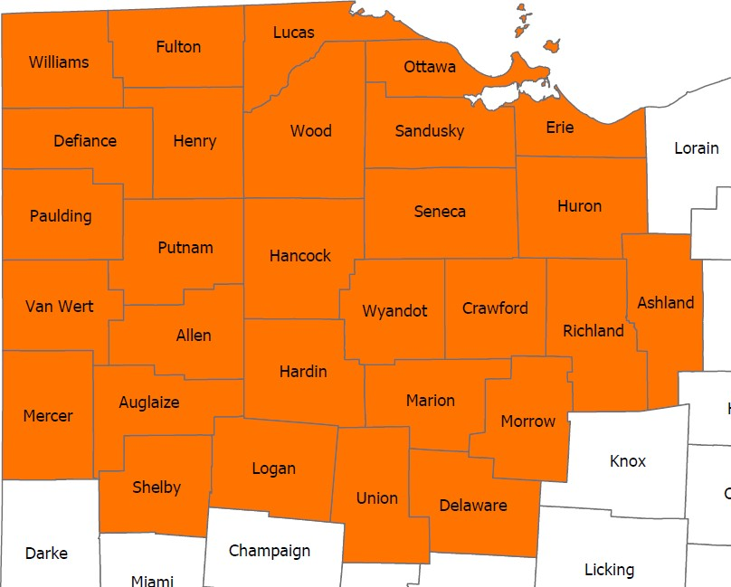
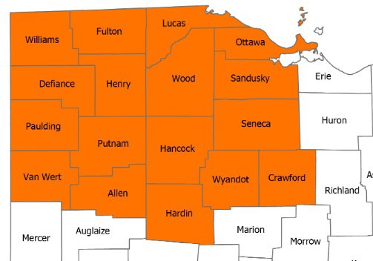
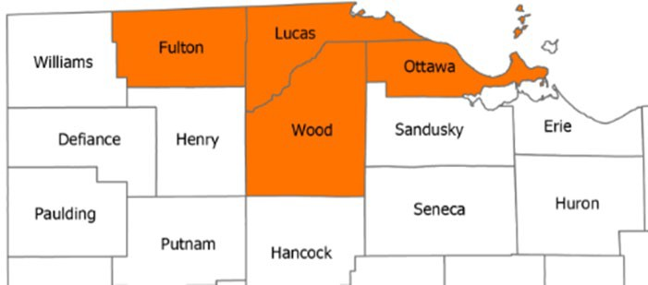
Defining the Region
Northwest Ohio Tech Prep Service Area
CRD 29-County EDA University Center Region
Toledo MSA

Slide 6
A Note on the Data
Much of the data in this presentation comes from EMSI, Chmura JobsEQ, IMPLAN, and Ohio Labor Market Information (LMI).
As expected, the COVID-19 pandemic had a significant effect on the national, state and regional economy, particularly in Q2 2020 (April-June 2020).
The latest available release of EMSI employment data is based on the Q2 2020 Quarterly Census of Employment and Wages from the BLS.
To provide a glimpse into the economic recovery and the return to normal, the jobs numbers presented here are from the Q1 2020 Quarterly Census of Employment and Wages from the BLS.
The occupation projection data presented here is based in Q3 2020 data from JobsEQ that takes the economic recovery into account. The job posting data presented here is from EMSI and is from February and March 2021.

Slide 7
The Macro-Level Jobs Picture
Monthly Change in Nonfarm Payroll (Thousands)
10,000
5,000
916
0
-5,000
-10,000
-15,000
-20,000
-20,679
-25,000
Mar-18
Apr-18 May-18 Jun-18 Jul-18 Aug-18 Sep-18 Oct-18 Nov-18 Dec-18 Jan-19 Feb-19 Mar-19 Apr-19 May-19 Jun-19 Jul-19 Aug-19 Sep-19 Oct-19 Nov-19 Dec-19 Jan-20 Feb-20 Mar-20 Apr-20 May-20 Jun-20 Jul-20 Aug-20 Sep-20 Oct-20 Nov-20 Dec-20 Jan-21 Feb-21 Mar-21
Source: BLS

Slide 8
The Macro-Level Jobs Picture
Total Nonfarm Employees (Thousands)
155,000
152,523
150,000
144,120
145,000
140,000
135,000
130,000
130,161
125,000
Nov-19
Dec-19
Jan-20
Feb-20
Mar-20
Apr-20
May-20
Jun-20
Jul-20
Aug-20
Sep-20
Oct-20
Nov-20
Dec-20
Jan-21
Feb-21
Mar-21
Source: BLS

Slide 9
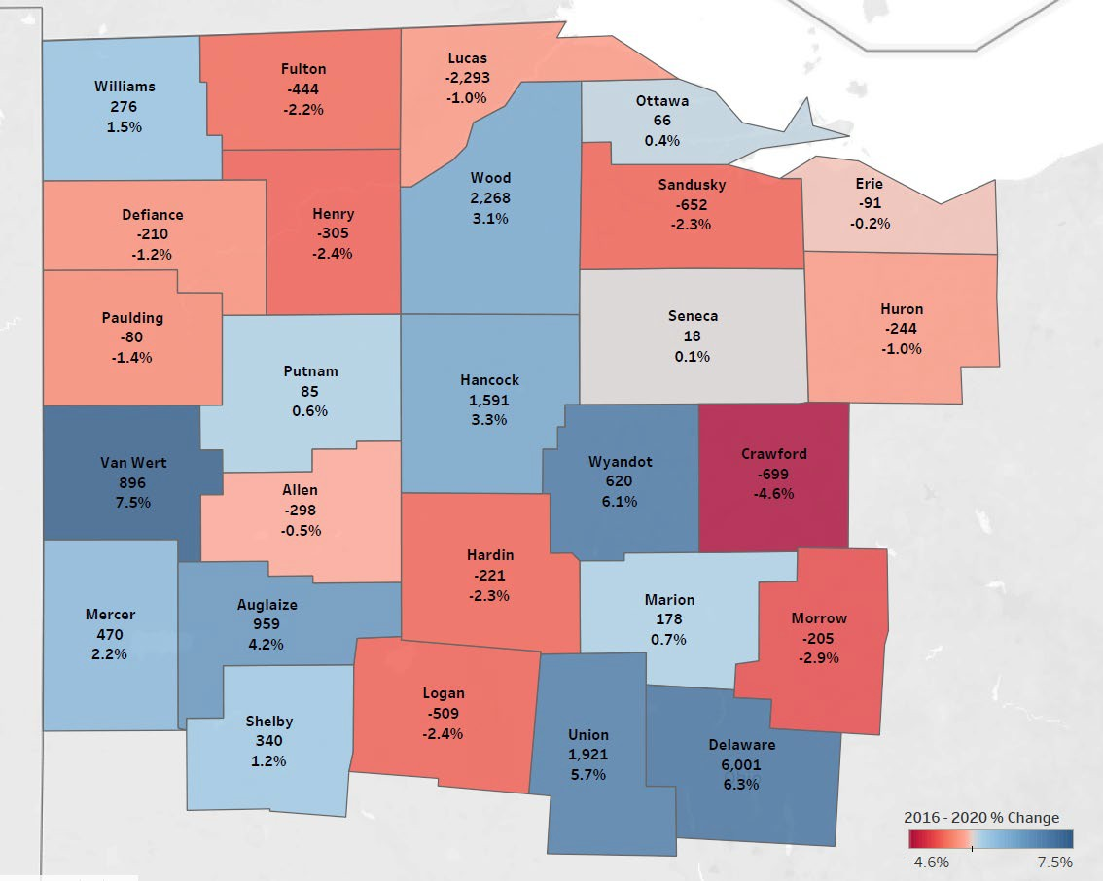
NW Ohio Job Growth by County (2016-2020)
Top 5 in Total Job Growth
Van Wert County 896 (7.5%)
Delaware County 6,001 (6.3%)
Wyandot County 620 (6.1%)
Union County 1,921 (5.7%)
Auglaize County 959 (4.2%)
Source: EMSI 2020.4

Slide 10
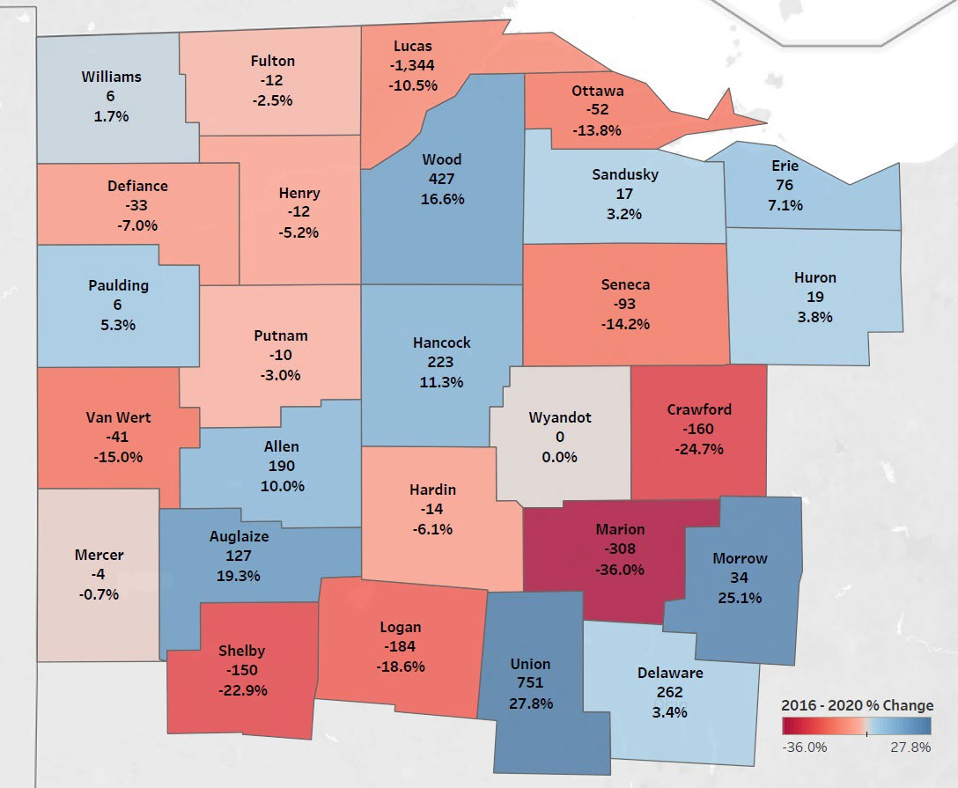
NW Ohio Job Growth: Information and Professional, Scientific, and Technical Services (2016-2020)
Overall Regional Loss: 277 Lucas County Loss: 1,344
Top 3 Counties With Increases:
Union County (751)
Wood County (427)
Delaware County (262)
Source: EMSI 2020.4

Slide 11
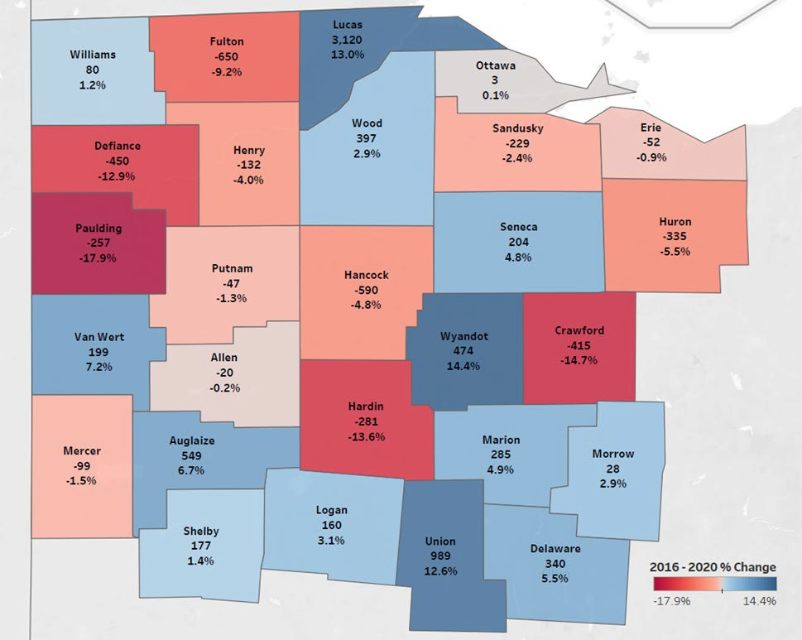
NW Ohio Job Growth: Manufacturing (2016-2020)
Overall Regional Increase: 3,449 Top 3 Counties With Increases:
Lucas County (3,120)
Union County (989)
Wyandot County (475)
Source: EMSI 2020.4

Slide 12
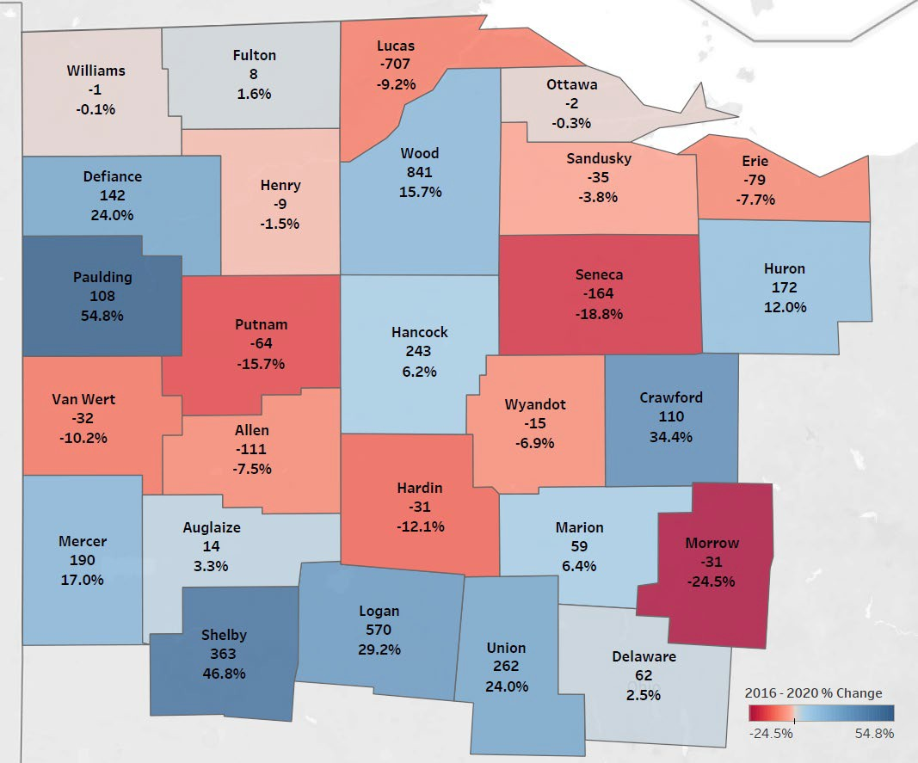
NW Ohio Job Growth: Transportation and Warehousing (2016-2020)
Overall Regional Increase: 1,863
Top 3 Counties (Number of Jobs):
Wood County (841)
Logan County (570)
Shelby County (363)
Source: EMSI 2020.4

Slide 13
NW Ohio (Tech Prep Region) Projected Job Growth
Occupation | Employment | Mean Annual Wages | Total Demand (5-Years) | Employment Growth (5-Years)
Food Preparation and Serving Related Occupations | 46,853 | $22,800 | 40,289 | 32
Production Occupations | 70,728 | $40,700 | 34,273 | -4,043
Transportation and Material Moving Occupations | 52,626 | $35,700 | 31,479 | -1,098
Sales and Related Occupations | 49,643 | $38,400 | 30,746 | -2,529
Office and Administrative Support Occupations | 63,036 | $37,800 | 30,569 | -3,761
Healthcare Support Occupations | 25,253 | $28,600 | 17,383 | 1,340
Educational Instruction and Library Occupations | 31,246 | $51,500 | 12,583 | -750
Management Occupations | 30,925 | $95,800 | 12,047 | -689
Construction and Extraction Occupations | 22,852 | $51,400 | 11,954 | -402
Source: JobsEQ Q3 2020

Slide 14
NW Ohio (Tech Prep Region) Projected Job Growth Transportation and Manufacturing (6-Digit SOC)
Occupation | Employment (2020) | Mean Annual Wages | Total Demand (5-Years) | Employment Growth (5-Years)
Laborers and Freight, Stock, and Material Movers, Hand | 12,944 | $31,700 | 8,779 | -122
Team Assemblers | 13,272 | $39,300 | 5,995 | -1,164
Stockers and Order Fillers | 8,267 | $27,700 | 5,086 | -251
Heavy and Tractor-Trailer Truck Drivers | 9,321 | $48,000 | 4,880 | -275
Light Truck Drivers | 4,224 | $35,000 | 2,381 | -15
First-Line Supervisors of Production and Operating Workers | 4,603 | $64,000 | 2,143 | -139
Industrial Truck and Tractor Operators | 3,619 | $37,300 | 1,945 | -63
Inspectors, Testers, Sorters, Samplers, and Weighers | 4,089 | $45,800 | 1,766 | -497
Packers and Packagers, Hand | 2,666 | $28,300 | 1,663 | -154
Source: JobsEQ Q3 2020

Slide 15
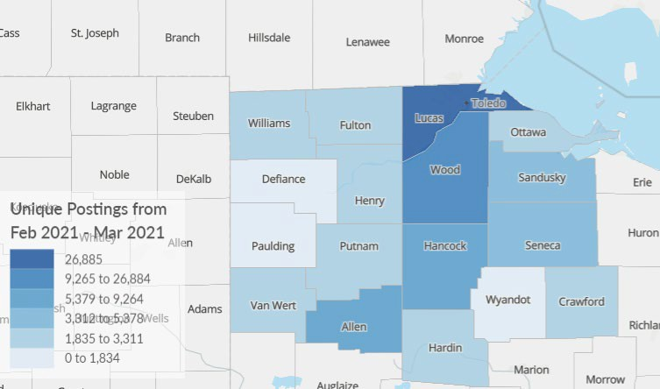
NW Ohio Unique Job Postings (Feb-Mar 2021)
Top 5 Counties (Number of Unique Postings):
Lucas County (26,885)
Wood County (9,265)
Allen County (6,686)
Hancock County (5,379)
Sandusky County (3,503)

Slide 16
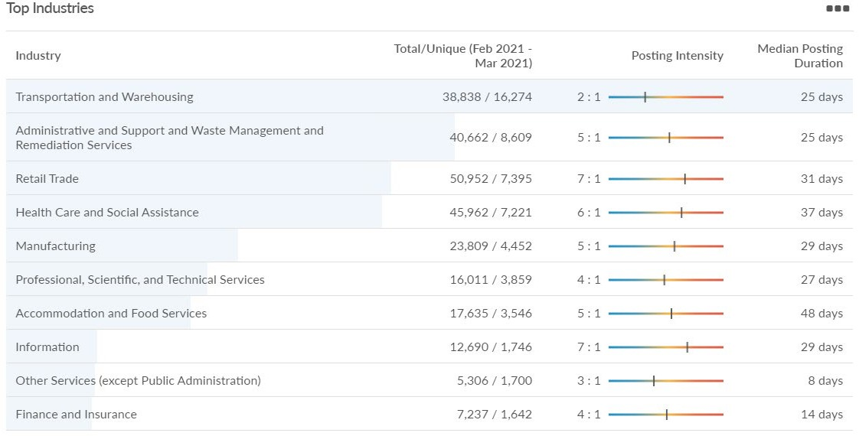
NW Ohio Unique Job Postings (Feb-Mar 2021)

Slide 17
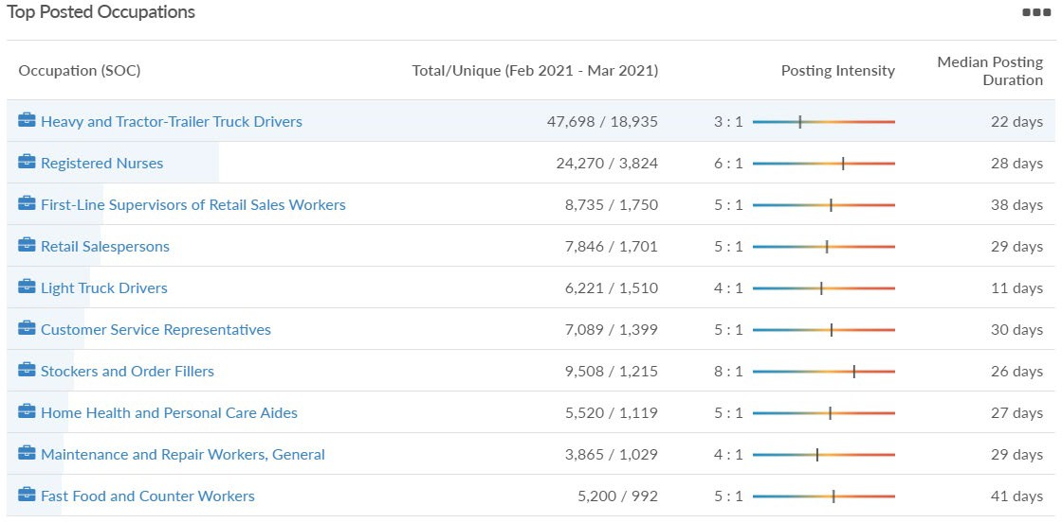
NW Ohio Unique Job Postings (Feb-Mar 2021)

Slide 18
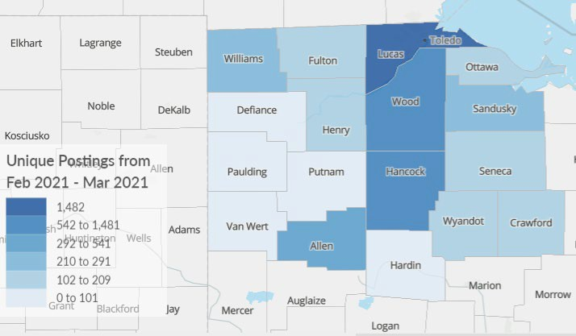
Manufacturing Job Posting Analytics (Feb-Mar 2021)
Top 5 Counties (Number of Unique Postings):
Lucas County (1,482)
Wood County (611)
Hancock County (542)
Allen County (292)
Sandusky County (235)

Slide 19
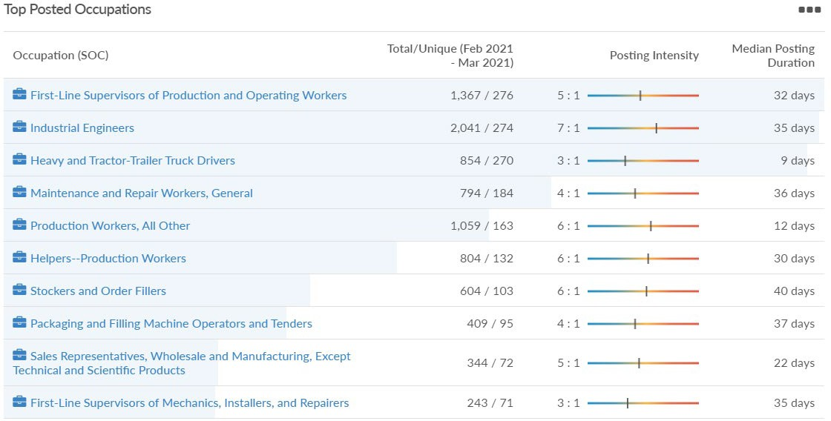
Manufacturing Job Posting Analytics (Feb-Mar 2021)

Slide 20
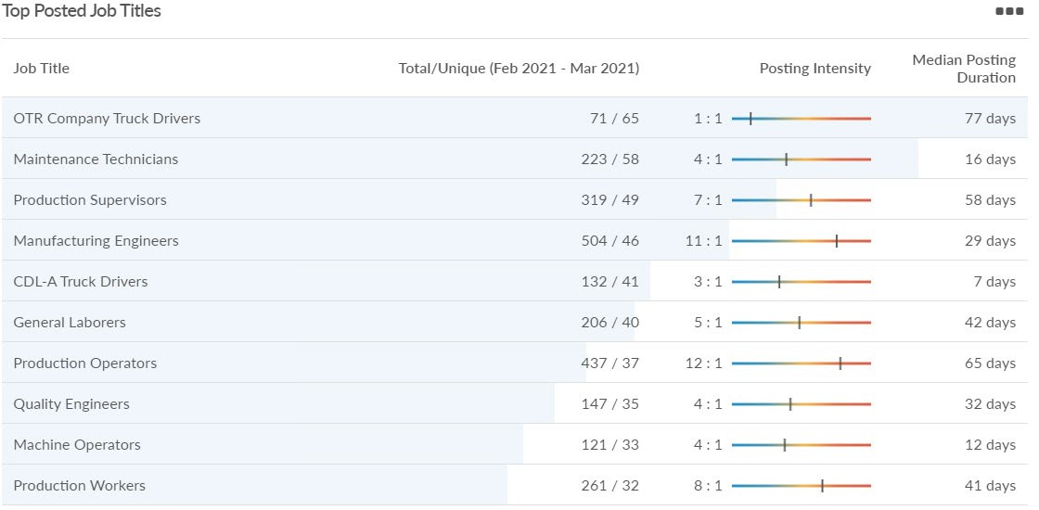
Manufacturing Job Posting Analytics (Feb-Mar 2021)

Slide 21
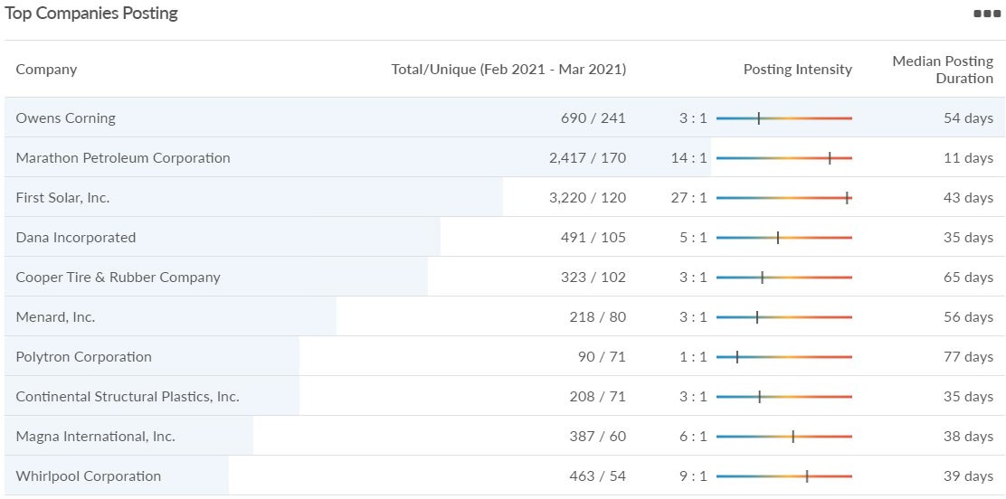
Manufacturing Job Posting Analytics (Feb-Mar 2021)

Slide 22
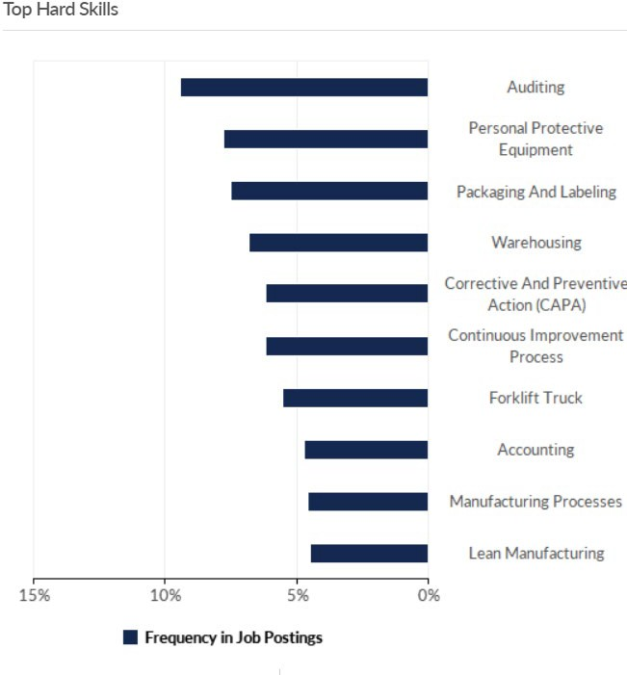
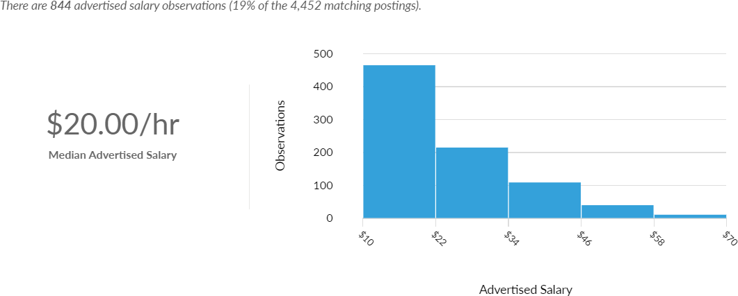
Manufacturing Job Posting Analytics (Feb-Mar 2021)

Slide 23
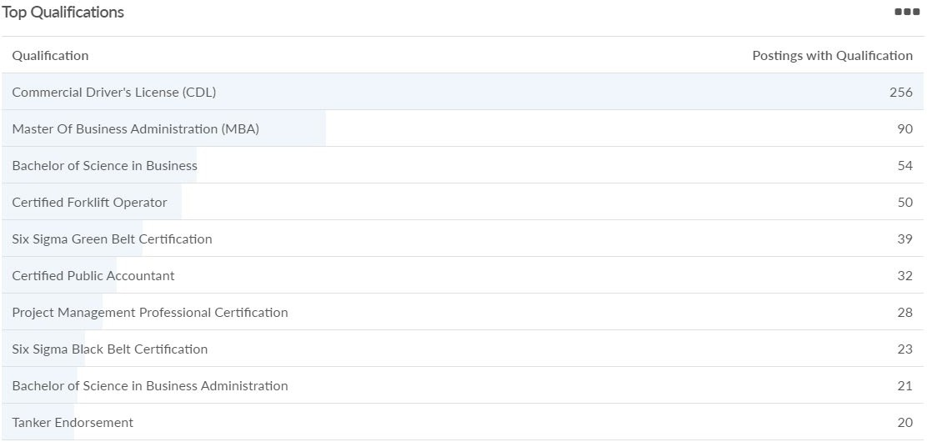
Manufacturing Job Posting Analytics (Feb-Mar 2021)

Slide 24
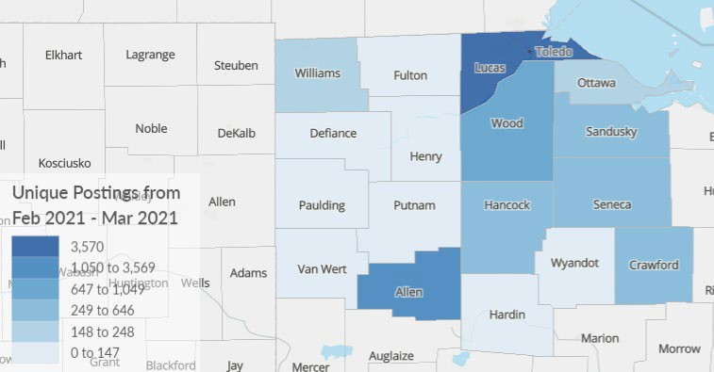
Health Care and Social Assistance Job Posting Analytics (Feb-Mar 2021)
Top 5 Counties (Number of Unique Postings):
Lucas County (3,570)
Allen County (1,050)
Wood County (647)
Sandusky County (329)
Hancock County (316)

Slide 25
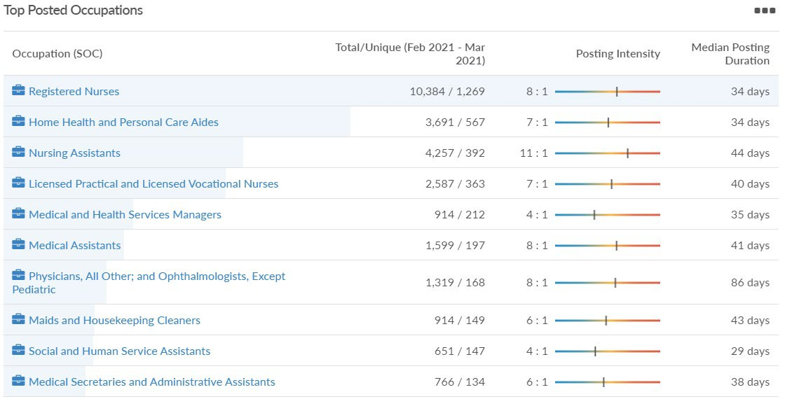
Health Care and Social Assistance Job Posting Analytics (Feb-Mar 2021)

Slide 26
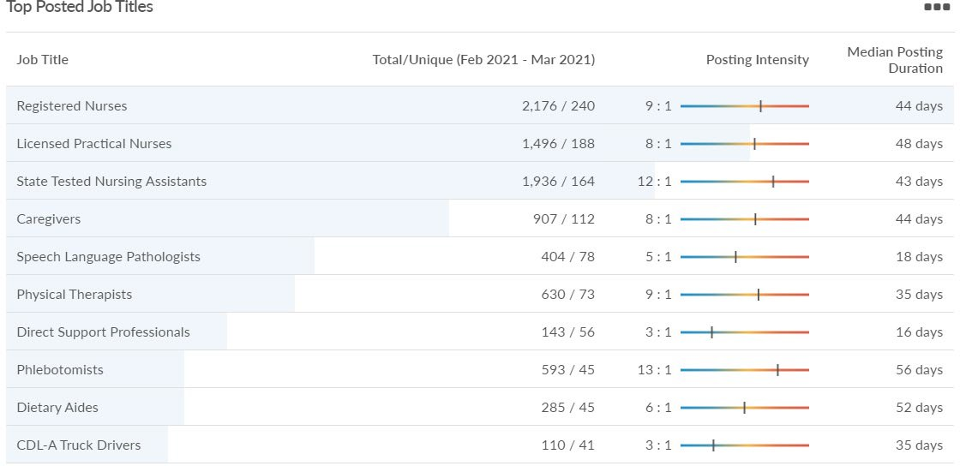
Health Care and Social Assistance Job Posting Analytics (Feb-Mar 2021)

Slide 27
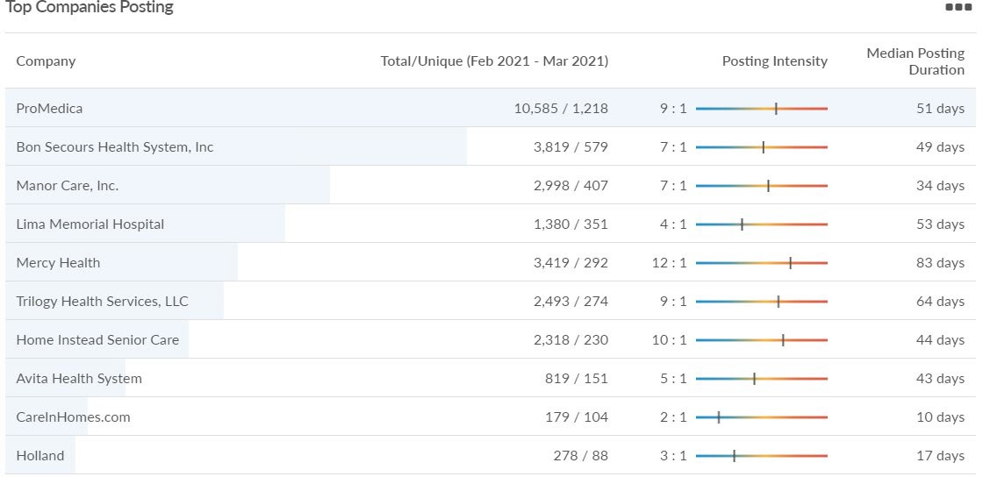
Health Care and Social Assistance Job Posting Analytics (Feb-Mar 2021)

Slide 28
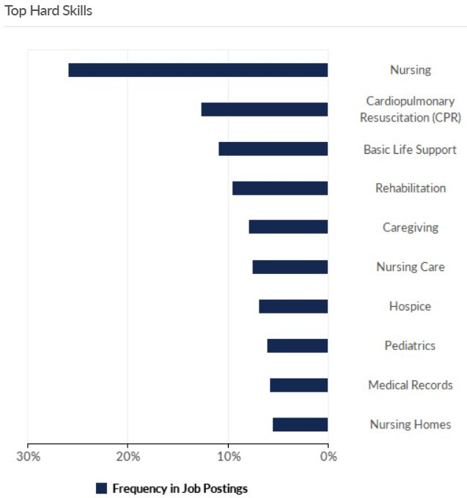
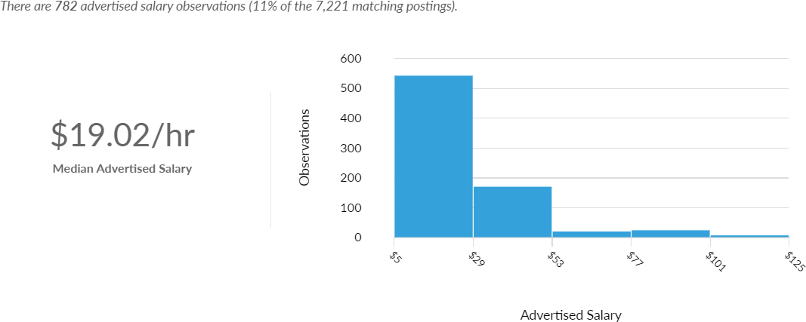
Health Care and Social Assistance Job Posting Analytics (Feb-Mar 2021)

Slide 29
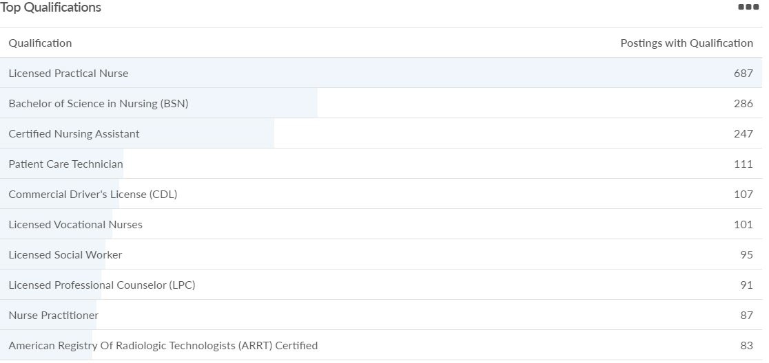
Health Care and Social Assistance Job Posting Analytics (Feb-Mar 2021)

Slide 30
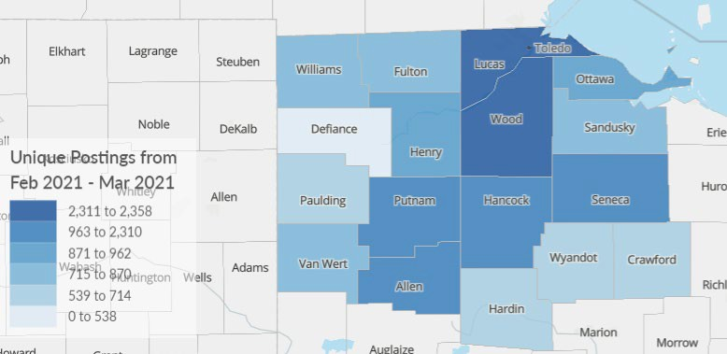
Transportation and Warehousing Job Posting Analytics (Feb-Mar 2021)
Top 5 Counties (Number of Unique Postings):
Lucas County (2,358)
Wood County (2,311)
Hancock County (1,097)
Putnam County (999)
Seneca County (987)

Slide 31
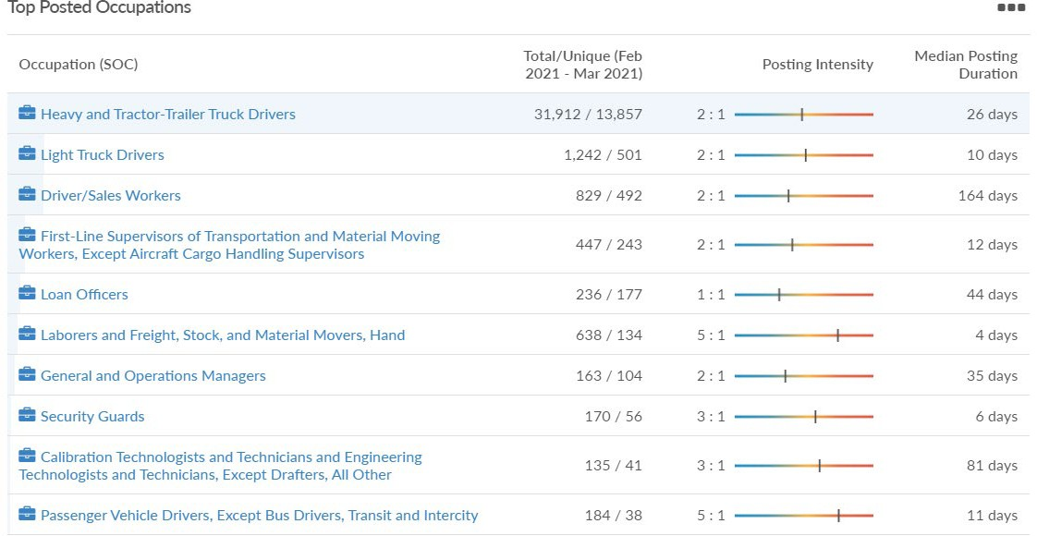
Transportation and Warehousing Job Posting Analytics (Feb-Mar 2021)

Slide 32
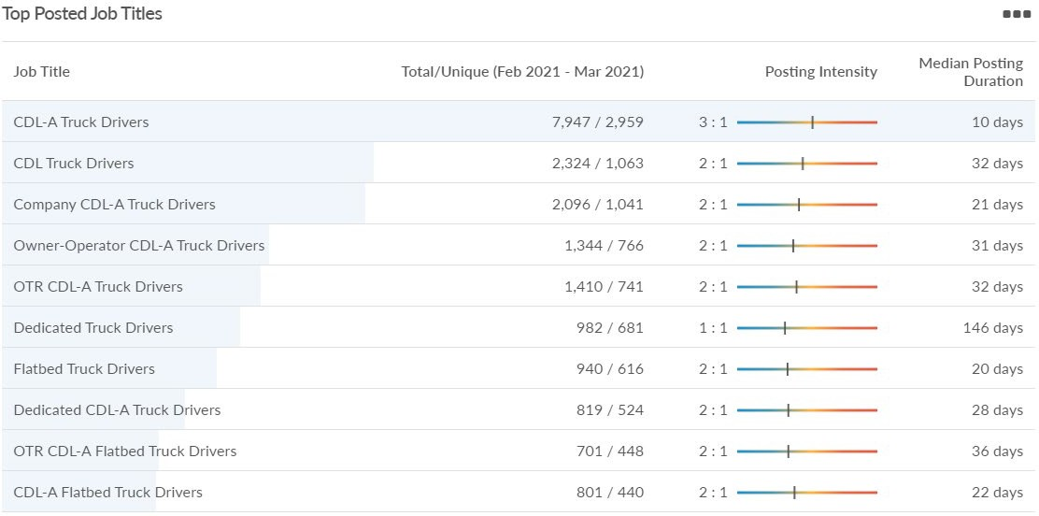
Transportation and Warehousing Job Posting Analytics (Feb-Mar 2021)

Slide 33
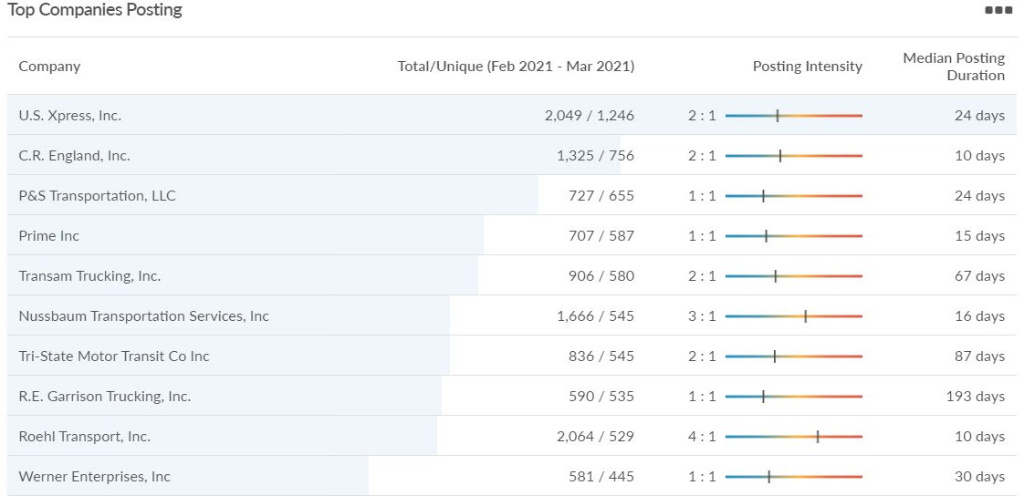
Transportation and Warehousing Job Posting Analytics (Feb-Mar 2021)

Slide 34
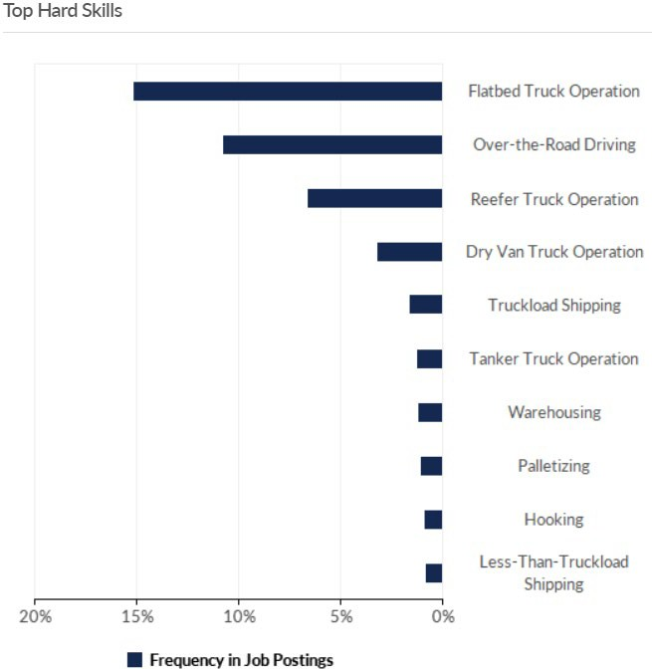
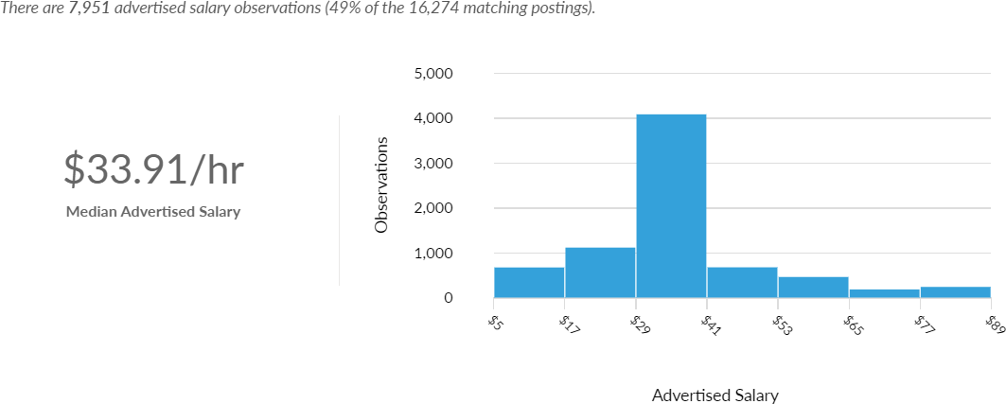
Transportation and Warehousing Job Posting Analytics (Feb-Mar 2021)

Slide 35
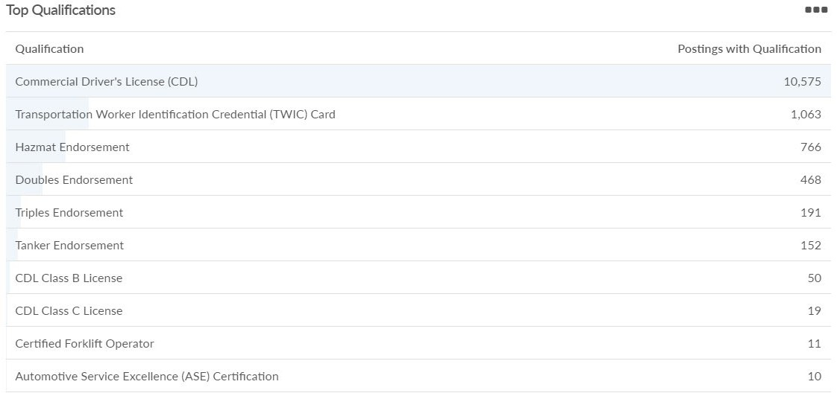
Transportation and Warehousing Job Posting Analytics (Feb-Mar 2021)

Slide 36
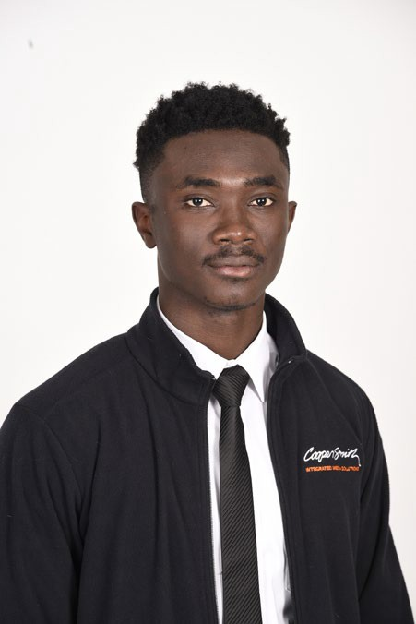
About CRD
Russell Mills, Ph.D.
Senior Director
Nichole Fifer, Ph.D.
Assistant Director
Deminique Heiks Economic Development Program Coordinator
Ben Hooper Economic Recovery Program Coordinator
Lisa Lawson-LaPointe Rural Development Program Coordinator
Vijaya Dasigi Operations and Budgets
Justin Rex, Ph.D.
Research Fellow
Maddi Georgoff
Graduate Assistant
Ian Reineck
Graduate Assistant
Danny Schlingman
Graduate Assistant
Summer McVicker
Graduate Assistant
Baffour Koduah
Graduate Assistant

