Slide 1
Partnerships Driving Change
Hancock County’s Strategy

Slide 2
The Partnerships

Slide 5
The Strategy

Slide 7
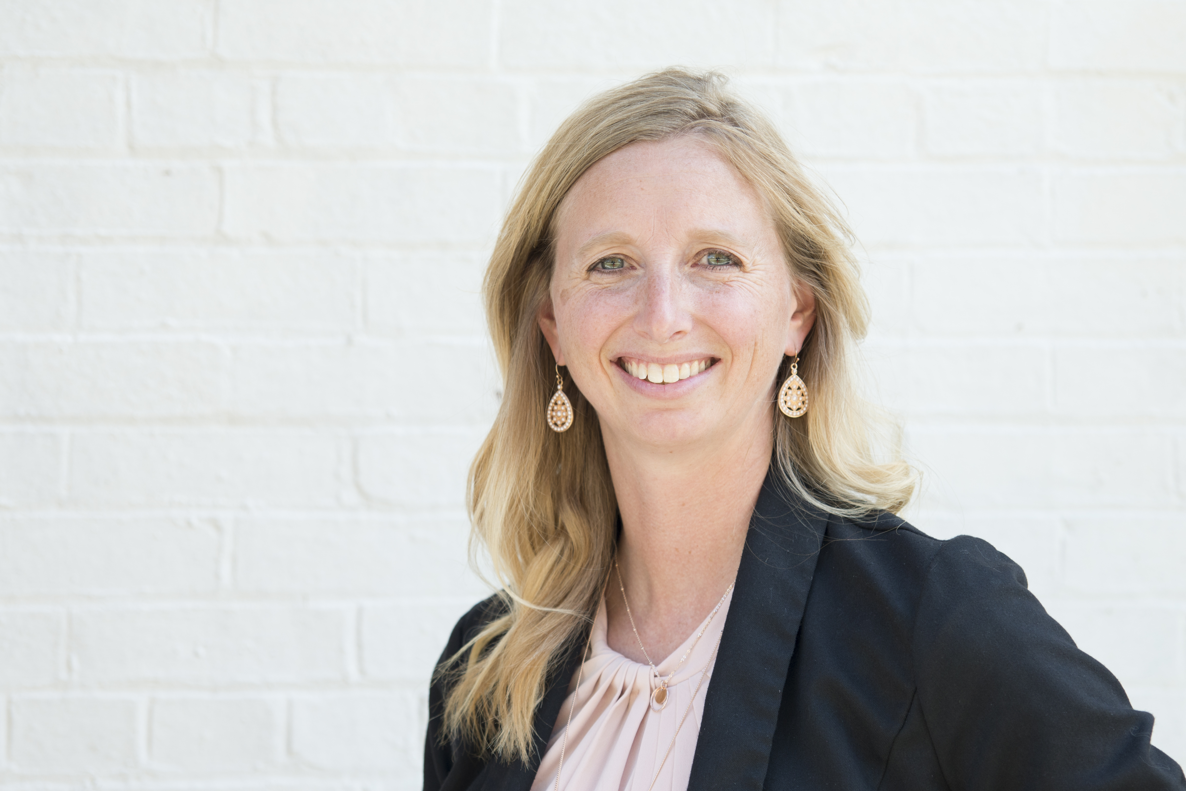
Let’s Connect
Tricia Valasek, Executive Director
tvalasek@raisethebarhancock.org
(567) 429-7038
www.raisethebarhancock.org
123 E. Main Cross Street, Findlay

