Slide 1


Work-Based Learning Series
Work-Based Learning 101
Session One
October 24, 2022
Notes:
Cassie

Slide 2





Brenna Bartlett
Assistant Director
Office of Career-Technical Education
Ohio Department of Education

Slide 3








Ohio Tech Prep Chief Administrators
Dr. Kathy Siebenaler Wilson
Northwest Ohio Regional Tech Prep
Chief Administrator
Naima Lusane
Northeast Ohio Regional Tech Prep
Chief Administrator
Carrie Scheiderer
Central Ohio Regional Tech Prep
Chief Administrator
Pam Hunt
West Ohio Regional Tech Prep
Chief Administrator
Rita Graf
Southwest Ohio Regional Tech Prep
Chief Administrator
Katie Good
Southeast Ohio Regional Tech Prep
Chief Administrator

Slide 4
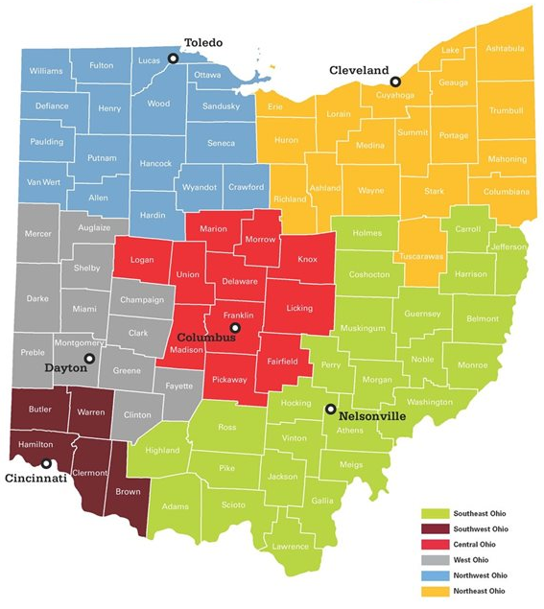
Ohio Tech Prep Regions
Northwest –
Dr. Kathy Siebenaler Wilson
Northeast – Naima Lusane
Central – Carrie Scheiderer
West – Pam Hunt
Southwest – Rita Graf
Southeast – Katie Good

Slide 5

Tech Prep Goals:
Build and foster relationships between education, business and community partners in the region.
Assist education partners in the region in developing high-quality career technical education pathways and programs of study.
Provide technical assistance and professional development opportunities to education partners on the implementation of high-quality work-based learning experiences.

Slide 6
Today’s Discussion
Why Work-Based Learning?
Definitions & Requirements
Types of Work-Based Learning
Work-Based Learning Guiding Principles

Slide 7

Why Work-Based Learning?

Slide 8
Why Work-Based Learning?
Business & Industry Need
Governor’s Office of Workforce Transformation
Ohio Excels
Labor Market Data
Policy & Legislation
Each Child Our Future; Graduation Requirements
Perkins V & CTE
Implementation
Minor Labor Laws; SB 166; State Supported Internships

Slide 9
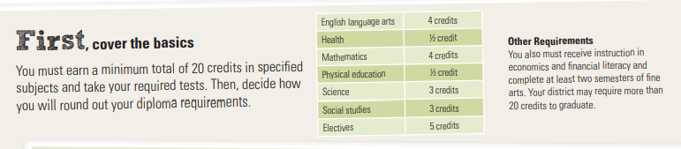
Ohio Graduation Requirements
Students can earn credit by participating in Work-Based Learning.

Slide 10
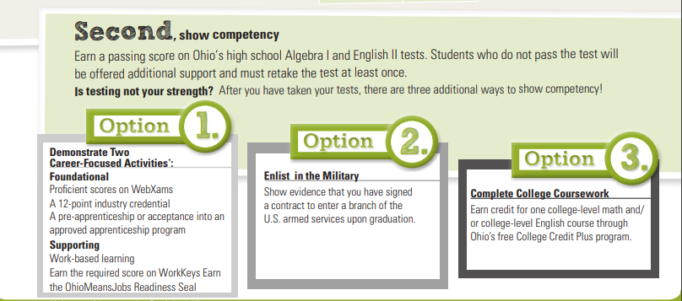
Ohio Graduation Requirements
Students can show competency through Work-Based Learning.

Slide 11
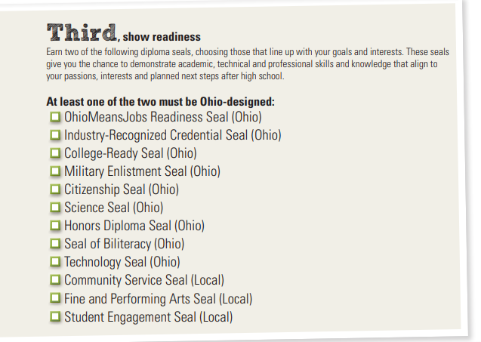
Ohio Graduation Requirements
Students can demonstrate readiness through Work-Based Learning.

Slide 12
Work-Based Learning & Career-Tech
Perkins V
Definition
Performance Indicator
Ohio Law
Grad Requirements
HB 82 – Prepared for Success
CTE
Sustained interactions with industry & community professionals
Aligned to curriculum and instruction – i.e., program of study
Working towards 250+ hours across grades 9-12
CTPD Report Card
There is a broad range of flexibility in the design of work-based learning experiences.
(i.e., type, scheduling, placement, etc.)
Notes:
HB 82 – LEA Report Card – Prepared for Success -

Slide 13

What is your motivation for creating high-quality work-based learning experiences?

Slide 14

Definitions & Requirements

Slide 15
Work-Based Learning Definition
Aligned to Graduation Requirements for the Class of 2023 and Beyond:
Supporting Demonstration of Competency in Career Experience & Technical Skill
Beginning as early as grade 9, students should accumulate 250 hours of work-based learning aligned to their program of study, or their student success or graduation plans, with evidence of positive evaluation.

Slide 16

Work-Based Learning Definition
From Perkins V…
Work-based learning is defined as “sustained interactions with industry or community professionals in real workplace settings, to the extent practicable, or simulated environments at an educational institution that fosters in-depth, firsthand engagement with the tasks required in a given career field, that are aligned to curriculum and instruction.”
Work-Based Learning Overview

Slide 17

Work-Based Learning Overview

Slide 18

Types of Work-Based Learning

Slide 19
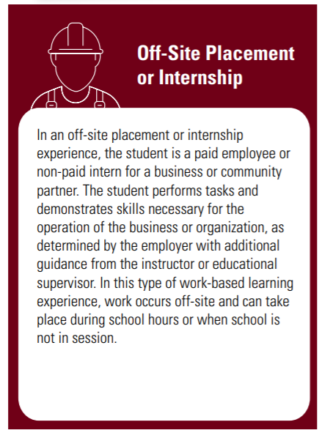
Internship & Off-Site Placement
Work-based learning experiences must occur at work-based learning sites.
Student would work at the physical location of the employer, during, before and/or after school.
Student would interact with clients/customers as is commiserate with the work environment.
Work-based learning experiences should be co-supervised and co-evaluated.
Student is an employee/intern of the business and should have a designated employer/supervisor.
Educator can supervise and evaluate:
  In a large group, small group or individual setting
  As frequently as meets educational needs

Slide 20
Internship & Off-Site Placement
A learning agreement aligned to the program of study or their student success or graduation plans, must be in place.
Student will identify work tasks from employer. Student will work with educator to align work tasks to learning standards.
Learning Standard | Work-Based Demonstration | Evidence of Demonstration
BUS 5.9.11 Employ publicity to inform audiences of business activities, to create goodwill and to establish or reinforce brand (e.g., press releases, public-service announcements, press kits). | Draft press release for upcoming change in organization leadership. | Completed Press Release; Employer Evaluation

Slide 21
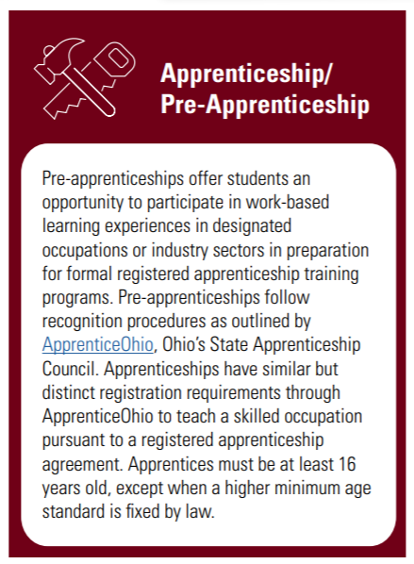
Apprenticeship & Pre-Apprenticeship
Work-based learning experiences must occur at work-based learning sites.
Student would work at a work site as determined by the recognized operating plan.
Student would interact with clients/customers as is commiserate with the work environment.
Work-based learning experiences should be co-supervised and co-evaluated.
Student is an apprentice/pre-apprentice of the business and should have a designated business supervisor.
Educator can supervise and evaluate:
  In a large group, small group or individual setting
  As frequently as meets educational needs

Slide 22
Apprenticeship & Pre-Apprenticeship
A learning agreement aligned to the program of study or their student success or graduation plans, must be in place.
Work tasks will be aligned to learning standards as part of the execution of the operating plan. The student, employer/business mentor and educator will contribute.
Learning Standard | Work-Based Demonstration | Evidence of Demonstration
CON 4.2.3 Analyze wiring schematics and diagrams to troubleshoot circuits. | Review wiring schematic and adjust. | Employer Evaluation; Student Record on Timesheet

Slide 23
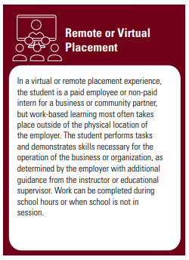
Remote or Virtual Placement
Work-based learning experiences must occur at work-based learning sites.
Student could work:
  In school facilities during or after school hours**
  From home before/after school & weekends
Student would interact with client/customer virtually (Zoom, e-mail, etc.)
Work-based learning experiences should be co-supervised and co-evaluated.
Student is an employee/intern of the business and should have a designated employer/supervisor.
Supervision/evaluation could occur virtually (scheduled 1:1s, e-mail, etc.) with both Employer and Educator supervisors.

Slide 24
Remote or Virtual Placement
A learning agreement aligned to the program of study or their student success or graduation plans, must be in place.
Student will identify work tasks from employer. Student will work with educator to align work tasks to learning standards.
Learning Standard | Work-Based Demonstration | Evidence of Demonstration
A&C 4.7.5. Correct color, condense and enhance a video production. | Edit video file for website. | Completed Video/Webpage; Student Journal

Slide 25
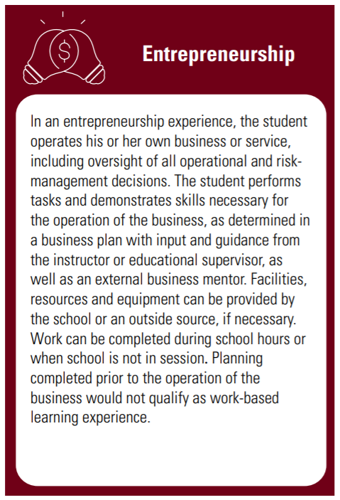
Entrepreneurship
Work-based learning experiences must occur at work-based learning sites.
Student could work:
  In school facilities during or after school hours**
  From home before/after school & weekends
  In another location or work site
Student would interact with clients/customers directly.
Work-based learning experiences should be co-supervised and co-evaluated.
Both the educator and the business mentor will supervise and evaluate work as it is completed independently by the student.

Slide 26
Entrepreneurship
A learning agreement aligned to the program of study or their student success or graduation plans, must be in place.
Student will identify work tasks with Educator input. Business mentor will also review and advise on work tasks.
Learning Standard | Work-Based Demonstration | Evidence of Demonstration
AG 8.4.14. Control plant growth through mechanical and chemical means. | Prepare fern plants for sale in greenhouse. | Student Record on Timesheet; Inventory Records; Student Artifact

Slide 27
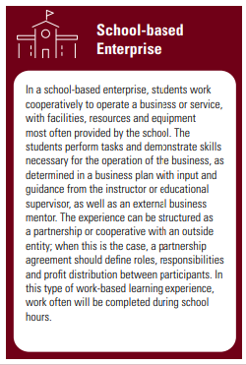
School-Based Enterprise
Work-based learning experiences must occur at work-based learning sites.
Student will likely work in the school facilities, during or after school.
Student will interact with clients/customers through services provided.
Work-based learning experiences should be co-supervised and co-evaluated.
Educator will likely be primary or day-to-day supervisor.
Business mentor can supervise and evaluate:
  In a large group, small group or individual settings
  As frequently as meets educational needs (**sustained interaction)
  Evaluations should be documented for each student

Slide 28
School-Based Enterprise
A learning agreement aligned to the program of study or their student success or graduation plans, must be in place.
Student will identify work tasks (may identify as group or team) with Educator input. Business mentor will also review and advise on work tasks.
Learning Standard | Work-Based Demonstration | Evidence of Demonstration
H&T 3.3.10. Mark, label, store and dispose of food and food by-products. | Follow procedure for proper labeling, storage and rotation of food products in production kitchen for bakery. | Student Record on Timesheet; Monthly Evaluation

Slide 29
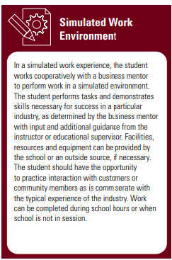
Simulated Work Environment
Work-based learning experiences must occur at work-based learning sites.
Will largely depend on design of experience
Student could work:
  In school facilities during or after school hours
  From home before/after school & weekends
Automotive Tech: Student works in the lab setting, interacts with customers who bring cars in for repair.
Work-based learning experiences should be co-supervised and co-evaluated.
Educator will likely be primary or day-to-day supervisor.
Business mentor can supervise and evaluate:
  In a large group, small group or individual settings
  As frequently as meets educational needs (**sustained interaction)
  Evaluations should be documented for each student

Slide 30
Simulated Work Environment
A learning agreement aligned to the program of study or their student success or graduation plans, must be in place.
Student should work with Business Mentor & Educator to identify typical tasks of the work experience. Student will work with educator to align tasks to learning standards.
Learning Standard | Work-Based Demonstration | Evidence of Demonstration
AT 2.4.2. Inspect fluid levels and fluid conditions on all mechanical systems. | Check all fluid levels & conditions for customer vehicle and replace as needed. | Student Record for Customer; Monthly Evaluation

Slide 31
Which types of work-based learning am I interested in exploring?

Slide 32
Work-Based Learning Guiding Principles
Work-based learning experiences must occur at work-based learning sites.
  A work-based learning site also can exist virtually or within the school facilities.
  All work-based learning sites should include regular interaction with clients/customers/community members as is commiserate with the typical experience of that industry.
Notes:
A work-based learning site also can exist virtually or within the school facilities. Work-based learning hours should never occur during instructional time and should otherwise not overlap or interfere with teacher-led activities.
All work-based learning sites should include regular interaction with community members as is commiserate with the typical experience of that industry. For example, students completing work-based learning experiences in an automotive services lab should have the opportunity to interact with and serve customers in the same fashion a professional mechanic would.

Slide 33
Work-based learning experiences should be co-supervised and co-evaluated by an instructor or other educational representative and an employer or business mentor.
  Supervisors are not required to visit job sites every day.
    Co-supervision can occur in groups, virtually, etc.
  Work-based learning supervision often requires additional time outside of the classroom/laboratory component of the program and may occur on a year-round basis.
Work-Based Learning Guiding Principles
Notes:
including, but not limited to the student, the parent or guardian, employer or business mentor and instructor or other educational representative.
Work-based learning experiences should be co-supervised by an instructor or other educational representative and an employer or business mentor.
Supervisors are not required to visit job sites every day. Additionally, co-supervision can occur in groups, through the use of technology or through any other appropriate measures, especially those that allow for supervision of multiple student experiences to be as efficient as possible. However, frequent, in-person instructional visits can be valuable for many types of work-based learning experiences. The student, instructor and employer or business mentor should work together to design a supervision schedule that meets educational needs.
Work-based learning supervision often requires additional time outside of the classroom/laboratory component of the program and may occur on a year-round basis. Therefore, some of this additional time likely will occur beyond the standard teaching contract. To accommodate this individualized, year-round instruction, the instructor should have appropriately scheduled coordination time and may be provided extended contract days to facilitate supervision during summer months.

Slide 34
Work-Based Learning Guiding Principles
A Learning Agreement built on professional, academic and technical competencies aligned to the student’s program of study must be in place.
  Learning agreements should be developed in partnership with all relevant stakeholders.
  Learning agreements and other documentation of the work-based learning experience can and should be considered as sources of data for demonstrating student growth.
Notes:
A Learning Agreement built on professional, academic and technical competencies aligned to the student’s program of study must be in place.
Learning agreements should be developed in partnership with all relevant stakeholders including, but not limited to the student, the parent or guardian, employer or business mentor and instructor or other educational representative. The student should be the primary leader and decision-maker of the experience.
Learning agreements and other documentation of the work-based learning experience (including financial records, evidence of planning, credentials or certifications earned, student reflections, supervisor evaluations, other records of skills and knowledge attained, etc.) can and should be considered as sources of data for demonstrating student growth. The learning agreement also could be used as a component of industry certification programs, a graded component of career-technical education coursework, or an opportunity for receiving technical credit through the local credit flexibility policy.

Slide 35
What types of work-based learning opportunities might already exist within your community?

Slide 36
Key Takeaways
Student needs and outcomes should be the primary driver of the experience.
.
The design of the experience is flexible but should focus on quality and continuous improvement
Work-based learning is distinct from work experience and career exploration activities.
Work-based learning is a priority program element of career-technical education in Ohio.

Slide 37
Why Work-Based Learning?
Aligned Education
Industry Engagement
Qualified Workforce & Talent Pipeline
“The educational models for the past 40 years have operated with Business as an advisor. In this role, they could only inform learning experiences, with engagement being at the end of the student’s educational journey—hiring based on the level of educational attainment.
Industries and businesses need to shift their focus to engaging in the educational system as a solution partner. The time is now to invest in the supply side of this equation—WBL provides the most effective way to close the skills gap.”
Notes:
HB 82 – LEA Report Card – Prepared for Success -

Slide 38

Questions?

Slide 39
Work-Based Learning Resources
Brenna Bartlett will talk about WBL Resources and the WBL Office Hours

Slide 40

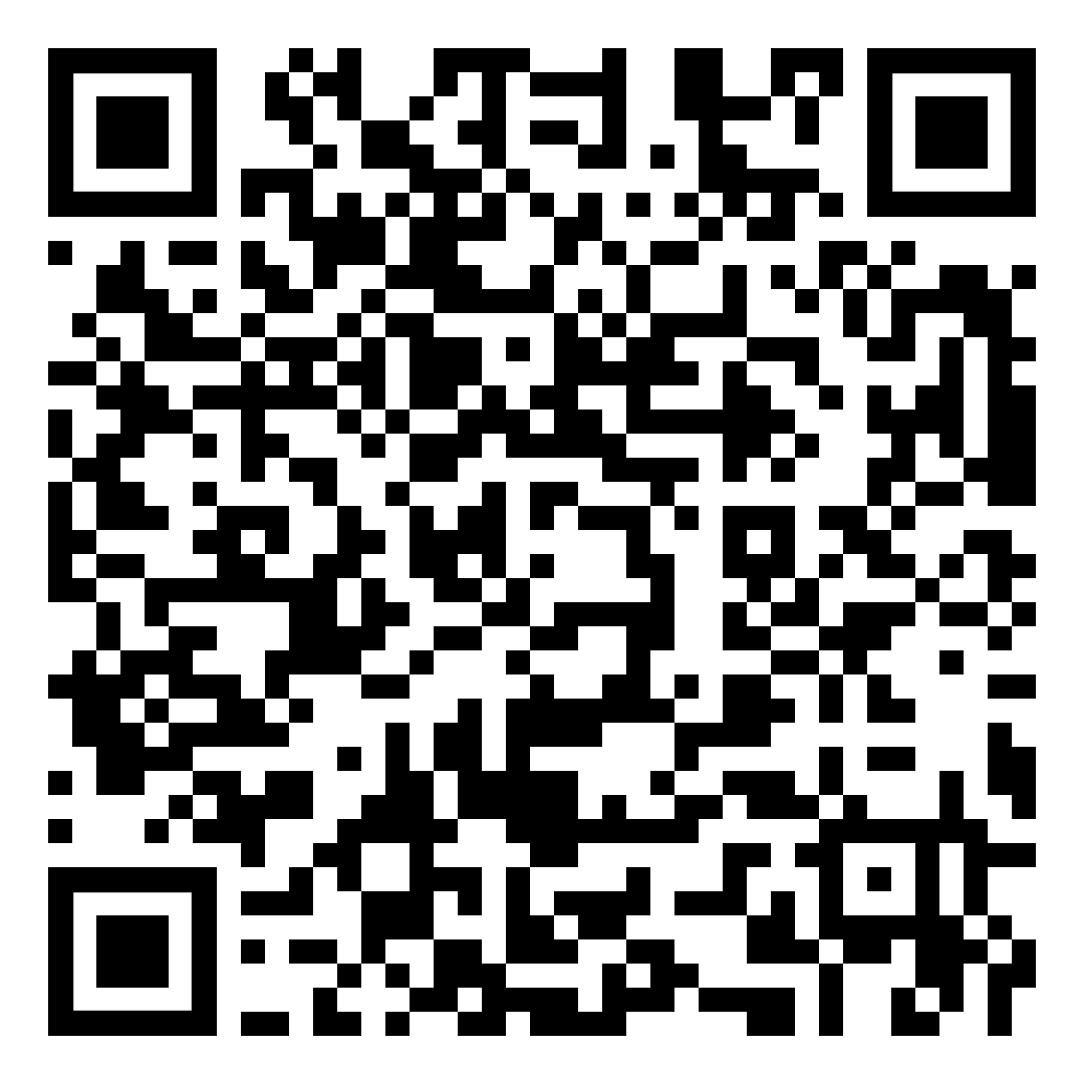
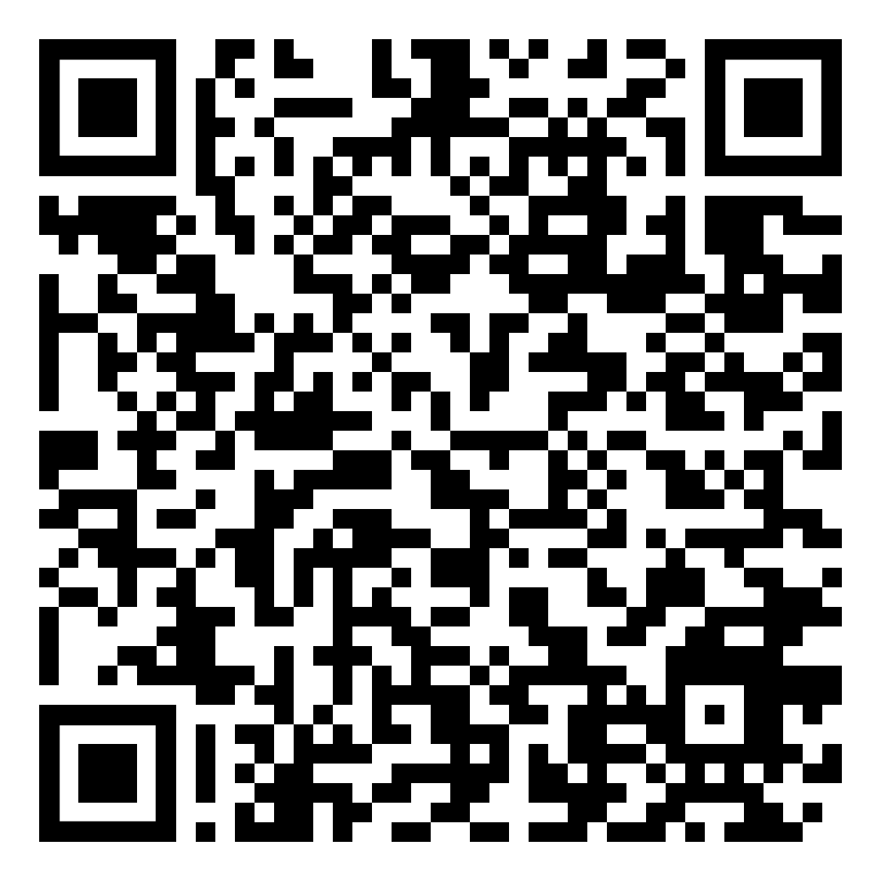


What’s next?
Register NOW!

Slide 41


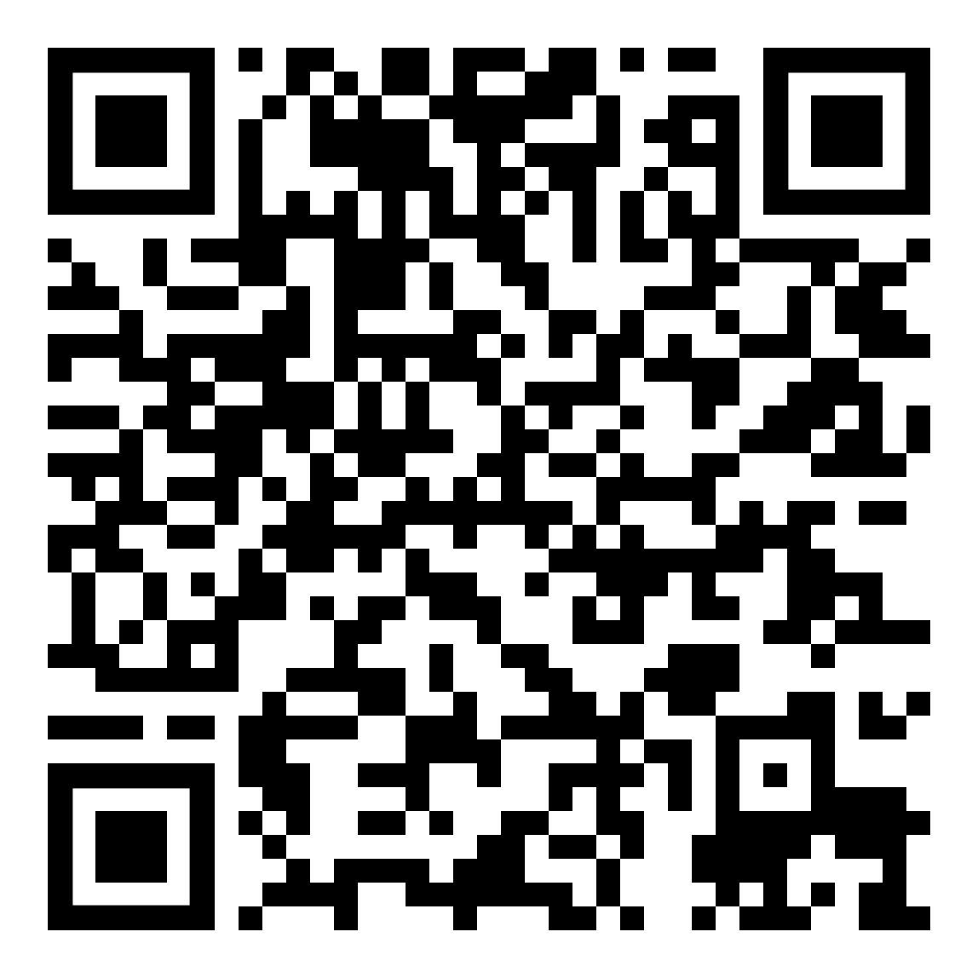
Thank you for joining us!
Please take a moment to fill out our brief survey
Feedback Survey Link: https://www.surveymonkey.com/r/GMSS2KD
For further information about Ohio College Tech Prep:
Ohio College Tech Prep Regional Centers
https://education.ohio.gov/Topics/Career-Tech/College-Tech-Prep

