Slide 1
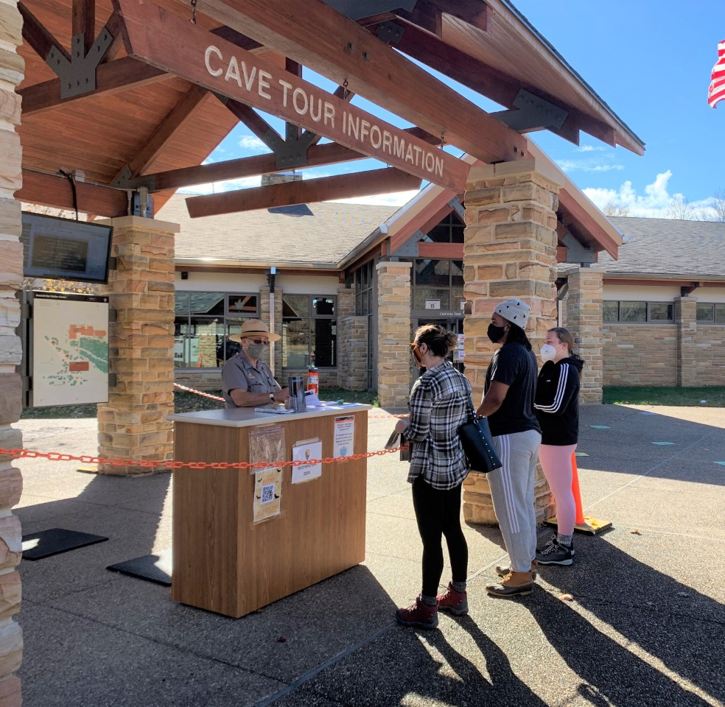
The Impacts of COVID-19 on Tourism in the BRADD, Summer 2020
Marissa Schorr

Slide 2




In 2019…
$460 million
In total visitor spending
$677 million
6,100 jobs
In total business sales
Generated by tourism
$50 million
In state and local taxes
Tourism is a driving factor in the BRADD’s economy!
Notes:
Tourism is a driving factor in the BRADD’s economy
According to a study done by Tourism Economics for the Kentucky Department of Tourism
In 2019
$460 million in total visitor spending
$677 million in total business sales
$50 million in state and local taxes ($442 in taxes per household)
Over 6,100 jobs generated by tourism (3.6% of all jobs in the BRADD)

Slide 3
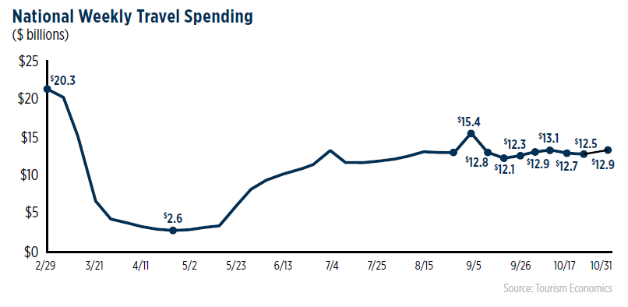
COVID-19: March – October 2020
According to the US Travel Association:
  $443 billion in cumulative losses for the U.S. Travel Economy
  Loss of $57 billion in federal, state, and local taxes
  3.5 million direct travel jobs lost
In Kentucky:
  $3.9 billion in cumulative losses over 2019 in weekly travel spending
  Weekly travel spending was down about 50% over 2019 on average

Slide 4
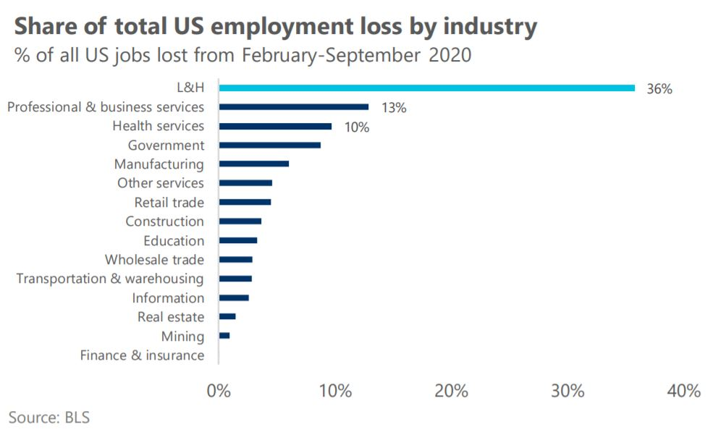
COVID-19
The leisure and hospitality industry has been particularly hard-hit by the pandemic
11% of US employment pre-pandemic
Has suffered 36% of all job losses
Notes:
According to the Bureau of Labor Statistics

Slide 5
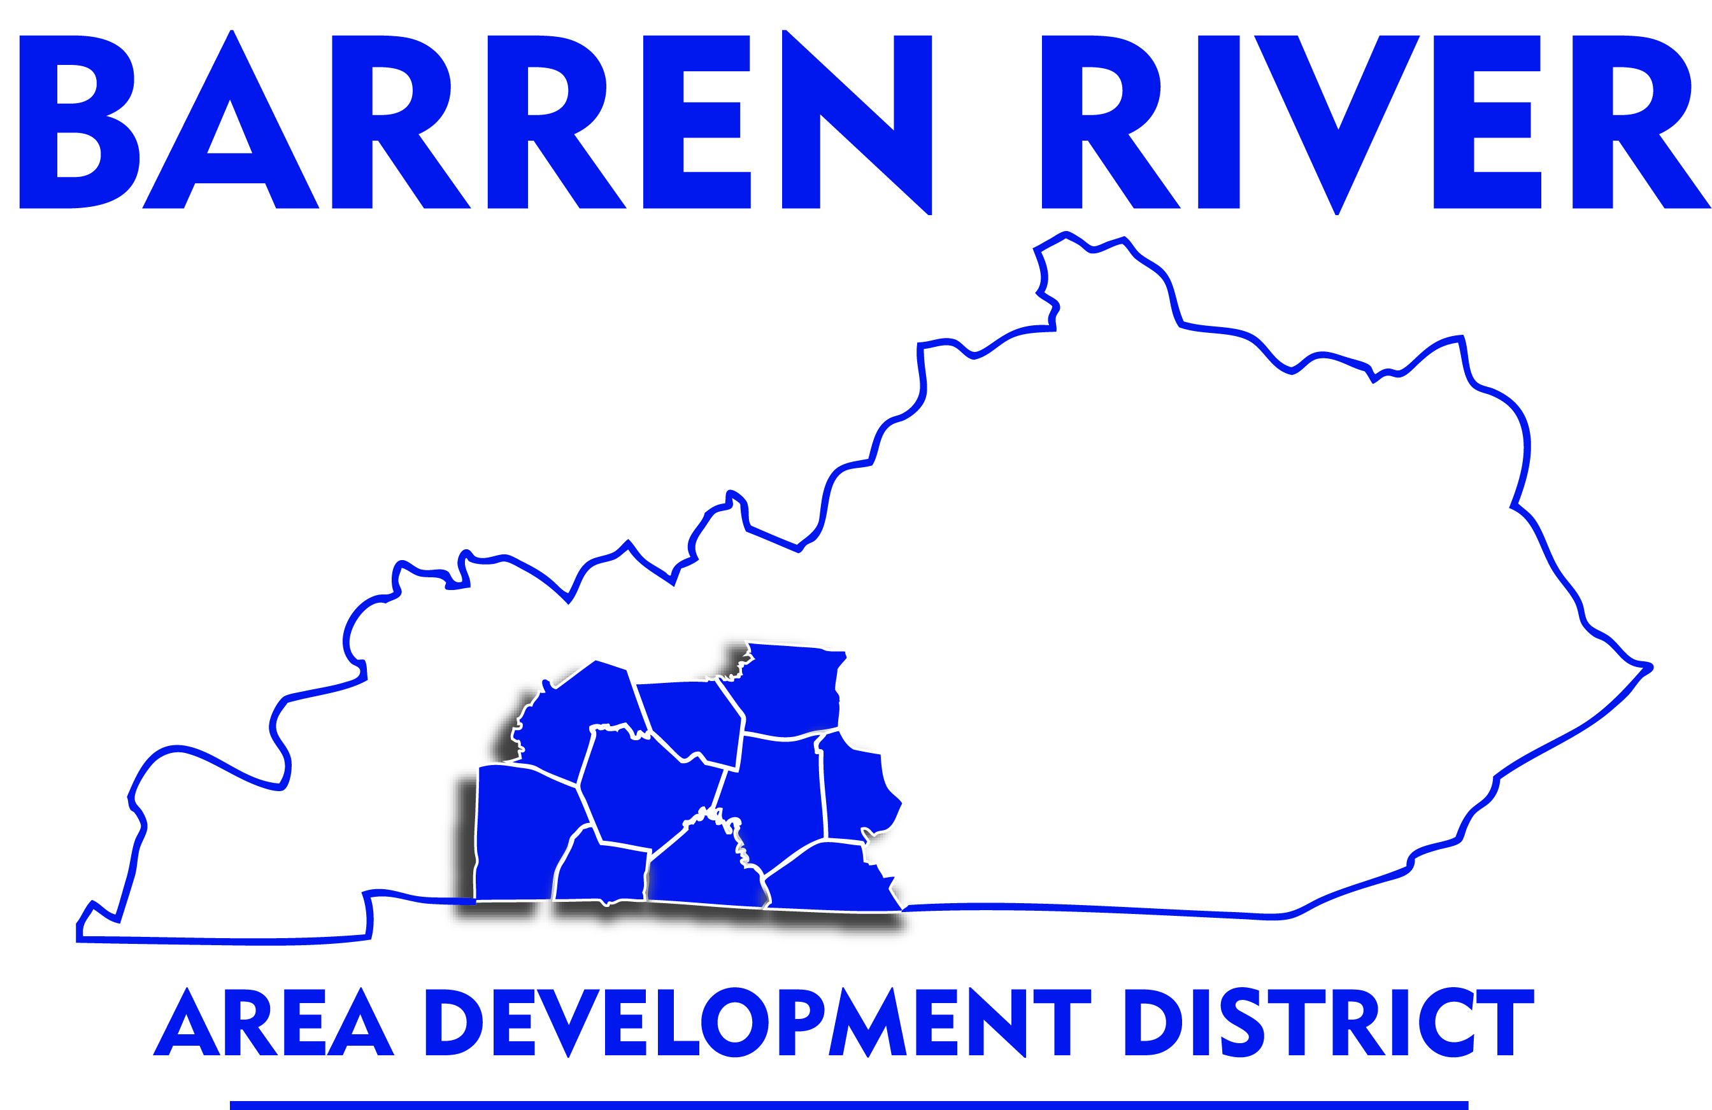
What has been happening in the BRADD?
Still too early to know the full impacts
This survey attempts to get a snapshot of how businesses fared during the usually busy summer season
Many of these businesses are seasonal and rely on their summer business to carry them through the rest of the year

Slide 6
Representation
Responses by County
12
10
Total responses: 46
8
*No responses recorded from Butler County
6
Number of Responses
4
2
0
Allen
Barren
Edmonson
Hart
Logan
Metcalfe
Monroe
Simpson
Warren
County
Notes:
Had some duplicate responses that were removed or consolidated
Had some responses from businesses that were not related to tourism (e.g. manufacturing, photo studio, bank)

Slide 7
Representation
Which sector does your business fall into?
Resorts, hotels, camping, cabins, RV Parks
Museums, show caves, entertainment, etc.
Accommodations 22 %
Attraction 39 %
Retail 15 %
Gift shops, art galleries, convenience stores
Other 11 %
Tourism Commissions and Chambers of Commerce
Restaurant 13 %

Slide 8
Visitation
How does your visitation this summer (June, July, August of 2020)
compare to your visitation last summer (June, July, August of 2019)?
down 30-50%
23 %
down 50-70%
down 10-30%
16 %
14 %
5 %
14 %
down less than 10%
up 10% or more
30 %
down more than 70%

Slide 9
Revenue
How does your revenue this summer (June, July, August of 2020)
compare to your revenue last summer (June, July, August of 2019)?
4
down 30-50%
4
2
2
0
Ac
At
Rs
Rt
0
23 %
Ac
At
O
Rs
down 50-70%
2
down 10-30%
0
23 %
7 %
Ac
At
2 %
about the same
2
2
0
0
14 %
Rt
Ac
At
Rs
Rt
9 %
up 10% or more
down less than 10%
4
23 %
2
6
4
0
Ac = Accommodations
At = Attractions
Rs = Restauraunts
Rt = Retail
O = Other (Tourism offices, etc.)
Ac
At
Rt
2
down more than 70%
0
Ac
At
O
Rs

Slide 10
Staffing
Was staffing challenging for your business
this summer?
Finding staff was challenging for over half of responding businesses
Some reasons why they found staffing challenging:
  Fewer people applying for jobs (especially seasonal positions)
  Unemployment could pay more than businesses could offer
  Current and prospective employees hesitant to work with the public
No 48 %
Yes 52 %

Slide 11
Pandemic Protocols
Pandemic Protocols Used
40
30
Outdoor seating or activities
Additional cleaning and sanitation
Hand sanitizer for staff
Number of Businesses
20
Hand sanitizer for visitors
Requiring staff face coverings
Signs encouraging face coverings
Signs encouraging distancing
Distancing protocols
Requiring visitor
face coverings
Business Closed
10
Other
0
Protocols
Notes:
All of the responding businesses that were open used multiple pandemic protocols
Other:
“acrylic barriers”
“asking staff in public areas to wear masks”
“Greatly limited and regulated cave tour visitor capacity.”
“Limited number of guests”
“only operated one of our two escape rooms at a time to limit risk of too many people in the building”
“PA announcements”
“ride sanitizing between every rider”

Slide 12
Pandemic Protocols
Did your pandemic protocols help
or hurt your business?
Most of the responding businesses believed that implementing the pandemic protocols helped their business (or at least didn’t hurt it).
Most businesses agreed that had they not implemented protocols it would have hurt their business
Help 56 %
Both 7 %
Neither 12 %
Hurt 24 %
Notes:
Those that indicated that protocols hurt their businesses cited many instances of customers leaving upon learning that they had to wear a mask
The most controversial protocol appeared to be that of requiring face masks for visitors

Slide 13
Federal Assistance
No 46 %
Applied for Federal Assistance
Over half of surveyed businesses applied for federal assistance
Most of those who applied received financial aid
Yes 54 %
Yes 92 %
No 8 %
Received Federal Assistance
Notes:
One of those who did not receive fed asst indicated that the process was too complicated

Slide 14
Federal Assistance
Those who did not apply for federal assistance gave various reasons for doing so
Most reported that they did not qualify for the assistance
Why did your business not apply for COVID-19 related
federal assistance?
Did not know we could
apply for assistance
10 %
Closed
10 %
67 %
5 %
the application process
was too complicated
did not qualify
10 %
Other
Notes:
Other:
“central office will do that for us”
“We did not apply, but were given mortgage payments by direct deposit.”

Slide 15
Greatest Challenges
What has been your greatest challenge during the pandemic?
Businesses faced many challenges during the pandemic
The most common were paying bills, implementing pandemic protocols, and attracting visitors
Fundraising
Finding staff
Changing Policy
4 %
9 %
4 %
Implementing pandemic
protocols
Attracting visitors
16 %
16 %
Maintenance/
cleaning
2 %
4 %
Paying staff
Multiple
4 %
None
4 %
9 %
27 %
Other
Paying business-related
rent/mortgage/utilities
Notes:
Other:
“During March-mid April, there was no traffic on the interstate therefore we had very few customers. Our sales dropped 75% during that time.”
“Inventory was harder to get than normal”
“Customers working from home, no in classroom learning, church services not back to normal. Local attractions closed.”
“Whether to open or not because our air filtering system is antiquated”

Slide 16



Adaptations
Many businesses felt that implementing additional safety measures like the pandemic protocols helped their businesses succeed
Businesses also changed their marketing strategies
  More social media promotion and events
  Shift to online options for ordering, shopping, etc.
  Special offers and discounted prices to entice visitors
Greater use of outdoor spaces

Slide 17


Helpful Resources
CDC website and state/local health officials and websites
Financial assistance (PPP loan, etc.)
Internet and social media
Networking and collaborating with other businesses
Notes:
One business mentioned getting a BRADD grant as a resource

Slide 18


Other Impacts
Stress
  Constantly changing situation and uncertainty of the future
  Childcare challenges due to hybrid schedules and school closures
Mandatory closures from March to May really hurt most businesses
More difficult to get inventory and supplies
Unable to hold large events (shows, fundraisers, etc.)
No school field trips

Slide 19
Conclusions
2020 has been a challenging year for many tourism businesses in the BRADD.
Most businesses saw losses in visitation and revenue when compared to 2019.
Many businesses had difficulties finding staff.
Financial assistance helped keep many businesses afloat.
Utilization of the internet, social media, and outdoor spaces in creative ways helped businesses succeed.
Notes:
Ways that BRADD could help?
Continue helping businesses find appropriate financial assistance
School to work programs and other programs to help with staffing?
Programs or trainings to help businesses learn to use social media and the internet more effectively

Slide 20
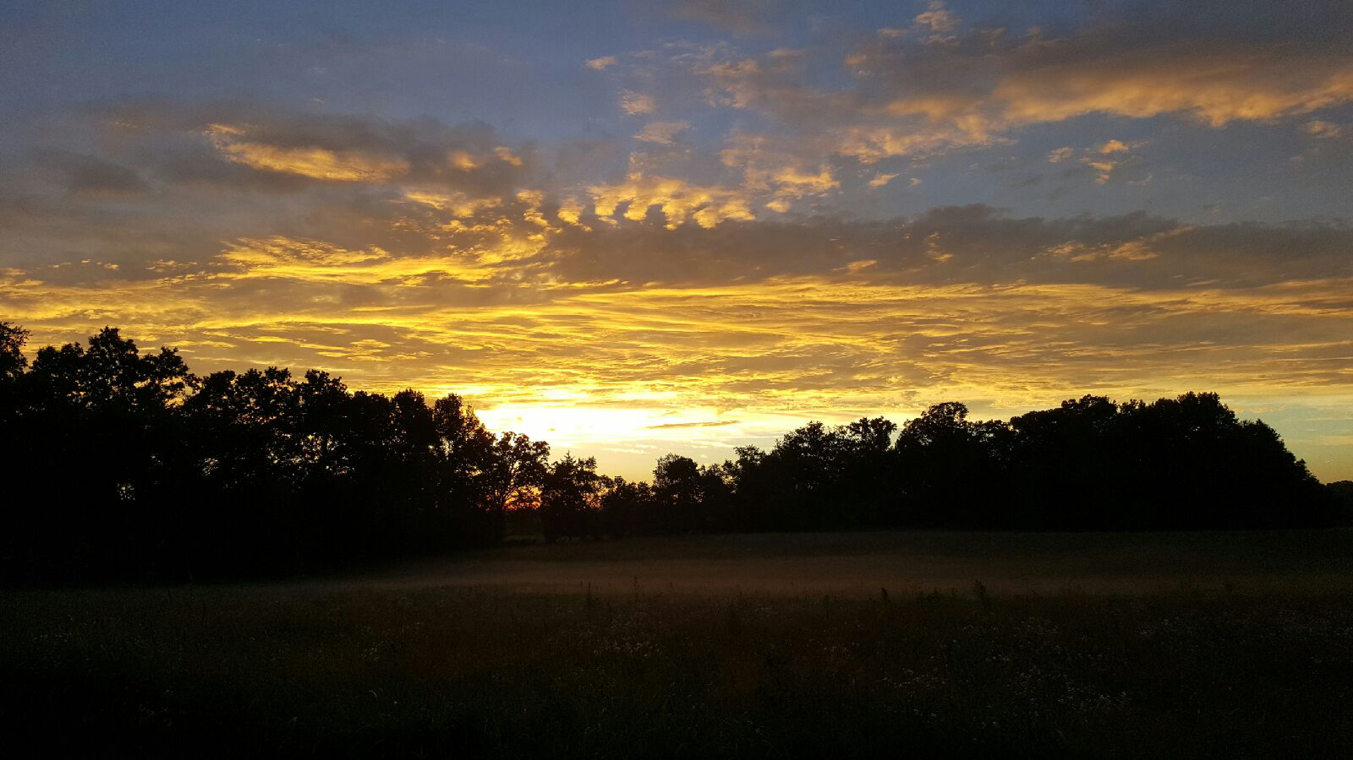
Thank You!
Notes:
Thanks for listening. Here’s a beautiful Kentucky sunset from our very own Mammoth Cave Biosphere Region.

