Slide 1
Long-term care Updates
Terri Kangas-Feller
October 22nd, 2024

Slide 2

Viral Respiratory Pathogens Toolkit for Nursing Homes
Influenza, COVID-19, RSV, Metapneumovirus, etc.
Notes:
This toolkit helps nursing home infection preventionists and leadership prepare for and respond to nursing home residents or healthcare personnel (HCP) who develop signs or symptoms of a respiratory viral infection. While the toolkit is tailored toward nursing homes, the resources and many of the listed actions could be adapted for use in other long-term care settings.

Slide 4
Why do we need a toolkit?
Prevent the spread of respiratory viruses
Comprehensive approach
  Vaccination
  Testing
  Treatment
  Infection prevention and control measures
Together these things help protects residents and staff
PREPARE, RESPOND, CONTROL!
Notes:
The toolkit is broken into 3 parts and is intended as guidance for all respiratory viruses, even COVID.

Slide 5
ACTION:
Prepare for respiratory viruses
Vaccinate
  Provide recommended vaccinations to residents and HCP
Allocate resources
  Evaluate supplies available before an outbreak begins
    PPE, Alcohol-based hand sanitizer
Monitor and mask
  Monitor community respiratory virus activity
  Consider masking if activity increases
Educate
  Educate and re-educate residents, staff, & HCP of IPC practices
  Encourage visitor with symptoms to postpone visits
Ventilate
  Improve ventilation with help from your maintenance team
  Do you have HEPA air scrubbers around?
Test and Treat
  Plan for quick clinical evaluation
  Provide timely treatment

Slide 6
Action:
Respond To signs or symptoms
Prevent spread
  Residents –
    Utilize appropriate transmission-based precautions
    Use private rooms if possible, cohort as appropriate, HCP use appropriate PPE
  Healthcare Personnel –
    Review sick leave policies with staff
Test
  Test anyone with respiratory illness signs or symptoms
Treatment & Prophylaxis
  Antivirals for influenza and COVID-19 treatment
Investigate
  Watch for potential spread among residents and HCP
  Make sure surveillance documents are up-to-date!
Notes:
When an acute respiratory infection is identified in a resident or HCP, it is important to take rapid action to prevent the spread to others in the facility. While decisions about treatment, prophylaxis, and the recommended duration of isolation vary depending on the pathogen, IPC strategies, such as placement of the resident in a single-person room, use of a facemask for source control, and physical distancing, are the same regardless of the pathogen.

Slide 7
Action:
Control Spread
Notify NMDOH when outbreaks are suspected or confirmed – they’re here to help!
Make initial attempts to control limited spread
  Vaccination, use HEPA air scrubbers or increase ventilation, universal masking, and active surveillance
  Consider quarantine of specific units if spread is limited to those areas
Take additional steps if initial actions fail
  Cohort residents with confirmed infections
  Limit group activities and communal dining
  Modify visitation policies – recommend family waits until the outbreak is over
  Avoid new admissions or transfers if widespread outbreak
Notes:
In addition to the actions described in the previous section, the following interventions should be considered.

Slide 8

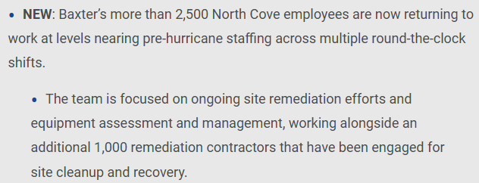
Assess inventory, supply, and conserve available IV solutions
Implement a facility-specific action plan to optimize the use of IV solutions using evidence-based fluid management protocols
Ensure multidisciplinary team involvement to determine and develop conservation and stewardship strategies
Communicate changes in current practice, disruption, new shortages, and action plan adjustments to frontline staff
Health Alert Network (HAN) - 00518 | Disruptions in Availability of Peritoneal Dialysis and Intravenous Solutions from Baxter International Facility in North Carolina (cdc.gov)
Notes:
Visit the CDC for more detail on guidance to ensure your facility is following the most current evidence-based practices

Slide 9
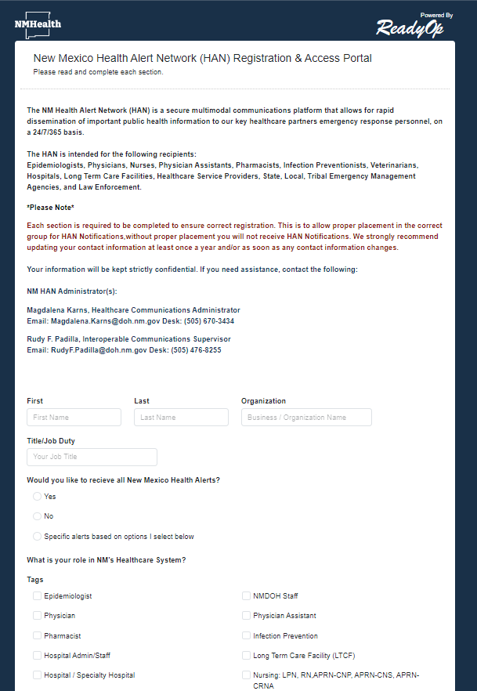

NM HAN
Sign Up for Health Alerts
Link in Chat

Slide 10

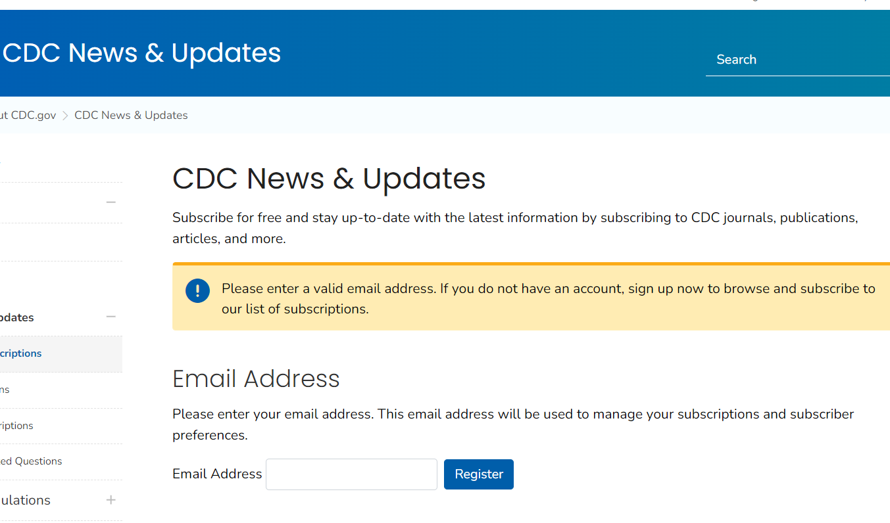
CDC HAN
CDC News & Updates | CDC
https://tools.cdc.gov/campaignproxyservice/subscriptions.aspx?topic_id=USCDC_486

Slide 11

Any questions for us?

