Slide 1

Handling Motions
Based on Chapter 3 of RONR-IB
3rd Edition

Slide 2

Meaning of “Motion”
Primary purpose of a meeting for a group that uses rules of order is to make decisions
A member begins this process by making a motion
A motion is a formal proposal by a member, in a meeting, that the group take a certain action [RONR (12th ed.) 3:22]
A main motion brings business before the assembly
There should be no debate before a motion is made
Only one main motion may be before the assembly at a time [RONR (12th ed.) 4:7-8, 6:1, 10:1.]

Slide 3
How you get to speak at a meeting
To make a motion or speak in debate is the same:
Immediately after the previous speaker has finished, stand and call out “Mr. Chairman”, “Madam President” or whatever the chair’s title may be
The chair recognizes you-calls out your name, title or by nodding to you
You now have the floor. When you are finished, you sit down, and yield the floor
[RONR (12th ed.) 3:30-35, 42:1-5]

Slide 4
How to make a motion
After obtaining the floor, simply say, "I move that..."
Important to say precisely what the words of the motion are to be. The group votes on exact language, not an idea
Motion is written in the minutes. Secretary's job is to copy the motions down accurately
Chair can require that main motions be submitted in writing [RONR (12th ed.) 4:18.] It is good practice to write out a motion
After making motion, immediately sit down and wait to give your reason for making the proposal [RONR (12th ed.) 4:4-8]

Slide 5
"Seconding" a Motion
A motion must be seconded in order to be considered by the group
Shows that at least two members want the proposal considered; it does not necessarily mean the seconder agrees with the motion
If there is no second, the motion is not considered by the group
You do not need to be recognized by the chair, simply call out "Second!" from you chair [RONR (12th ed.) 4:9-14]

Slide 6
The Chair "States" the Question
Once a motion is moved and seconded, the chair states the question
The chair says "It is moved and seconded that.." and repeats the exact wording of the motion
There are two reasons the chair must state the question after it is moved and seconded

Slide 7
Reasons for stating the Question
First, it is important that everyone in the group be able to know exactly what proposal is before it
Second, the chair has two duties before stating any motion:
A) The chair must determine if the motion is in order at the time. If the motion violates the rules in some way, the chair says "The chair rules that the motion is not in order because..."
B) The chair must ensure that the motion is clearly phrased. If the motion is unclear, the chair should help the mover reword it before stating it [RONR (12th ed. 4:15-24]

Slide 8
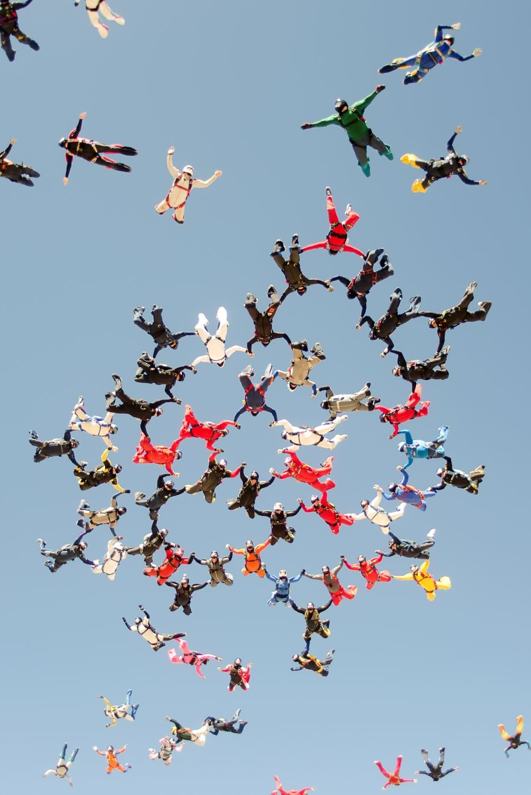
How the group considers a motion
When a motion has been stated by the chair, it is said to be pending or, commonly, "on the floor" The group may then debate and take action
Debate means discussion on the merits of the question, that is, should the action be taken
Right after stating the question on a motion, the chair usually recognizes the maker of the motion to give their reasons for the proposal

Slide 9
How the group considers a motion
After debate is finished the chair "Puts" the question
To put the question the chair may ask "Are you ready for the question?" Or "Is there further debate?" If no one else wants to speak to the motion, the chair stands and puts the question to a vote. [RONR (12th ed.) 4:34]
To put the question to a vote the chair says "The question is on the adoption of the motion that..." And repeats the exact wording of the motion to be voted on

Slide 10
How the group considers a motion
After repeating the motion to be voted on, the chair gives necessary directions for the group to vote on the motion. Most motions require a majority vote of those present and voting to pass. Some require a 2/3 vote. (Abstentions are not counted and have no effect on the result.)
The most common type of voting is voice vote. The chair says, "Those in favor of the motion say aye." The chair then says "Those opposed say no."
The chair judges whether more people called out "aye" or "no" and proceeds to announce the result of the vote. [RONR (12th ed.) 4:34-40.]

Slide 11

How the group considers a motion
When voting is complete, the chair announces the result of the vote.
Each announcement has three parts:
Reporting which side "has it";
Declaring that the motion is adopted or lost: and
Indicating the effect of the vote, if needed or appropriate
After announcing the result of the vote, the chair announces the next item of business when applicable

Slide 12
Example of announcing the vote
If there were more ayes than noes, the chair says "The ayes have it and the motion is adopted. The organization will...... The next item of business is.. (or, "Is there further new business?")
OR
If the noes prevailed, the chair says "The noes have it and the motion is lost. The next item of business is..." (or, "Is there any further new business?")
[RONR (12th ed.) 4:41-49.]

Slide 13
Review of steps to handle a motion
A member is recognized by the chair and makes a motion
A member then seconds the motion
The chair states the question
The members debate the motion
The chair puts the question and the members vote
The chair announces the result of the vote

Slide 14
Let's practice!
MEMBER A[Stands]: Madam President!
CHAIR: The chair recognizes Member A.
MEMBER A: I move that…..
ANOTHER MEMBER [Seated]: Second!
CHAIR: It is moved and seconded that…..
CHAIR: Are you ready for the question? [Nods towards member A or recognizes member A to begin debate]

Slide 15
Let’s practice!
MEMBER A: [States reason of support for proposed motion]
[Other members can seek recognition and debate after being recognized by the chair]
After no one else is seeking the floor:
CHAIR: Is there further debate?…The question is on the adoption of the motion that….. Those in favor of the motion, say aye. [Pause] Those opposed, say no.

Slide 16
Let’s practice!
CHAIR: The ayes(noes) have it, and the motion is adopted(lost). The unit will (not)…
CHAIR: Is there further new business?

