Slide 1

Dairyland Power
Mobile GIS Deployment
Presenters:
Denny Hoskins, Dairyland Power Cooperative
Vickie Rooker, Dairyland Power Cooperative

Slide 2

Dairyland Power Cooperative

Slide 3
Dairyland Power Service Territory

Slide 4

DPC Mobile GIS, The Beginning
Started with Pole inspections in the field
Grass roots movement
ArcPad was the 1st mobile application used
  GoSync used to synchronize data in the field
  Approx. 15 users
Grew into more field use cases
  Veg. Mgmt.
  Transmission Maint.
  Electrical Maint.
Moved to ArcGIS Mobile on windows mobile devices
Added a WebGIS application
Devices: Juniper Archer, Trimble Juno, Mobile Mapper
Has become a required tool by our field users

Slide 5
ArcGIS Mobile Application
Contracted New Wave Geographics for programming help
Configuration tool created
  Easy deployment
  Easy synchronization
  Easy Creation of custom forms
DPC programmer worked with New Wave Geographics
A tool was delivered to DPC that we could control and manage changes easily
In place and working for almost 5 years

Slide 6
WebGIS Application
Search Tools
Identify Features
Measure Distances
Driving Directions
Google Street View
Lightning Strike Data

Slide 7
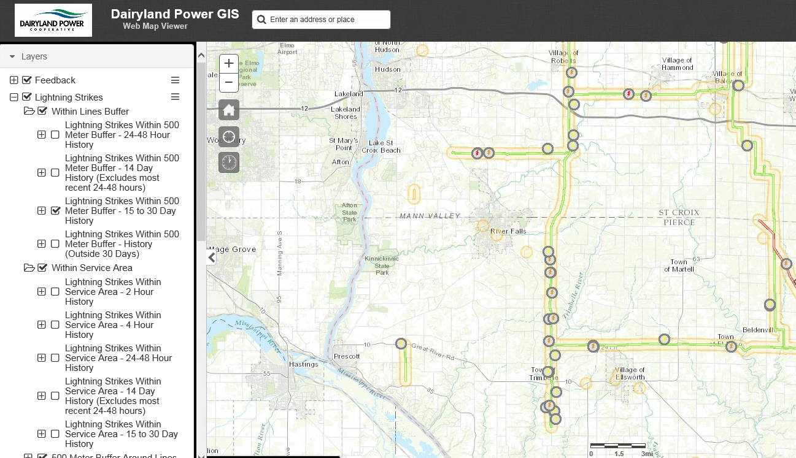
WebGIS Lightning Strikes

Slide 8
A New Mobile Idea
Take our configuration philosophy to mobile phones and tablets
Leverage ESRI products that are already in place at DPC
Utilize already built code to deploy to multiple OS devices
Keep using C# for all programming
Create platform agnostic tool that we control
Have the ability to create custom forms easily
The ability to update new configurations, forms, and data remotely
No connectivity required to view or edit GIS data
Easily develop and maintain in-house future needs

Slide 9
The Issues
Programming for multiple OS platforms (Android, iOS, UWP)
Applications which support a specific operating system or form factor
Deployment is difficult to manage
Free applications have limited functionality and force you to use specific platforms
Paid applications are not configurable or extensible
Testing on various devices is tough to manage
Disconnected viewing and editing of GIS data can be complex
Dairyland has limited resources

Slide 10
The Solution
Xamarin
Android
iOS
Windows10

Slide 11
Decisions, decisions..
What is Xamarin?
It’s a development tool used to create mobile apps
They are a company with 350+ employees, 15,000 customers, 1,400,000 developers
Why choose Xamarin?
One tool to rule them all…write once, deploy to any device
Android, iOS, Windows
Integrated within Visual Studio using C# (utilize existing skills)
In 2016 Xamarin became free after being bought by Microsoft
Partnered with ESRI in July of 2016, introduced Beta SDK

Slide 12

GeoCross Mobile
Ready, Set…..
Full working product in five months (Oct-Feb) for three platforms
Two programmers, one GIS specialist and one visionary
What is it?
Mobile Application with real time access to DPC information
Can be accessed on DPC issued tablets, phones or laptops
Robust options for viewing and editing data when out in the field
“Preloaded” offline maps when in areas of low cellular strength

Slide 13
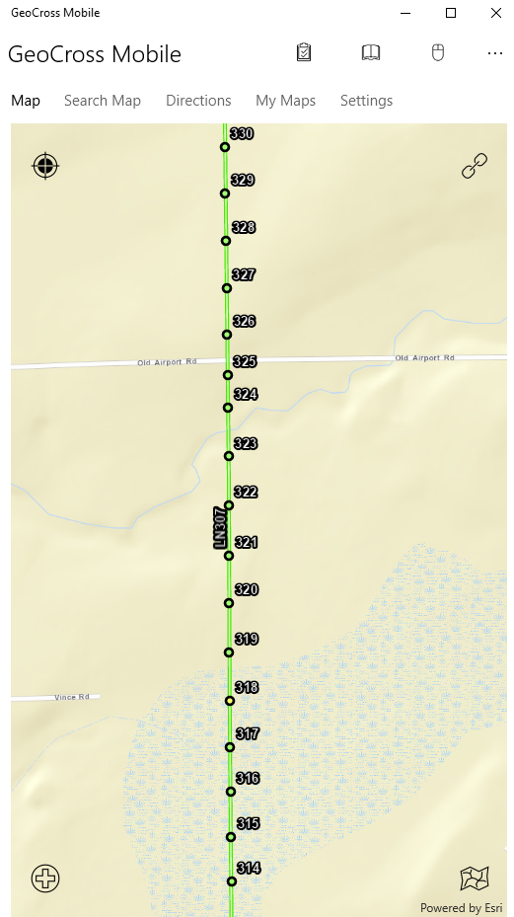
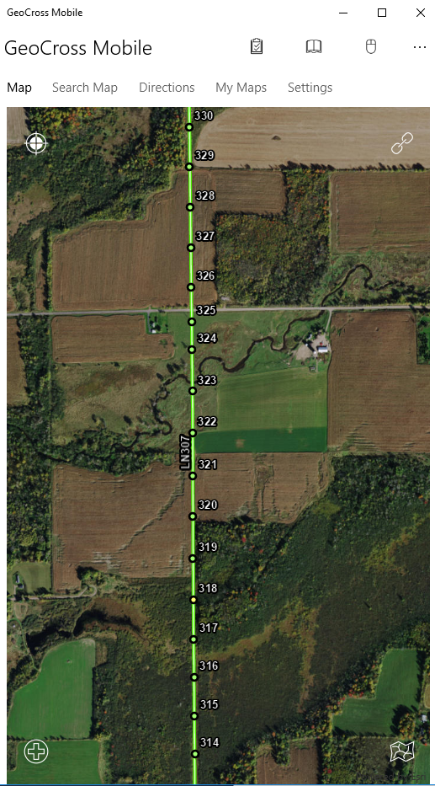
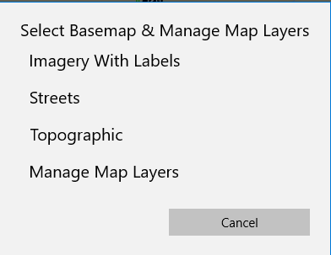

GeoCross

Slide 14
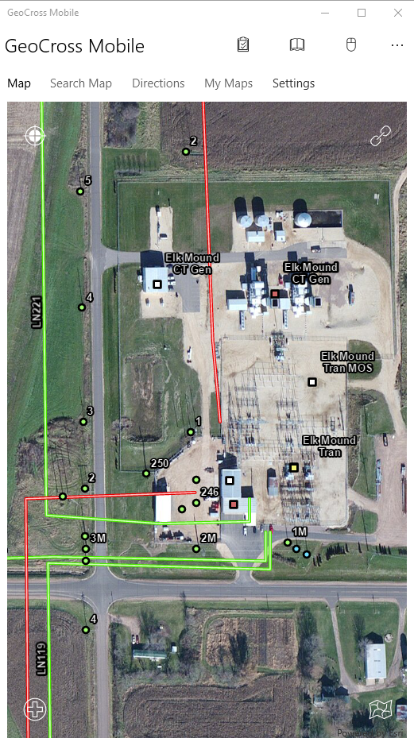
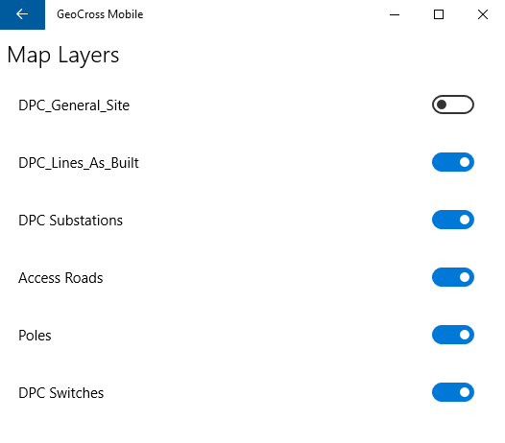
Elk Mound Area

Slide 15
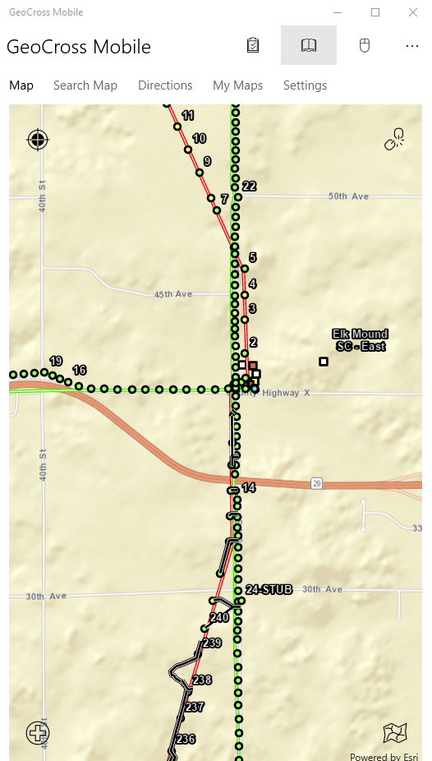
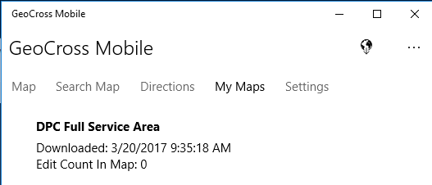
Preloaded offline map of service area

Slide 16
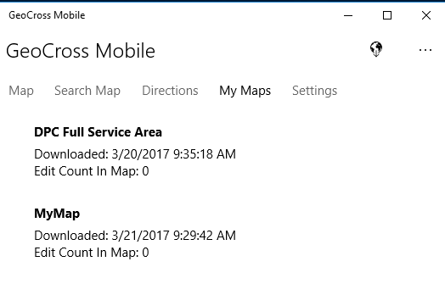
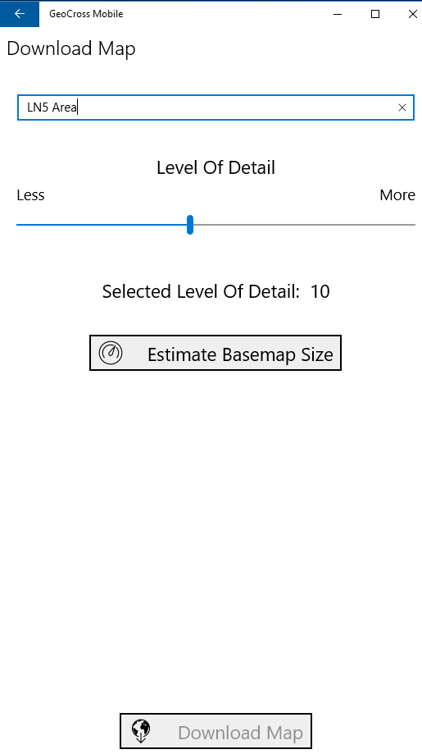
Create other offline maps for areas of interest

Slide 17
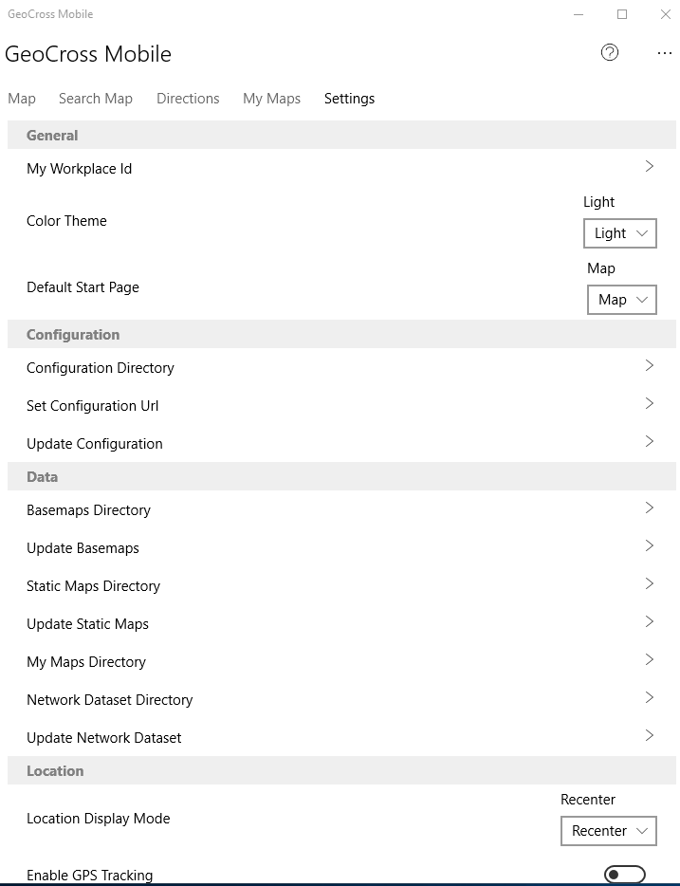
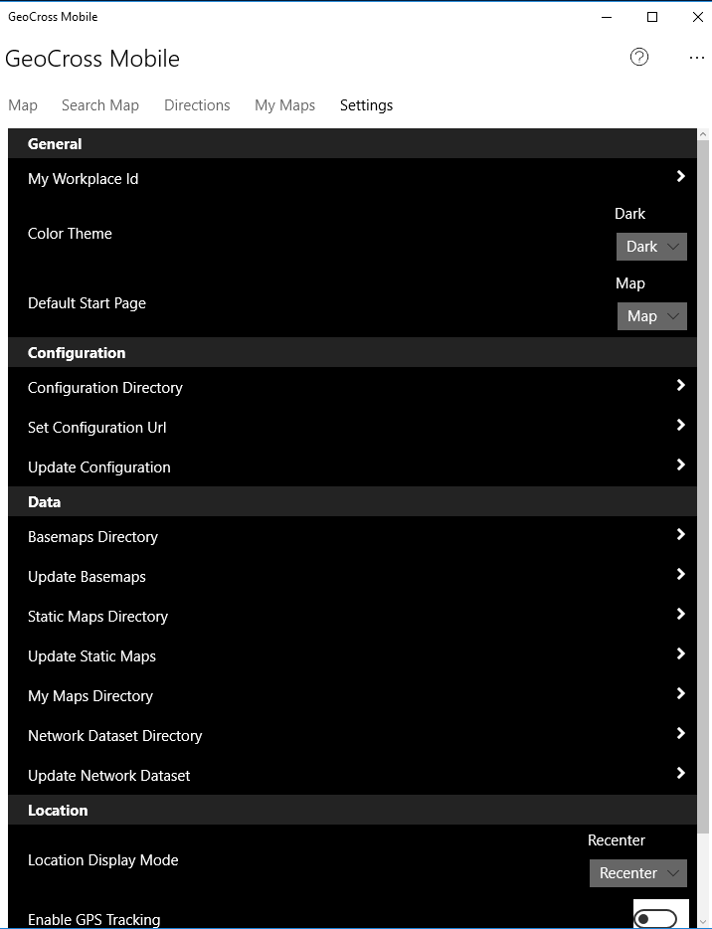
Easy updates for maps and application configurations

Slide 18
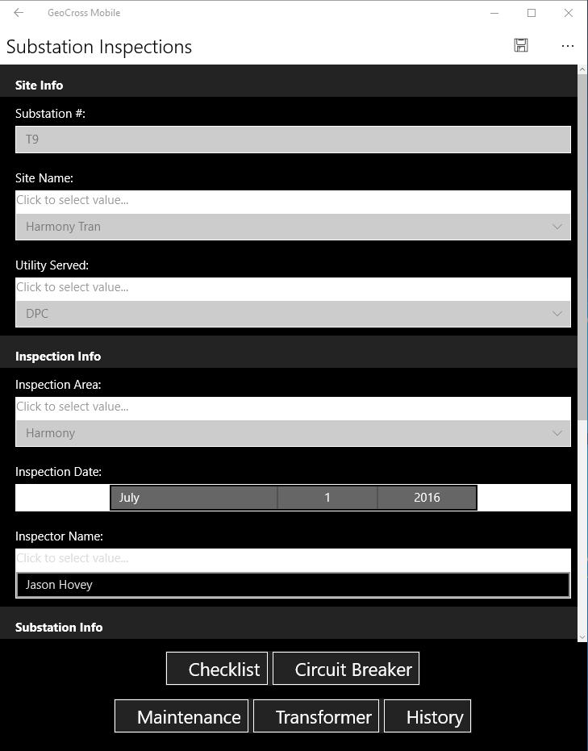
First task – Substation Inspections
5 Separate data sets accessed from one inspection form

Slide 19
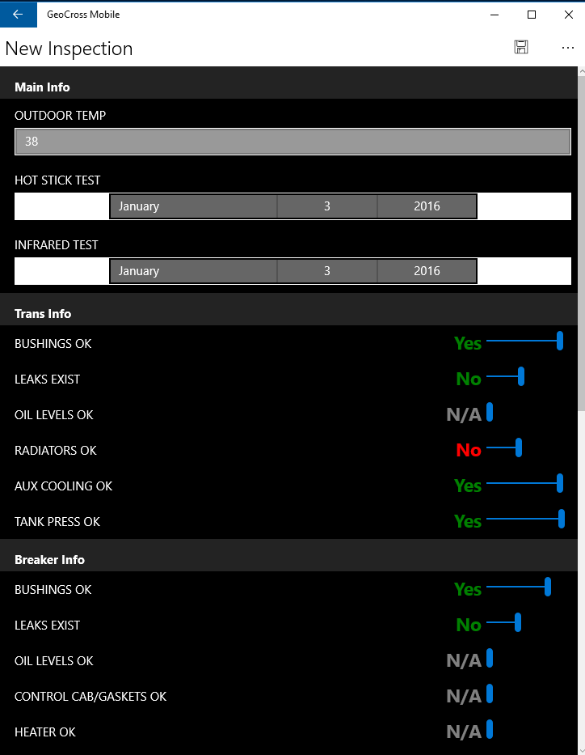
First task – Substation Inspections
Text color based on “normal state” definition in configuration file

Slide 20
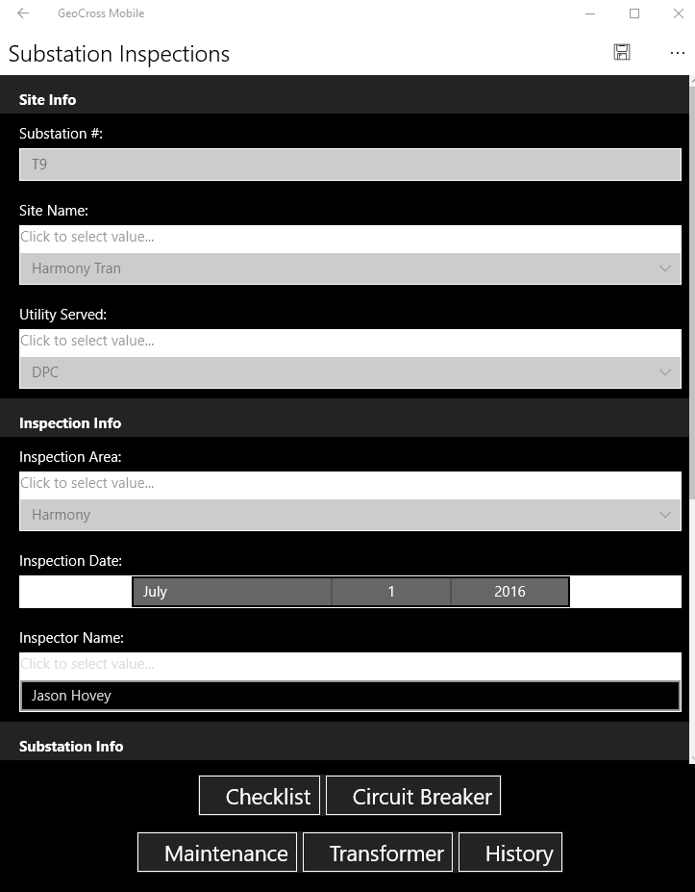
First task – Substation Inspections

Slide 21
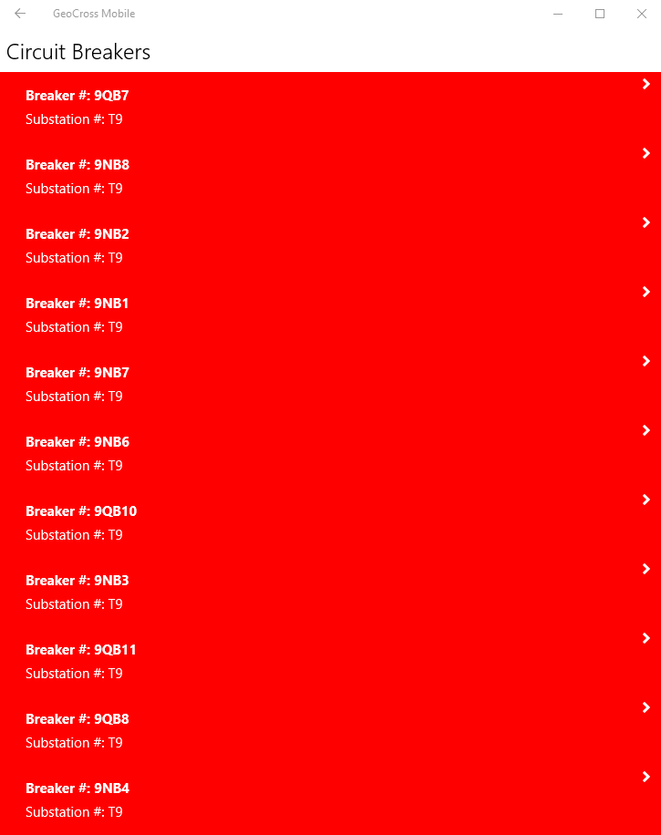
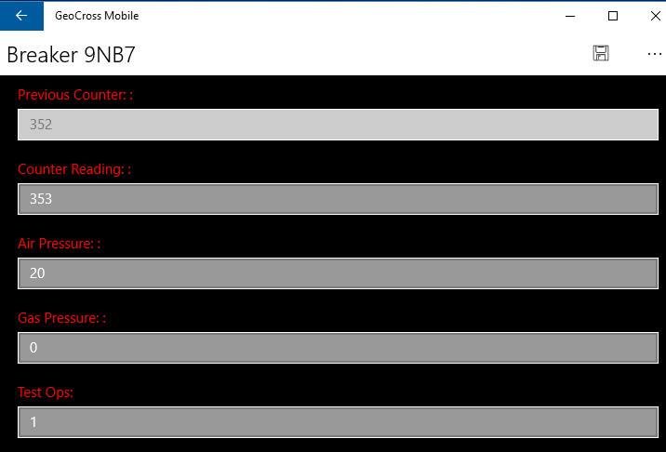
First task – Substation Inspections

Slide 22
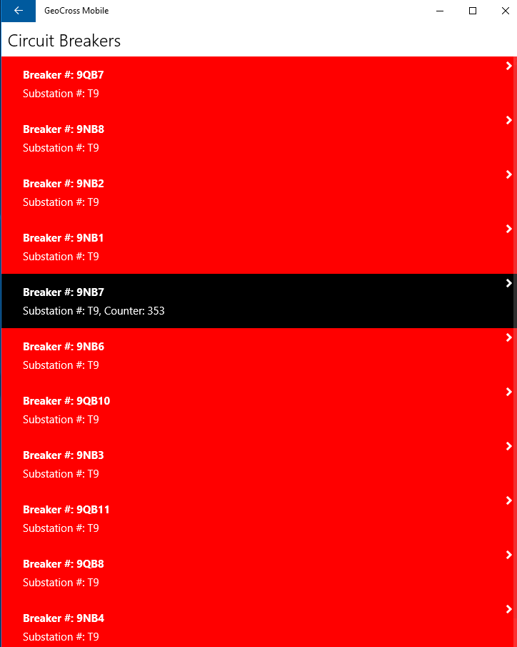
First task – Substation Inspections

Slide 23
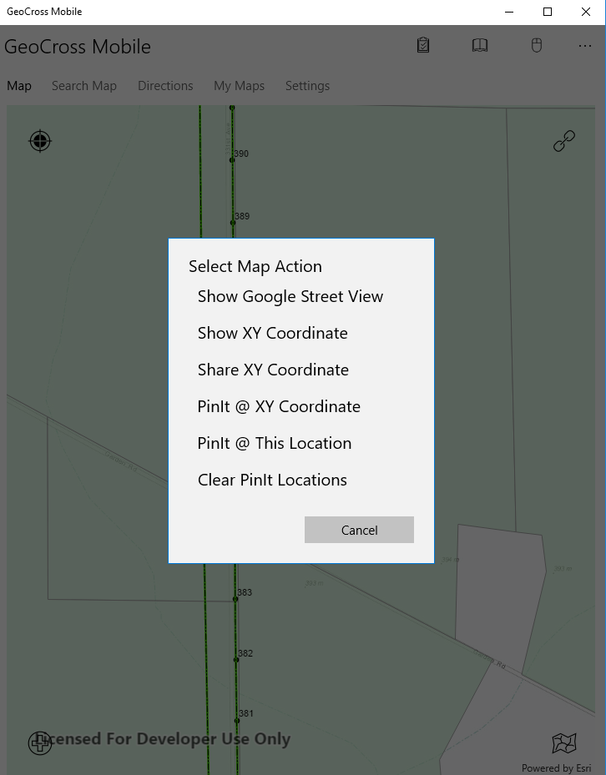
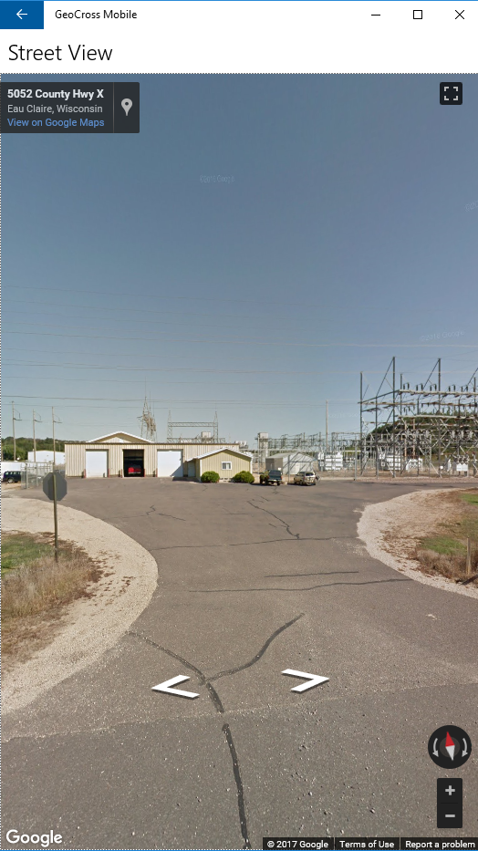
“Pin It” feature (Tap and Hold on the Map)

Slide 24
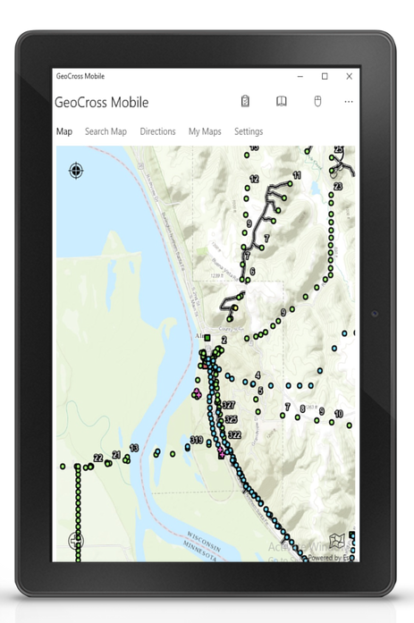
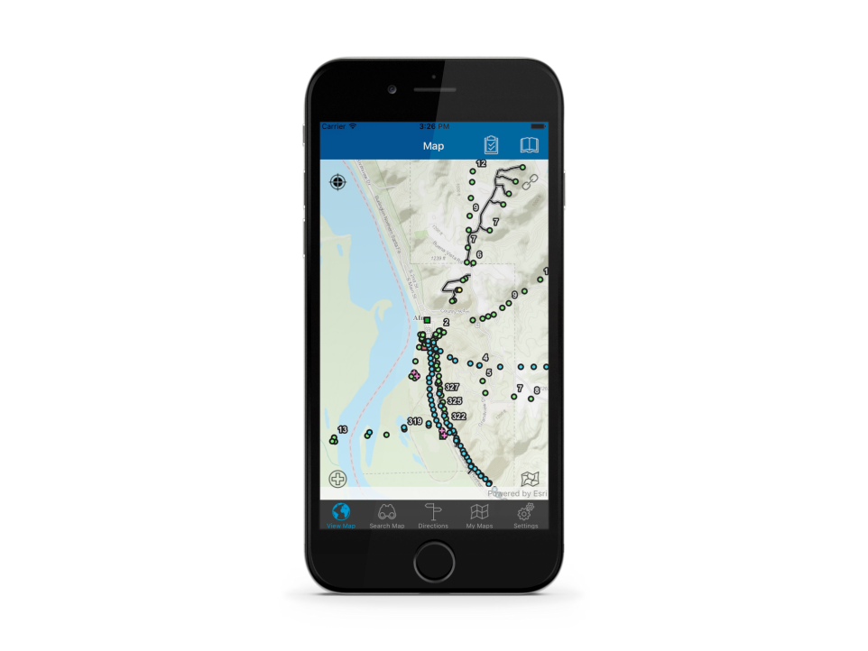
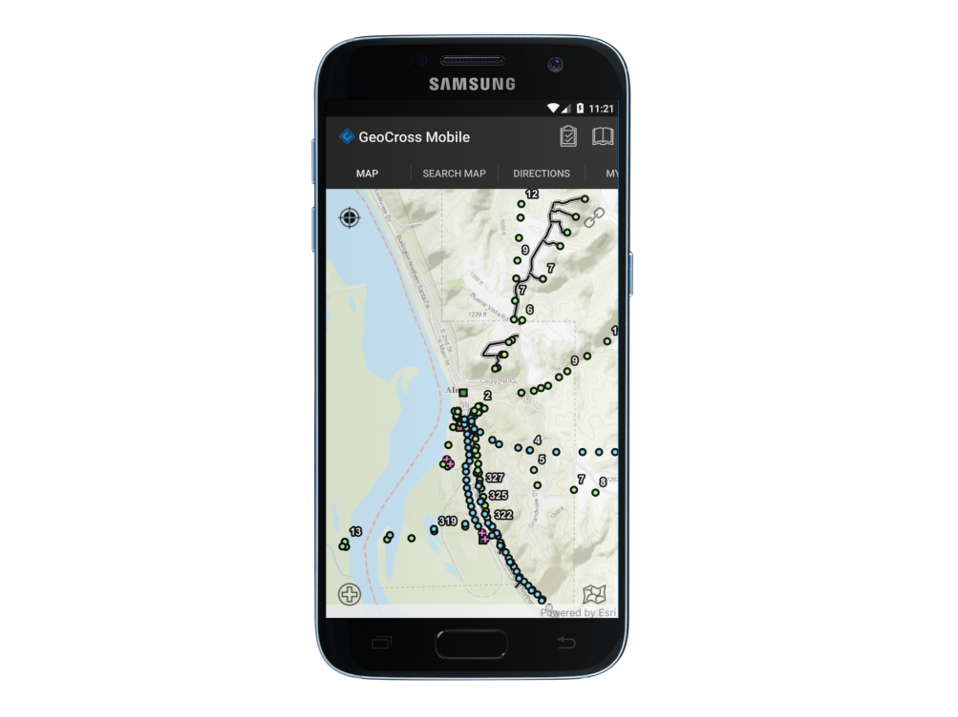
GeoCross Mobile running on all 3 mobile platforms
Windows 10
iOS
Android

Slide 25
GeoCross Mobile
Benefits
Ability to customize per job classification
Simple forms based on domain definitions
Create custom forms
Easily update background data (i.e. new wetland info)
Same look and feel across devices
View and attach photos
Choose whatever device works best in the field
Simple navigation ability
Disconnected editing and viewing of data
One person supports “one” program for 50+ users

Slide 26
What We Learned
Xamarin was the right tool for Dairyland
Feedback from the field users was crucial
Network setup more difficult than expected (VMware Tunnel)
Production roll out is fluid due to the nature of field workers schedules. We need to be flexible.
Training was pretty easy
Xamarin/ArcGIS SDK was our major decision driver
Our partnership with New Wave Geographics was crucial
Quickly create maps with forms for Non-Dairyland personnel
Build it and they will come

Slide 27
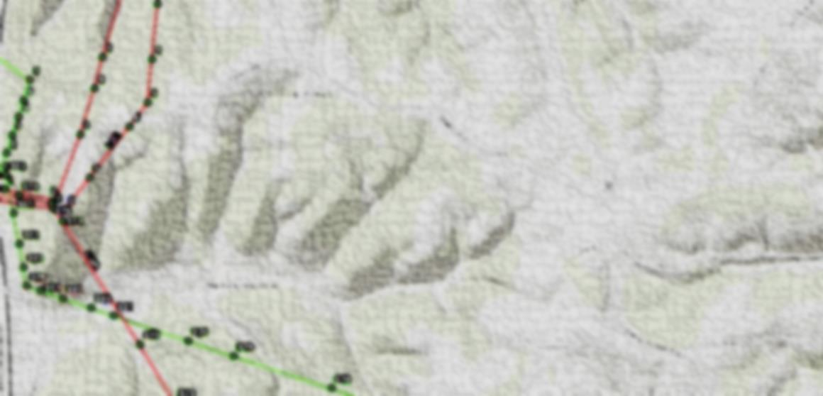
The Future
Work ticketing functionality
Telecom inspection/work ticket forms
Monthly vehicle inspection forms
Pole inspection upgrade
Meter data testing inspection forms
Vegetation Management upgrade
Use Web app as dashboard

Slide 28
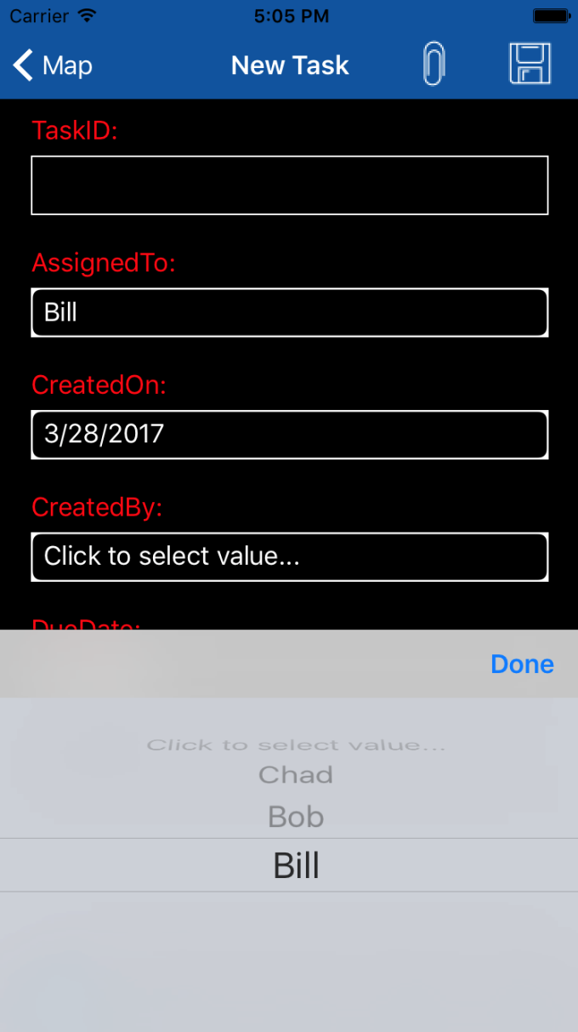
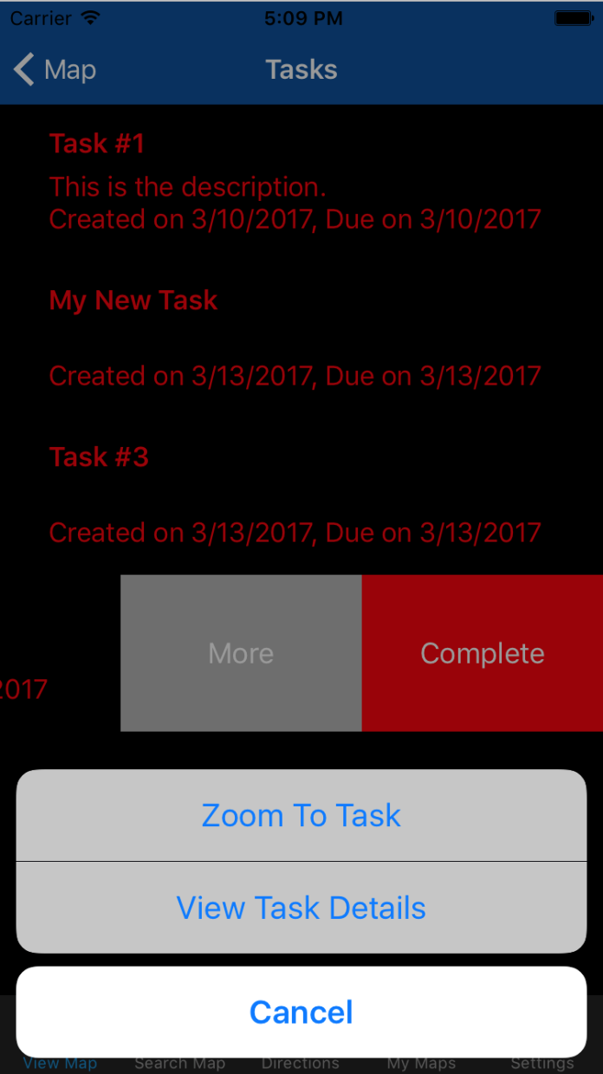
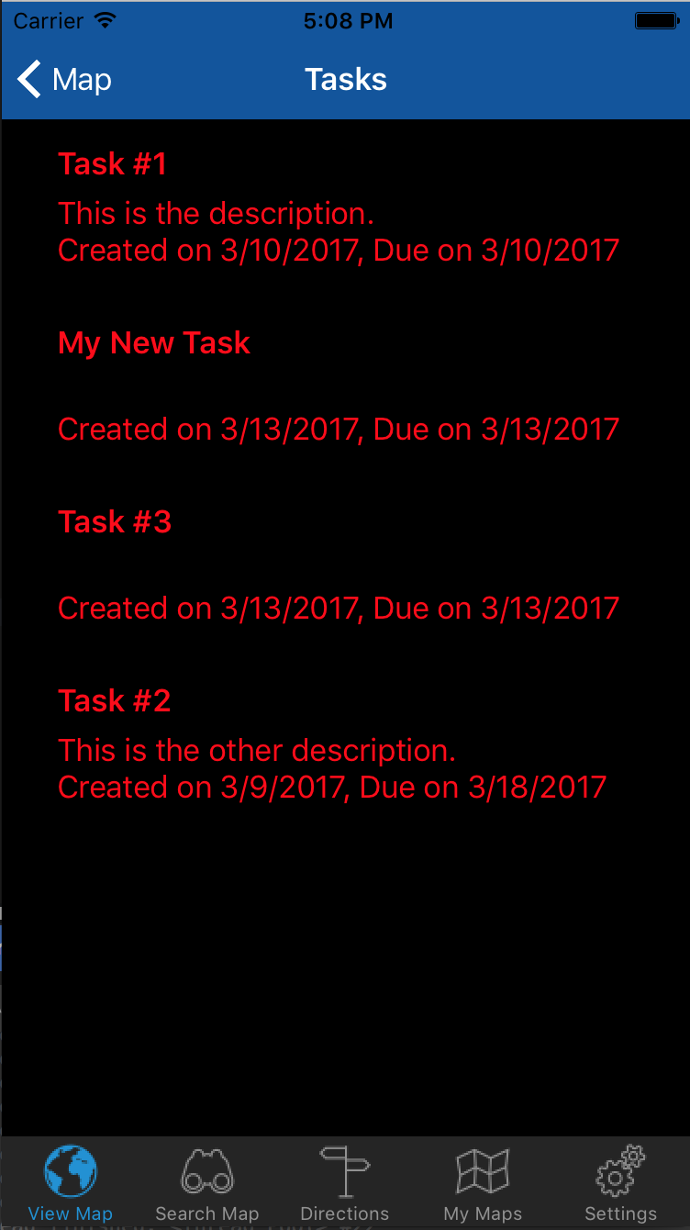
The Future, Work Tickets
Create tasks
Assign tasks
Complete tasks
Works through GIS database
Set alarms based on fields
Set priorities
Tasks show up in users task list
Tasks disappear when complete
Use “dashboard” to deploy

Slide 29
In Conclusion
What’s great about the ESRI product suite, is they let you decide how you will solve business challenges.
They do this by providing multiple tools to choose from, or the ability to create your own solution using SDK’s
GeoCross Mobile works for Dairyland
It could work for others as well

Slide 30

Thank You!
denny.hoskins@dairylandpower.com
vickie.rooker@dairylandpower.com
chad.yoder@nw-gis.com

