Slide 1

Project Management Workflows and Notifications with GIS
Jay Forstner
GIS Coordinator
Rochester Public Utilities

Slide 2

Project Management - Background
Water Project Database
  20 year old Access Database
  Tied to GIS assets by Project ID
Project Life Cycle
  Project Created in database
  GIS has to stay in tune with project start dates
    Enters dates for testing, etc from paper trail
  Water crews do walk-thrus to inspect the project
    Paper process
    GIS updates attributes based of information
  Water Department must stay in touch with Public Works over project for warranty and other deadlines

Slide 3
Project Management - Background
Problems
  Lack of workflow procedures/standards
  Many hands entering data
  Paper based workflows
  Communication issues
  Viewing of information utility wide
  Dates getting missed for warranties
  Staff turnover

Slide 4
Project Management - Proposal
Move to GIS Benefits
  Multiuser enterprise database
  Accessible internal and external utility wide
    Public Works access to project information
  View projects spatially
    Dashboard capabilities and analytics
  Mobile attribute updates
    Data in hands of those that use it
  Defined workflow
  Automation of notifications to stakeholders

Slide 5
Project Management - Proposal

Slide 6







Project Management - Components
ArcGIS Server
GeoEvent
ArcMap
Collector
Explorer
Operations Dashboard
Access
Web Maps

Slide 7
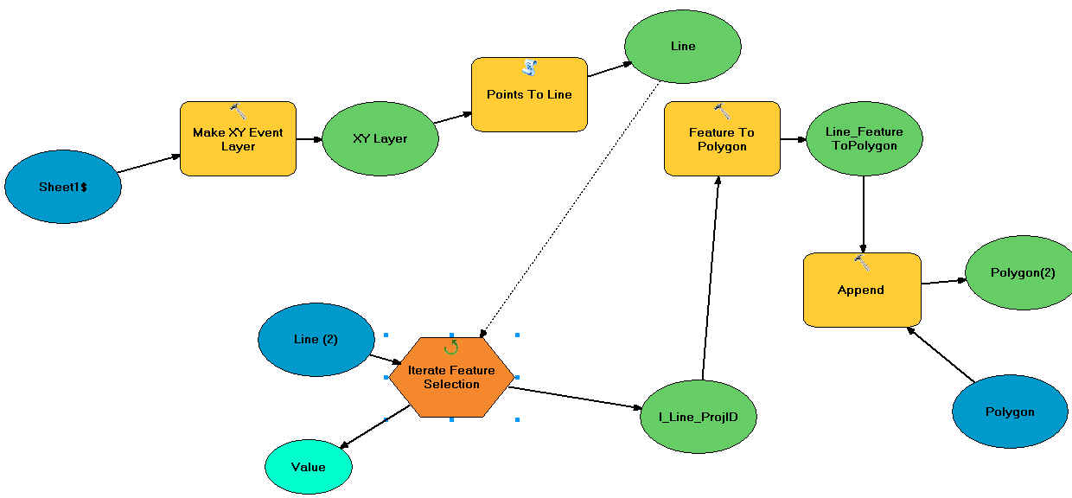
Project Management – Set Up
Moving from Access to SQL
  Model Builder to create polygons
    XY to line by ProjID
    Line to Polygons
    Append the project information by ProjID

Slide 8
Project Management – Set Up
Making Data Accessible and Easy to Use
  Set up Domains and field values
  Publish out map services
    Set up field alias and field order in ArcMap
    Feature Templates – for predefined editing
    Used for all applications
      Web maps
      Dashboards
      GeoEvent
      Mobile apps

Slide 9
Project Management – Set Up
ArcGIS Online
  Web Maps
      Specific Purposes/Don’t clutter
      Pop-ups
      Searches
Web App Builder/Configurable Templates
    Configure Widgets/Tools
    Each have different advantages and disadvantages (bugs)
    Training during implementation

Slide 10
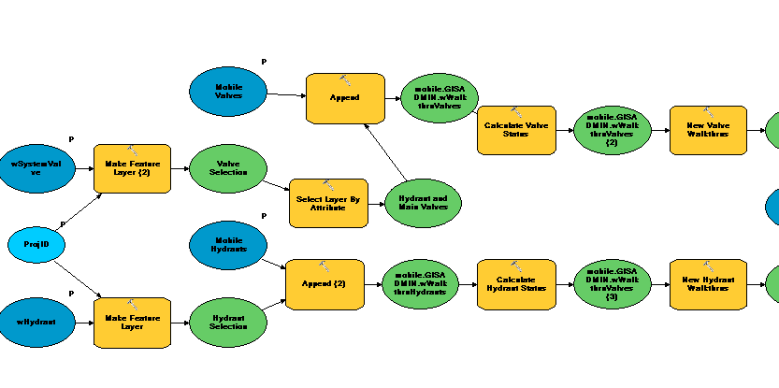
Project Management – Set Up
iPad Apps – Mobile
  Collector
    Edit walk thru inspections created from project polygons
    Attributes pulled back into production GIS
        Using models
Explorer
  Map viewer for engineering in field
  Data access anywhere

Slide 11
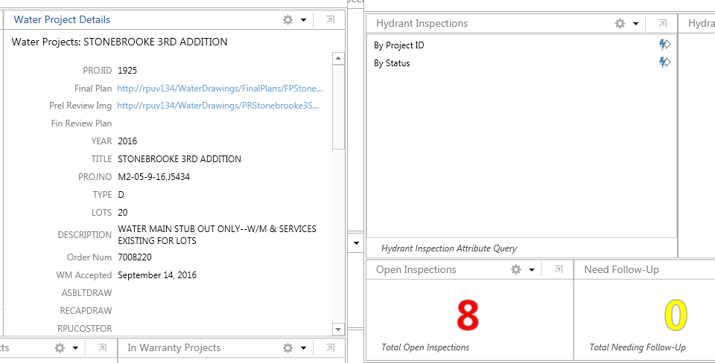
Project Management – Set Up
Operations Dashboard
  Executive/Manager level information
    Project counts
    Field work out there
    Predefined queries

Slide 12
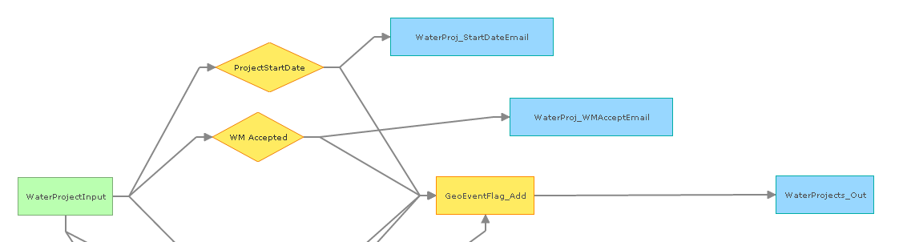
Project Management – Set Up
GeoEvent
    Input
    Feature service of projects
GeoEvent Services
  Inputs
  Filters – Using Regular Expression
  Processors
  Outputs
Outputs
  Feature Updates
  Notifications

Slide 13
Project Management – Set Up
Demo

Slide 14
Project Management – Set Up
Questions
?

