Slide 1
Who takes home the title in the Portal versus ArcGIS Online Battle?
Portal
Online
VS
Let’s Find Out!!

Slide 2
Tale of the Tape
ArcGIS Online® - Secure hosted cloud based GIS that allows you to create and share maps, scenes, apps, layers, analytics, and data on the Internet or your mobile device.
Portal® for ArcGIS® is a secure central hub for managing your organization’s sensitive mapping and GIS assets. Portal for ArcGIS is designed to run on your infrastructure (on-premises or in the cloud).
Notes:
ArcGIS Portal and AcrGIS Online basically accomplish the same thing but in different ways. The Online portal is already set up and ready to go for you with your ESRI Server licensing. However, additional user accounts or logins may need to be purchased depending on your requirements for access.
With Portal for ArcGIS you have to install and configure it in your local environment. Essentially setting up your own private online portal. Published maps can be shared with everyone in your organization without additional account licenses.

Slide 3
Iiiiiiiiiiit’s TIME…… to find out who takes home the title belt in the Portal vs ArcGIS Online Main Event between two GIS Content Delivering Elites !!
Disclaimer: Actual, true to life representations of the presenters.
Who is going to land the first shot? HERE WE GO..

Slide 4
Portal Comes Out Swinging!
Empowering users to securely view maps without Named user Accounts…….

Slide 5
What does this mean?
Portal sits inside the firewall and has access to your organizations intranet
You can share with everyone and since its in on the intranet only users that are connected to your internal network or via a proxy can see your content
ArcGIS Online is in the cloud
If you share with everyone you share to the entire internet you still wont need a named user but you content will not be secure

Slide 6
Online counters with a Cheap Shot!
Additional local resources like hardware software or IT staff are NOT required…….
Notes:
Access to Online content is administered by GIS staff, not IT staff.

Slide 7
Portal Reacts…….
Low Blow!

Slide 8
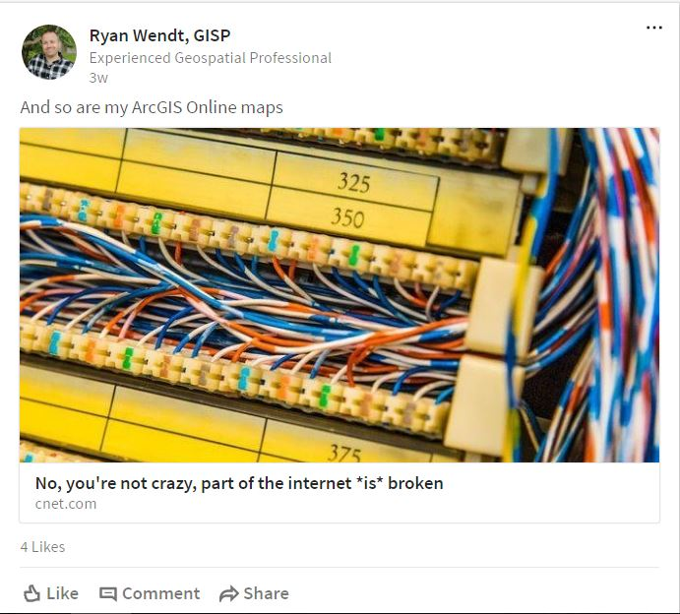
Portal recovers and returns fire with a solid shot!
An internet connection is not required to view published content….
Notes:
Data and applications can all be stored in house and made available without the need for an internet connection. Critical for us as a distribution cooperative because our outage management system maps are published web applications.

Slide 9
Woah! Online is dazed but still in it!
With online I don’t have any administrative tasks to worry about. ESRI takes care of it all….
Notes:
ESRI is responsible for making sure the online portal is available. Backups, recovery, redunancy and fault tolerance are all handled by ESRI.

Slide 10
Portal is not fazed and thinks he has it, going for the knockout!
Portal supports Integrated Windows Authentication or IWA…. Single sign-on in laymen “Online” terms….
Notes:
In this configuration, Portal for ArcGIS and ArcGIS for Server are more closely integrated. When you federate an ArcGIS Server site with Portal, it uses Portal’s identity store. This means that all Portal for ArcGIS members are now the only valid logins to the ArcGIS Server site. The ArcGIS Server site’s identity store is no longer used. Any web services that are published to the ArcGIS Server site will automatically be available as an item in Portal, and when users try to access the item, they will have a single sign-on user experience. Portal can be federated with multiple ArcGIS Server sites.

Slide 11
Ohh… Online is offended by the taunting and comes back with a solid shot to the chin!
Online works much the same way Portal does without the need for complex server configurations and in fact, I can publish much of my local content in my Online organization……

Slide 12
Portal, able to shake it off delivers a devastating shot to the head!
Portal says – Little “p” Big “P” – Mine’s bigger……

Slide 13
Online is not having any of that and swings for the fence!
Analysis Tools are ready to go in ArcGIS Online. Things like the ability to Summarize Data, Find Locations, Analyze Patterns and many more are built in with no added development required…

Slide 14
Portal thinks he has this “secured”
You may have confidential data that cannot be stored in the cloud for security reasons….

Slide 15
As expected this fight is turning out to be a nail biter. Going into the final round it is too close to call it. Who’s it gonna be?? It’s anyone’s guess right now!
As you can see these fighters are weary but they have a lot of heart and neither will go down easily! FINAL ROUND…ding ding ding…

Slide 16
Looking for knockouts, both fighters connect with hard shots right in the face!
Portal - High Availability is supported. Two servers running the same web apps from a shared content location. “Can you even pronounce Fault Tolerance Mr. ArcGIS Online?”
Online – Seamlessly integrate content with Apps for Everyone. Collector, Navigator, Dashboard, Explorer, Workforce and Survey123 all easily integrate with your ArcGIS Online content. “Go back to school Portal cuz you can’t hang with the big boy……”

Slide 17
Fight of the year folks and we will be going to the judge’s score cards

Slide 18
Is it Portal?

Slide 19
Or is it ArcGIS Online?

Slide 20
By Unanimous Decision
We have a draw!
Notes:
There is no winner or loser here. Weigh out your options and requirements and make the best decision to suit your company’s needs.

Slide 21
Since nether fighter can be beat this dynamic duo has decided to join forces

Slide 22
You can use a combination of Portal and ArcGIS they actually work well together

Slide 23
esri web based solutions deliver a devastating knock out blow to all other web mapping platforms

Slide 24
http://www.esri.com/software/arcgis/arcgisonline
http://www.esri.com/software/web-appbuilder
http://www.esri.com/esri-news/arcuser/winter-2014/portal-for-arcgis-101
https://www.esri.com/training/catalog/search/
http://www.esri.com/software/arcgis/data-appliance
http://www.esri.com/library/fliers/pdfs/portal-for-arcgis.pdf

Slide 25
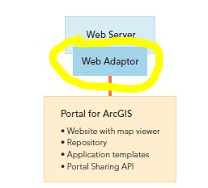
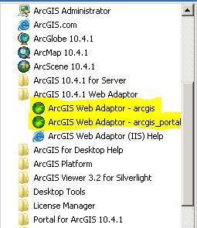
Web Adapter - ArcGIS Web Adaptor allows ArcGIS Server to integrate with your existing web server. It is compatible with IIS and Java EE servers such as WebSphere and WebLogic. The Web Adaptor is an application that runs in your existing website and forwards requests to your ArcGIS Server machines.
Notes:
We haven really talked about this but its important. Web Adapter must be installed on your server and registered with your Portal in order to be able to publish and view web content. You may already me using adapter with ArcGIS Server but you will need a separate one registered for Portal.

