Slide 1

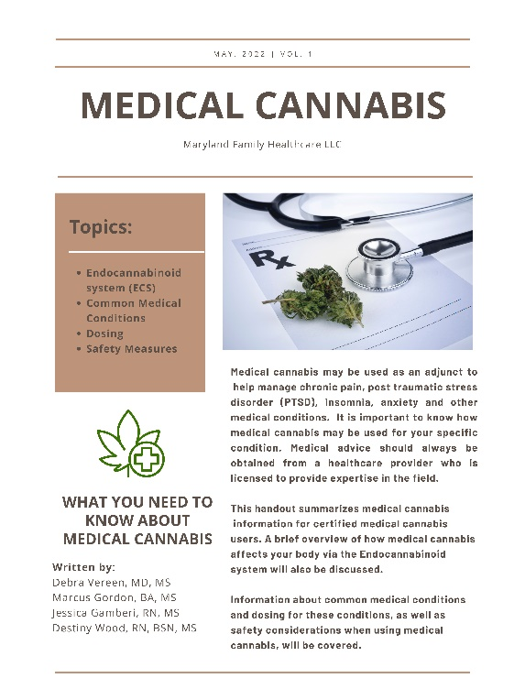
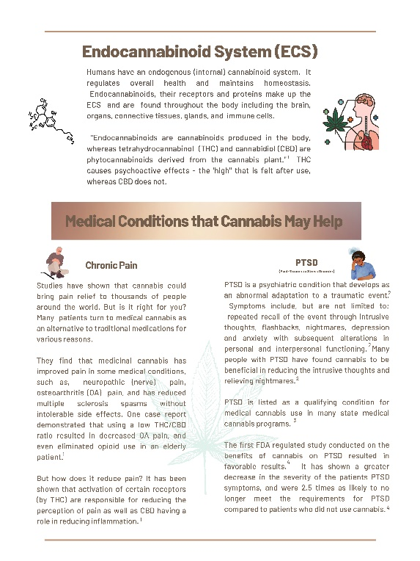
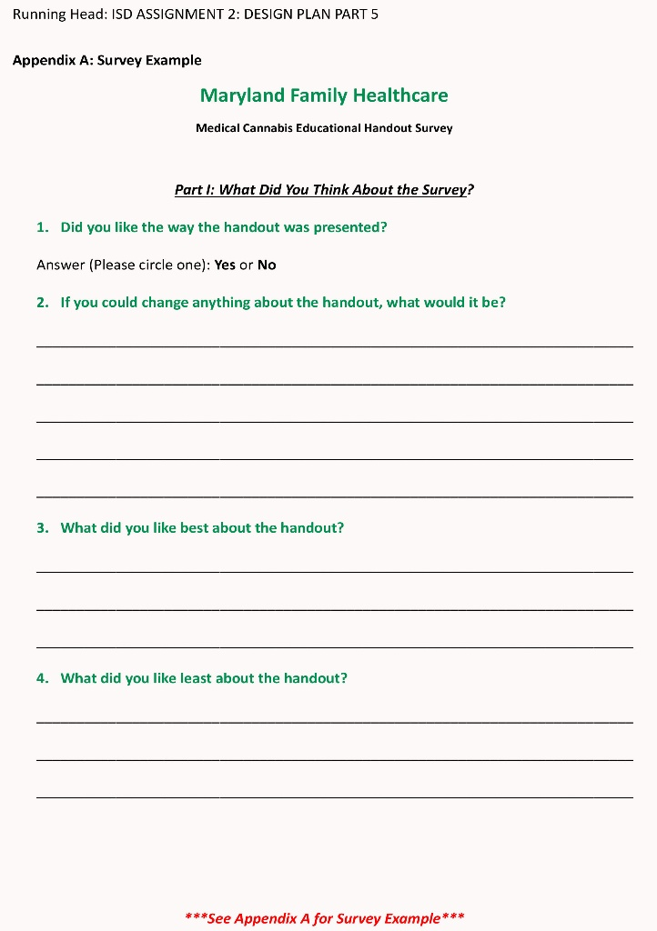
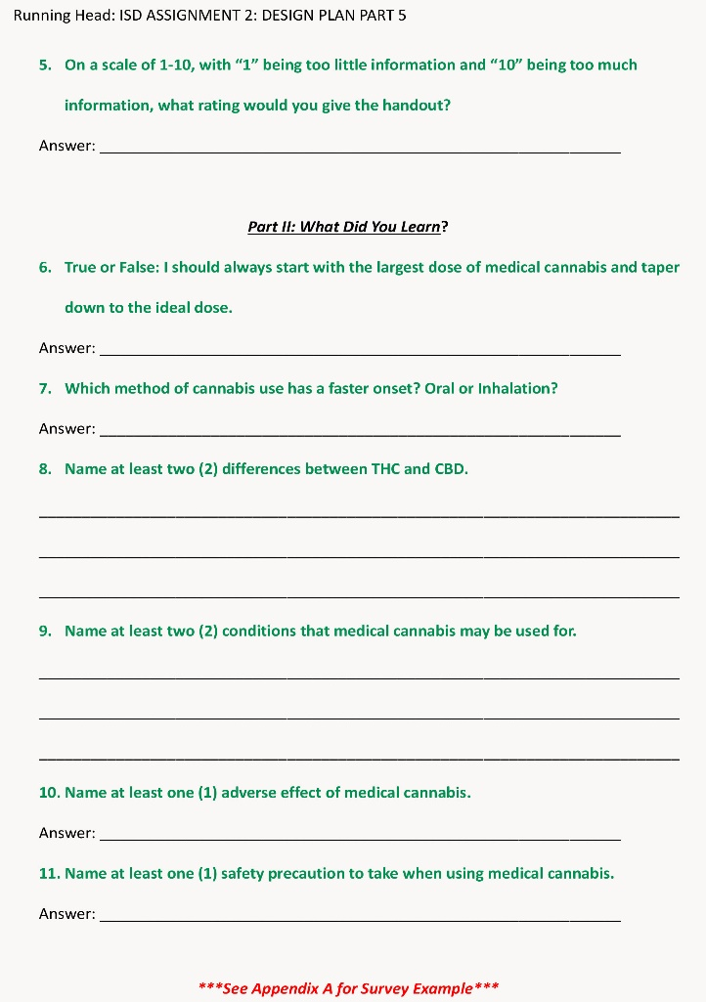
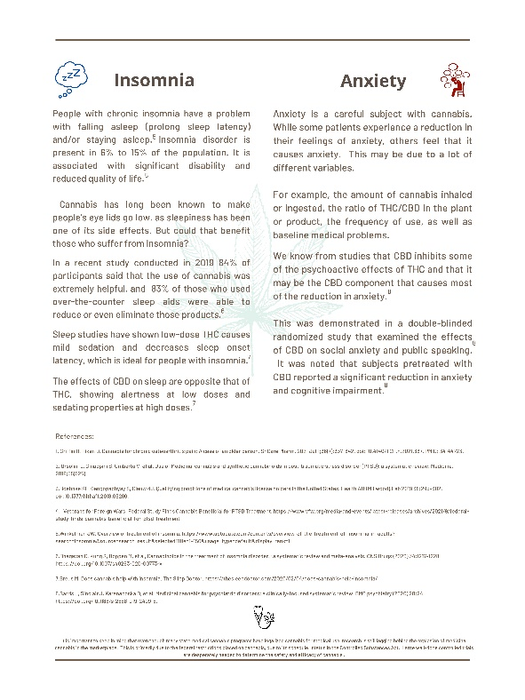

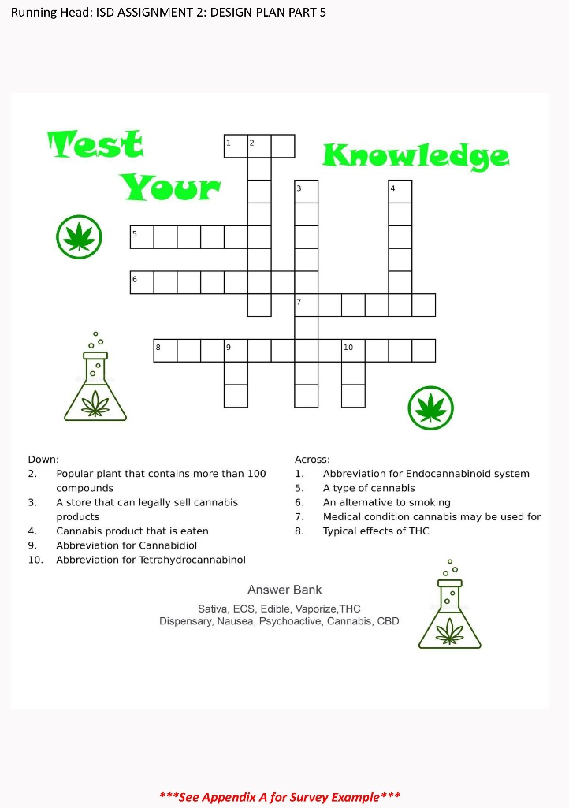
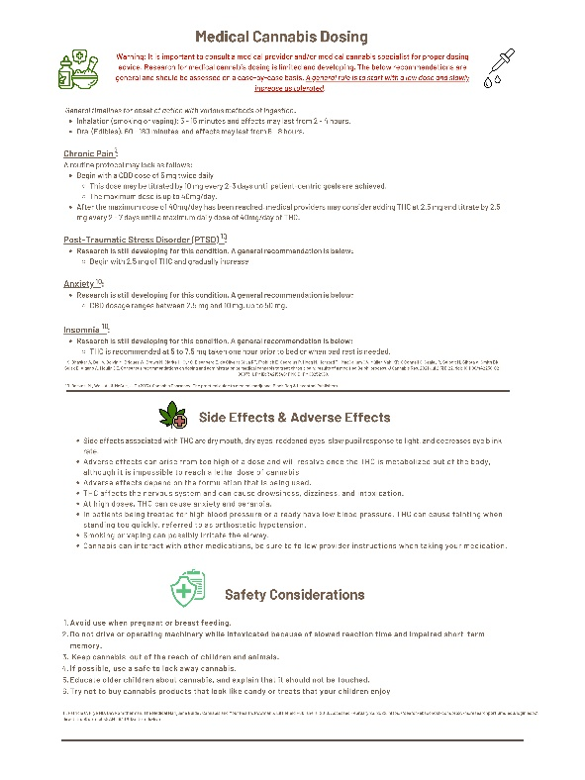
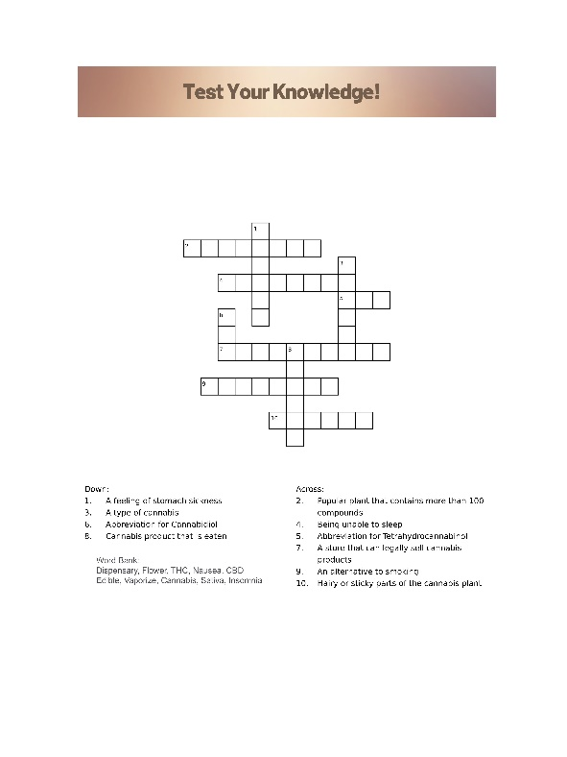
Medical Cannabis Handout for Maryland Family Healthcare LLC
Debra Vereen, MD, MS - Marcus Gordon BA, MS - Jessica Gamberi, MSN, FNP-C, MS - Destiny Wood, BSN, RN, MS
University of Maryland Baltimore School of Pharmacy Medical Cannabis Science and Therapeutics
Spring 2022 MCST 615 Medical Cannabis Capstone II Group 36
Objective
Description of Instructional Materials
Evaluation Plan
Lessons Learned
The MEDICAL CANNABIS HANDOUT was developed for Maryland Family Healthcare, LLC (MFHC) patients who will obtain first time certification for medical cannabis use.
Patients presenting to a medical office to obtain first time certification for medical cannabis usually do not have a fund of knowledge or understanding about how cannabis will help their medical condition. (1) They may have experimented with cannabis following a family or friend's recommendation and gotten a positive outcome. However, they usually have not had communication with a health professional about how cannabis works for their medical condition. Therefore, their knowledge gap is low and at their first medical cannabis appointment they may have questions about how cannabis works.
Full color double sided brochure developed to cover the most common diagnoses for medical cannabis certification at Maryland Family Healthcare LLC, that include chronic pain, insomnia, anxiety, and post traumatic stress disorder. Also covers dosing strategies, safety, and the endocannabinoid system for an overview so they know what to expect.
The intention of our group is to use a series of digital and paper surveys that will be distributed to patients at the end of their first certification visit, and at their first follow-up visit. Reward incentives such as gift cards or service discounts will be used to encourage the completion of distributed surveys. The surveys will consist of questions designed for each level of Kilpatrick’s evaluation process.
It is critical to have a plan for reaching patients to complete surveys and to make them interactive and engaging. Individuals are inundated with questionnaires/surveys, so it is important to design plans that will encourage completion.
Setting buffers in for deadlines. When working with multiple groups to complete a task, it is important to have buffer times to account for delays that may occur in the timeline.
Communicate with stakeholders frequently. There are many unpredictably things that may happen, but when communication is open and effective then solutions can be developed.
Our group found that it was beneficial to have teammates who are knowledgeable about information technology, because it helps to expedite and complete deliverables.
Having a diverse team adds depth and perspective to planning and creating strategy.
With medical cannabis still being researched and many of its effects unknown, we found it valuable to provide a balanced view. Offering both positive and negative effects that have supported through clinical research [2].
Medical Cannabis Handout
Medical Cannabis Questionnaire
Rationale
The MEDICAL CANNABIS HANDOUT provides information on a general overview of medical cannabis and will provide initial education and an introduction to medical cannabis. This is done by offering a brief summary of medical conditions that cannabis is most used for within the MFHC patient population, as well as dosing suggestions, adverse reactions and precautions.
Audience
Identified caregivers and patients of Maryland Family Healthcare who have been recommended by their providers to use medical cannabis as a treatment option. Patients will receive the medical cannabis handout during their clinical consultation which is required of all Maryland residents when registering with the Maryland Medical Cannabis Commission to legally purchase and use Medical cannabis.
References
Oldfield K, et al. Knowledge & perspective about the use of cannabis as a medicine: a mixed methods observational study in cohort of New Zealand general practice patients. The New Zealand medical Journal. 133(1522) 96-111, 2020.
Cannabis (marijuana) Drugfacts. National Institutes of Health. https://nida.nih.gov/publications/drugfacts/cannabis-marijuana. Published March 22, 2022. Accessed April 26, 2022.

