Slide 1
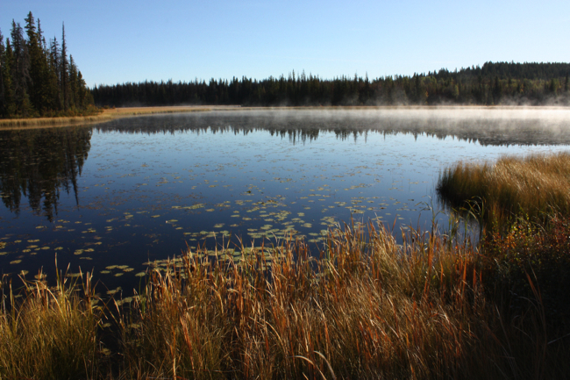
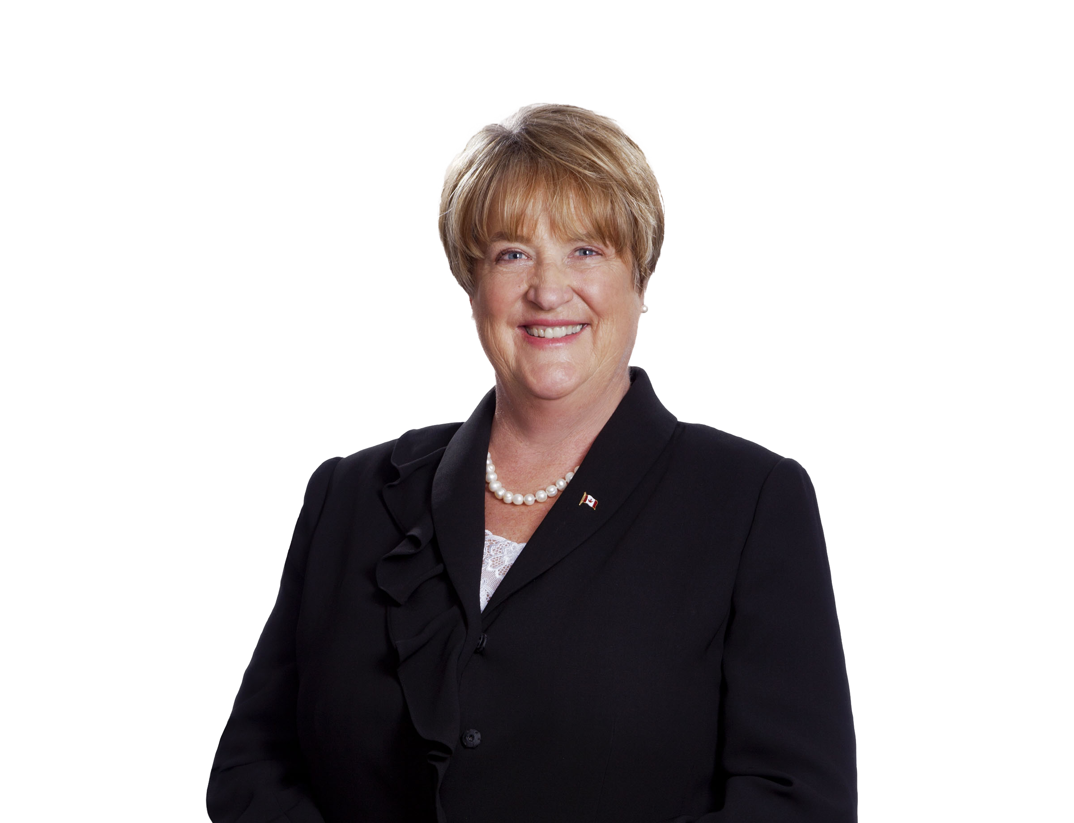
100 Mile House
Town Hall
Bill C-71
The current Liberal gun legislation
New Rules, Regulations & Problems
for Law-Abiding Firearms Owners
Presentation by
Bob Zimmer, MP
Prince George-Peace River-Northern Rockies
Co-Chair of the Parliamentary Outdoor Caucus
November 17th, 2018
1:00pm – 3:00pm
Cariboo Elders’ Building & Rec Society
Cathy McLeod, MP
Kamloops-Thompson-Cariboo
118-475 Birch Avenue
South Cariboo Business Centre
P.O. Box 1977
100 Mile House, BC V0K 2E0
Creekside Seniors Centre
501 Cedar Ave
100 Mile House, V0K 2E0

Slide 2


WHAT BILL C-71 DOES
NEW RULES, REGULATIONS, AND PROBLEMS FOR LAW-ABIDING FIREARMS OWNERS
LICENSE
VERIFICATION
BACKGROUND
CHECKS
Requires that whenever a non-restricted firearm is transferred, the buyer must produce a licence, and the vendor/seller must verify that it is valid
A “Registrar” must issue a “reference number” for such transactions. Many see this as a “stealth registry” in practice
Removes the reference to a five-year period for background checks on license applications
This eliminates any temporal restrictions on these checks

Slide 3

WHAT BILL C-71 DOES
NEW RULES, REGULATIONS, AND PROBLEMS FOR LAW-ABIDING FIREARMS OWNERS
RETAILER
RECORDS
AUTHORIZATIONS TO TRANSPORT
Requires commercial retailers to maintain records for 20 years of their inventories and sales
In some instances, such records would be accessible to police officers without a warrant
Should a retailer go out of business, records would be required to be given to the federal government
Removes common-sense transportation authorizations, requiring permission and a permit whenever restricted or prohibited guns are moved through the community
The only exception is between a residence and an approved shooting range.

Slide 4

WHAT BILL C-71 DOES
NEW RULES, REGULATIONS, AND PROBLEMS FOR LAW-ABIDING FIREARMS OWNERS
PARLIAMENTARY
OVERSIGHT
CLASSIFICATION
CHANGES
Removes the ability of parliamentarians to override firearm classifications instead of the RCMP having final say
A recent example of this was the Conservative Government’s decision to reverse the RCMP’s prohibition of the CZ-858s and Swiss Arms rifles.
Lists newly- restricted firearms in the Act meaning that future classification changes (such as discontinuation or new variants) will require an Act of Parliament
Typically, the classification of firearms is done through regulation

Slide 5
WHAT BILL C-71 DOESN’T DO
NOTHING TO TACKLE ACTUAL CRIME OR ENSURE PUBLIC SAFETY
No measures related to identify large and unusual firearms transactions, especially those involving restricted and prohibited guns, such as illicit straw purchasing schemes, gang activity, or trafficking operations
No measures to ensure the prompt and accurate data transfer of court records of new criminal charges or convictions to the Canadian Police Information Centre (CPIC) and Canadian Firearms Information System
No measures to ensure that background checks are completed fully and with appropriate references
No measures to address or reduce instances of firearm-related injury or death, especially when related to mental health issues, domestic violence, or suicide.

Slide 6
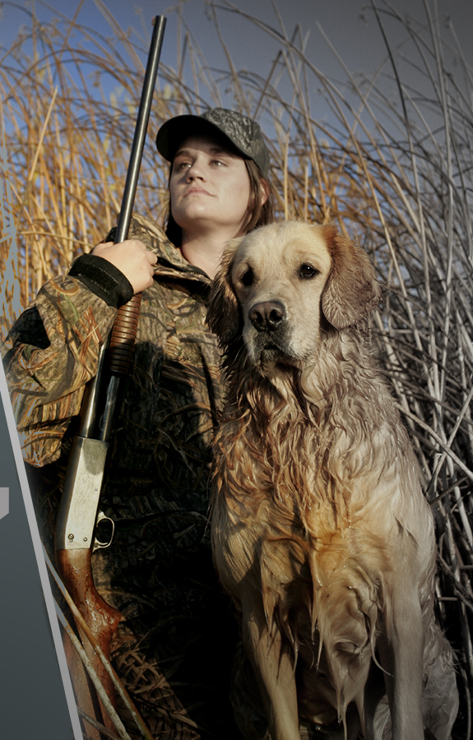
PUBLIC RESPONSE TO BILL C-71
97% of firearms owners believe C-71 focuses too much on law-abiding firearms owners without increasing public safety
More than 85,000 Canadians signed e-petition 1608 calling on the Liberal government to scrap Bill C-71
Tens of Thousands of Canadians contacted the Public Safety Minister and the rest of the Liberal Government expressing their concerns with Bill C-71
Law-Abiding Firearms Owners Oppose the Liberal Firearms Bill

Slide 7
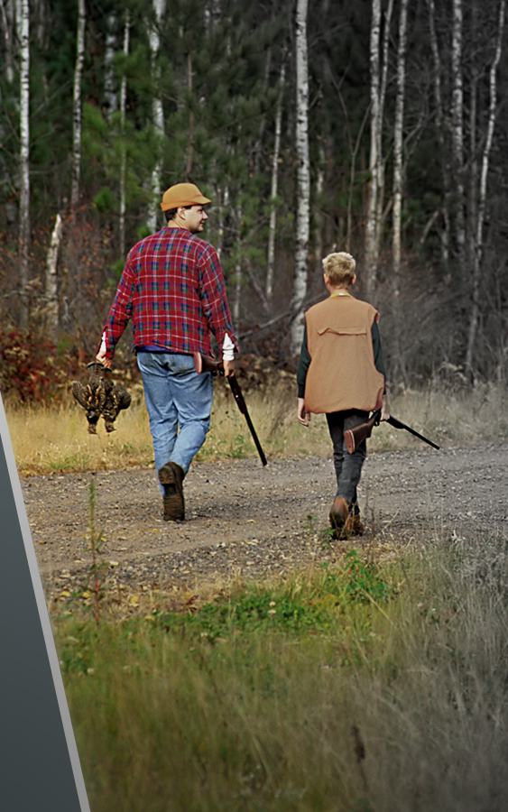
CONSERVATIVE PLAN FOR FIREARMS
Canada’s Conservatives voted unanimously against Bill C-71 at Third Reading
A Conservative Government will repeal and replace Bill C-71 with common-sense legislation that targets criminals, actually protects the public, and respects law-abiding firearms owners
This Conservative legislation will target gangs and organized crime, crack down on firearms trafficking, and increase law enforcement resources to ensure that Canadians are safe
Canada’s Conservatives understand that law-abiding firearms owners are not the problem
Common-Sense Solutions That
Ensure Public Safety While
Respecting Law-Abiding
Firearms Owners

Slide 8
NEXT STEPS
WHAT YOU CAN DO & WHY IT’S IMPORTANT TO KEEP UP THE PRESSURE
PRESSURE SENATORS
Having passed from the House of Commons, Bill C-71 is now before the Senate. Concerned firearms owners should contact individual Senators – especially the majority ‘Independent’ Senators and pressure them to oppose Bill C-71
OPPOSE OUTRAGEOUS LIBERAL FIREARMS POLICIES
The Liberal Government has suggested that they may introduce a sweeping handgun or ‘assault rifle’ ban in the near future
Further legislation similar to Bill C-71 will continue to target law-abiding firearms owners instead of gang members and other criminals who use guns to commit violence
MAKE SURE YOUR VOICE IS HEARD
Continue to contact Liberal Members of Parliament and Public Safety Minister Ralph Goodale to express your displeasure and your issues will Bill C-71

