Slide 1
Fostering Resilience: A Conversation about Youth Mental Health
Radha Nandagopal, MD FAAP
Pediatric Endocrinologist
Associate Dean for Faculty Affairs and Continuing Professional Development
Washington State University Elson S. Floyd College of Medicine

Slide 2
Disclosures
None

Slide 3
Why me and why this topic?

Slide 6
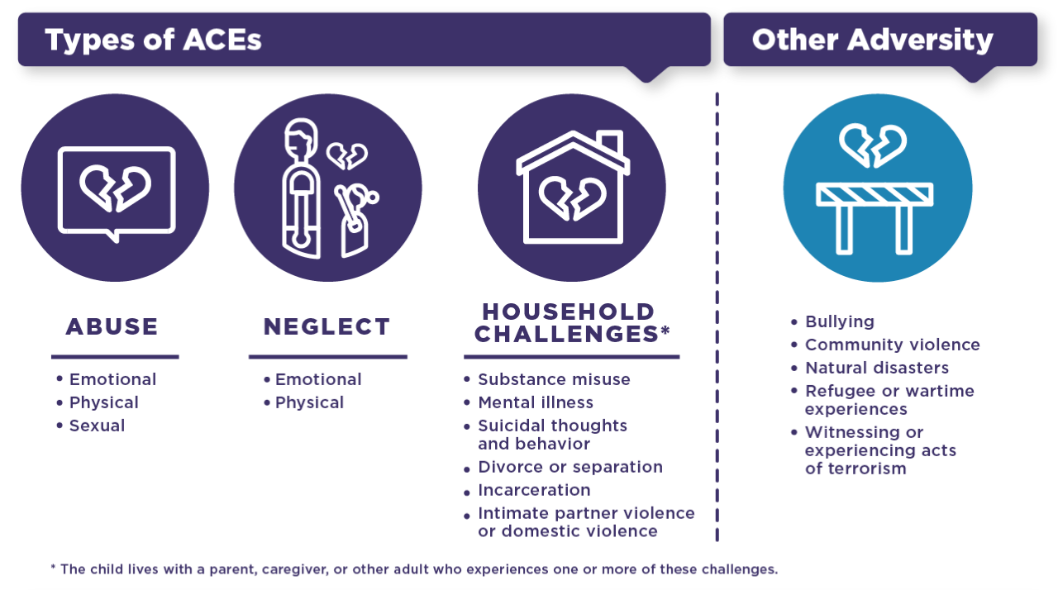

Slide 7
Why do ACEs matter?

Slide 8
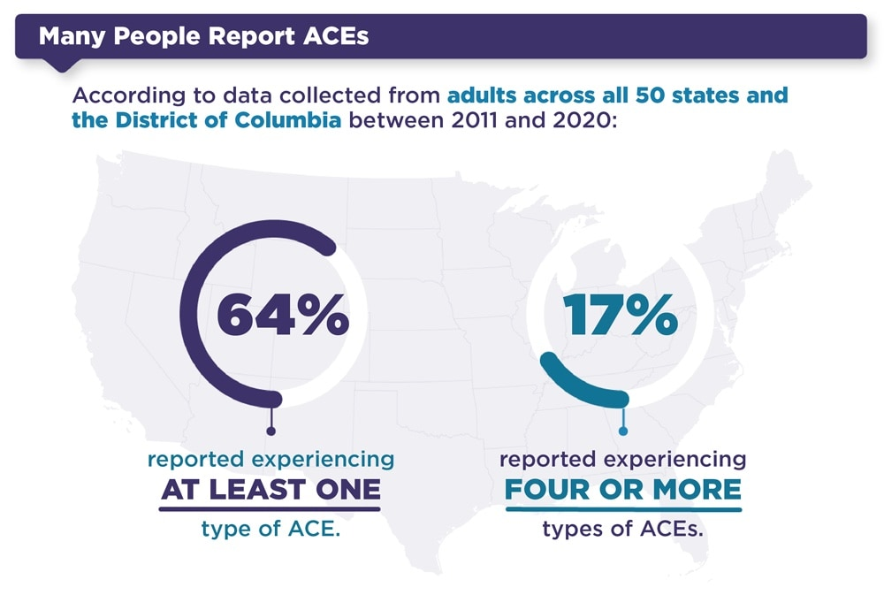

Slide 11
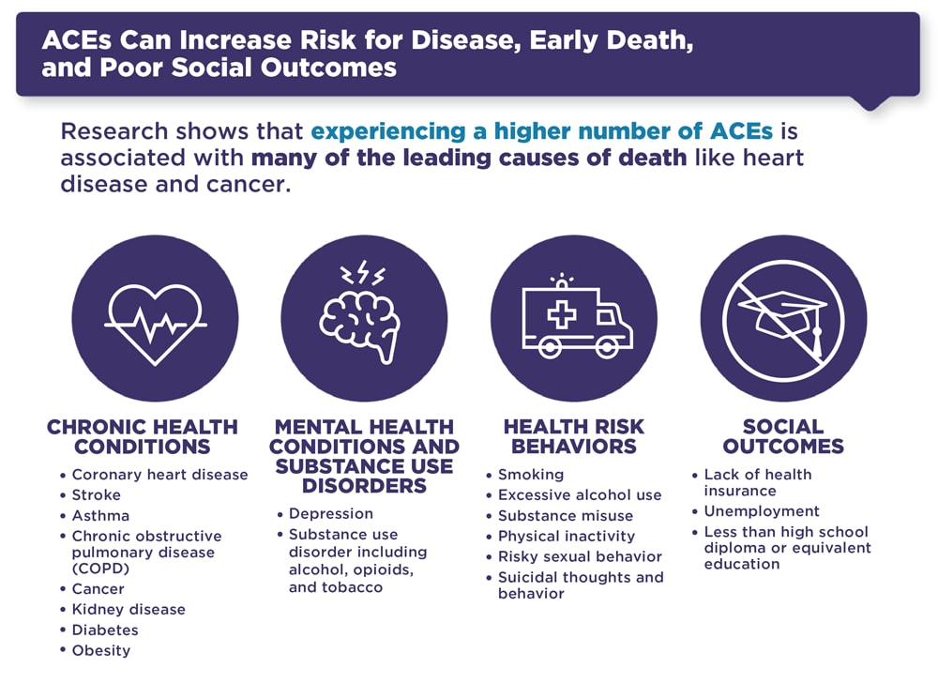

Slide 12
How can we help kids?
Genes + Environment = Disease

Slide 13
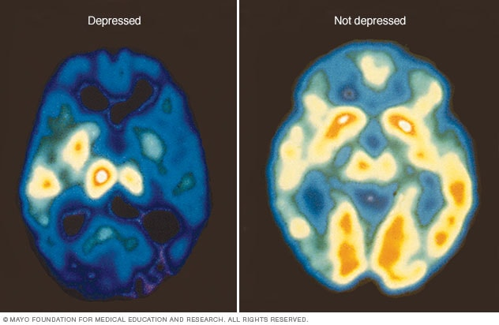

Slide 14
Important Stats
50% of all lifetime mental illnesses begin at age 14
(National Alliance on Mental Illness)
42% of teens experience persistent feelings of sadness or hopelessness
(Centers for Disease Control and Prevention)
22% of teens have seriously considered attempting suicide
(American Psychological Association)
Suicide is the second-leading cause of death for teens and young adults, ages 10-34
(Centers for Disease Control and Prevention)

Slide 16
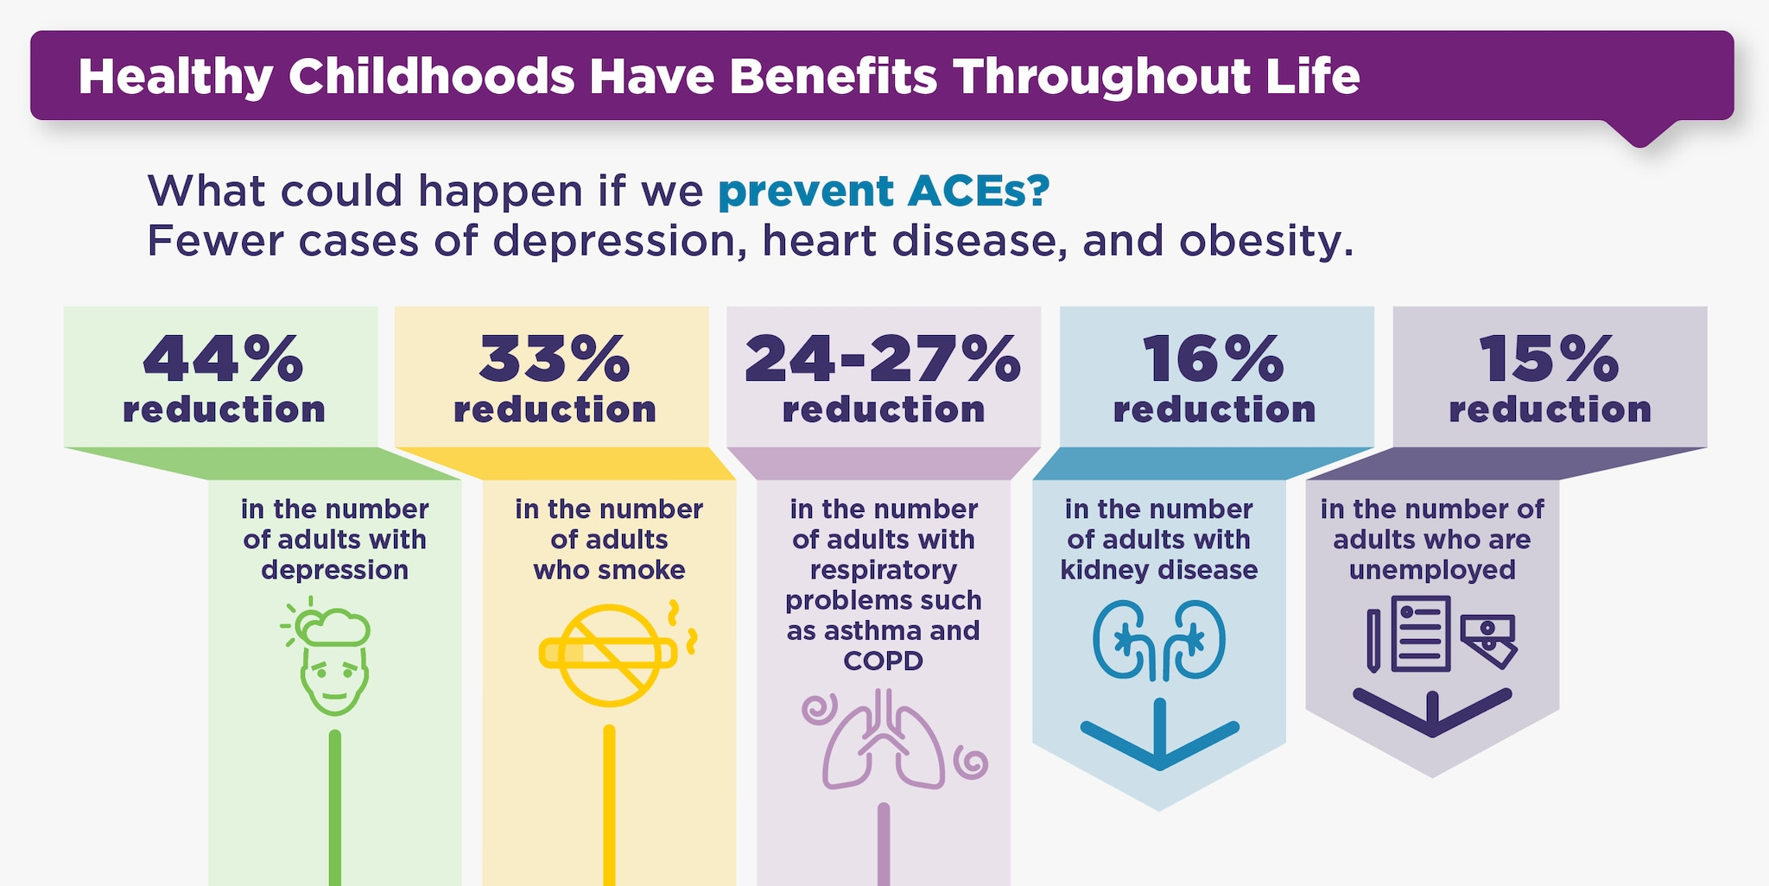

Slide 17
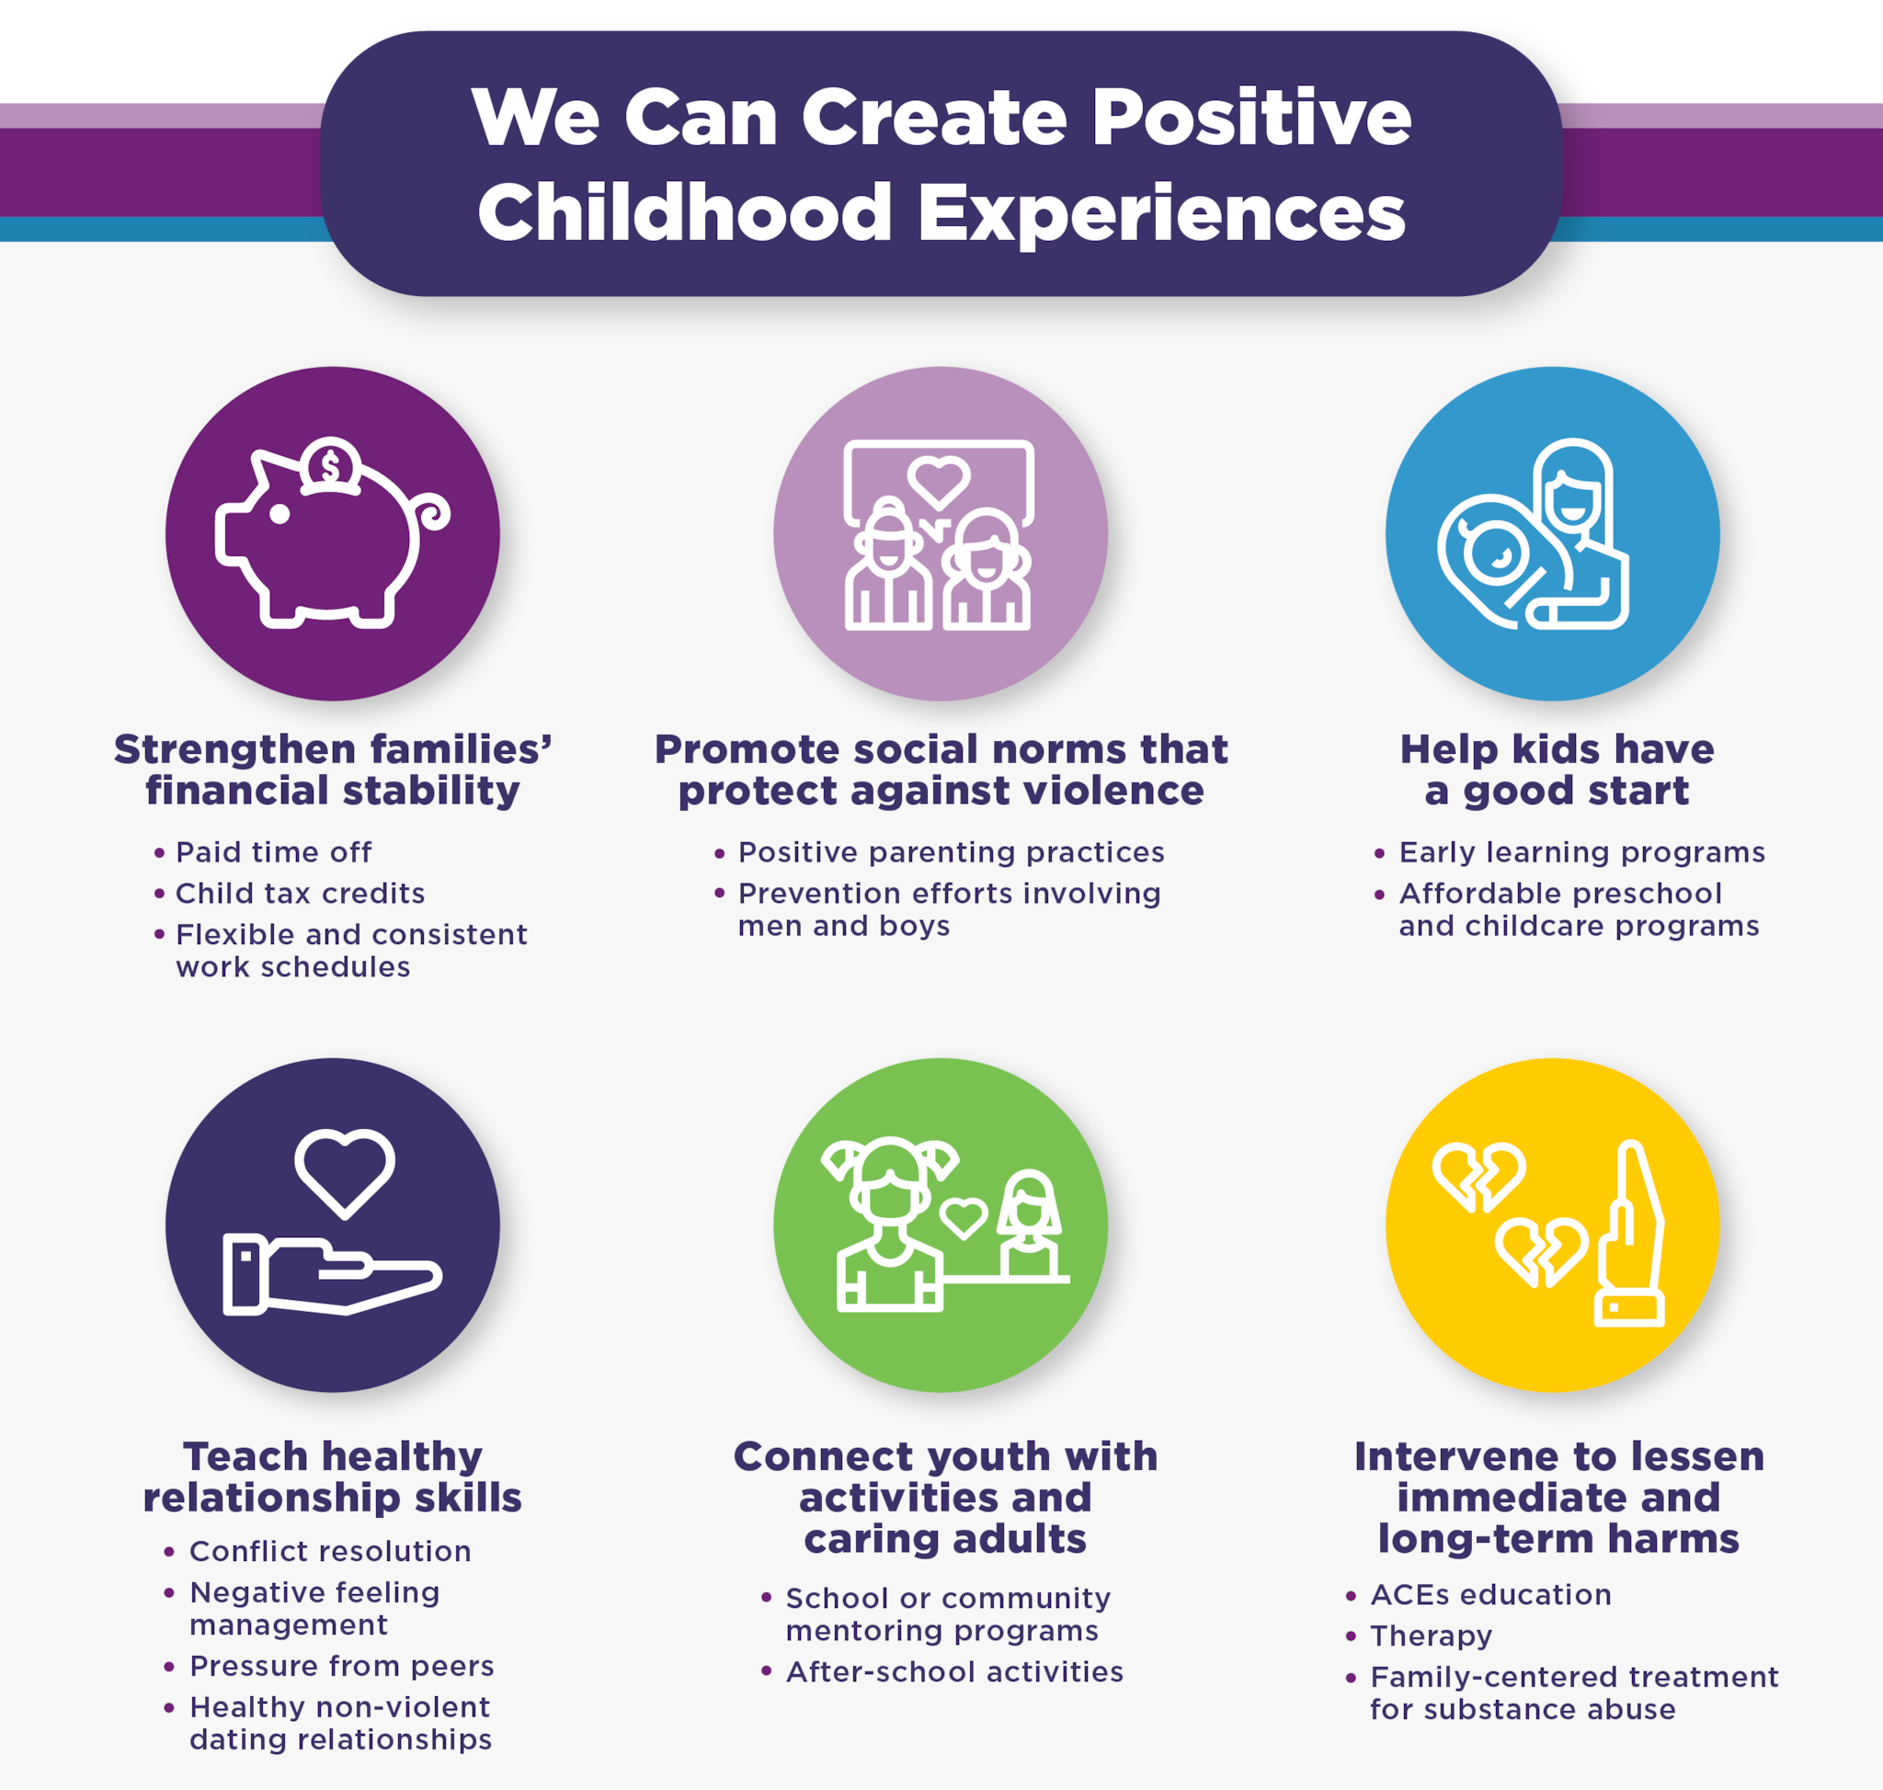

Slide 18
And what about convincing kids and families to access care?
Many families do not want or can’t access mental health care
Stigma
Social/structural barriers – transportation, finances, time

Slide 19
Spoon Theory: A helpful conversation with patients (and families)
Imagine you start your day with 100 spoons, but if you have depression you might start with 30 spoons
What if once a week therapy gave you 40 spoons back? What would that be like?

Slide 20
Back to J…how can we help him?

Slide 21
Thank you! radha@wsu.edu

