Slide 1
Home Economics ACF Entries

Slide 2
Table of Contents
Website to Catalog
Directions to How to fill out entry cards/tags
What you need to fill out
Youth Division
Adult Division
Flower Show
Fine Arts Department

Slide 3
Home Economics Catalog can be found at https://austincountyfair.com/home-economics
Hard Copy Catalogs available at the Fair Office
Check In Items – Monday, 4 pm to 6:45 pm/Tuesday, 9 am to 11:45 am
Judging – Tuesday Noon until Complete
Removal/Pick up Items – Sunday, 11 am to 2 pm

Slide 4
Home Economics Age Divisions
4H/FFA Junior – Green – 3rd to 8th grade
4H/FFA/FCCLA Senior – Pink – 9th to 12th grade
Open Youth –Yellow (Any Austin Cty Resident)
Extension Education – Light Blue – Member TEEA
Open Adult – Lilac (Any Austin Cty Resident)
Fine Arts – Coral
Flower Show - Blue

Slide 5
How to fill out the Entry Forms!
Determine which category you are in
Youth (Pages 10-26 in the Home Economics Catalog)
4H/FFA Junior - 4H/FFA member Grades 3 thru 8
4H/FFA/FCCLA Senior- 4H/FFA/FCCLA member Grades 9 thru 12
Open Youth – Enrolled in Austin County School Grade K thru 12
Adult (Pages 27-42 in the Home Economics Catalog)
Extension – Active member of Austin County Extension Education Club
Open Adult – Any adult who resides in Austin County

Slide 6
Section: Color Coded Cards & Tags
2. Forms are Color coded based on Section
4H/FFA Junior – Green
4H/FFA/FCCLA Senior – Pink
Open Youth –Yellow
Extension Education – Blue
Open Adult - Lilac
Flower Show - Blue
Fine Art – Coral
Forms are available at the Fair Office
New Colors for
Divisions!

Slide 7
What do you need?
3. Large Entry Card Per Division, Item Tags & Fair Catalog
Fair Catalog is available Online
Large Entry card for each category you enter
Top of each card states Corresponding Category
Corresponding Item tag for each item in the Division
Example of How many of each needed:
Plan to Enter Flowers, Baked Good, & Canned Foods
You will need three Large Entry Cards (3 Divisions)
I will enter 3 Flowers, 4 Baked Goods and 5 Canned Goods
You will need 12 small Item Tags (Total of 12 Entries)
*If entering cakes, pies or breads please take an additional tag for each item

Slide 8
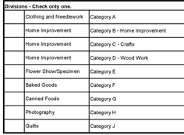
Instructions to Fill Out Large Cards
Last Name/First Name
Address/City
Cell Phone – Daytime cell phone number
Club, Chapter, Home School
Division – Choose one Division per Card
Example Clothing and Needlework – Category A
You need one Large Card per Division!

Slide 9
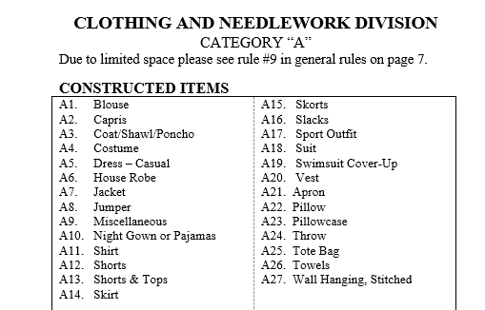
Refer to Home Economics Catalog
Example: You have Constructed a Blouse
A Constructed Blouse goes in Category A - Clothing and Needlework – Class A1

Slide 10
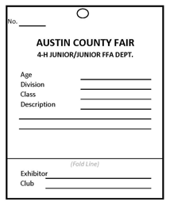
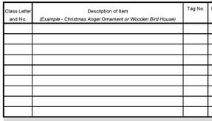
Cards & Item Tags
1. Age of Exhibitor
2. Division (Ex. Baked Foods)
3. Class Letter and Number
Example: Write A1
4. Description of Item
Example: Constructed Blouse – Blue Short Sleeve
5. Tag Number (Red Ovals)
Example: Place the Corresponding Tag number in this block
Each Item must have a Tag – each tag has a corresponding No.
Securely attach the tag to your item. (Tied or Pinned)
6. List all items under this category together on this card. You need a separate card per Division.
7. Cards must be signed by both a parent and Exhibitors.

Slide 11
Notes for Entry Tags!
Exhibitor number is required for Open Adult and Extension Education
Exhibitor numbers are available at the Fair office
Exhibitor numbers are NOT required for Youth Categories
Division Ex: Clothing and Needlework – Category A
Class Ex: A1
Description of Article Ex: Constructed Blouse
Exhibitor: Name of Exhibitor
School or Club: Ex: 4H/FFA Chapter, EEA or leave blank for Open Adult

Slide 12
Procedure to Check In Entries
It is requested to have Cards and Tags filled out before arrival
Items will be accepted in the Expo Building IAW the Schedule
Take your items to the Payment Table
Present your Large Cards to the Clerk
Items are $3.00 each
The clerk will mark each of your large cards PAID
Take items to your Corresponding Division
(4H/FFA Junior, 4H/FFA/FCCLA/TAFE Senior, Open Youth, Extension Education, Open Adult)
A Volunteer will check off your items and place them in the location of that specific category
You are done! Now to wait for Judging to be Completed!

Slide 13
Procedure to Check Out Entries
Items will be released IAW the Schedule
Items removed prior to the Schedule will forfeit prize money.
Prize money will be available IAW the Schedule
Any prize money not claimed by Nov 1 will be forfeited
Locate your items per category
Volunteers may have combined categories, ask a Volunteer
A Volunteer will check off your items and release them to you.
If you win Grand or Reserve Champion. Please take pictures for the paper and Award Recognition.
If you received High Point Honors please take pictures and pick up your trophy.
You are done!

Slide 14
Flower Show

Slide 15
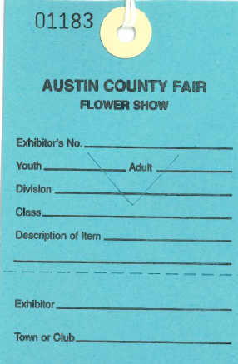
Flower Show

Slide 16
Flower Show
This is a separate show. No Exhibitor Number Required
Group I – Any adult citizen of Austin County and not an owner of a nursery or floral shop.
Group II – Students of Austin County that are not part of 4H, FFA, FCCLA/TAFE.
Group III – Any commercial owners of a nursery, floral shop, or floral designer who perform their duties in a professional capacity.
Please see specific rules in the Home Economics Catalog
Please see pages 47-50 in the Home Economics Catalog

Slide 17
Fine Arts Department
School & Open

Slide 18
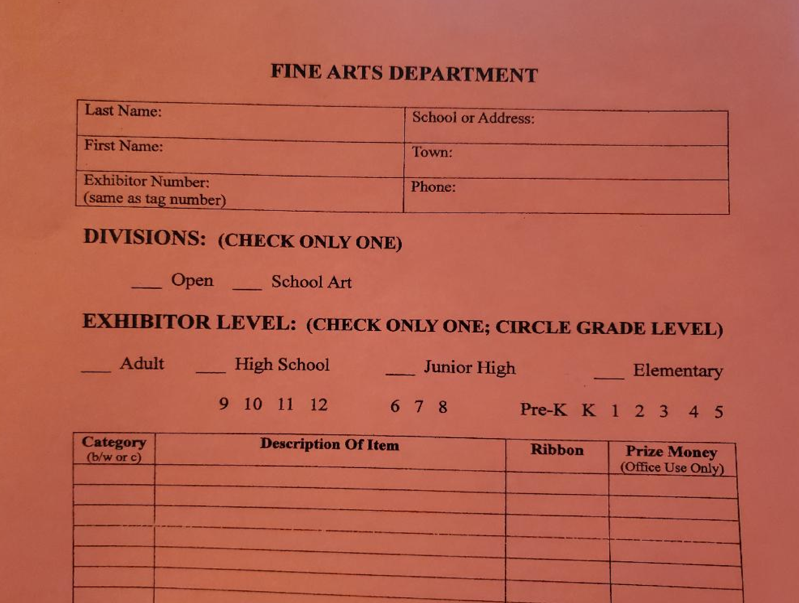
Fine Arts Department

Slide 19
School & Open Fine Arts Dept.
All artwork submitted must have been made since the previous fair.
Only one (1) piece of artwork per person will be accepted.
All exhibits in this department must be labeled, giving name, address, school, exhibitor division and email address.
Exhibitor divisions are:
Open: Adult (non-professional), high school, junior high and youth
School Art: High school, Junior high and Elementary

Slide 20
Youth Supreme & Country Auction
Details for the Youth Supreme & Country Auction can be found in the Home Economics Catalog per contest.
Please note that Ag Mechanics rules are located in the Fair Catalog
The Youth Supreme & Country Auction will be held on the second Saturday of the fair. See official schedule for details.

Slide 21
Thank you!
Home Economics Committee and Department Chairs take great pride and care working with your entries!
If you have any questions, please see the Department Chair of your specific department.
We appreciate your support, your time and your efforts!
Thank you for participating in the Austin County Fair Home Economics Department!

