Slide 1
Session One: Preliminaries to Studying the Psalms
St. Frances Cabrini
10 September 2026
Fr. Jan Michael Joncas

Slide 2
Course Text: The Abbey Psalms and Canticles
Printed Editions
  Ascension Press
  Magnificat [Press]
  Ignatius Press
  United States Conference of Catholic Bishops
Online Editions
  https://www.logos.com/product/294836/the-abbey-psalms-and-canticles
  https://mbreal23.wordpress.com/2024/10/01/abbey-psalms-and-canticles-pdf-file/
  https://www.amazon.com/dp/B0CNM6HV4Q?lv=shuf&channelId=510&plpRedirect=mhFallback

Slide 3
Original Languages and Ancient Translations
Hebrew Text
  “Masoretic Text” (MT) 10th C CE = standard text of the Heb Psalter
  “Dead Sea Scrolls” =
    Qumran caves (found 1947) ca. 30 Pss mss
    Masada (found 1964/1964) Psalm 140, Pss 81-85 fragments dated 1 C BCE
    Wadi Murabba’at
    Nahal Hever (1st C CE Pss ms)

Slide 4
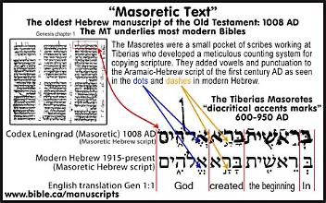

Slide 5
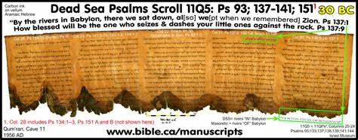

Slide 6
Aramaic Translation
  “Targum” Mss from 5th C CE
    Not simply a straightforward translation of MT or DSS, but a good deal of interpretation of the text

Slide 7
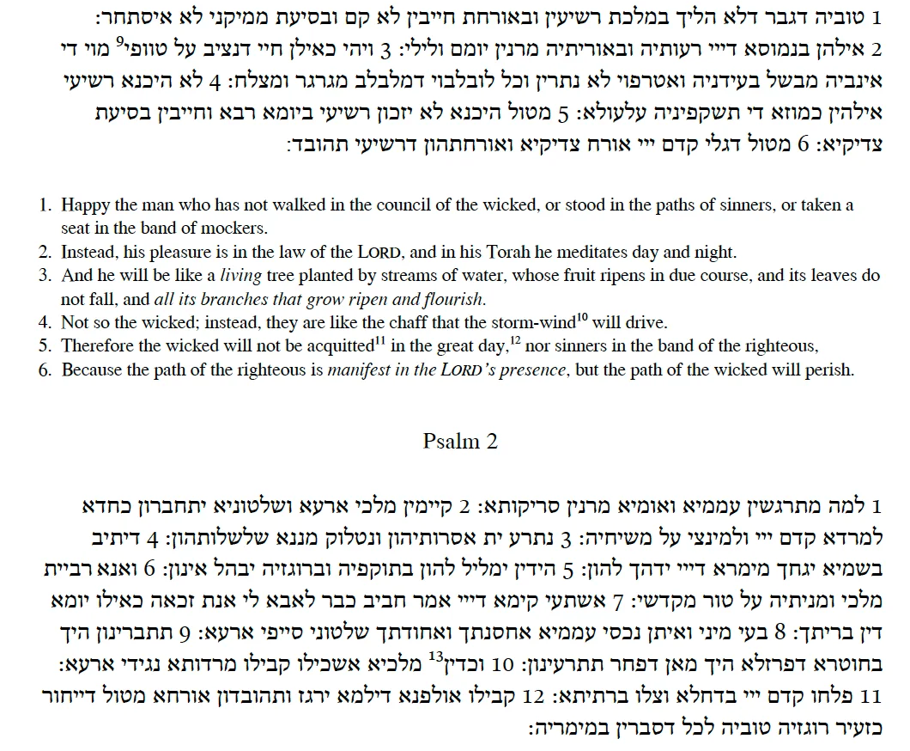


Slide 8
Greek Translation
  “Septuagint” (LXX) 3rd – 2nd C BCE based on a Hebrew text somewhat different from the MT
    85% of citations of the Psalms in the NT are taken from the LXX
    N.B. Psalm 151
  3 ancient translations found in Origen’s Hexapla
    Translation of Aquila of Sinope (c. 140 CE): ultra-literal
    Translation of Theodotion (c. 150 CE): intermediate
    Translation of Symmachus: (c. 200-250 CE): free rendering

Slide 9
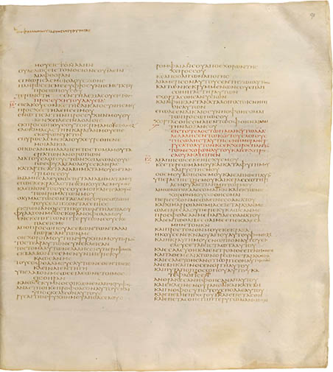
Codex Sinaiaticus: Psalm 15:10-17:11 (Quire 59; folio 4; recto)

Slide 10
Latin Translation
  “Vetus Itala” (2nd C CE) = translation of the LXX
  Translations by Jerome
    “Roman Psalter” (late 4th C) = revision of the Vetus Itala
    “Gallican Psalter” (later 4th C) = revision of Roman Psalter working from the Greek of Origen’s Hexapla (used in the Liturgy of the Hours and incorporated into the Vulgate)
    “Psalerium iusta Hebreos” = translation from Hebrew

Slide 11
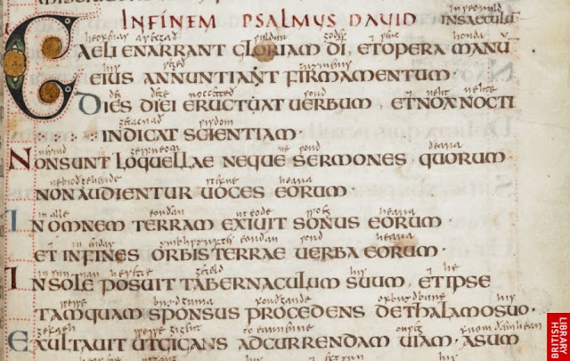
British Library MS Cotton Vespasian A.1, fol. 24r

Slide 12
Organization of the Book of Psalms
The canonical Book of Psalms has 150 psalms, but their numbering into chapters and verses varies in different traditions
The Greek (LXX) version of the Hebrew text:
  combined Psalms Heb Pss 9-10 into one (LXX Ps 9)
  joined Heb Pss 115 + 114 as LXX Ps 113
  divided Heb Ps 116 into two (Heb Ps 116:1-9 = LXX Ps 114; Heb Ps 116:12-20 = LXX Ps 115)
  divided Heb Ps 147 into two (LXX 146-147)
Protestant translations follow Heb numbering
Older Roman Catholic translations follow the LXX/Vulgate numbering

Slide 13
In Heb the “psalm titles” are numbered as verses of the text but not in LXX/Vulgate
  If the “title” is more than a few words, it is counted as a separate verse (or 2 verses in Pss 51, 52, 54, 60)
This accounts for different numbering of verses in Protestant and [older] Catholic translations

Slide 14
The canonical Book of Psalms has been edited into five “books” each marked by a closing doxology
Book 1 (Pss 1-41) with concluding doxology (Ps 41:14)
  “Blest be the LORD, the God of Israel,
  from age to age. Amen. Amen.”
Book 2 (Pss 42-72) with concluding doxology (Ps 72:18-20)
  “Blest be the LORD, God of Israel,
  who alone works wonders,
  ever blest his glorious name.
  let his glory fill the earth.
  Amen. Amen.”
  [Here end the Psalms of David, son of Jesse]

Slide 15
Book 3 (Pss 73-89) with concluding doxology (Ps 89:5)
  “Blest be the LORD forever.
  Amen and amen!”
Book 4 (Pss 90-106) with concluding doxology (Ps 106:48)
  “Blest be the LORD, God of Israel,
  Forever, from age to age.
  Let all the people say,
  'Amen! Amen! Alleluia!’”
Book 5 (Pss 107-150) with concluding doxology (Ps 150)

Slide 16
Other organizations of psalms within the canonical Book of Psalms
Ps 1 appears as a preface wisdom psalm, opening the entire collection, contrasting 2 ways of life (righteous / wicked)
Ps 2 is another preface, contrasting 2 ways of life (submission / perdition) in relation to God’s Anointed
Pss 3-41 appears to be an early collection:
  prefers to name God YHWH
  recounts dramatic struggles with God
  favors composition in the first person singular
Pss 42-83 is an alternative collection containing other versions of some psalms in Book 1 (Ps 14 = Ps 53; Ps 40:14-18 = Ps 70)
  prefers to name God ‘ělohîm
  begins with a preface psalm of personal introspection
  most psalms are marked by historical and international references
  most are community laments

Slide 17
“Reign of God” psalms appear as Pss 93, 96-99 + Ps 100 (doxology)
“Hymns” appear as Pss 103-106
“Songs of Ascents” appear as Pss 120-133 + Ps 134 (doxology)
“Halleluyah” psalms appear as Pss 104-106, 111-117, 135 + Pss 146-150 (doxology)

