Slide 1
Session Five: Studying the Psalms
St. Cecilia
8 October 2026
Fr. Jan Michael Joncas

Slide 2
Names for God in the Psalms
YHWH = LORD/the Tetragrammaton [650 times in the Psalter]
  Yah [43 times in the Psalter]
  ‘ehyah asher ‘ehyah = I AM WHO I AM [Exodus 3:14]
El = God [75 times in the Psalter]
  Elohim/Eloah = Gods/Godhead [365 times in the Psalter]
  [El] ‘Elyon = God Most High
  [El] ‘Olam = Everlasting God
  [El] Shaddai = [God] Almighty / Mountain God / High-Breasted One
  [El] Sebaoth = [God] of hosts/armies

Slide 3
Adon/Adonai = [my] Lord[s] / master
Baal = owner
Melek = king
“My strength, my rock, my refuge, my savior, my God, my shield, horn of my salvation, my fortress” [Ps 18:1-2]
HaShem = The Name

Slide 4
Characteristics of God in the Psalms
God = creator and redeemer of the people of Israel
God = savior of individual humans
God’s self-revelation in word [torah]
God’s self-revelation in the history of his acts
God’s glory = kavod
God’s righteousness = zedakah
God’s steadfast love = hesed
God’s faithfulness, reliability = emet/emunah

Slide 5
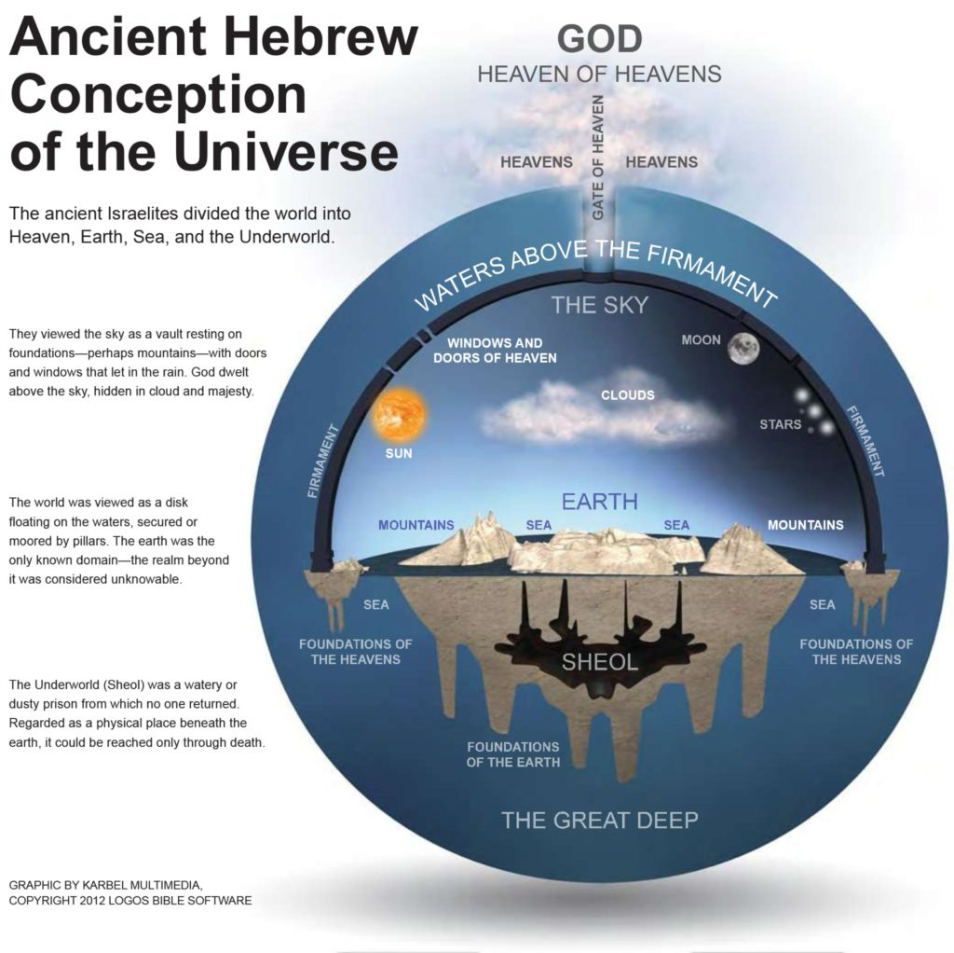

Slide 6
Tehom
Heavens (shamayim), earth (eres) and underworld (sheol) floated in the mythological cosmic ocean (tehom)
The tehom is hostile to God, confronting him at the beginning of the world (Ps 104:6)
The tehom is the home of monsters that God conquers (Rahab, Leviathan, dragons [tannin])

Slide 7
Shamayim
shamayim = “the heavens,” abode of God and divine beings, where YHWH sits “enthroned over the flood” in his heavenly palace (Ps 29:10)
raqia = “the firmament,” a solid inverted bowl over the earth, colored blue from the heavenly ocean above it; rain, snow, wind and hail were kept in storehouses inside the raqia that had “windows” to allow them in
bene Elohim = “the sons of God,” a divine council
malakim = “the messengers,” angels

Slide 8
Eres
eres = flat disk floating on water
nagu = “distant regions,” equally space triangles (islands? mountains?) considered the “ends of the earth”

Slide 9
Sheol
sheol = the unseen world of the dead to which departed spirits go, shadowy and silent existence of weakened forms having an inactive remnant of humanity (rephaim)
‘abaddon = “ruin”

Slide 10
Characteristics of Humans in the Psalms
enosh = “the human,” weak, vulnerable humanity
baśar = “flesh,” physical existence subject to attack, injury, damage and decay
nepeš = “throat,” “soul,” means by which humans receive nourishment and air
leb/lebab = “heart,” site of all thought, planning, reflection, explanation and ambition
ruah/nišmah = “breath, wind,” divine life-giving power

Slide 11
Canonical and Rhetorical Criticism of Biblical Texts: Nancy L. deClaissé-Walford
Canonical critics look at the Big Picture – the shaping of (a book of) the Bible (in this case, the Psalter) to convince the postexilic Israelite people that they could survive as a separate and identifiable entity in which they were simply one of many vassal nations
Rhetorical critics examine texts’ attempts to persuade readers and hearers to adopt a certain mind-set, to accept a certain set of givens, and to adhere to a certain set of societal norms

Slide 12
Prologue: How to read the Psalter
Psalm 1 (no superscription): words encouraging fidelity to the Torah (Ps 1:2)
Psalm 2 (no superscription): words of warning to the nations and their rulers to recognize the God of Israel as king over all (Ps 2:10-11)

Slide 13
Book 1: The Reign of King David
Pss 3-41: 39 psalms “of David” make up the rest of Book 1
59 % are laments that provide insights into every facet of David’s life: as king, human being, warrior, parent, servant of the Lord

Slide 14
Book 2: The Succession of Solomon
Pss 42-49 ascribed to “Korahites”, temple singers during the reigns of David and Solomon
Pss 51-65 ascribed “to David”: 14 laments, with 8 of the 14 connected to “historical” superscriptions of particular events in the life of David
Psalm 72, one of only 2 psalms ascribed “to Solomon,” a collections of wishes and prayers for the well-being of the king in Jerusalem, “for Solomon,” offered by David
N.B. Ps 72:20: “The prayers of David are ended.” (David moves into the background.)

Slide 15
Book 3: The Divided Kingdom
15 of the 17 pss in Book 3 are ascribed to Asaph and the sons of Korah, with only 1 ascribed to David (Ps 86)
Ps 73 “A psalm of Asaph” begins a new chapter in the Psalter’s history. David’s reign has come to an end and Solomon’s reign will conclude with the nation divided into two rival kingdoms
Community laments and community hymns dominate Book 3
Pss 88-89 conclude Book 3
  Ps 88 = almost totally complaint with no themes of trust and praise
  Ps 89:1-37 = praise God for good treatment of David + 38-51 questions why God has “renounced the covenant” and “removed the scepter from the king’s hands”
N.B. 722 BCE: Assyrians destroy Samaria / 587 BCE: Babylonians destroy Jerusalem / 539 BCE: Cyrus the Great conquers Babylon and allows the Jewish people to return to their homeland and rebuild their Temple

Slide 16
Book 4: In Exile in Babylon
Book 4 opens with “A prayer of Moses, the Man of God,” with Moses mentioned 7 times (Pss 90:1, 99:6, 103:7, 105:26, 106:16, 23, 32)
The community of faith in exile in Babylon cannot effect a return to the days of the united monarchy. They can only move forward.
Pss 93-100 = enthronement psalms of YHWH, not an earthly king
Moses intervenes for the community of faith as he did in the wilderness wandering (Ps 90:13. cf. Ex 32:12)
Conclusion of Book 4:
  Ps 105 = hymn of praise, recalling how God provided for, protected and sustained the community throughout history
  Ps 106 = community lament, reminding the community of their continued unfaithfulness despite God’s faithfulness to them

Slide 17
Book 5: Return from Exile
Book 5 opens with Ps 107, a hymn celebrating God’s graciousness in delivering the community of faith from peril
David’s return to the Psalter: Pss 108-110
  Pss 113-118 = the Egyptian Hallel, recited during Passover
  Ps 119 = a wisdom acrostic about Torah piety, recited during the feast of Pentecost
  Pss 120-134 = Songs of Ascents, recited during the feast of Booths
David’s conclusion of the Psalter: Pss 138-145
Ps 145 = last psalm “of David,” a masterful alphabetic acrostic celebrating the sovereignty of God over the community of faith and over all creation

Slide 18
Conclusion
Pss 146-150: Concluding Doxology
  Ps 146: individual hymn
  Ps 147: community hymn
  Ps 148: creation psalm
  Pss 149-150: exuberant praise

Slide 19
Summary
The 5 books of the Psalter narrate the history of ancient Israel, recorded in the books of Samuel, Kings, Chronicles, Ezra, Nehemiah, and a number of the prophets
The story of the Psalter gave the postexilic community a new rationale for existence, a new statement of national identity
With YHWH as sovereign, the people could survive as a separate and identifiable entity within the vast empires -- Persian, Greek, and Roman – of which they were a part

