Slide 1
Easy Ways To Reduce Your Carbon Footprint: An Alternative Solution 2020 Gas/Electric Conference
Michael Alcantara
Senior Applications Engineer
Toshiba International Corporation
2020.02.06

Slide 2
Overview
01
Introduction to a VFD
02
Synchronous Transfer (Sync-Xfer)

Slide 3
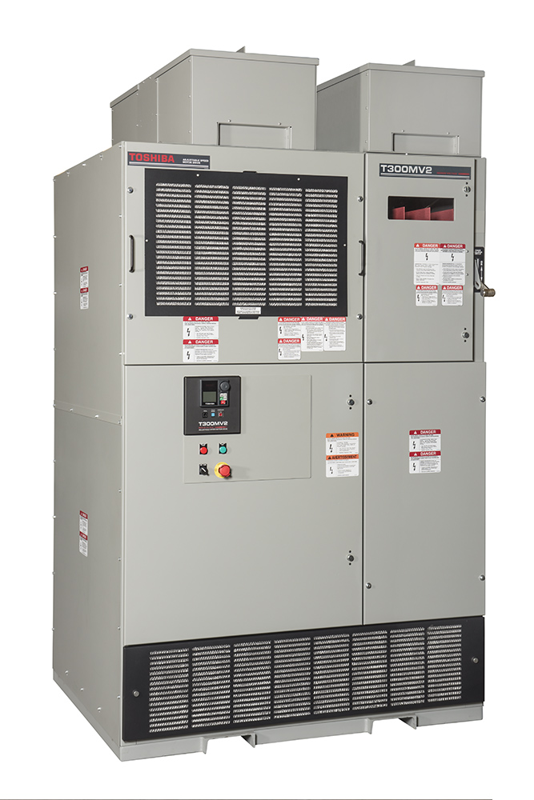
What Is A VFD?
Variable Frequency Drive
Used in Electro-Mechanical Drive Systems to Control the Speed of AC Motors By Varying Input Frequency & Voltage
Reduces Inrush Current

Slide 4
VFD BTU/Hr Losses
Voltage | VFD HP | kW Losses | BTU/Hr Losses
4160 | 1000 | 27.2 | 92,871
 | 1250 | 34.0 | 116,059
 | 1500 | 40.8 | 139,366
 | 1750 | 47.6 | 162,554
 | 2000 | 54.4 | 185,742
 | 2250 | 61.2 | 208,930
 | 2500 | 68.0 | 232,237
 | 3000 | 81.6 | 278,613
 | 3500 | 95.2 | 325,108
 | 4000 | 108.8 | 371,484
 | 4500 | 122.4 | 417,979
 | 5000 | 136.0 | 464,355
 | 5500 | 149.6 | 510,850
 | 6000 | 163.2 | 557,226
 | 7000 | 190.4 | 650,096
 | 8000 | 217.6 | 742,967

Slide 5
5000HP VFD
 | 1 Motor VFD | 4 Motor VFDs
kW Losses | 136.0 | 544.0
BTU/Hr Losses | 464,355 | 1,857,420
HVAC | 39 Tons | 155 Tons
Dimensions | 104”H x 222”W x 49.5”D | 104”H x 888”W x 49.5”D
104”H
49.5”D
222”W

Slide 6
What Is Sync-Xfer?
Motor Operating in Variable Speed Mode
VFD Synchronizes with Utility Supply
Transfer Motor Operating on VFD to Utility Supply for Fixed Speed Operation (Transfer)
Motor Operating on Utility Supply on Fixed Speed Operation Can Be Captured by VFD to Operate on Variable Speed Mode (Capture)

Slide 7
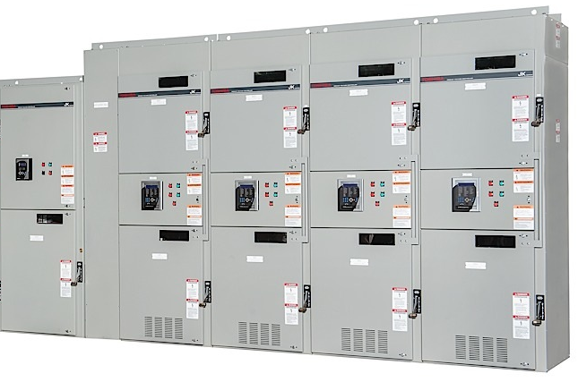
5000HP VFD / Sync-Xfer MCC Alternative
M
M
M
M

Slide 8
5000HP VFD / Sync-Xfer MCC Alternative
 | 4 Motor VFDs | 4 Motor VFD w/Sync-Xfer
kW Losses | 544.0 | 140.15
HVAC | 155 Tons | 40 Tons
Dimensions | 104”H x 888”W x 49.5”D | 104”H x 231 x 44”D

Slide 9
Sync-Xfer Advantages
Reduced Building Size
Reduced Heat Loss
Reduced HVAC Requirements
Less Carbon Footprint
Make Before Break
No Catching
Reduced Total System Cost

Slide 10
Thank you

