Slide 1
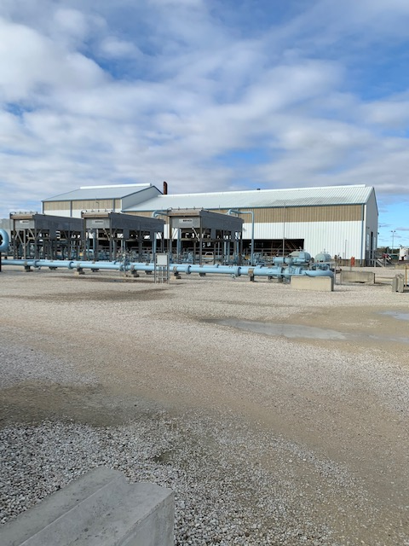
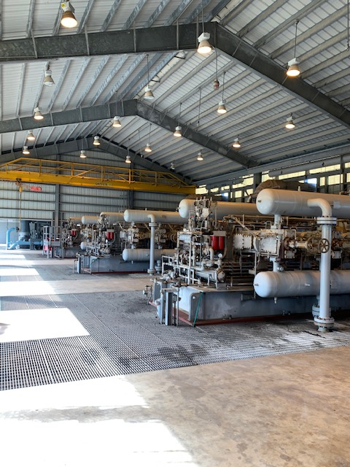
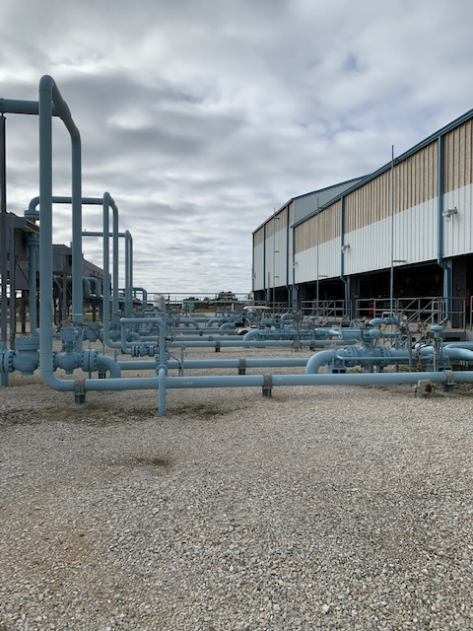
Compression Options for
Gas Storage Applications
Gas Electric Partnership : February 5-6, 2020
Marybeth McBain
Kinder Morgan Midstream Group
Compression Projects – Sr. Pipeline Engineer

Slide 2
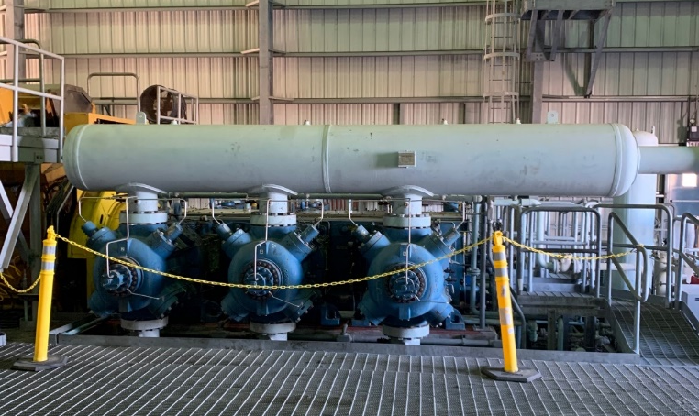
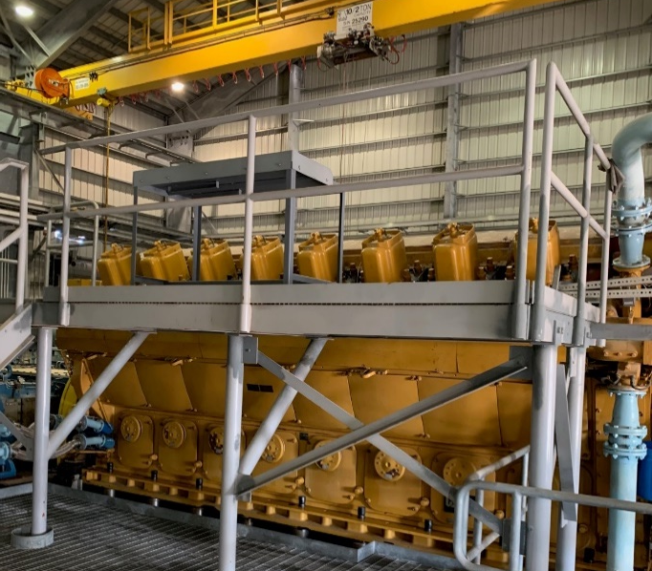
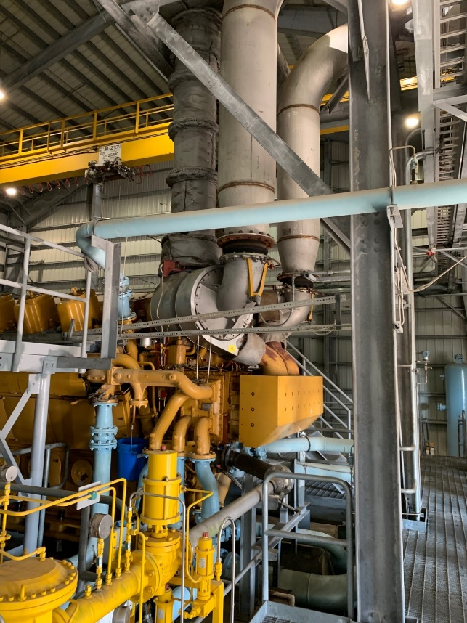
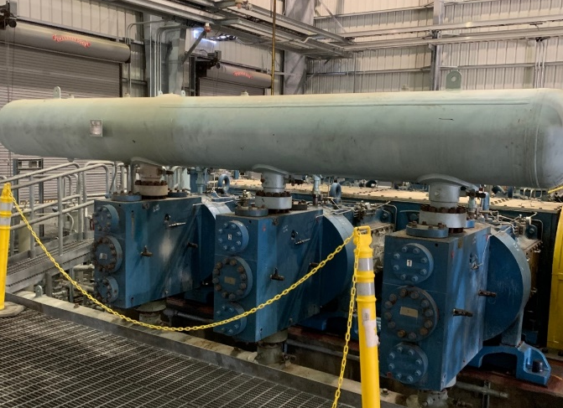
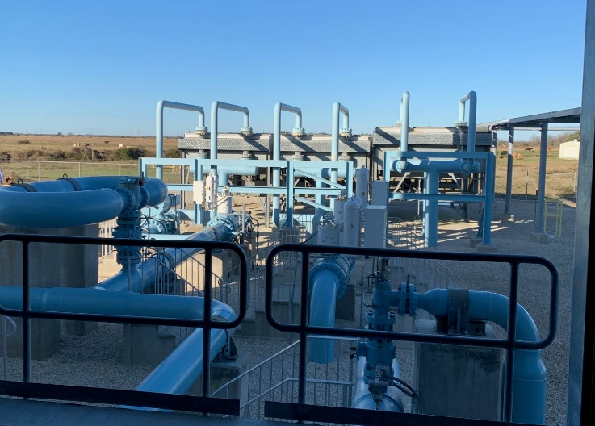
Compression for Gas Storage: Then vs. Now
Reliable unit with 7600 bhp gas engine drive.
In building with overhead crane / atypical compared to pipeline units / block mounted.
Extensive cooling for engine Aux water, jacket water, gas cooling.
Opex costs: oil usage, oil systems, low cost parts, valves.
Recips need upstream and downstream scrubbers (for oil)
Markham Storage: KBV-6 two stage unit with G16 CM-34 CAT engine

Slide 3
Compression for Gas Storage: Incorporating Midstream Lessons
Avoid extensive compressor buildings – specifically for midstream in Texas – especially for non EMD units.=
Look for optimal sized units considering pipeline fluctuations and infrastructure (take-off points), moving away from > 5000 hp recip engines
Consider commonality of midstream / storage equipment – Ariel KBx line, Solar compressors
Engage power company early on, especially for large HP motor drive applications (> 2000 hp)
Avoid shared VFD’s or VFDs all together
Add downstream cyclone scrubbers on recips
Lower capex through GCX lessons learned

Slide 4
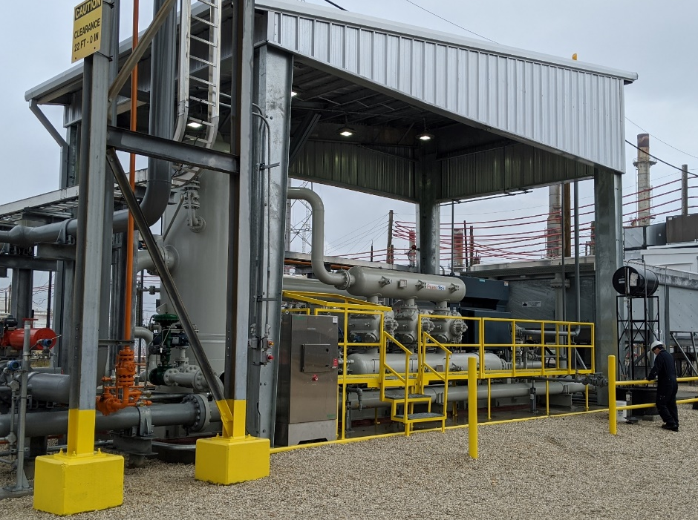
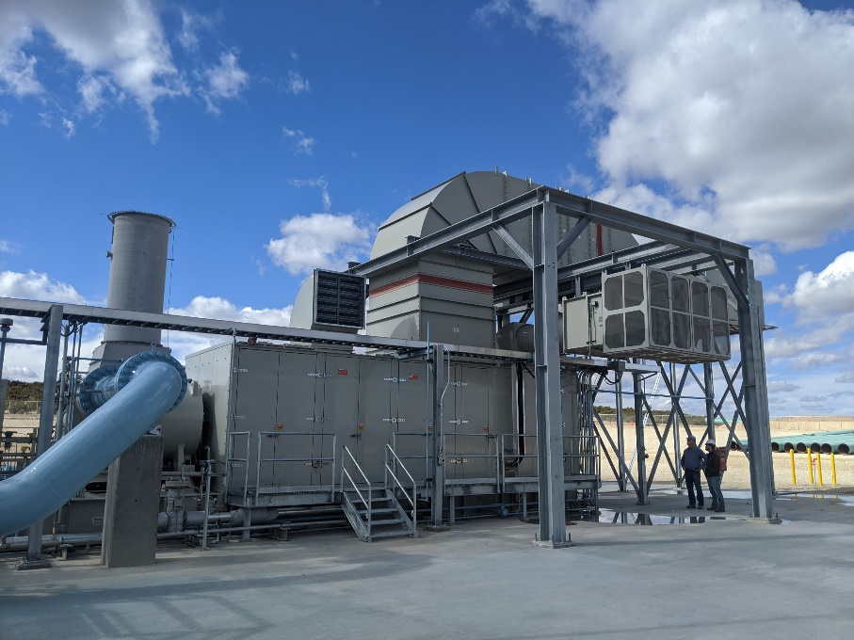
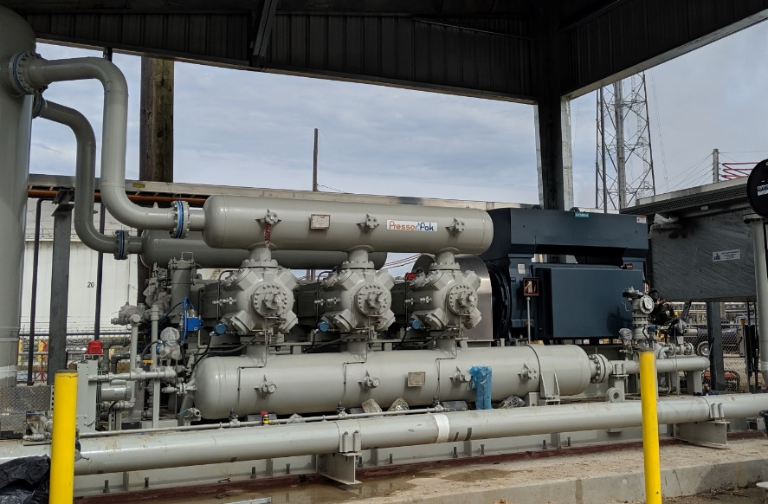
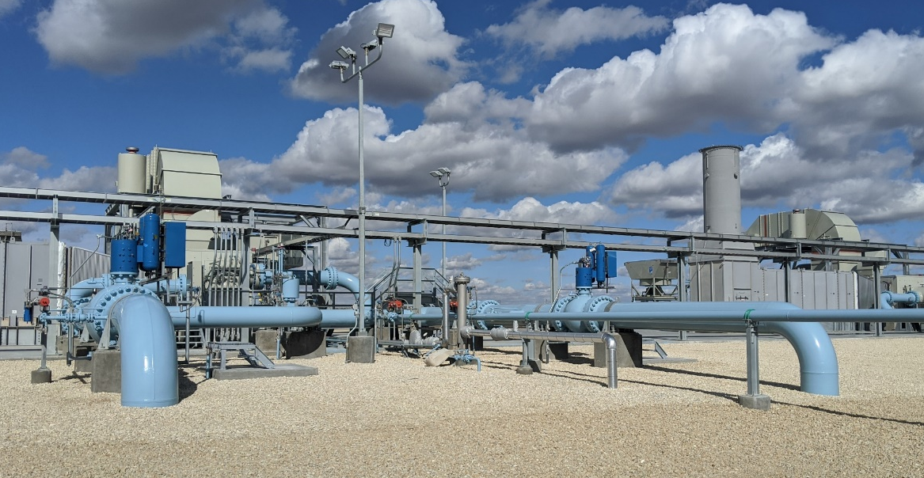
Compression in KM Midstream: Recent Examples of Successful Projects
KM Midstream Examples: Ariel KBK-6 single stage unit with 4000 hp EMD and
GCX Solar Turbines T-130 / T-250 with Enclosures / Pipeline compressors

Slide 5
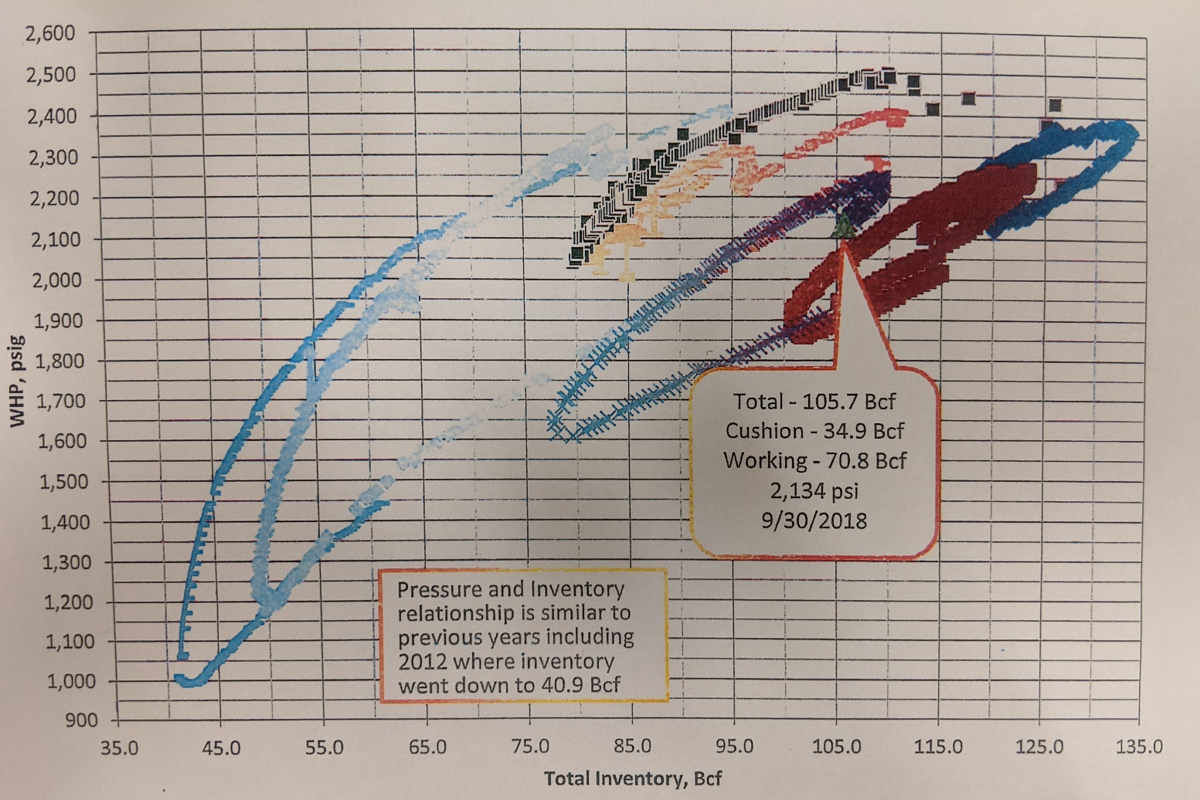
Storage Applications – Characteristics different from pipeline applications!
Injection pressure (compressor discharge)
At end of storage cycle, injection pressures are highest for 1-2 weeks out of the year
Pressure curves show effect of building up reservoir gas – Initial pressure depends on w/d cycle. Final pressure depends on reservoir characteristics.
Summary Point for Storage: Must size compressors for worst case injection pressure but also know that the high injection pressures will not be seen year-round. Need compression that can adapt to large discharge pressure variation AND offer more flow at lower pressures within pipeline system limits.
Storage Inventory (BCF of Gas)

Slide 6
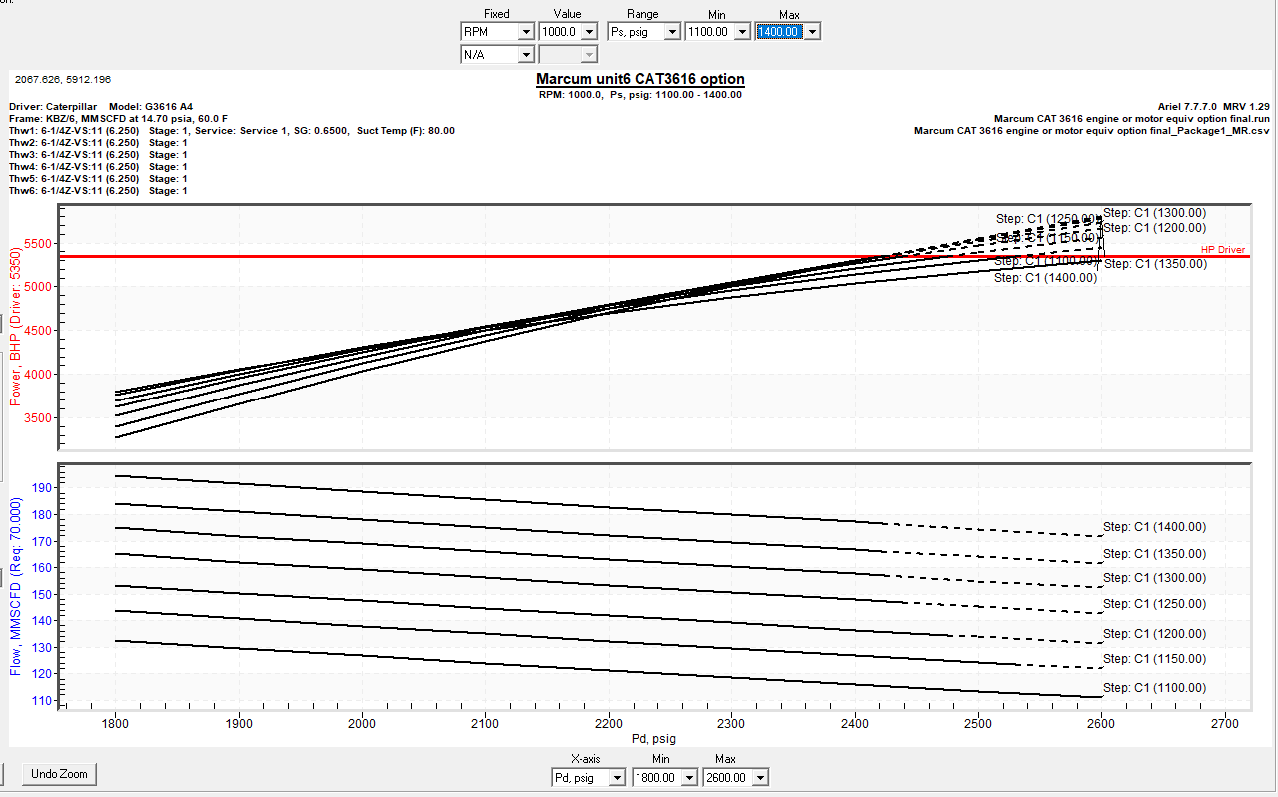
Reciprocating Compressor – Typical Curves for Storage Application
Curves shown below – assume KBZ-6 compressor with 1100 – 1400 psig suction pressures from pipeline with nearby booster station.
Blue Dot early storage = Use 6 cylinder compressor in single stage mode – LP injection up to 1800 psi (1.3-1.4x flow of late storage)
Green / Red Dots late storage as reservoir volume increases = Use compressor in two stage mode - HP injection at 2220-2600 psi
5300 HP Driver with a KBZ-6 Ariel Compressor
HP of driver limit
BHP
Typical pipeline curve (for comparison)
Flow Rate
HP of driver limit
110 mmscfd
Discharge Pressure (psig)

Slide 7
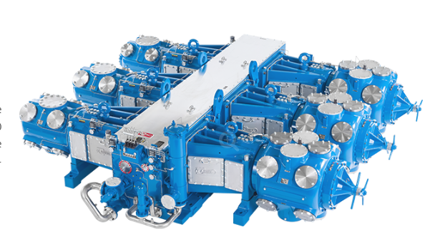
Reciprocating Compressors – High speed options configured for Single & Two Stage Mode
High speed Recip compressors lend themselves to easy configuration of single stage and 2-stg mode. This will help to maximize flow at all reservoir pressures.
However, single stage mode will provide significantly more flow for all cylinders if the pressure ratio can stay within ~ 1.5-2.3
To accomplish single stage mode at high storage pressures ~ 2600 psi, consider a suction booster unit to maintain 1200-1400 psi suction header.
Must still add automatic unloaders (VVCPs, SVU’s, FVCP’s) to manage HP at high injection pressures.
Make sure you work with a packager that you trust on delivery and one who ensures high quality package.

Slide 8
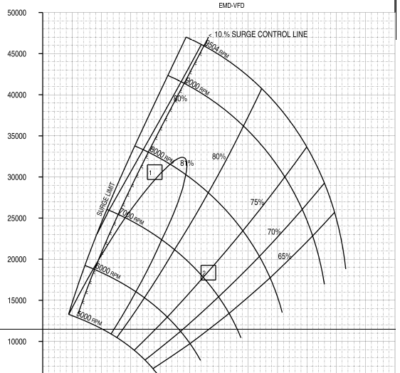
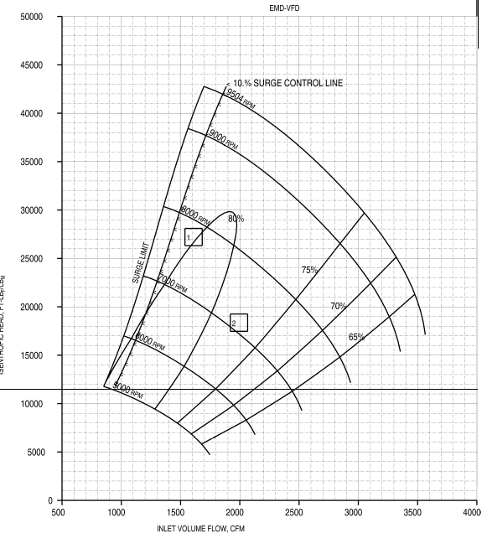
Centrifugal Compressor – Storage Application Curve: Tandem Unit in Series / Parallel
Curves shown below – assume EMD 17.5k HP Solar tandem C51 / C41 compressors with 700-800 suction pressures from pipeline (no booster station required).
Blue = parallel – LP injection with tandem units in parallel at 1200 psi injection (2x flow)
Green / Red = In series - HP injection with tandem units in series at 2220-2600 psi injection
17k Hp Driver with LP Stage – 4-5 impellers
17k HP Driver with HP Stage – 3-4 impellers
Isentropic / Polytropic Head
Isentropic / Polytropic Head
HP of driver limit
HP of driver limit
Flow Rate
Flow Rate
250 mmscfd
250 mmscfd
Typical pipeline curve (for comparison)

Slide 9
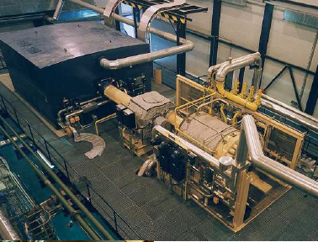
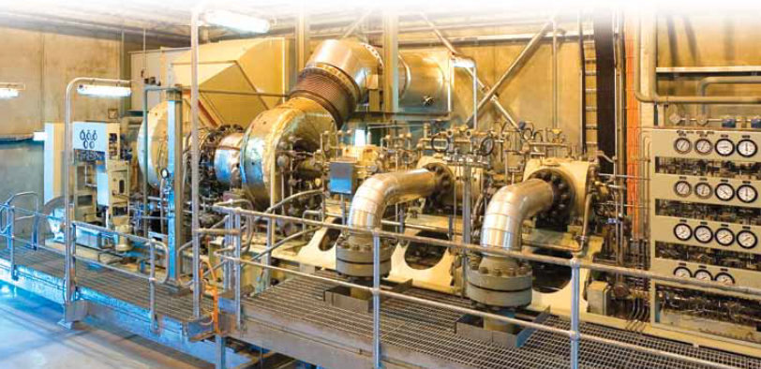
Centrifugal Compression – Tandem Options
MAN electric motor driven tandem unit
Solar GT driven tandem, skid mounted
Traditional GB or Voith Hydraulic planetary GB
Electric Motor Drive, Induction or Synchronous
LP compressor casing
HP compressor casing

Slide 10
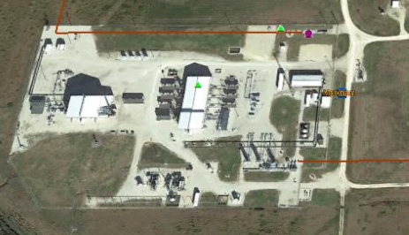
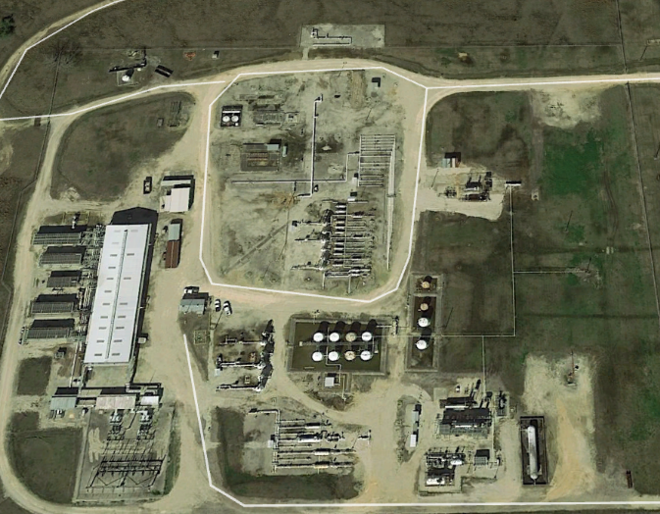
Recips and Centrifugals in Gas Storage
Markham Storage: 1 x 3616, 1 x CM34, 3 White Superiors – all gas engines. +20kvA lines within 1/4 mile
Important Considerations:
  Existing units at storage field and in operating company fleet: both the good and bad actors
  Non-attainment area?
  Electric power availability – need high voltage lines within ¼ mile to make economics work,
  Act early to engage power company!
  Starting large motors – consider range of options including soft-starters or lower rated VFDs
  OEM support for outages / repairs
  Maintaining reservoir health and low oil injection
West Clear Lake – 5 x Electric Motor driven recips, total = 32,000 hp

Slide 11
Recips and Centrifugals in Gas Storage
Advantages:
  Recips handle high pressure ratios easily, easily skid mounted, tend to have high operator familiarity, switching from single to 2-stage mode is not complicated, but good packaging is key.
  Centrifugal tandem units can be skid-mounted, use less oil and have low vibrations / no pulsation issues, but somewhat more complicated especially surge control.
Courtesy of Ariel
Courtesy of Solar Turbines

Slide 12
Finding the “Sweet” Spot for Driver Size and Common Gas Storage Compressors
Bigger is not necessarily always better: 1x 20,000 hp vs 2 x 10,000 hp
Larger motor will be:
  Harder to start
  Less turndown
  Tends to be synchronous – not induction =More $$, less reliable, less available.
Consider the KBZ-6 as an alternative to KBB /KBV frames. Can go up to 1000 RPM, slightly smaller driver.
Ariel KBZ-6 with 7500 hp Motor or CAT 3616 or Waukesha 275 GL+ = Skid-mounted package, high reliability, single or two stage operation.
For storage applications, tandem units are actually fairly mainstream in Europe.
Centrifugals offer good efficiency, low opex and can be skid-mounted. Avoid pulsation headaches and lower oil consumption. Must consider separate surge control valves and interstage piping / valves.

Slide 13
Questions / Comments??
Special thanks to the KM Operations team at Markham Storage (Randy Goldman) and West Clear Lake Storage for help with this presentation.
And for awesome pictures –
thanks to Solar, MAN and Ariel !

