Slide 1
DCP 2.0 Transformation
GAS ELECTRIC PARTNERSHIP
Bill Johnson | Chief Transformation Officer
Feb. 6, 2020

Slide 2
Forward-Looking Statements
Under the Private Securities Litigation Act of 1995
This document may contain or incorporate by reference forward-looking statements regarding DCP Midstream, LP (the “Partnership” or “DCP”) and its affiliates, including projections, estimates, forecasts, plans and objectives. Although management believes that expectations reflected in such forward-looking statements are reasonable, no assurance can be given that such expectations will prove to be correct. In addition, these statements are subject to certain risks, uncertainties and other assumptions that are difficult to predict and may be beyond our control. If one or more of these risks or uncertainties materialize, or if underlying assumptions prove incorrect, the Partnership’s actual results may vary materially from what management anticipated, estimated, projected or expected.
The key risk factors that may have a direct bearing on the Partnership’s results of operations and financial condition are described in detail in the Partnership’s periodic reports most recently filed with the Securities and Exchange Commission, including its most recent Forms 10-Q and 10-K. Investors are encouraged to consider closely the disclosures and risk factors contained in the Partnership’s annual and quarterly reports filed from time to time with the Securities and Exchange Commission. The Partnership undertakes no obligation to publicly update or revise any forward-looking statements, whether as a result of new information, future events or otherwise except as required by applicable securities laws. Information contained in this document speaks only as of the date hereof, is unaudited, and is subject to change.
Regulation G
This document may include certain non-GAAP financial measures as defined under SEC Regulation G, such as distributable cash flow, adjusted EBITDA, adjusted segment EBITDA, forecasted distributable cash flow and forecasted adjusted EBITDA. A reconciliation of these measures to the most directly comparable GAAP measures is included in the Appendix to this presentation.

Slide 3
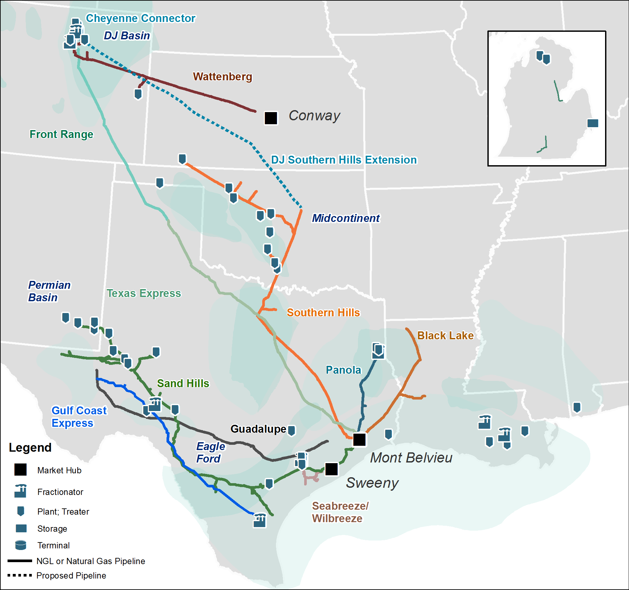
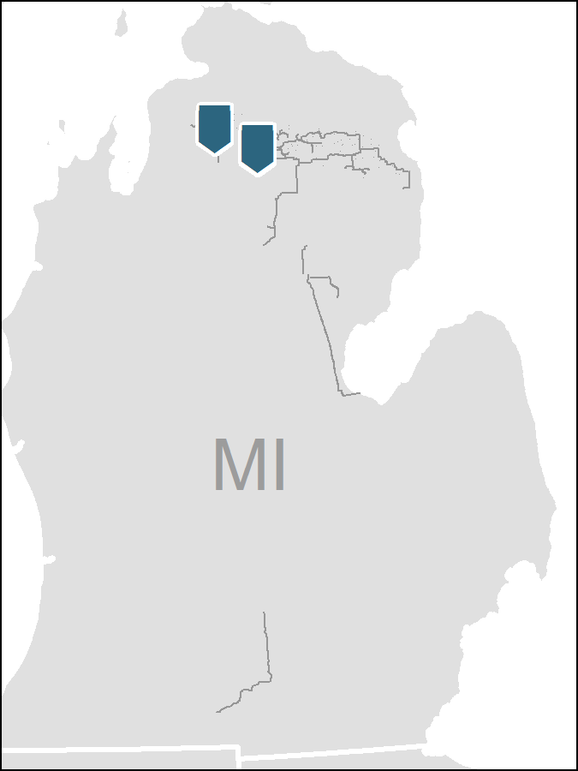
DCP Midstream Overview
Leading Integrated
Midstream Service Provider
Integrated Logistics & Marketing and G&P business with competitive footprint and geographic diversity
Leading the industry in digital transformation through our people, process, and technology
Environmental, Health and Safety leader in the midstream space
62K
60
8.0
Bcf/d processing capacity ⁽¹⁾
1,450
Miles of Pipeline
Plants
MBpd gross NGL
Pipeline capacity
One of the largest NGL producers and gas processors in the United States
Note: Statistics as of September 30, 2019. Plants and processing capacity includes inactive plants.
(1) Includes only DCP processing plant capacity

Slide 4
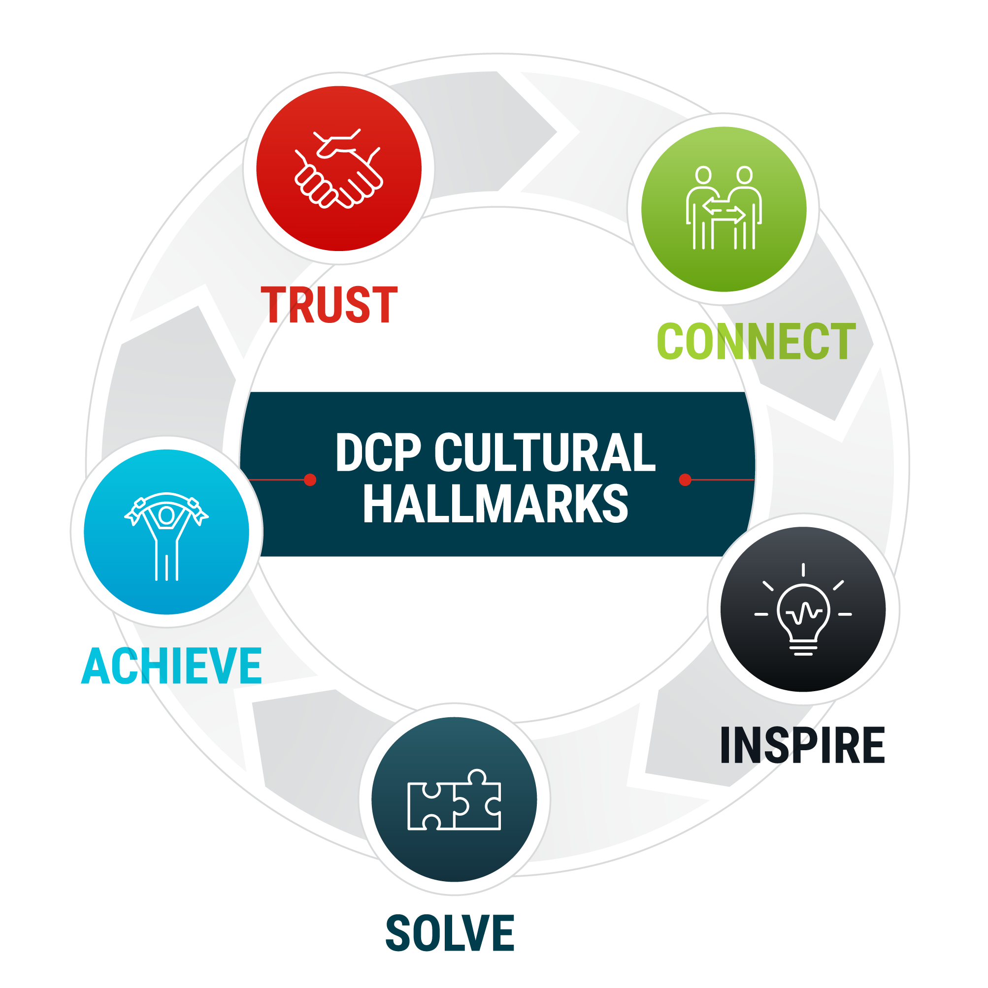
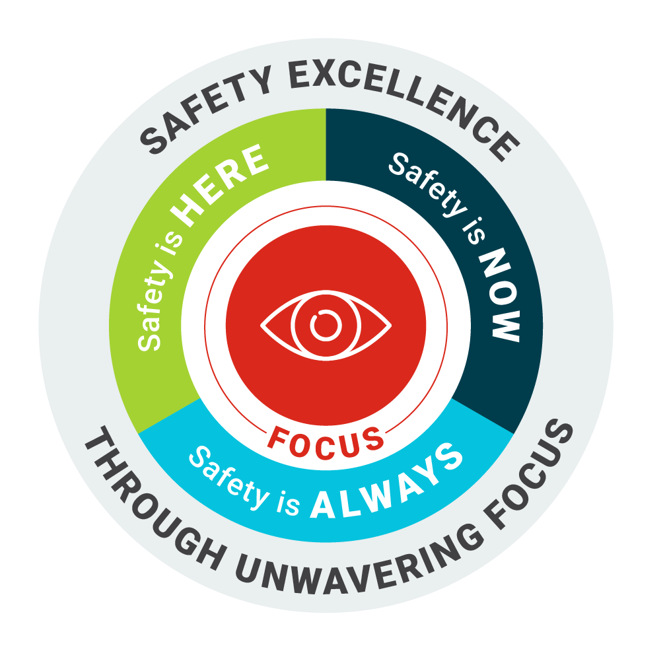
Committed to Our Purpose & Mission
DCP Purpose
DCP Mission
Building Connections to Enable Better Lives
To be the safest, most reliable, low-cost midstream service provider, sustainable in any environment

Slide 5
DCP 2.0

Slide 6
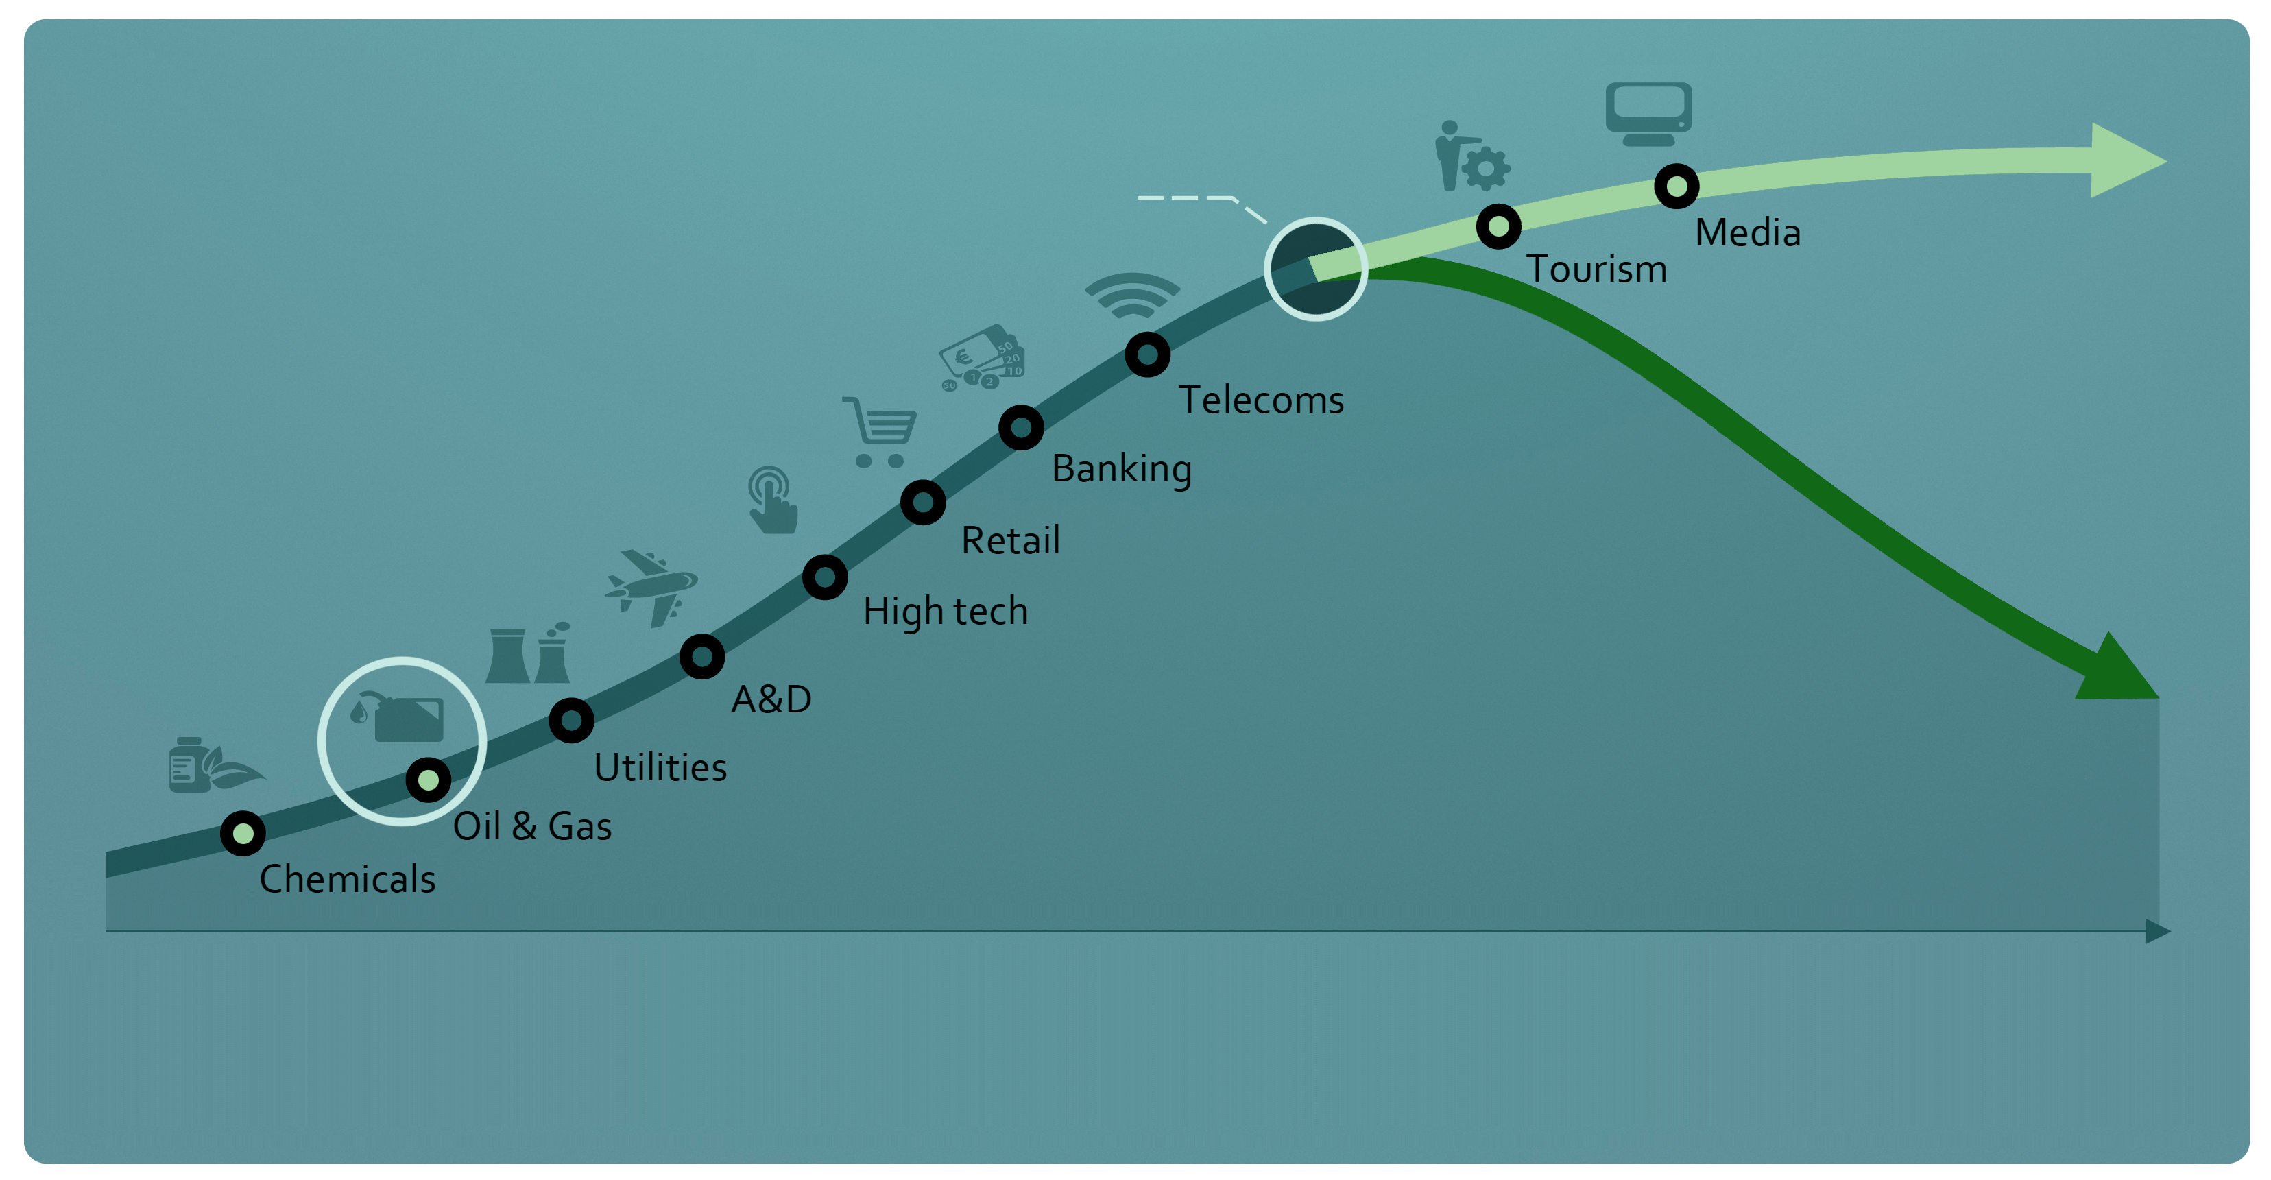
Digital Adoption
Data and analytics are creating clear winners and losers across industry
Tipping point
Winner takes all dynamic
Implies opportunities for new entrants or incumbents to create a competitive advantage
Digital followers
Emerging on the adoption curve
The new normal
< 10%
~ 10–40%
> 40%
Source: McKinsey & Company

Slide 7
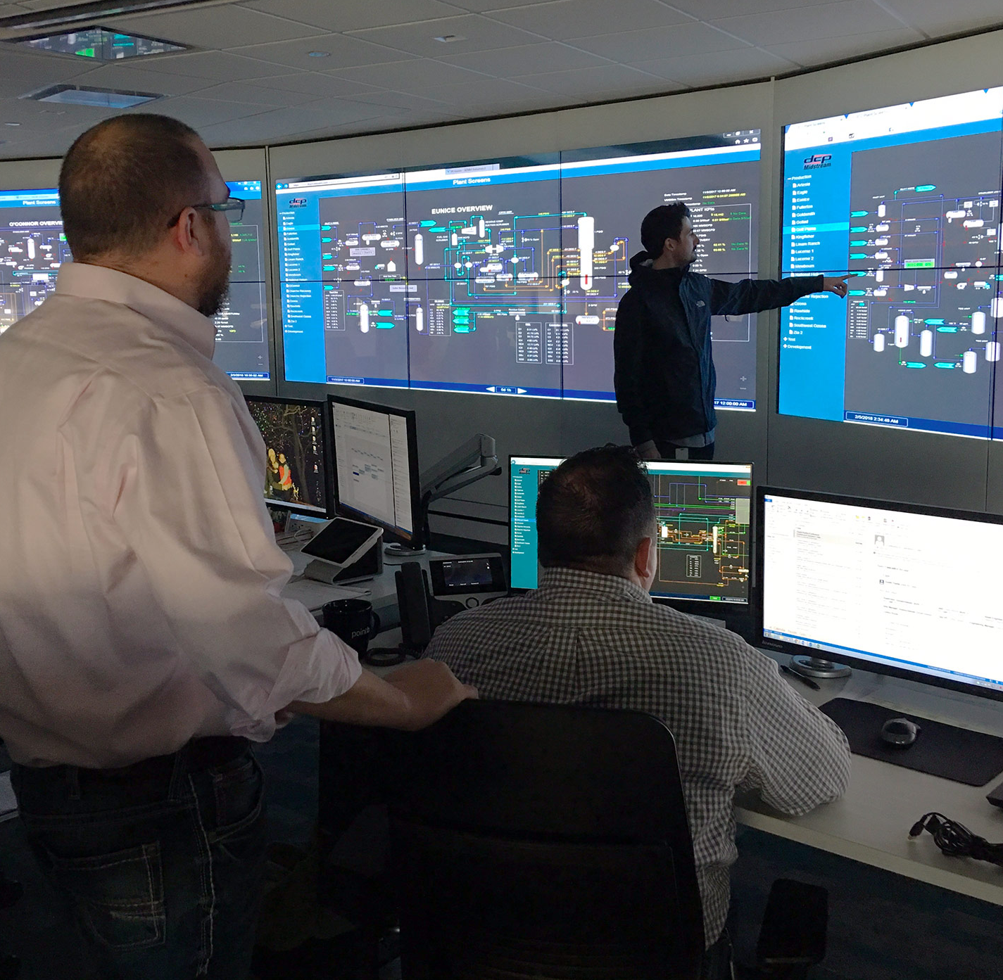
TIRED
TO
WIRED

Slide 8
Transformation Journey to Date
2015: Genesis & Vision
Changing competitive landscape
Backward looking financial and operational metrics
Digital revolution
2017: DCP 2.0 Launch
Establish ICC & Energy Lab teams
Deliver business solutions
One-year payback
2019: Acceleration
Four Transformation Priorities
Expand ICC, including remote operations
2016: Foundation & Focus
Outside-in discovery process
External learning tours
Refining the vision
2018: Initiative-Based to Enterprise-Wide
Integrate DCP 2.0 culture and drive for transformation throughout company
2020: Overhaul Employee and Customer Experience
Culture & People
Workforce of Today
Digital customer portal

Slide 9
DCP 2.0 Key Learnings
The Trifecta of Transformation
Ongoing Real-Time Process
Analysis
Decisions
Optimization
Cash Flow Improvement
PEOPLE
PROCESS
TECHNOLOGY

Slide 10
Driving the Operations of the Future
DCP 2.0 Strategic Objectives
Achieve Real-Time Optimization & Decision Making
Digitally Enable the Business and Workforce
Increase Cash Flow While Diminishing Risk
Utilize real-time data from a variety of sources to make the most strategic business decisions
Increase reliability and asset runtime
Improve margin by optimizing value of every asset and every molecule
Drive workforce efficiencies through automation
Create digital platforms to improve employees’ quality of life
Build high-tech portfolio and world-class Workforce of Tomorrow
Establish culture of innovation and agility
Improve safety and decrease emissions
Enhance process and equipment monitoring program
Drive substantial cost reduction via lean manufacturing platform
Utilize predictive analytics to improve asset maintenance
Real-time decisions
Better reliability and safety
Asset optimization
Higher margins
Cost Savings
Industry leading transformation through people, process, and technology

Slide 11
ICC and Remote Operations
Integrated Collaboration Center (ICC)
Linking Numerous Data Sources
SCADA and DCS
Financial Data
Real-Time Prices
KPIs
Contracts
Engineering Data
Integrated Collaboration Center
ICC continues to gain momentum with functionality; now tracking data from majority of plants
Focus expanding to the field, including large infrastructure of pipelines and compressors
24/7 monitoring for major field assets
A platform by which plant operation best practices can be identified and quickly replicated
Remote Operations
Now remotely operating over 20 assets from the ICC in Denver
Set goal to bring approximately majority of facilities into the ICC for remote operations by year end 2020
Driving increased cross-functional collaboration internally among gas controllers, plant and field coordinators, optimizers, and board operators
Strengthening integration between plants and across regions
DCP 2.0 driving optimization and efficiencies to increase cash flow, lower costs, and minimize risk
Notes:
Zia 200, 90,

Slide 12
DCP 2.0 Outcomes
20+
7B
18%
Gas plants running remotely from Denver ICC
Data points processed per day
Increase in proactive safety observation reporting
5
$50M+
65K
Successful pilots through DCP Technology Ventures
Total incremental margin improvement
Barrels per day capacity increase on pipelines
3%
500+
57%
Increase in plant efficiency
Predictive work orders generated
Reduction in print volume

Slide 13
Creating Value for All Stakeholders
Employees
Customers
Better decisions driving better business outcomes and accomplishments
Humans doing what only humans can do
World-class workforce, who are well-trained, multi-skilled, and engaged
Increased reliability and throughput
Better, more efficient access to real-time data
Enhanced relationships
General Public
Investors
Better operations produce better environmental outcomes, including less flares and lower emissions
Improved safety outcomes
Decreased traffic
Driving higher margins and lower cost via efficiency
Lean manufacturing platform positions DCP to be the consolidator, not the consolidatee

Slide 14
Questions?
@billj_denver
bill-johnson1

