Slide 1
Wind & Solar Growth: Effects on Base Load & Peaking Demand
Martin Lin
Specialist Leader, Deloitte Transactions and Business Analytics LLP
February 5, 2020

Slide 2
Contents
Continuation of major trends
Natural gas prices
Capacity additions and retirements
Renewable and clean energy targets
Generation profiles
Implications on gas generation from renewables

Slide 3
Continuation of major trends

Slide 4
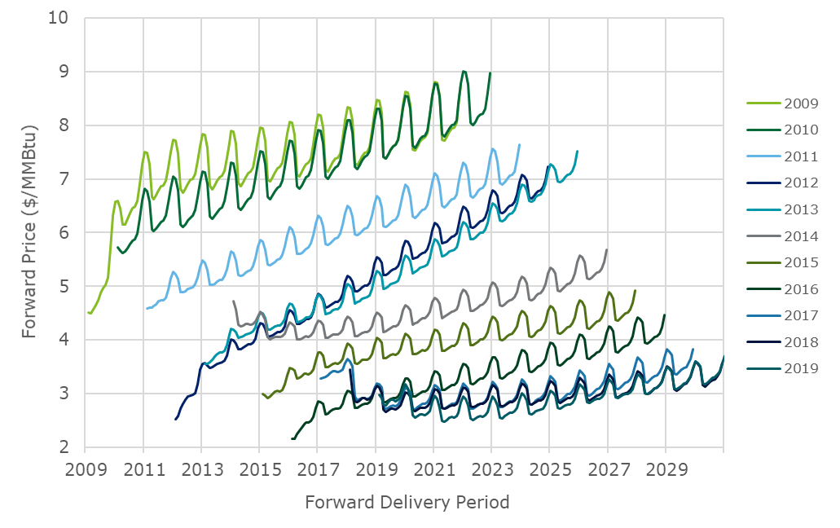
Natural gas demand has been growing, while production has been growing even more
Prices continue the downward trend, though the pace has slowed
The Energy Information Administration (EIA) reported average total dry gas production of 92 billion cubic feet per day (Bcf/d), an increase from reported
83 Bcf/d in 2018
75 Bcf/d in 2017
The natural gas forward price curve has been in general decline for over a decade
Comparing forward curves from late January for the past dozen years
2020 forwards in 2019 are:
Almost 75% lower than in 2009
Almost 50% lower than in 2014
Mild front-end backwardation seen in the last few years has essentially disappeared
Historical Henry Hub Forward Curves
Observed in Late January
Source: Total Dry Gas Production from EIA Short-Term Energy Outlook (STEO), January 14, 2020; Henry Hub forward prices from S&P Global Market Intelligence, accessed January 30, 2020; chart compiled by Deloitte

Slide 5
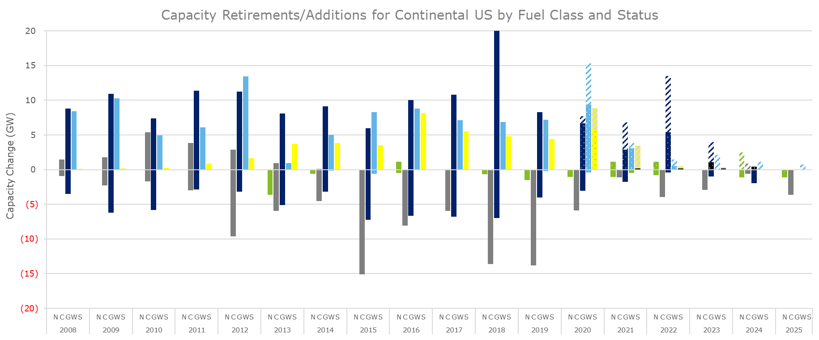
Changes to capacity have also been shifting
Nuclear and coal capacity have retired while new capacity shifted to primarily gas, wind, and solar
Fuel Class
N – Nuclear
C – Coal
G – Gas
W – Wind
S – Solar
Project Status
Completed
Under Construction
Advanced Development
Source: : S&P Global Market Intelligence unit capacity data, accessed January 30, 2020; chart compiled by Deloitte

Slide 6
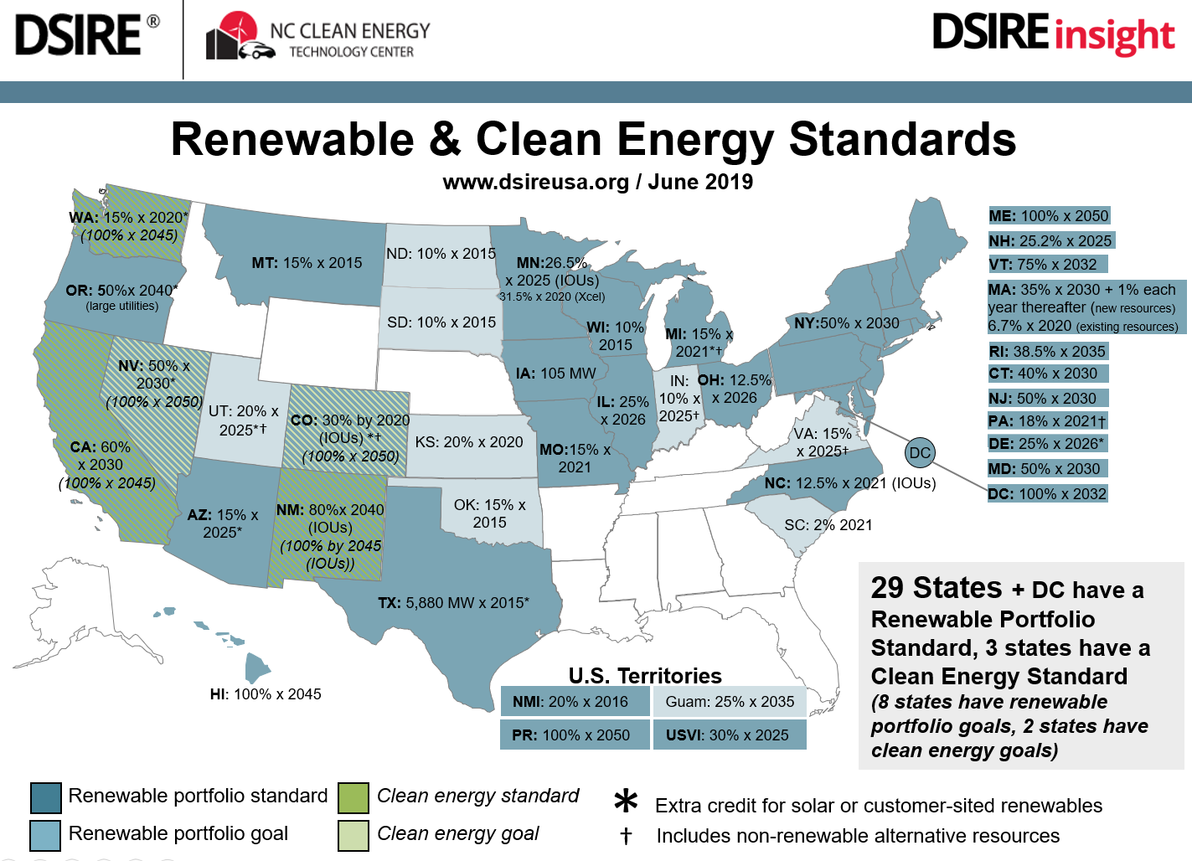
Renewable Portfolio standards have expanded to Clean Energy Standards
Target levels have increased in several states as well
Besides Hawaii’s 100% renewable portfolio standard (RPS), several other states have adopted by law or are considering 100% clean energy standard (CES) or variations, including:
California (SB100, September 10, 2018)
New Mexico (SB489, March 22, 2019)
Nevada (SB358, April 22, 2019)
Washington (SB5116, May 7, 2019)
Wind and solar resources have been expected to be the primary sources of qualifying energy, and the expectation remains going forward
While federal tax credits are scheduled to phase out, RPS and CES are expected to provide continued incentives in some states
Source: Renewable & Clean Energy Standards graphic from DSIRE by N.C. Clean Energy Technology Center, funded by US Department of Energy, https://s3.amazonaws.com/ncsolarcen-prod/wp-content/uploads/2019/07/RPS-CES-June2019.pptx; California SB100, https://leginfo.legislature.ca.gov/faces/billNavClient.xhtml?bill_id=201720180SB100; New Mexico SB 489, https://www.nmlegis.gov/Legislation/Legislation?Chamber=S&LegType=B&LegNo=489&year=19; Nevada SB358, https://www.leg.state.nv.us/App/NELIS/REL/80th2019/Bill/6651/Overview; Washington SB5116, https://app.leg.wa.gov/billsummary?BillNumber=5116&Year=2019&initiative=

Slide 7
Generation profiles
Renewables and gas generation

Slide 8
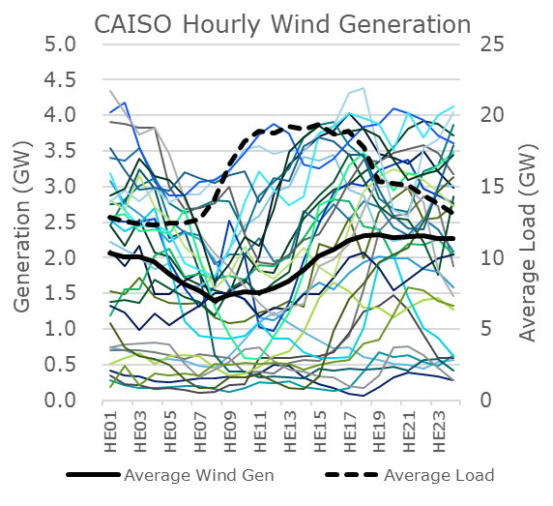
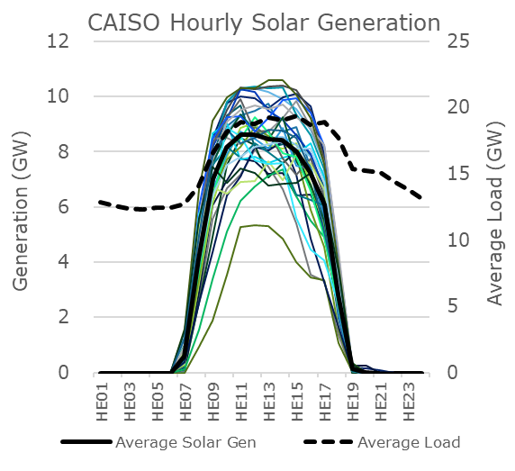
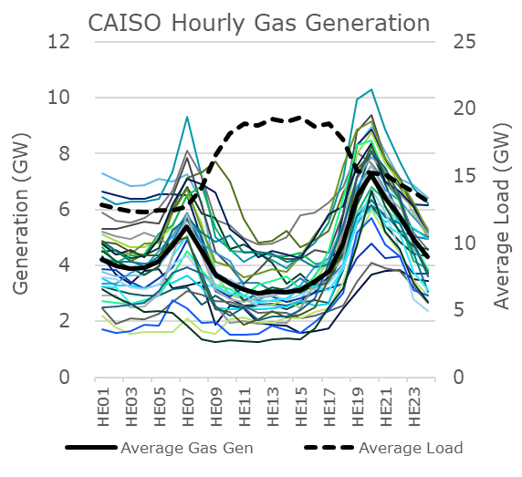
Generation patterns can differ widely by technology
Renewable sources such as wind and solar typically have profiles that differ from the underlying system demand
Comparing the daily generation in California Independent System Operator (CAISO) from March 16, 2019 to April 15, 2019 for wind, solar, and gas sources shows qualitatively different profiles
Wind can be highly variable and does not generally follow the load profile
Solar more closely aligns with load than wind, but solar often declines earlier in the day than demand
Gas is frequently the marginal supply, balancing the system, and following the residual load
Source: Generation data from Energy Information Administration (EIA) Hourly Electric Grid Monitor (Beta), https://www.eia.gov/beta/electricity/gridmonitor, accessed January 30, 2020; charts compiled by Deloitte

Slide 9
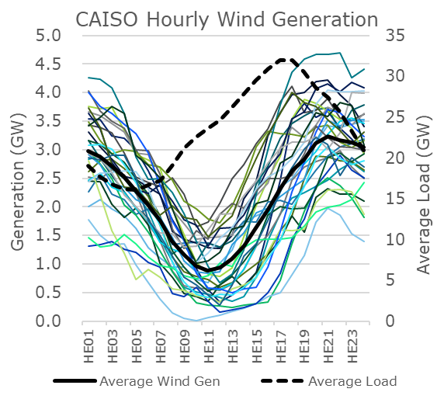
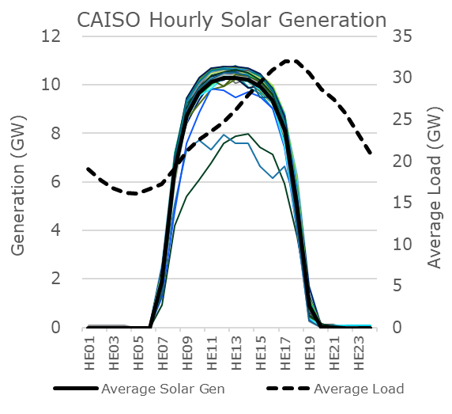
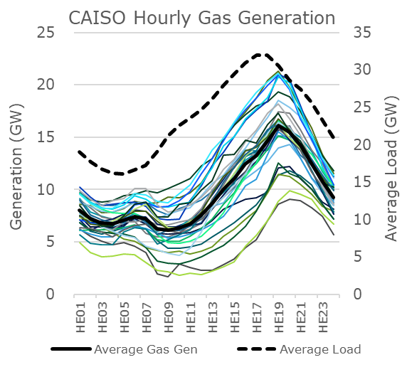
Generation patterns can also differ by season
Renewable sources such as wind and solar typically have profiles that can change throughout the year while load also changes in magnitude and shape
Comparing the daily generation in CAISO for August 2019 from wind, solar, and gas sources illustrates seasonal changes in profiles
Wind is variable in summer but less so than in spring
Solar is also less variable in summer than spring and declines while load is still peaking
Gas faces a larger range due to higher overall load, though late-day ramp is less dramatic than in spring
Source: Generation data from Energy Information Administration (EIA) Hourly Electric Grid Monitor (Beta), https://www.eia.gov/beta/electricity/gridmonitor, accessed January 30, 2020; charts compiled by Deloitte

Slide 10
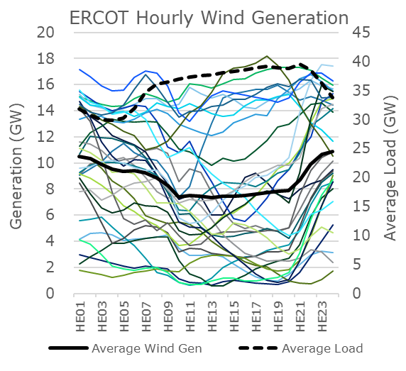
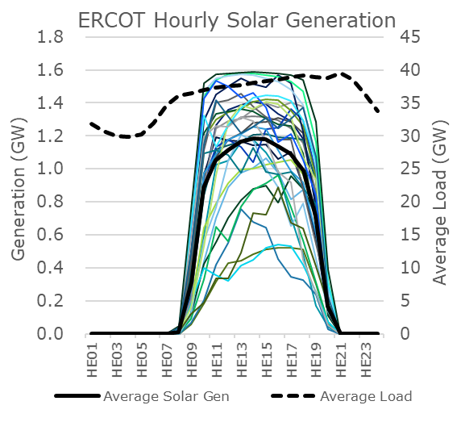
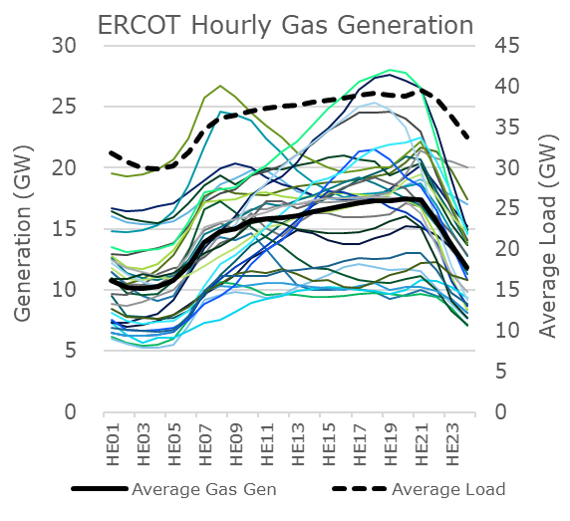
Generation patterns can also differ by geography
Electric Reliability Council of Texas (ERCOT) displays differences in generation profiles when compared to CAISO
Comparing the daily generation in ERCOT from March 16, 2019 to April 15, 2019 for wind, solar, and gas sources shows wide variation from day to day
Wind varies widely and does not generally follow the load profile
Solar capacity is relatively low in ERCOT, though growth is expected and should increase its influence
Gas faces a range of generation levels resulting from wide wind variation relative to lower seasonal loads
Source: Generation data from Energy Information Administration (EIA) Hourly Electric Grid Monitor (Beta), https://www.eia.gov/beta/electricity/gridmonitor, accessed January 30, 2020; charts compiled by Deloitte

Slide 11
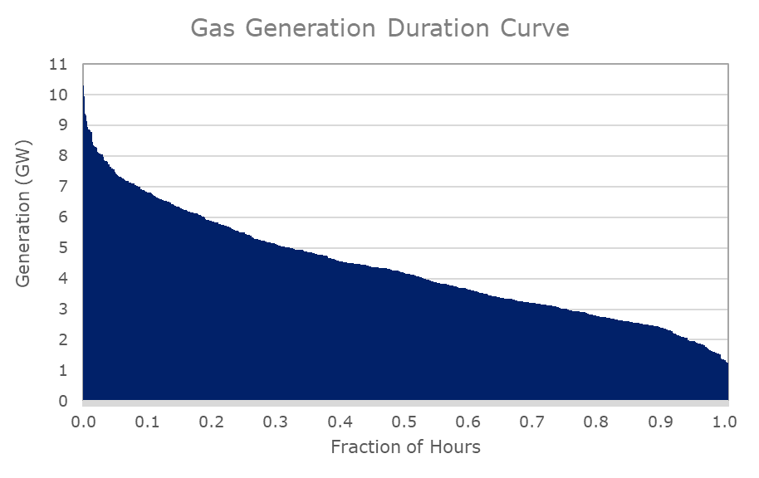
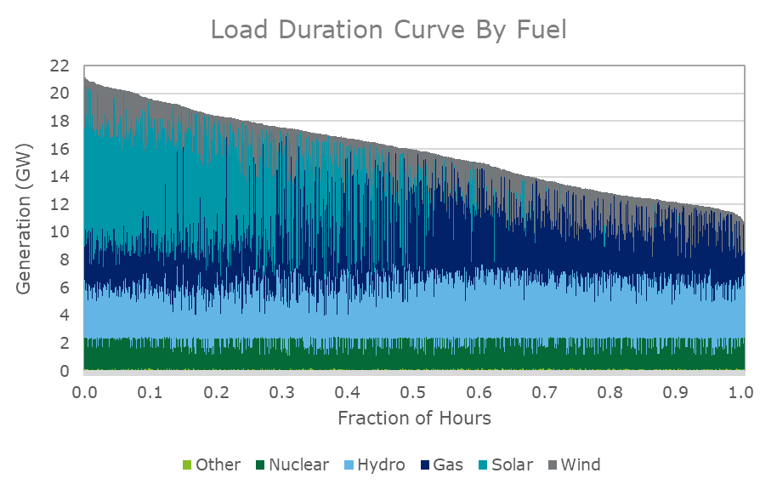
Generation and load duration curves suggest value of gas flexibility
Gas generation during high output periods are well above baseload level during spring in CAISO
Load duration curve shows gas generation levels vary widely across system net load levels
High correlation of solar generation and load concentrate gas generations in mid- to low-load periods
Source: Generation data from Energy Information Administration (EIA) Hourly Electric Grid Monitor (Beta), https://www.eia.gov/beta/electricity/gridmonitor, accessed January 30, 2020; charts compiled by Deloitte

Slide 12
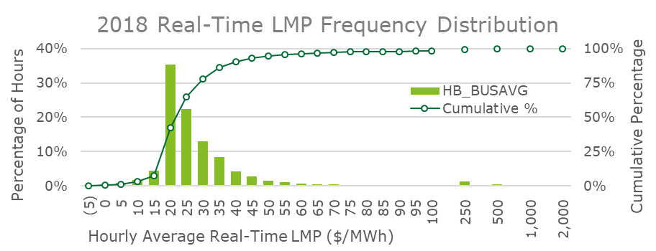
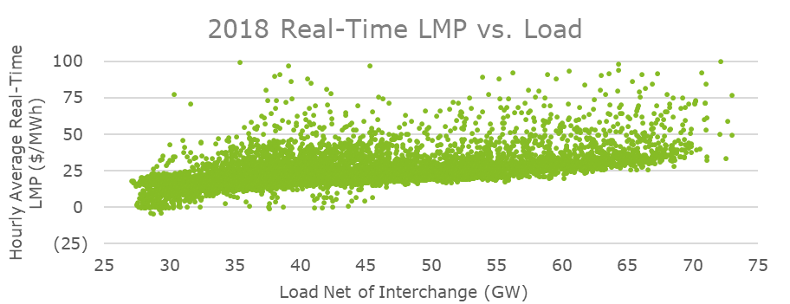
Relatively low energy prices attributed to high penetration of wind generation in ERCOT
With the largest installed base of wind capacity of any state and relatively low cost natural gas, power prices have trended lower in Texas
In 2018, of the 8,760 hourly average real-time locational marginal prices (LMPs) for settlement point HB_BUSAVG:
65% were at or below $25/MWh
Less than 2% were above $100/MWh
Many hours of high load were still served at relatively low energy prices.
Many generator were uneconomic to operate with such low energy prices, and over 4 GW of coal capacity retired in 2018.
Price spikes experienced in 2019 may lead the market to prices that are high enough to support baseload gas generation
Expected increases in renewable generation may continue to limit power prices during most hours
Source: Price and load data from ERCOT: Historical RTM Load Zone and Hub Prices report for 2018; 2018 ERCOT Hourly Load Data report;; charts compiled by Deloitte

Slide 13
This presentation contains general information only and Deloitte is not, by means of this presentation, rendering accounting, business, financial, investment, legal, tax, or other professional advice or services. This presentation is not a substitute for such professional advice or services, nor should it be used as a basis for any decision or action that may affect your business. Before making any decision or taking any action that may affect your business, you should consult a qualified professional advisor.
Deloitte shall not be responsible for any loss sustained by any person who relies on this presentation.
About Deloitte Deloitte refers to one or more of Deloitte Touche Tohmatsu Limited, a UK private company limited by guarantee (“DTTL”), its network of member firms, and their related entities. DTTL and each of its member firms are legally separate and independent entities. DTTL (also referred to as “Deloitte Global”) does not provide services to clients. In the United States, Deloitte refers to one or more of the US member firms of DTTL, their related entities that operate using the “Deloitte” name in the United States and their respective affiliates. Certain services may not be available to attest clients under the rules and regulations of public accounting. Please see www.deloitte.com/about to learn more about our global network of member firms. Copyright © 2020 Deloitte Development LLC. All rights reserved.

