Slide 1
Natural Gas and NGL Midstream Processing
Digitalization and ESG
Kenneth L’Anglois | DCP Midstream
February 6, 2020

Slide 2
Forward-Looking Statements
Under the Private Securities Litigation Reform Act of 1995
This document may contain or incorporate by reference forward-looking statements regarding DCP Midstream, LP (the “Partnership” or “DCP”) and its affiliates, including projections, estimates, forecasts, plans and objectives. Although management believes that expectations reflected in such forward-looking statements are reasonable, no assurance can be given that such expectations will prove to be correct. In addition, these statements are subject to certain risks, uncertainties and other assumptions that are difficult to predict and may be beyond our control. If one or more of these risks or uncertainties materialize, or if underlying assumptions prove incorrect, the Partnership’s actual results may vary materially from what management anticipated, estimated, forecasted, projected or expected.
The key risk factors that may have a direct bearing on the Partnership’s results of operations and financial condition are described in detail in the Partnership’s periodic reports most recently filed with the Securities and Exchange Commission, including its most recent Forms 10-Q and 10-K. Investors are encouraged to consider closely the disclosures and risk factors contained in the Partnership’s annual and quarterly reports filed from time to time with the Securities and Exchange Commission. The Partnership undertakes no obligation to publicly update or revise any forward-looking statements, whether as a result of new information, future events or otherwise except as required by applicable securities laws. Information contained in this document speaks only as of the date hereof, is unaudited, and is subject to change.
Regulation G
This document includes certain non-GAAP financial measures as defined under SEC Regulation G, such as distributable cash flow, adjusted EBITDA, adjusted segment EBITDA, gross margin, segment gross margin, forecasted distributable cash flow, and forecasted adjusted EBITDA. A reconciliation of these financial measures to the most directly comparable GAAP measure is included in the Appendix to this presentation. Due to the forward-looking nature of estimated annualized adjusted EBITDA attributable to certain growth projects, DCP is unable to provide a reconciliation to net income, which would be the most directly comparable GAAP financial measure, because management does not track and is unable to predict the adjustments necessary for a reconciliation at a project-level without unreasonable effort and expense.

Slide 3
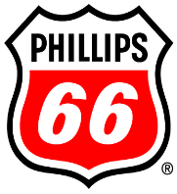
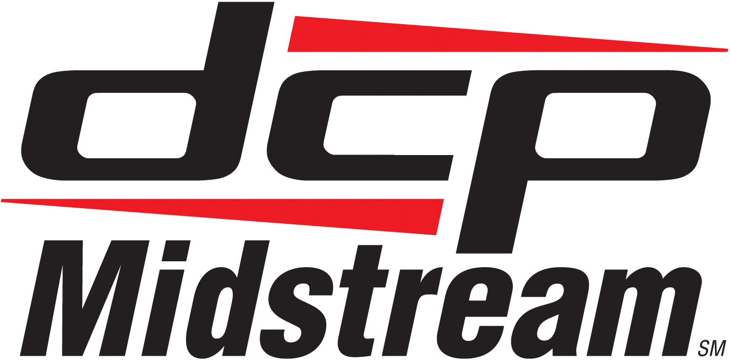
DCP Structure
Baa2 / BBB+ / BBB+⁽³⁾
(NYSE:ENB)
A3 / BBB+ / NR⁽³⁾
(NYSE:PSX)
~$129 billion enterprise value⁽¹⁾
~$58 billion
enterprise value⁽¹⁾
50%
50%
57% Common LP Interest
General Partner
Public Unitholders⁽²⁾
43% Common LP Interest
Ba2 / BB+ / BB+⁽³⁾
(NYSE:DCP)
Publicly Traded MLP
~$11.4 billion enterprise value⁽¹⁾
Win-win transaction creating full economic alignment for all stakeholders
ENB and PSX EV based on ycharts.com as of September 30, 2019; DCP EV based on post-transaction calculation using 20-day volume-weighted average price as of the markets close on November 5
Includes Series A, B, and C Preferred LP interests
Moody’s / S&P / Fitch ratings
Notes:
DCP has continued to transform, improving our structure by having eliminated our IDRs and by becoming nearly 100% self-funding for capital growth and sustainability

Slide 4
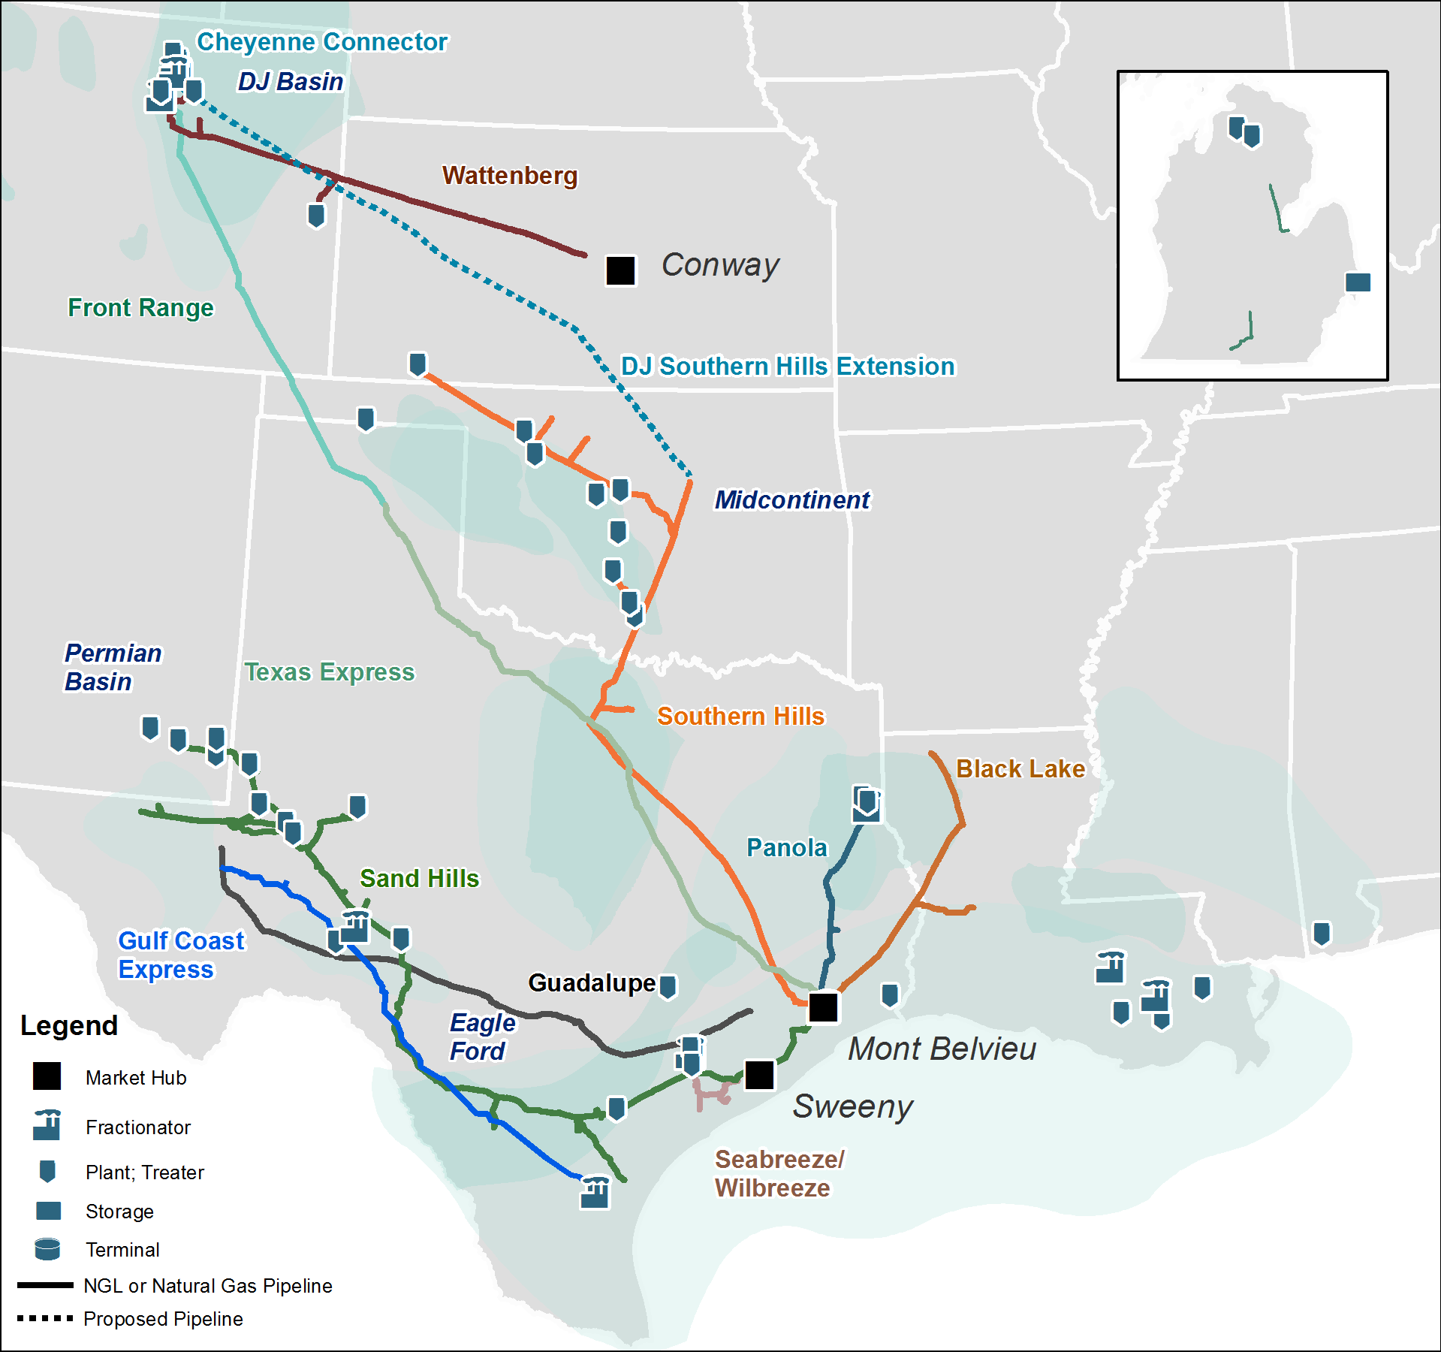
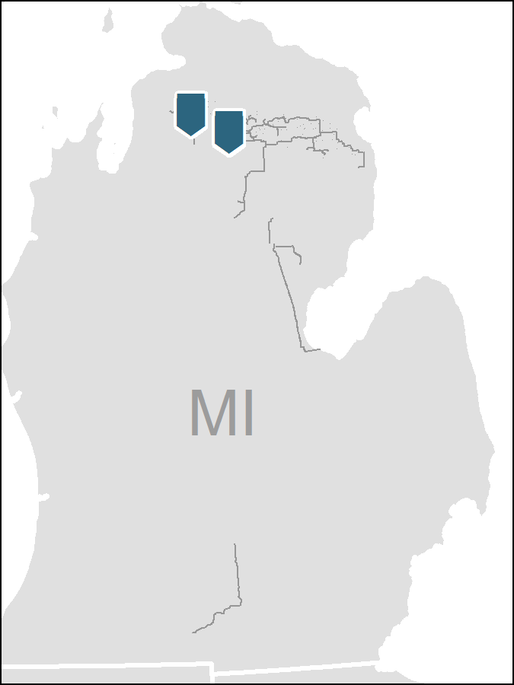
Strong Portfolio of Assets
Leading Midstream Provider
Integrated Logistics & Marketing and Gathering & Processing business with competitive footprint and geographic diversity
Unparalleled interconnectivity and access to fractionators on the Gulf Coast, including Mt. Belvieu and Sweeny, with Conway for optionality
Leading industry positions in premier basins, including the DJ Basin, Permian, Eagle Ford, and SCOOP
62K
60
8.0
Bcf/d processing capacity ⁽¹⁾
1,450
Miles of Pipeline
Plants
MBpd gross NGL
Pipeline capacity
One of the largest NGL producers and gas processors in the United States
Note: Statistics as of September 30, 2019. Plants and processing capacity includes inactive plants.
(1) Includes only DCP processing plant capacity
Notes:
DCP has continued to transform. We are moving more gas with fewer facilities and a more interconnected infrastructure as 2020 progresses.

Slide 5
We Are DCP Midstream
OUR ROLE WITHIN IT
(Our Why)
OUR BUSINESS STRATEGY
(Our What)
OUR PLAN OF ACTION
(Our How)
WHERE THE WORLD IS GOING
WHAT MATTERS HERE
YOU MATTER
The Horizon
Dynamic market and commodity price environment | Declining public sentiment toward hydrocarbons | Digital and data disruption
Our Purpose
Building Connections to Enable Better Lives
Our Vision
To be the safest, most reliable, low-cost midstream service provider
Our Priorities
Operational Excellence | Culture & People
Workforce of Tomorrow | Customer Experience
Our Culture
SAFETY
Trust | Connect | Inspire | Solve | Achieve
Your Role
Understand where the world is going | Engage with our purpose | Drive our strategy | Align efforts with our priorities | Live by and enhance our culture
Notes:
Purpose: Building connections to enable better lives
Vision: to be the safest, most reliable, low-cost midstream service provider
Safety Culture: Paramount

Slide 6
Digitization
Data Sources
Data Processing, Artificial Intelligence and Remote Ops
Operational Discipline
Notes:
Implementing digitalization has a much wider impact than just reducing the human intensity of the operation; you reduce the number of miles driven per person which impacts PVAs, you reduce downtime by addressing the correct problem the first time, you increase quality of life for employees, solutions become more sustainable due to having more data input, people do fewer “mundane” tasks which impacts improved safety performance, your company can expand its reach faster to positively impact more lives, your customers will be positively impacted by better service over the long term.
Remote Operations: Allows DCP to apply the best talent and minds to everyday operations to better leverage a very geographically distributed enterprise.

Slide 7
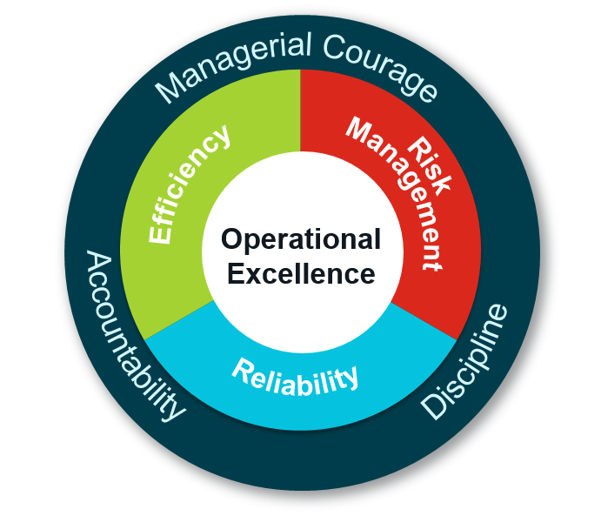
ESG Environmental, Social, and Governance
Environmental Commitment - Focused on reducing methane, CO2 and VOC emissions at DCP facilities through innovation, investment in reliability, and pipeline integrity
Industry Leader - Collaborative thought leader and industry influencer with NGOs, trade associations, and regulatory agencies, including DOT/PHMSA, EPA, and state and local regulators
Ethical Leadership and Culture - Committed to promoting an organizational culture that encourages the highest standards of personal, professional, and business ethical conduct
Social and Community Engagement - Active engagement with the communities where we live and work via community investment and outreach
Board of Directors Governance - Board sanctioned Operational Excellence committee oversees EHS risk management programs; comprised of DCP, Phillips 66 and Enbridge EHS/Ops leadership
Executive Compensation - Aligned with company DCF, operational and safety performance, and focused on driving long-term unitholder value as reflected by total shareholder return relative to the peer group
ESG Council - Internal working group established to deliver first ESG report in 2020
1ST PLACE 2018 COMPANY SAFETY AWARD FOR DIVISION I
GPA Midstream recognizes DCP for outstanding safety performance
2018 CEO AWARD FOR COMPANY SERVICE
GPA Midstream recognizes DCP for significant contributions to, and leadership within, the midstream industry
TOP CORPORATE FUNDRAISER NATIONWIDE FOR 2018 AHA HEART WALK
AHA recognized DCP for raising awareness and funds for cardiovascular health research
LARGE COMPANY COMMUNITY IMPACT AWARD FOR 2018
COGA recognizes DCP’s significant impact and focus on community investment and outreach
2019 FORBES BEST MIDSIZE EMPLOYER
Forbes recognizes DCP’s culture and workplace environment based on direct employee feedback
DCP Purpose: Building Connections to Enable Better Lives

Slide 8
ESG Operational Implementation
Detection
Control Equipment
Operational Discipline
New Technology
Notes:
Detection: This involves aerial photography/FLIR detection, on-the ground with FLIR hand-held (new tech. available), gas leak detection equipment, rapid reporting methods, flare measurement on SCADA
Control Equipment: Pressure regulators, HI/LO valves, vent/flare design, automation for reaction to pressure changes to decrease or increase capacity rapidly, rapid dissemination of information
Operational Discipline: Trained and regular observations, efficient and risk-based work order processing, running equipment responsibly, prompt reporting and RCFA with follow-through
New Technologies: Upgrades to engine controls to lower emissions, waste heat recovery, renewable energy options, fuel cell technologies, power factor correction technologies, CO2 sequestration; DCP Technology Ventures (launched in 2018)

Slide 9
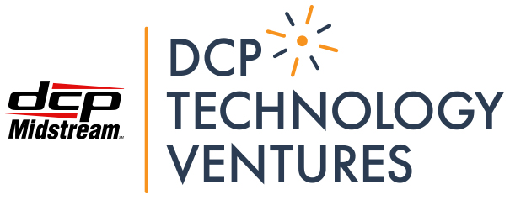
Commitment to seek and incorporate new technologies
Notes:
DCP Technology Ventures (launched in 2018)

Slide 10
Q&A

