Slide 1
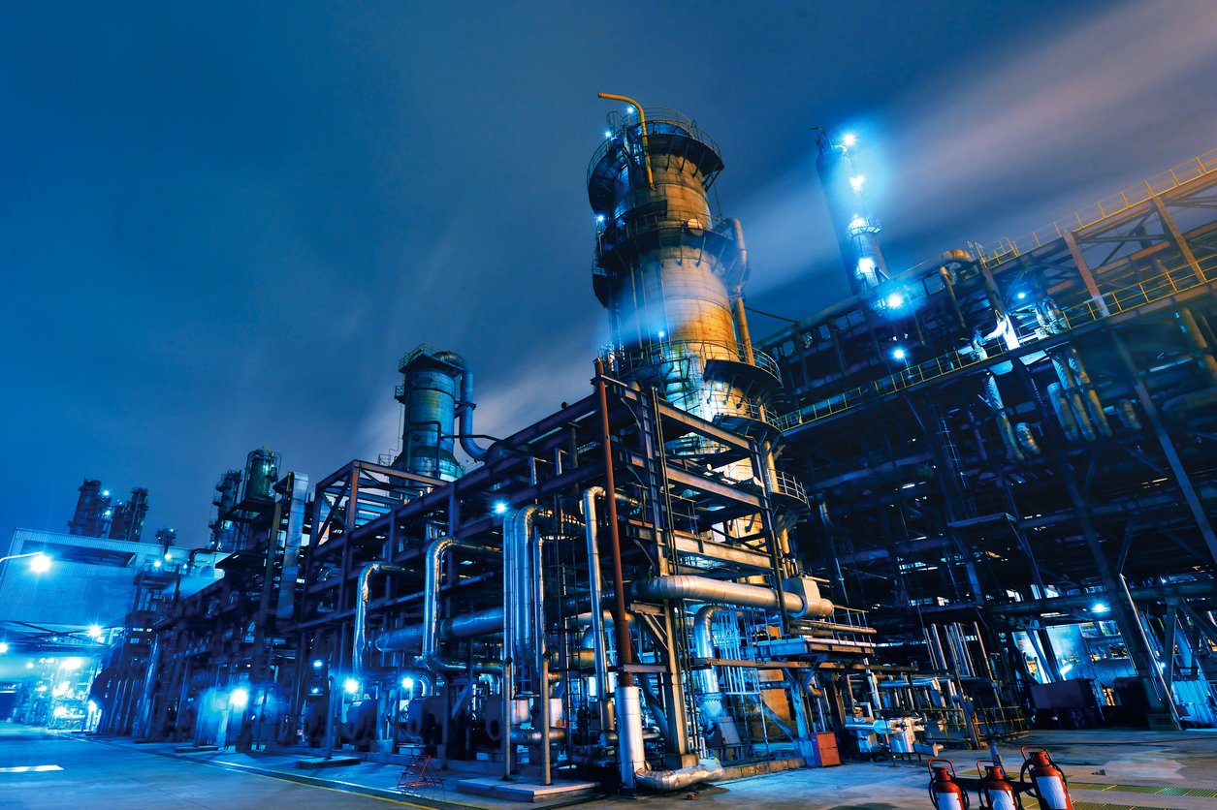
Predictive Maintenance for Rotating Equipment

Slide 2
Introduction: Predictive maintenance
Predictive maintenance is a multi-step process of monitoring a specific set of variables for a machine or asset to determine its condition, forecast its future condition, and schedule maintenance in accordance with need instead of at model-based time intervals.
The process involves:
Monitoring equipment to collect data about its condition and performance
Analyzing the data to convert it into actionable information
Acting on the insights consistent with established policy

Slide 3
Host: Itoro Meshioye
Radix Engineering & Software
Over 20 years of progressive experience across a broad range of Engineering & IT functions in the O&G industry. Detailed knowledge of Asset Performance Management technologies for data capture, integration, visualization and analytics tied together for the explicit purpose of improving the reliability and availability of physical assets. Previously held positions with ExxonMobil, OSIsoft, Oceaneering, HP and AT&T prior to joining Radix.
Graduated with a BSc in Electrical /Electronics Engineering, BSc in Technology Management, and an MSc in Computer Information Systems.

Slide 4
Mike Teter
Sr Engineer at Williams Company
Mike is a seasoned O&G industry subject matter expert with over 28 years in the Natural Gas Industry:
20 yrs. Engine/Compressor Controls Design, Commissioning , Compressor Performance, Technical Support and project Management- Gas Transmission
2.5 yrs. Facility and Project Engineering (Cryogenic Gas processing)
5.5 yrs. Operational Data Analysis ( Gathering, Processing, storage and Transmission)
He graduated with a B. Sc in Electrical and Electronics Engineering from the University of Wyoming

Slide 5
Maria Sylte
Team Lead, Asset Excellence at TC Energy
Maria enjoys creating tools that allow organizations leverage information to make data-driven decisions, and see enormous potential in digital transformation. She has held engineering and project management positions in both upstream and midstream sectors of the energy industry. In her current role at TC Energy, she leads a team that integrates real-time data analytics, operational intelligence, and long-term performance indicators to transform decision-making within the reliability organization. She graduated with a BSc in Mechanical Engineering from The University of Texas at Austin.

Slide 6
Steve Beamer
VP of Customer Success & Transformation at Element
Steve has 36 years of industry experience, 30 of those working in Oil and Gas. Prior to joining Element, Steve worked for 8 years at BP Upstream as VP Reliability and Maintenance, and VP Continuous Improvement and Transformation. In addition to his time at BP, Steve worked 17 years at ExxonMobil alternating between site and central roles, was VP Technology, and Director of Reliability and Inspection, at the Hess HOVENSA refinery, and VP Asset Management at Peabody Energy. Steve started his career in the US Navy serving as an nuclear submarine officer.
He holds a B.S. in Mechanical Engineering from Auburn University and an M.B.A. from Pepperdine University.

Slide 7
Kenneth Smith
Account Executive at Seeq Corporation
Kenneth has 20 years of sales and business development experience across multiple verticals, the last eight spent in the energy sector. He is a trusted advisor, relationship builder, and strategic thinker with a passion for helping companies in the energy and manufacturing industries achieve transformative business value through the adoption of emerging technologies. He previously held positions with Hortonworks, Bit Stew Systems and Weatherford. He earned a Bachelor of Business Administration in Marketing from Texas A&M.

