Slide 1
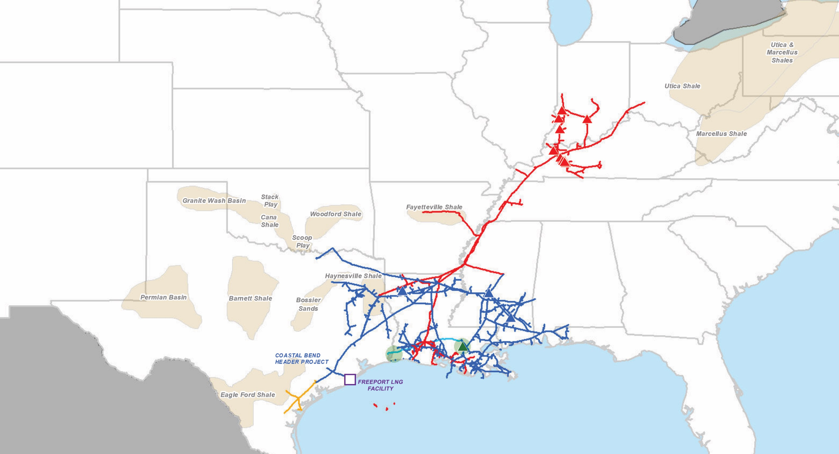
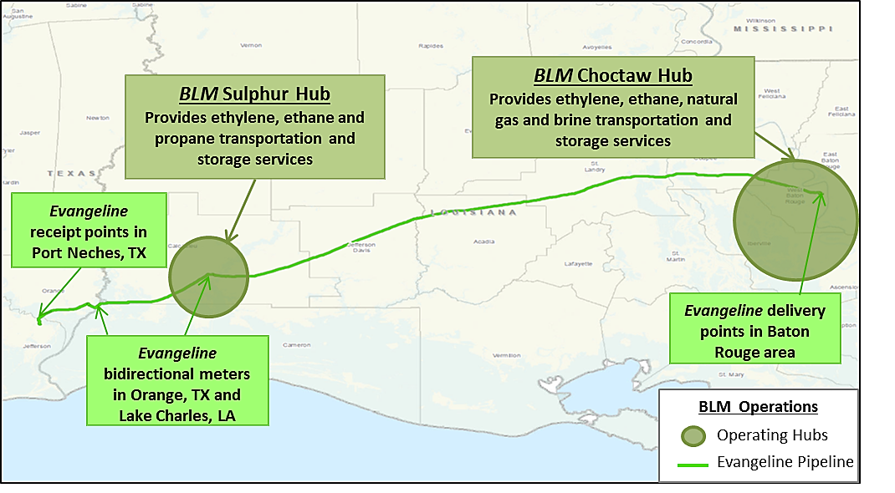
Boardwalk Asset Map Boardwalk predominantly transports and stores natural gas and liquids for its customers
Boardwalk 2018 Operational Highlights
Natural Gas Liquids
Pipelines 13,805 miles 425 miles
Throughput 2.7 Tcf 70.8 MMbbls
Storage Capacity 205 Bcf 31.8 MMbbls
Boardwalk Storage Company
Gulf South Storage Facilities
Texas Gas Storage Facilities
Boardwalk Louisiana Midstream Hubs
Evangeline Ethylene Pipeline
Boardwalk Texas Intrastate
Gulf South Pipeline
Texas Gas Transmission
Boardwalk Louisiana Midstream and Evangeline Ethylene Pipeline

