Slide 1
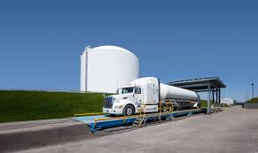

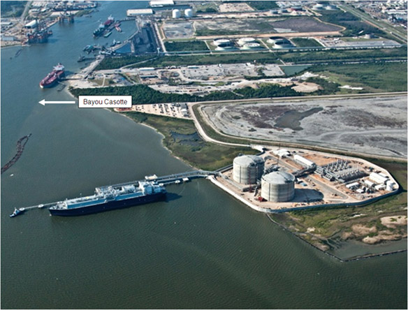
GAS/ELECTRIC PARTNERSHIP CONFERENCE XXVIII
FEBRUARY 5, 2020
LNG Facility Applications for the 21st Century
LNG Peak Shaving, LNG as Commodity, LNG as Energy Storage
Presented by
Tom Quine, Partner
978-337-0391
TQuine@NewEnergyDev.com
www.NewenergyDev.com

Slide 2
What We Do
We deliver to midstream companies, local distribution companies, utilities, and other sponsors completely optimized, commercially operating LNG, natural gas, sustainability, and storage solutions stemming from our comprehensive capabilities:
Strategic market assessment and commercial structuring,
Complete project development and
Institutional co-investment

Slide 3



Meet the New Energy Development Leaders
Alexander “Hap” Ellis III, Managing Member, New Energy Development Company provides project development, strategic and advisory services in LNG, natural gas, and sustainable investments relating to his extensive experience in project development, corporate and industry strategy, commercial structuring and negotiations, risk management and corporate finance.
Mr. Ellis has served for 18 years as General Partner at RockPort Capital Partners ($845 million AUM), a multi-stage venture capital firm that invests in alternative and traditional energy, mobility, and sustainability. He has over 40 years of executive experience originating, developing, funding and serving as executive in leading independent power companies and sustainable energy firms. Mr. Ellis is the chairman of The George and Barbara Bush Foundation Board of Directors as well as the Old Westbury Funds ($34 billion AUM) Board of Directors. He is a graduate of Colorado College with a BA in Political Science and earned an MPPM from the Yale School of Management.
Hap Elliot
Thomas G. Quine, Partner, New Energy Development Company provides project development, strategic and engineering advisory services in LNG, natural gas, and energy relating to his more than forty years of experience in LNG and natural gas project development, company leadership, complex LNG plant operations, systems design and mechanical engineering, and project planning and control.
Mr. Quine was recently Founder, CEO, and Chairman of Northstar Industries LLC, a prominent and respected LNG and natural gas engineering and construction business. Mr. Quine grew Northstar over 24 years, successfully developing and leading many high-profile LNG and energy projects, revolutionizing the small and medium-scale LNG and natural gas midstream industry, including by means of modular liquefaction designs and other patented systems. Mr. Quine graduated with a BS in Electrical Engineering from Wentworth Institute of Technology and a BA in Legal Studies from the University of Massachusetts, Amherst.
Thomas Quine
Mr. Shields, Partner, New Energy Development Company provides project development, strategic and advisory services in LNG, natural gas, energy and sustainable investments relating to his extensive experience in project development, corporate and industry strategy, commercial structuring and negotiations, trading, risk management and corporate finance. He most recently provided strategic consultancy services through Morgan Shields Energy LLC, a company he founded 10 years ago.
Scott Shields brings 25 years of executive experience from Repsol LNG, Exxon Corporation, and Enron Capital & Trade, combined with integrated start up consulting from many LNG projects and energy companies over 10 years at Morgan Shields Energy LLC. He is a military veteran and served as co-founder & board member at Oasis Bank SSB before its merger and subsequent IPO at nearly $1 billion in valuation (NASDAQ: STXB). Mr. Shields is FINRA-licensed Series 79, 82, and 63, graduated with an MBA from the University of Chicago Booth School of Business, and a BS in Finance from the Pennsylvania State University.
Scott Shields
www.NewenergyDev.com

Slide 4
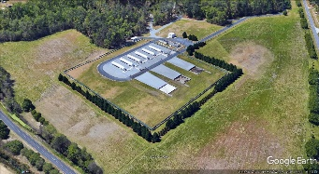
AGENDA FOR PRESENTATION
US Gas History: Manufactured Gas, Natural Gas Pipelines, LDC’s Gas Storage, LNG, LPG/Air
Regulatory Milestones: 1938-Present
Overview of Supply Chain: Emphasis on LNG
21st Century Applications – Welcome to The Future
Closing Thoughts, Q&A,
Appendix Technical Items: (As Time Permits)
LNG Plant Design Site layouts, Process Flow Plant Systems
Siting Requirements: Thermals and Vapors
Jurisdiction: 49 CFR 193/FERC/NFPA 59 A for Other
Stage Gate Project Development Cycle and Low Risk Schedules
www.NewenergyDev.com

Slide 5
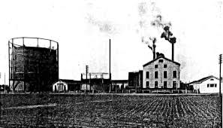

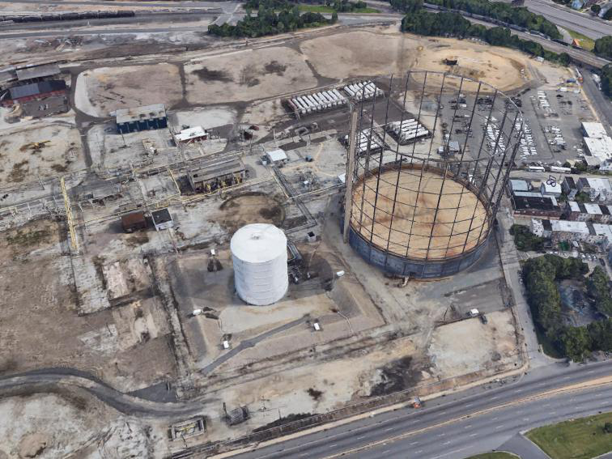
Manufactured Gas & Nat Gas by Decade
Mid-1800 : 500 BTU/CF Manufactured Coal Gas was being utilized in major US cities by the Civil War
  Numerous Municipal gas lighting and
  Then heavy industrial applications
1950: Natural Gas Transmission arrived in NE
  Complete Appliance Conversion was Required
  1000 BTU/CF Fuel
1960: Propane Air was quickly identified as a peak shaving Fuel
1960-70: LNG and NY/PA midstream gas storage were developed in parallel
1999: LNG Import peaked at 800 BCF/Y
21st Century Fracking Technology Shale plays make importing LNG unattractive
Current: Abundant supply of natural gas lowers prices and creates LNG commodity market
www.NewEnergyDev.com

Slide 6
Key Regulatory Milestones
1938
Natural Gas Act 1938: First Gas Industry Federal Regulation for Defined Rates, Section 7 Permits, Public Convenience, and Section 3 Permits for Import and Export.
1970
49 CFR 192: Minimum Safety Standards for Gas Distribution and Transmission became federal law in 1970.
1978
49CFR 193: Minimum Federal Safety Standards for LNG became Federal Law in 1978.
1992
FERC Order 636 decoupled capacity and commodity and created Open Access in 1992.
2005
Energy Policy Act 2005: Established Pre-Filing Process.

Slide 7
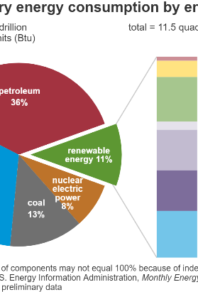
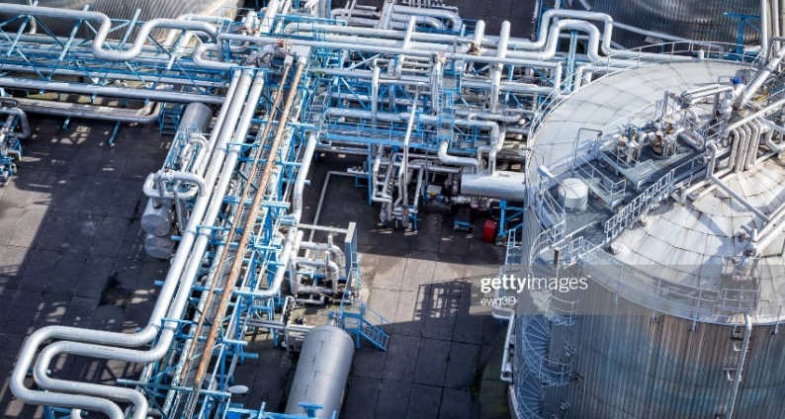
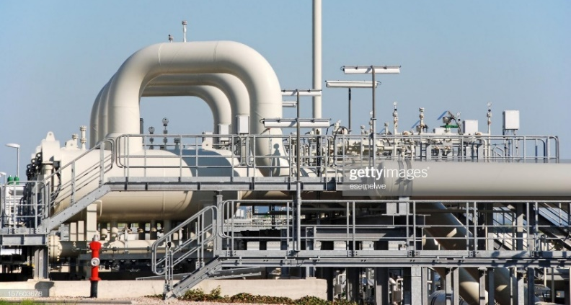
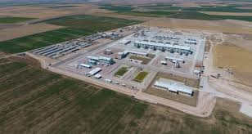
US Gas Supply Summary
      US LARGEST NG PRODUCER IN WORLD: 30 TCF/Y
      US consumes 40 Quads/year as oil; half of it is imported
      Oil is about twice the cost of NG yet we import 20 Quads/Year
      ~110 LNG Facilities in US
      ~120 BCF of LNG storage in US
      38 LNG plants located in Northeast
      ~4 TCF of underground storage in US
      ~400 gas storage fields in US
      Gas costs $2.60/dekatherm or MMBTU
      In a 100 Quadrillion BTU/Year US Economy oil/gas/coal/renewables are converging at a quickening PACE.
www.NewEnergyDev.com

Slide 8
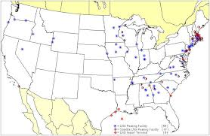
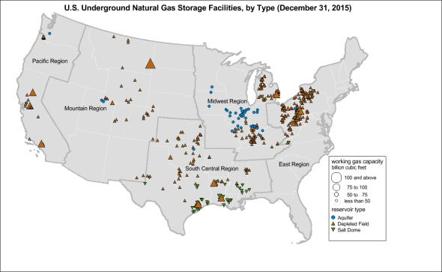
Pipelines, Underground Storage, LNG
2.25 MM Miles of Gas Distribution and 250,000 Miles Gas Transmission
110 LNG Plants with 100 BCF of Storage
400 Natural Gas Storage Fields in US with 30 TCF Storage

Slide 9
DOE Crossover Points*: UG GEO Storage, LNG, CNG
1. Geological Underground Nat Gas Storage
20 BCF (20,000,000 DT) Underground Gas Storage facility: US $250 MM or $12.5/Dt
2. Liquefied Nat Gas
2 BCF (2,000,000 Dt) LNG facility: USD $250 MM or $125/Dt
3. Compressed Nat Gas - Gas Cylinders
.2 BCF (200,000 Dt) CNG cylinder Storage: USD $250 MM or US $1,250/Dt

Slide 10
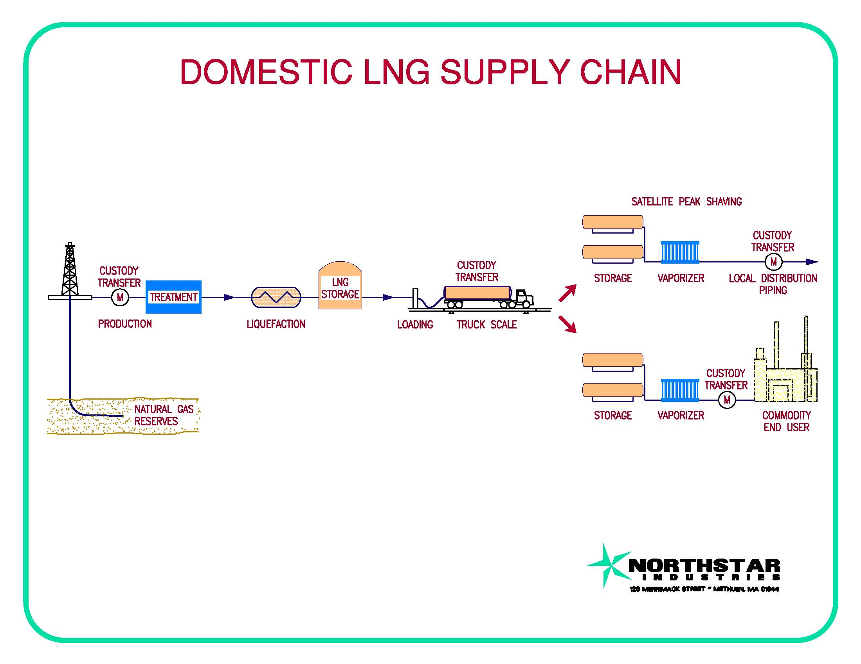
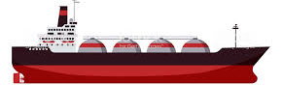
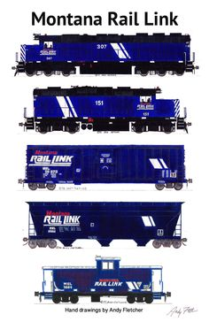

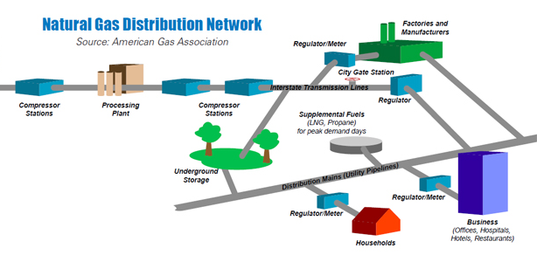
LNG Supply Chain in the 21st Century
LNG TRANSPORT AND FUEL: MARINE, RAIL, TRUCKING
PEAKSHAVING PLANT
NATURAL GAS E&P
LNG PRODUCTION & VAPORIZATION
INDUSTRIAL END USE AND POWER GENERATION
END-USE INDUSTRIAL
&
GAS FIRED GENERATION
LDC’S & GAS TRANSMISSION

Slide 11
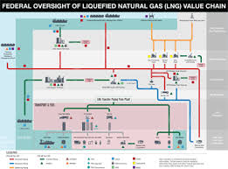
LNG PLANT JURISDICTION in US
LNG facilities that provide LNG vaporization into pipelines or distribution systems regulated by 49 CFR Part 192 are subject to regulation by 49 CFR Part 193. There are approximately 100 LNG facilities in the USA, which fall under the jurisdiction of 49 CFR Part 193. Some are defined as Interstate and also FERC regulated. Some are Intrastate.
INTERSTATE /FERC Regulated Facilities are LNG Facilities Supplying Interstate
Pipelines or LNG Marine Terminals for import and export.
Intrastate DOT 49 CFR 193 Regulated Facilities are LNG Facilities Supplying
Intrastate Pipelines or Distribution Systems. Some states have their own
LNG regulations for intrastate and Private facilities.
Private LNG facilities not subject to 49 CFR 193. Other LNG facilities that are not associated with jurisdiction pipes or LDC’s would need to determine the local and state authorities having jurisdiction. In some case NFPA-59A would dictate standards. In others not.

Slide 12
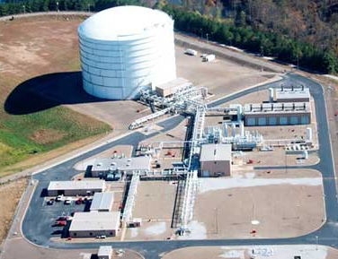
Why LNG Makes Sense for Energy Storage
LNG IS VERY HIGH-DENSITY ENERGY STORAGE (beachball to ping pong ball)
LNG AVOIDS PIPELINE CAPACITY: For LDC’s and End Users: New Capacity is US $72MMY– US $ 150 MMY each 100,000 DT/D
LNG AS COMMODITY SUPPLY INSTEAD OF OIL: Market For Transportation and Industrials 25 Quadrillion BTU’s/Y
LNG AS HEDGE FOR HIGH NG SPOT PRICES OVER US $10/DT: For LDC’s and End Users paying $140/DT.
LNG AS NATURAL GAS LOAD FOLLOWING FOR ELECTRIC GENERATION: To Fill in for Intermittent Renewable Solar/Wind
TO AVOID REGIONAL PENALTIES FOR MISSING GENERATION CALL: $50 MM /Day for 500 MW Electric Gen Facility in NE

Slide 13
Example of Economic LNG Use
6 BCF/Day
4 BCF/Day
2 BCF/Day
  Potential LNG Peaking Facilities
  Typically consist of 33-50% of Peak Day
  Complement existing pipeline capacity
  Provide domestic supply and local solution
  Needed peak-day/peak-hour support
  High % of Peak Day/Low % of Annual Volumes
  100,000 Dt/D of capacity costs US $72MM/Y
  2BCF/D of LNG Capacity is worth about $1.5 B in demand charges alone
2 BCFD / 20 BCFY Storage: New England LNG Infrastructure
33% of Peak Day Capacity yet only 2% of Annual Volume
4 BCFD/900 BCFY New England Natural Gas Pipelines
98% of Annual Volumes Delivered by Pipelines
0 40 180 365
Days Per Year
*REGIONAL LOAD DURATION/GAS SUPPLY CURVE AT CAPACITY FOR 2020

Slide 14
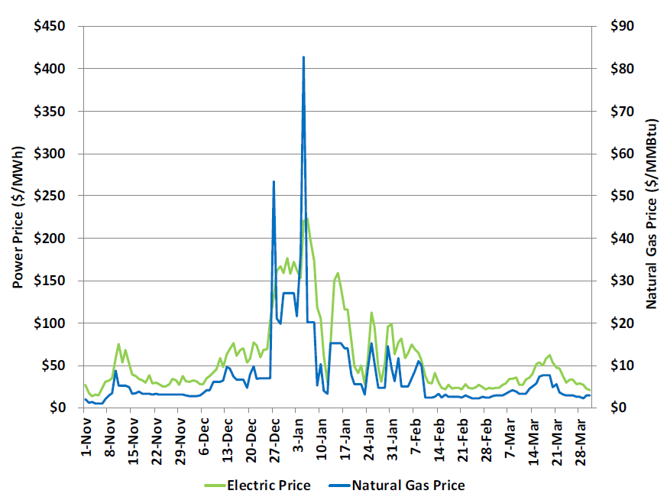
Economic Hedge Against Extreme Winter Weather
Supplemental natural gas supply and LNG storage refill during short term peak hour/day or multiday cold snaps
  During cold snap of late 2017/early 2018, natural gas prices rose to historical levels for a short period of time.
  Cold weather occurred early in the heating season. LDCs must maintain LNG storage inventory for mid and late winter cold snaps.
  February 15-28 AGT Citygates natural gas spot price averaged only $2.50 per dth.
  Additional LNG:
    Storage and vaporization can provide supplemental peak period supply at an economically attractive price
    Liquefaction can provide LNG refill for remaining winter period needs as temperature and demand moderates
New England Natural Gas and Power Prices- Winter 2017/18
Source: Concentric Energy Advisors, Mass Coalition for Sustainable Energy

Slide 15
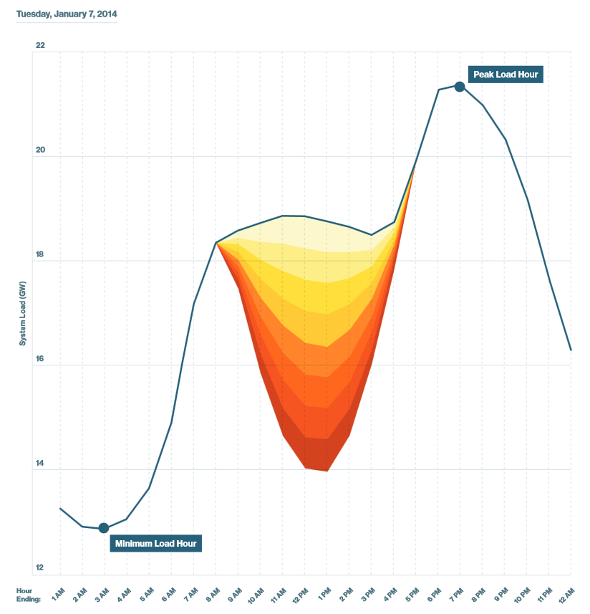
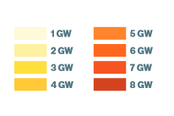
Load Following as Energy Storage For Renewables
Increased reliance on intermittent renewable energy adds more pronounced peaks and valleys (volatility) during the electric day
Renewables (solar, wind) are used as baseload supply source and displace natural gas and coal-fired generation
Regional increases in reliance on natural gas for load following and peaking, not baseload generation. This could impede new, large scale pipeline construction particularly in markets without vertically integrated electric market structure.
ISO-NE 2017 Regional Electricity Outlook

Slide 16

LNG Future Applications
NUMEROUS SMALL/MIDSCALE LNG FACILITIES FOR DOMESTIC USE:
  Peak shaving, Liquid Supply, Commodity Blowout Hedge, Point of Use Fuel, and Energy Storage,
  $US 30 MM- $500MM
LNG FOR TRANSPORTATION FUEL: VEHICLES, RAIL, MARINE
LNG CO-LOCATED ELECTRIC GENERATION,GAS STORAGE FACILITIES
LNG CO-LOCATED WITH H2 PRODUCTION AND RENEWABLE ENEGY
LNG CO-LOCATED WITH RNG FACILITIES

Slide 17
CLOSING THOUGHTS
The gas industry began in the 19th Century with manufactured coal gas plants in every major US City.
In the 20th Century it morphed into the natural gas supply chain: pipes, UG storage, LNG, LDC’s
Oil use created 200,000 gasoline stations, and trade deficit imports of Oil.
In the 21st century the US became the largest producer of NG and oil in the world.
In the 21st Century, expect an integrated energy infrastructure with decarbonization and renewable energy supply.
Natural Gas, H2, RNG, Energy Storage, Renewable Electric Generation, Cleaner Base Load.

Slide 18
Q&A AND OPEN DISCUSSION

Slide 19

APPENDIX FOR LNG PRESENTATIONS:
DESIGN, JURISDICTION, SITING, DEVELOPMENT PROCESS
Tom Quine, Partner
978-337-0391
TQuine@NewEnergyDev.com

Slide 20
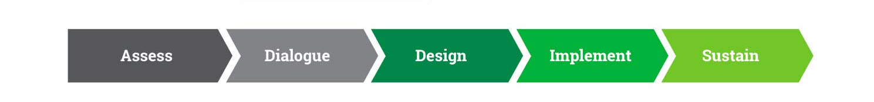
PROJECT DEVELOPMENT PROCESS DEFINED
Establish business case and credit
Perform Preliminary Engineering
Site Selection and Options in Friendly Places
Meet or Exceed Siting Requirements
Execute Precedent Agreements
Procure Equipment and Professional Services
Seismic, Geotech, Fire Studies
HAZID/HAZOP
Complete Engineering Design
Adjudicate Permits and Approvals
Prefabricate Components/Buildings
Conduct Field Construction,
NDT Testing
Commissioning, Training, Documentation
Commercial Operations

Slide 21

6 Month Phase 1:
Perform Conceptual Engineering To Define Technical Design Basis and Commercial Services
Define business case offerings and engage customers
Execute Precedent Agreements
Go/No-Go
18 Month Phase 2:
Perform Preliminary Engineering
Site Selection and Options in Friendly Places
Define & Engage Stakeholders, Including First Responders
Perform Open Season and Finalize Design Baseline and Customers.
Conduct Public Hearings and Agency Contacts.
Meet or Exceed Siting Requirements
Procure/Engage Engineering, Equipment Engineering Support and Other Professional Services
Seismic, Geotech, Fire Studies
HAZID/HAZOP
Complete Engineering Design
Adjudicate Permits and Approvals
Go/No Go
30 Month Phase 3
Procure Equipment, Prefabricate Components Buildings, Conduct Factory Acceptance Testing (FAT)
Conduct Field Construction,
Hire Operating Team Early In Process
NDT Testing, Environmental and quality Inspections,
Commissioning, Training, Documentation TO Commercial Operations
KEYS TO SUCCESSFUL
STAGE GATE PROJECT DEVELOPMENT PLAN

Slide 22
LOW FINANCIAL RISK PROJECT SCHEDULE & MILESTONES
Months 0 6 12 18 24 30 36 42 48 54 58
Project Initiation
6 Months
Conceptualize Facilities & Services:
6 Months
Anchor Customer Agreements:
6 Months
Pre- Engineering/Site Selection:
8 Months
Pre-Filing Meet Prep and Pre-Filing:
12 Months
Pre-Feed & Feed Engineering
12 Months
FERC Filing, Adjudication, Approval
36 Months
Final Eng., Procure, Prefab. and FAT:
30 Months
Field Construct, Comm., Train., Doc.:
Commercial Operations Begin:

Slide 23



SITE LAYOUT LNG FACILITY: PRE-TREATMENT, LIQUEFACTION, TRAILER LOADING, VAPORIZATION, GREEN POWER 15 ACRE FACILITY FOOTPRINT EQUAL TO ONLY 1 MILE OF NG PIPELINE
14
LNG FACILITY MAJOR EQUIPMENT LIST
Natural Gas Line To/From TGP
TGP M&R Facility and EGM Building.
Security Gate Checkpoint Via Access Road
NG Connecting plant Pipe
N2 Refrigeration Compressor
LN2 Storage Tank and Vaporizer
LNG Pretreatment
LNG Tank Tertiary Impoundment
LNG Storage Tank Internal Pumps
LNG Vaporizer and Sub-impoundment
LNG Cold Box and Expander Skids
Boil off Handling
Odorant Storage and injection system
LNG Refrigeration Cooling Fans
LNG Load Rack, Scales, Sub-imp., Shelter
Control Room, Heaters, Elect/MCC, AUX.
Fire Prot. Water tank and Pump House
Utilities ROW: Water, Elec., Comm., Sewer
Solar Array
Storage
Vaporization
18.
1.
16.
17.
10.
12.
13.
XX X
.
15.
19.
9.
11.
x x x
x x x
14.
x x x
XX X
x x x
Truck Loading
8
5.
7.
6.
3.
2.
Pretreatment & Liquefaction
4.
1.
Pipeline Interconnect

Slide 24

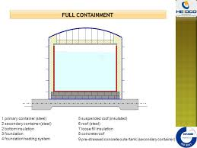
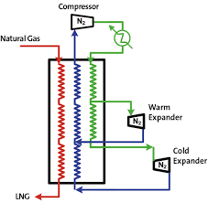



SS
CS
P IC
BOIL OFF GAS TO PIPELINE
M
C
BOIL-OFF HANDLING
ESD 50-FT VALVE
ESD TCV
T IC
LNG FROM TANK
LNG SAMPLING
SS
LNG TO TANK
CHR
CH
T IC
CS
VAPORIZED LNG TO PIPELINE
FUEL GAS
M
LNG TO VAPORIZER
LNG TO TANKER
P
P
GLYCOL/H2O
REMOTE HEAT
SS
M
CS
4. LNG VAPORIZATION
SHELL & TUBE/REMOTE HEAT
3. LNG DOUBLE CONTAINMENT STORAGE
NO BOTTOM PENETRATIONS
2. LNG PRETREATMENT & LIQUEFACTION
DOUBLE N2 EXPANDER CYCLE
FUEL GAS
M
LNG TANKER
ODORANT STORAGE
& INJECTION
LNG FACILITY PRIMARY COMPONENTS:
PIPELINE TAP, INTERCONNECT AND EGM
NATURAL GAS PRETREATMENT AND LIQUEFACTION
LNG STORAGE
LNG CUSTODY TRANSFER VAPORIZATION
LNG CUSTODY TRANSFER LIQUID SALES
LNG TRUCK SCALE
5. LNG LIQUID SALES BY
LNG WEIGHT AND LNG QUALITY
Pipeline
M&R
NG INTO LNG PLANT
1. PIPELINE METERING AND REGULATING
10

Slide 25
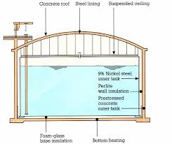
VAPOR DISPERSION PROTECTION
The regulations instruct that provisions need to be made to minimize the possibility of a flammable mixture of vapors from a design spill, from reaching a property line that can be built upon that would result in a distinct hazard.
For LNG tanks with no bottom penetrations, the design spill for calculating vapor dispersion is a 10-minute spill. Even at 100,000 dekatherms per day of flow, that is less than a 10,000 USG spill. Very manageable.

Slide 26
49 CFR 193 LNG THERMAL EXCLUSION ZONES WILL BE LIMITING FACTOR IN SITING:
The Following Zones are Defined in Siting Regulations:
1,600 Btu/hr.ft2
At a property line that can be
built upon for ignition of a process
design spill.
1,600 Btu/hr.ft2:
At the nearest point located
outside the owner’s property line that,
IS used for outdoor assembly by groups
of 50 or more persons
3,000 Btu/hr.ft2:
at the nearest point of the building or
structure outside the owner’s property
line used for occupancies
10,000 Btu/hr.ft2
A property line that can be built upon for a fire
over an impounding area.
1600 BTU/HR.FT2
For a Facility WITH LNG tanks with no Bottom Penetrations , the limiting Factor for Siting will be the Thermal Radiation Zone Created by the LNG Tank secondary Containment.
It is recommended that the Project will meet, and in some cases, exceed the Requirements.
3000 BTU/HR.FT2
10,000 BTU/HR.FT2
3,000 BTU/HR.FT2
LNG TANK
10,000 BTU/HR.FT2

Slide 27
49 CFR Part 193 and NFPA-59A SITING CONSIDERATIONS
  THERMAL RADIATION ZONE
  VAPOR DISPERSION ZONE
  FULL SEISMIC INVESTIGATION LIMIT
  100 YEAR FLOODING
  SOIL CONDITIONS
  DESIGN WIND SPEED
  OTHER SEVERE WEATHER
  ADJACENT ACTIVITIES TO THE SITE
  PROPERTY LINES AND EQUIPMENT SEPARATION
  PROXIMITY TO AIRPORTS
  LOCAL SITE ZONING

Slide 28
PRACTICAL SITING CONSIDERATIONS
  MEET OR EXCEED SITING REQUIREMENTS
  OVER SIZER SITE TO LIMIT EXCLUSION ON SITE
  SITE FACILITIES IN COMMUNITIES THAT SUPPORT

Slide 29
THERMAL EXCLUSION ZONES:
The Following are Defined:
1,600 Btu/hr.ft2
At a property line that can be
built upon for ignition of a process
design spill.
1,600 Btu/hr.ft2:
At the nearest point located
outside the owner’s property line that,
IS used for outdoor assembly by groups
of 50 or more persons
3,000 Btu/hr.ft2:
at the nearest point of the building or
structure outside the owner’s property
line used for occupancies
10,000 Btu/hr.ft2
A property line that can be built upon for a fire
over an impounding area.
LNLNGG
LNG TANK

Slide 30
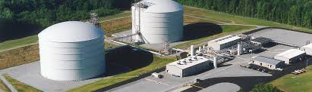
LNG Rules of Thumb
For Leak Detection: LNG is Odorless and Colorless
Boiling point: -260 Degrees F.
Expansion Ratio from Liquid to Vapor: 618 to 1
Expansion Ratio of 9,100 PSIG CNG: 618 to 1
Gallons LNG liquid per dekatherm: 12.1 Gallons
Dekatherms 10,000 Gallon LNG Trailer: 826 dekatherms
GPM LNG for 100,000 DEK/D Vapor Flow: 840 US GPM
10 Minute Design Spill at 100,000 Deks/D 8,400 US Gallons
Specific Gravity of LNG (Water = 1): .46
Specific Gravity of NG Vapor -260 F (Air = 1): 1.43
Latent Heat Vaporization Atmospheric P: 219 Btu’s / #
Specific Heat of Vapor at Atmospheric P: .52 Btu’s / # / Degree F.

Slide 31
SIMPLIFIED LNG NITROGEN GAS (N2) REFRIGERATION CYCLE
Cold Box
LNG To Tank
N2 Refrigeration Loop
PT NG inlet
N2 Turboexpander
Forced Air Cooling
N2 Refrigeration Compressor

Slide 32
THANK YOU
 | LNG FACTS
 | Detection | Odorless, Colorless
 | Hazards | Extreme Cold, Asphyxiation
 | Boiling Point at Atm Pressure | - 260 Degrees F
 | Expansion Ration Liquid to Vapor | 618 to 1
 | CNG Expansion Ratio at 10,000 PSIG | 618 to 1
 | Latent Heat of Vaporization | 219 BTU's per Pound
 | Specific Heat of gas at Atm Pressure | .52 BTU's/Pound- Degree F
 | CNG Comp Trailer @ Weight Limit | 450 MMBTU
 | LNG Trailer @ Max Weight | 833 MMBYU/10,000 USG
 | LNG Rail Car Carrier | 2,499 MMBTU/30,000 USG
 | LNG CONVERSIONS
 | 12.1 US Gallon | 1 MMBTU/1MSF
 | 1 US Gallon | 3.6 Pounds
 | 1 International Tonne | 2,200 Pounds
 | 1 International Tonne | 611 US Gallons
 | 1 Cubic Meter | 264.2 US Gallons
 | 1 US Gallon | 82,645 BTU
 | 1 US Gallon Diesel | 139,000 BTU
 | 1 US Gallon Gasoline | 126,000 BTU
 | 1 Horse power | 745 Watts
 | 1 Therm | 105.5 Megajoule
 | 1 Cubic Foot of Natural Gas | .045 Pounds

