Slide 1

Voith Turbo ™
Tech Update: EcoStart™ Engine Start
Thad Berry

Slide 2
EcoStart™
Tech Update Agenda
Introduction to Voith
  Very Brief, I swear
Concept History
Concept Design
Industry Issues and Solutions
Conclusion

Slide 3
Voith in Figures
Overview
In more than
60
19, 000
5
countries
Employees
Markets
R&D ratio
Family-owned since
Sales
$4.7 Billion
5.3 %
1867
As of: 2016/17

Slide 4
Four Divisions
A Well-Positioned Company
Voith Holding
Voith Paper
Manufacturer of paper machines and
components
Voith Hydro
Manufacturer and EPC
of hydro power plants
and equipment
Voith Digital Ventures
Solutions for the
industrial internet of
things: networking and digitalization
Voith Turbo
Manufacturer of intelligent power transmission machinery and products

Slide 5
EcoStart™
Concept History
Mar. 2015 - Voith begins discussion regarding hydraulic start systems based on feedback from industry contacts, concept is submitted to our Innovation Pipeline
Nov. 2015 - Voith Turbo R&D team explore feasibility and approval is given to proceed with development as all components can be developed internally by Voith
May 2016 - Approval for prototype testing achieved
Nov 2016 – Testing of prototype begins, launch customer identified
June 2017 – Launch customer begins procurement process for 1K HP Skid
November 2017 – Second customer Issues PO for redundant 4K HP Skid
December 2018 – FAT for EcoStart Skids Completed
April 2019 – Ecostart Commissioning Completed
Jan 2020 – Final Sign Off Completed

Slide 6
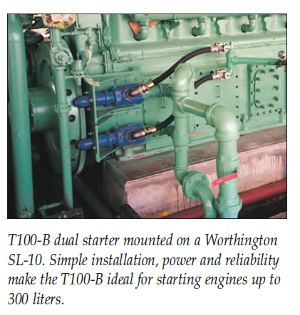
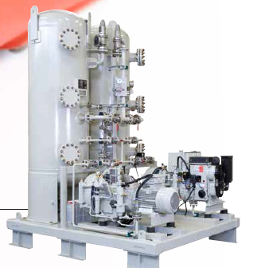
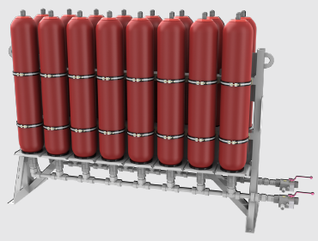
EcoStart™
Concept History: Competitive Landscape
Improved performance compared to competitor technology:
Gas starter systems – Vented Emissions, Safety
Air starter systems – Vastly smaller footprint, O&M
Electric starter systems – Impractical for large recips
Hydraulic starter systems – No comparable designs at present
Notes:
air: either air2head or same technology as gas starters

Slide 7
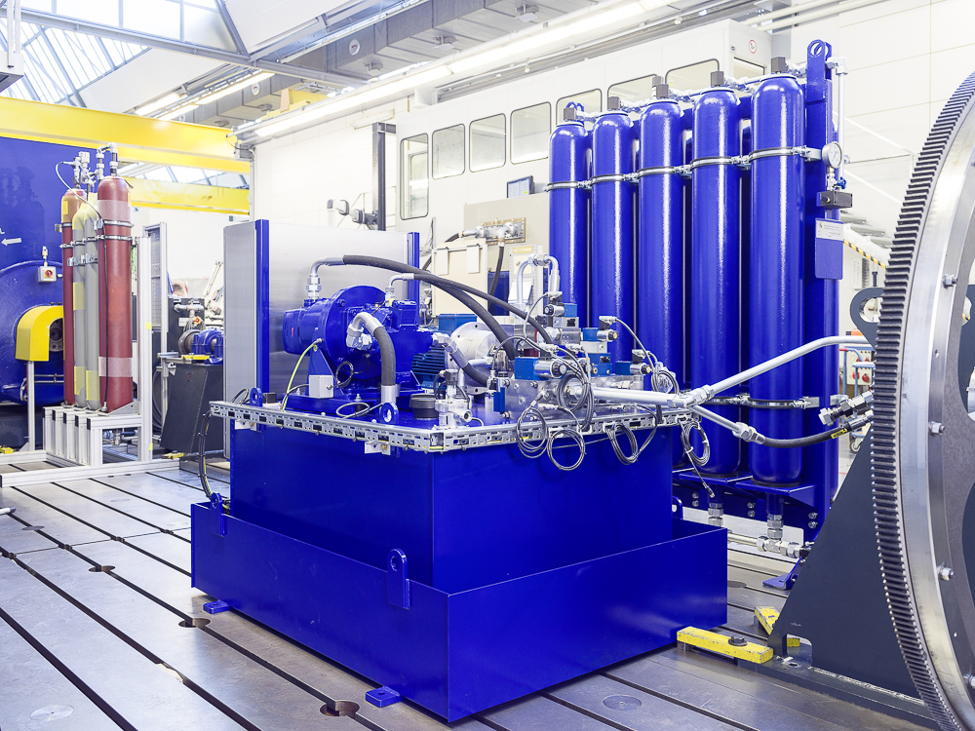
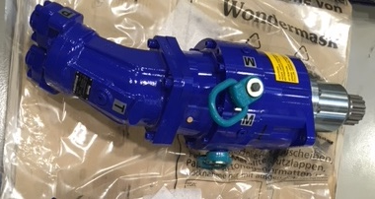
EcoStart™
Hydraulic Start System for Recip Engines 1000 – 9000 HP
System Design
Single Skid can tie into multiple engines
Hydraulic Accumulator and Nitrogen bottle pairs provide stored start energy
Starter Engagement Motors use existing ring gear and mounting points
Integrated Control System
Indoor / Outdoor (ExProof/ NonEx)
Simplex or Redundant Pump Motor Units

Slide 8
EcoStart™
Issue No. 1: Emissions
Increasingly stringent regulatory environment impacting all segments of Midstream Industry
  Gas Start Systems largest source of vented emissions
Commodity prices incentivize minimal product loss
  What are lost product costs for each engine start attempt
  Can ROI be quantified
Electrical Consumption and Carbon Offsets
  Will we impact the local grid conditions, especially at remote sites
Noise pollution
  Start attempts can produce >120 decibels

Slide 9
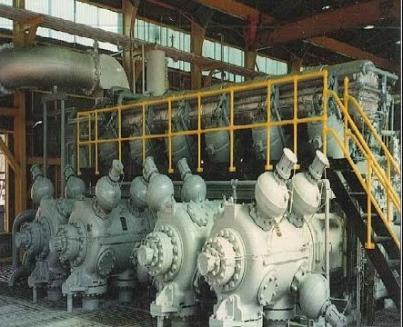
EcoStart™
Solution: Emissions and Costs
All Hydraulic Start system eliminates vented emissions during start up
No Product Loss during start attempts
10 – 15 HP Motors for EcoStart Pump require 15 – 30 Amps (up to 50 if redundant)
  Should not overload available power supplies
  No supporting infrastructure for grid tie in required
  Auxiliary drives reduces other consumers
  Pump motor not always active
Less than 85 decibels at three feet at all phases

Slide 10
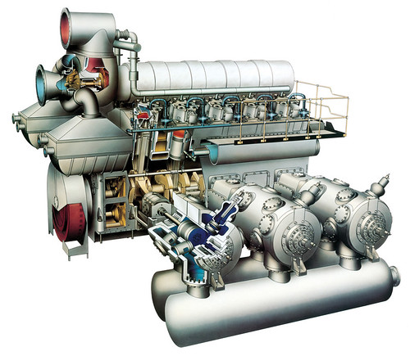
EcoStart™
Solution: Emissions
Turbo Assist: Drive turbos for 30 minutes after Start
Pre / Post Lube Drive: Drive Pre and Post Lube Pumps from EcoStart skid

Slide 11
EcoStart™
Issue No. 2: Start Reliability
Gas Starters allow multiple start attempts
Air Start technologies have several considerations that can be addressed
  Limited Start Attempts
  Recharge Times
Reduce potential penalties for missed start calls
  What are grid conditions at remote sites
  Can we reduce electrical power consumption during start cycles

Slide 12
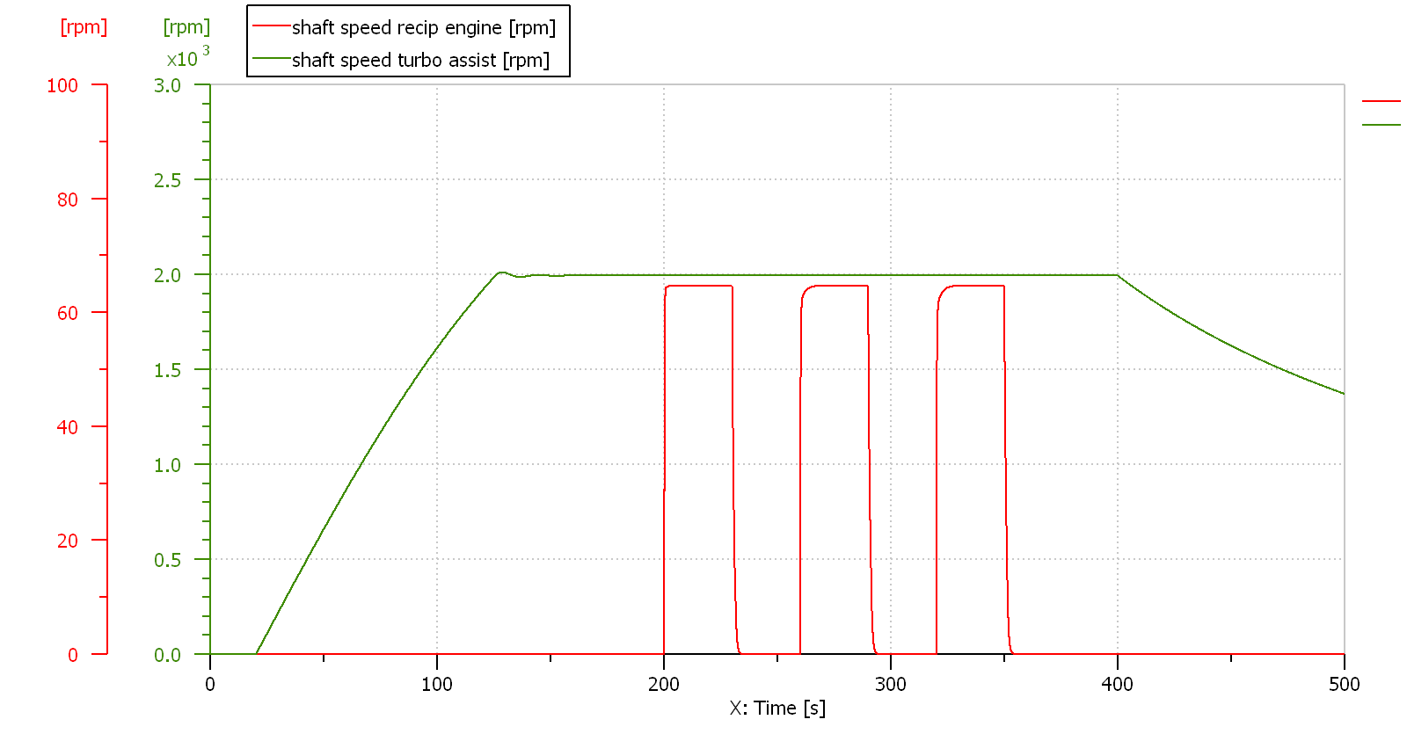
EcoStart™
Volumetric Flow
30 s startup Recip
30 s startup Recip
30 s startup Recip
100 s startup Turbo Assist

Slide 13
EcoStart™
Solution: Start Reliability
Original Concept called for 3 x 30 Second Start Attempts per charge
  Accumulator bank determines starting capability
  System Recharge time varies, but less than 15 minutes from min to full prime
Black Start capability as hydraulic charge is stored
Multiple skids at site can be interconnected (theoretically)
Starter Engagement Motor Design

Slide 14
EcoStart™
Issue No. 3: Safety
Greatest number of safety incidents occur during maintenance turns
  Pneumatic jacking system most common means of turning driveshaft
    Potential for back drive hazardous to personnel
    Unintended motor start possible
Can alternative systems be built to meet site requirements
  New technology acceptable to site personnel
  Area Classification

Slide 15
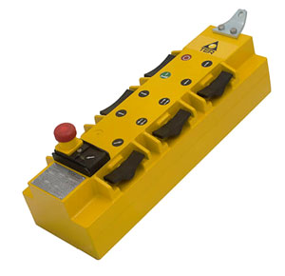
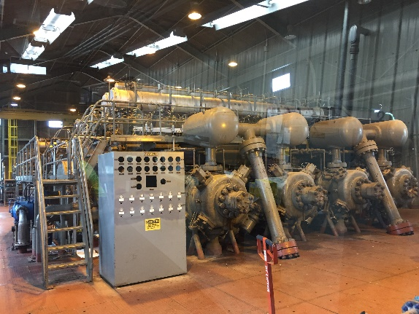
EcoStart™
Solution: Safety
EcoStart uses precision control of hydraulic output to allow slow roll for maintenance turns
  1 ½ RPM for 4000 HP system
  6 RPM for 1000 HP system
Maintenance function can be controlled by Engine Control Panel or remote control pendant
One direction of rotation only
No specialized training required

Slide 16
EcoStart™
Issue No. 4: O&M and Service Support
Gas Start Systems very simple and low O&M requirements
Air Start relatively simple, but design varies
  Pneumatic piping
  Head wear with Air to Start systems
Is local support and parts availability an issue
Current Starter Engagement Motor options
  Some legacy models difficult to maintain
  TBO varies between make and model
  Ring Gear wear

Slide 17
EcoStart™
Solution: O&M and Service Support
We use 1” to 1 ½” inch piping hydraulic piping, 2 “ for drain
Hydraulic accumulators require annual nitrogen charging
Service Reps based in nationwide locations
24/7 parts availability integral part of Service Plan
  EcoStart assembled in the US
  Most components are COTS, Controls platform is Allen Bradley
Starter Motors designed for many starts
  Over 2000 starts on Test Stand, no internal wear
  Soft engagement greatly reduces ring gear wear

Slide 18
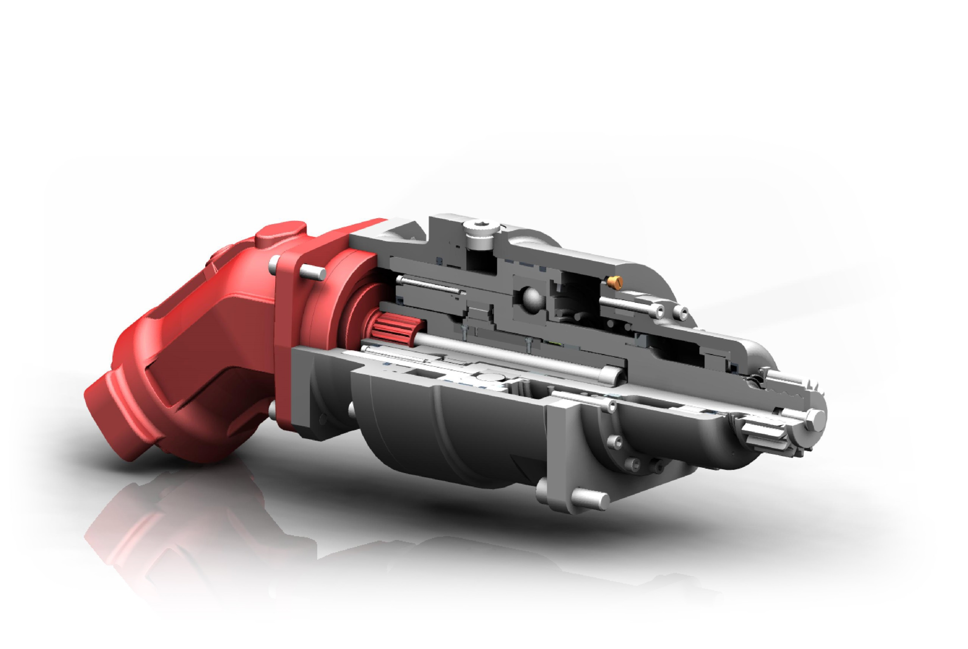
Starter Engagement Motor
Designed to Fit in Existing Motor Mount
Engagement
Pressure Connection
One-way Clutch
Disengagement Spring
Hydraulic Motor
Engagement Spring
Pinion

Slide 19
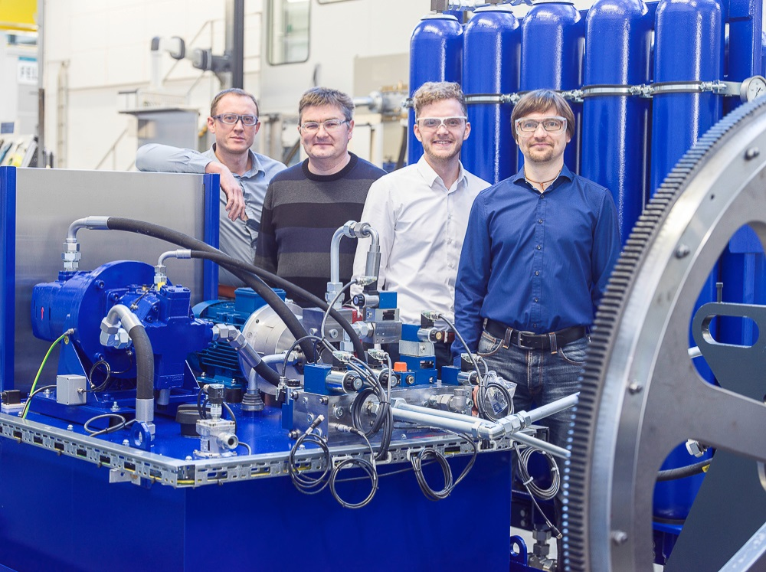
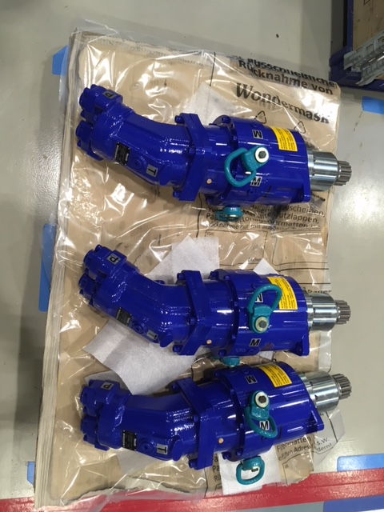
EcoStart™
1000 HP Skid After FAT
Key Facts:
Size - 95" x 67" x 91"
Weight - 5,000 lbs
5 x Hydraulic Accumulator and Nitrogen bottle pairs

Slide 20
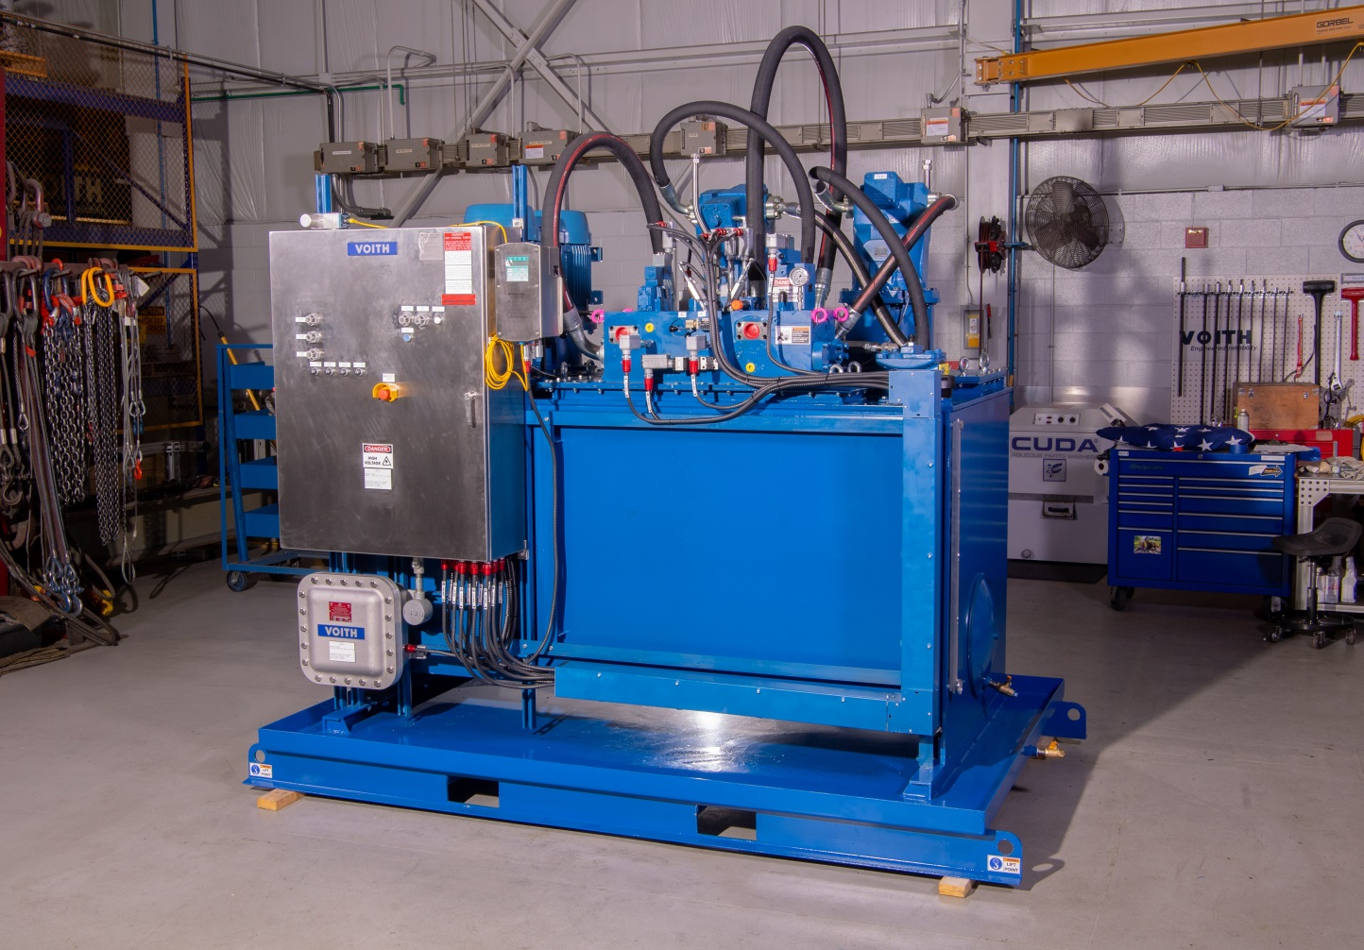
EcoStart™
4000 HP Skid After FAT
Key Facts:
Size - 120" x 96" x 100"
Weight - 8,000 lbs
25 x Hydraulic Accumulator and Nitrogen bottle pairs (20 for production units)
Assembled in US
Service Group based out of US facilities

Slide 21
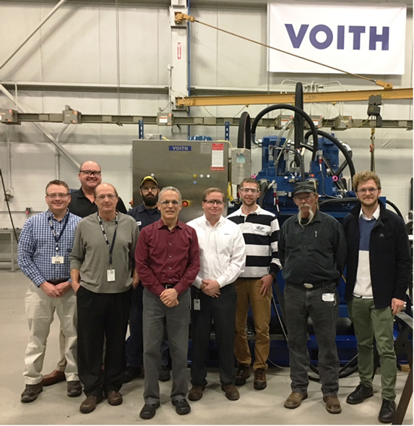
EcoStart™
Conclusion
Current Status:
Over 120 engine starts
  4 missed starts, not due to Voith
Ongoing incorporation of field/ design notes
Standardized Design finalization by Mar 20
Assembly moved to US
Service Plan development in final stage

Slide 22
Thank you!
Thad Berry
Sales Account Manager - Oil & Gas
Voith Turbo Inc
Cell 832-350-2664
thad.berry@voith.com
www.usa.voithturbo.com

