Slide 1

Cybersecurity for
Non-Cyber Professionals
North Texas Mensa Regional Gathering
November 24, 2017
Ray Tye
3 Forks Consulting
3ForksConsulting.com
For best viewing, run this presentation in PowerPoint Slide Show. Each slide will load with animations; just wait a few seconds to allow animation to end, then hit the enter key or mouse click move to the next slide and the backspace or delete key to go back.
We hope you find this presentation of value. We welcome comments and feedback at RayTye@3ForksConsulting.com

Slide 2
We Hold More Computing Power In One Hand…
Than all of the computers combined that put men on the moon…
We can access more information than ever…
And the combined knowledge of the recorded history of the world…
And what do we do with it?

Slide 3





We discuss Important social issues… such as best dressed… and worst dressed…

Slide 4
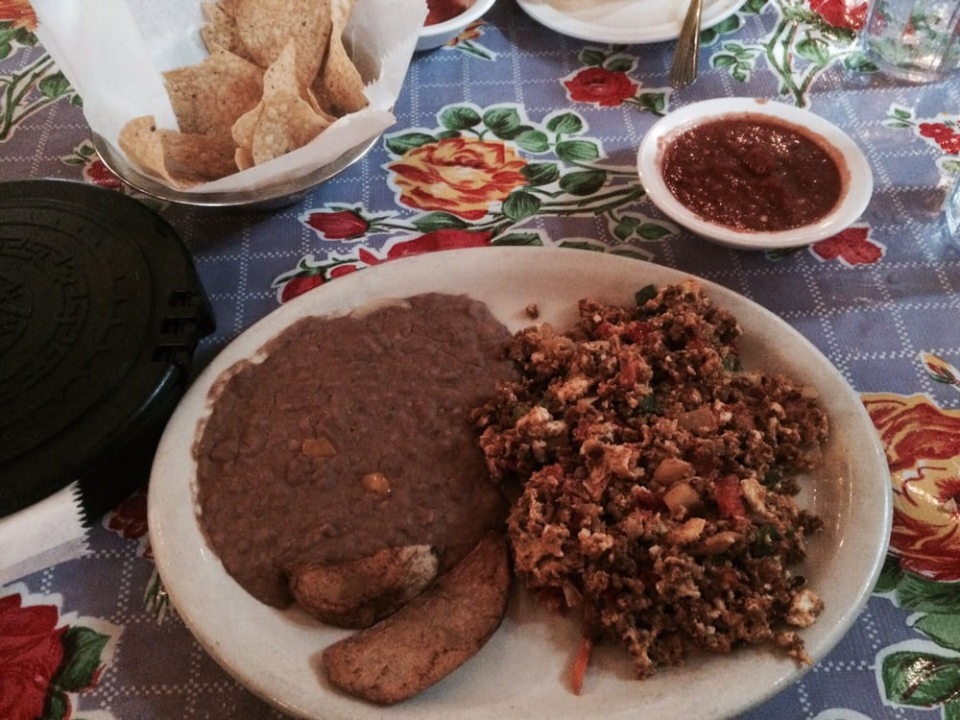
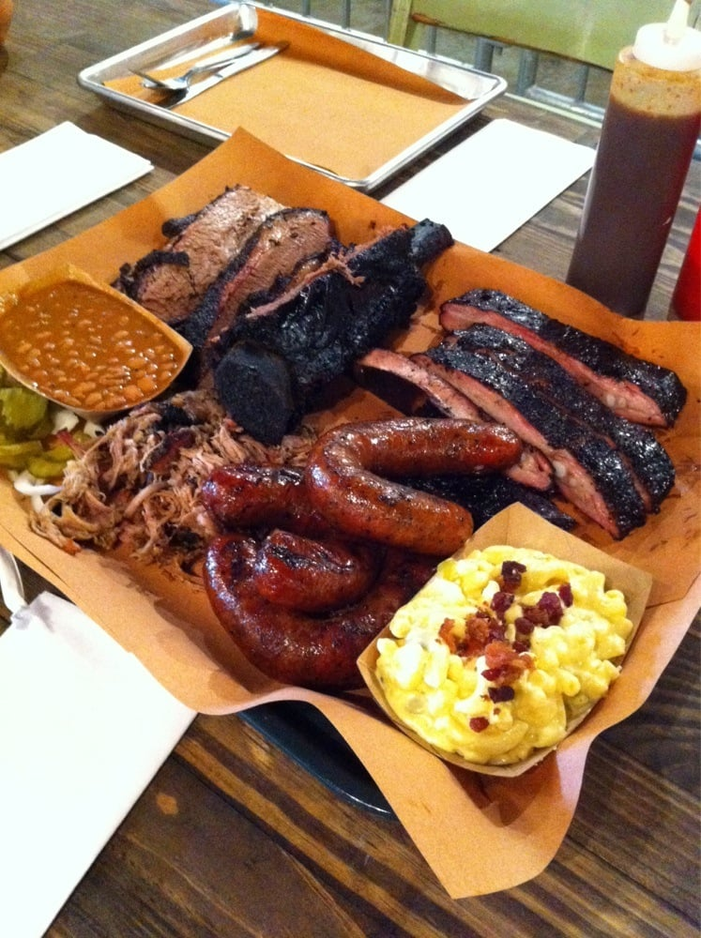
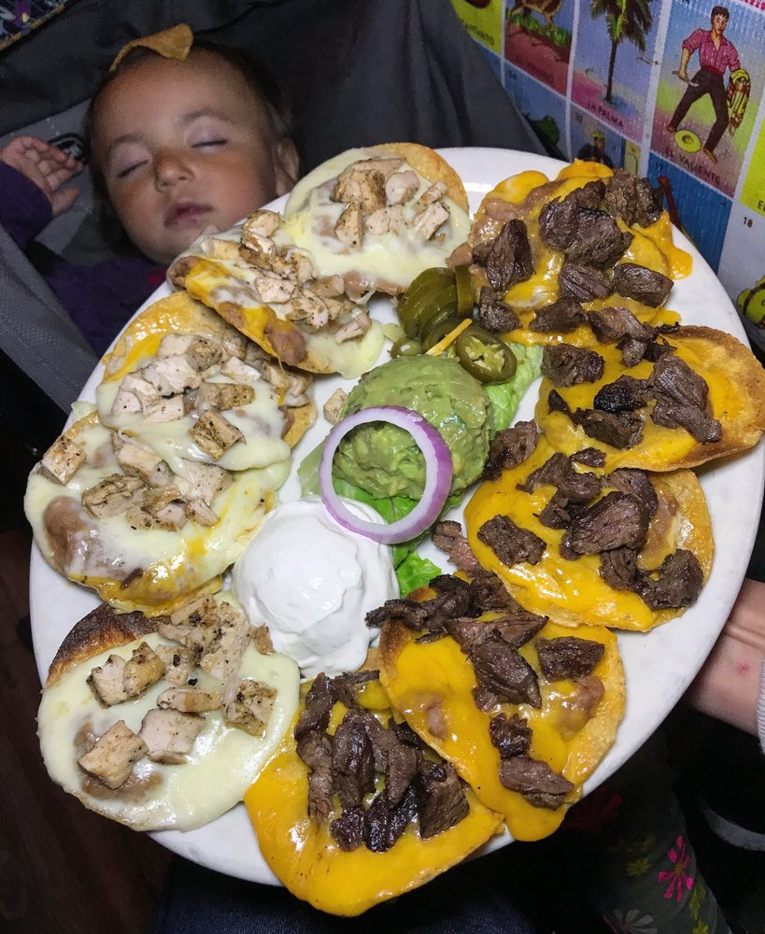
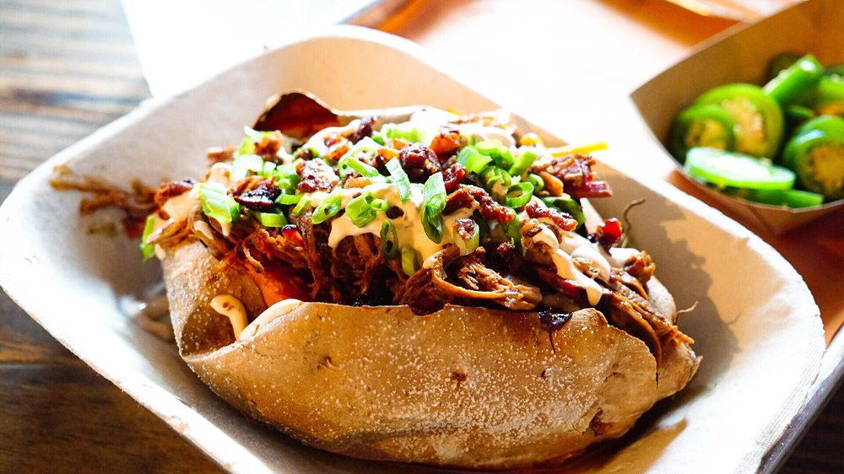
…and important health & nutritional issues…
Since this is Dallas, that’s
who has the best BBQ and Tex-Mex

Slide 5
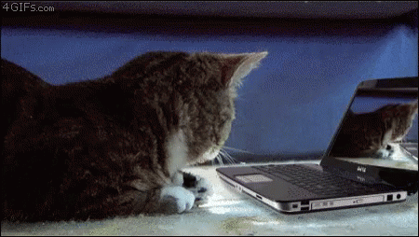
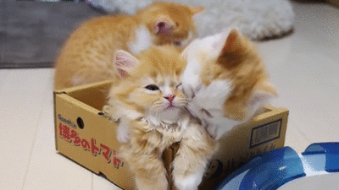
…and, of course…

Slide 6
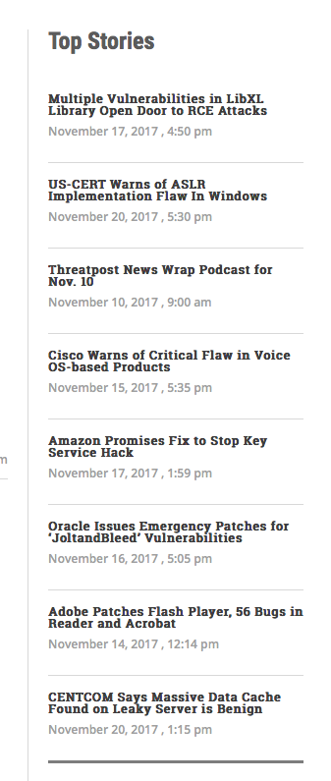
In the News
Remember this one…

Slide 7
Today’s Discussion
We’ll talk about cybersecurity…
Common vulnerabilities & threats
Personal cybersecurity management
…within your personal space:
The Internet of Things
Network security
Computer security
Mobile security
We won’t talk about…
The audit trail required for configuring a Federally-certified secure server
How to program for elliptic curve cryptography
Technical details on how to perform network and large-scale attacks, e.g. SQL Injection, DDoS, Man-in-the-Middle
Anything else that’s very technical
Any products mentioned are only for examples, not recommendations

Slide 8
Basic Definitions for Today
Authentication – The process of identifying an individual, usually based on a username and password; you are who you say you are
Authorization – Gives individuals access based on their identity
Two Factor Authentication – Pick 2 of the 3
  Something you are: your fingerprint, iris, or facial recognition
  Something you have: a chip in your USB drive, smart card or credit card
  Something you know: your username, password, pin, mother’s maiden name or dog’s DOB (note that any two of these is still only a single factor)
  Many applications now provide two-factor authentication: you log on to a site; they send you a 4-8 digit verification code; you must then use that code to complete the log-in, usually within a limited time

Slide 9
Older Cyber Threats in General
Intent
  Mischief
  Information destruction
Attack focus
  Broad, generic (e.g., email-based worms)
Attack vector
  Network and operating system weaknesses (hacker targets)
  Transmitted by just a few methods (mainly email and network services)

Slide 10
Current Cyber Threat Trends
Intent
  Information capture
  Financial gain
Attack focus
  More targeted attacks
Attack vector
  Applications and human weaknesses
  Transmitted in many ways
Increasing risk especially for all mobile devices
  Political gain
  Embarrass an organization or person

Slide 11
Common Attacks on Individuals
But remember, “An attack on me is also an attack on my home, my family, my friends and my organization…”

Slide 12
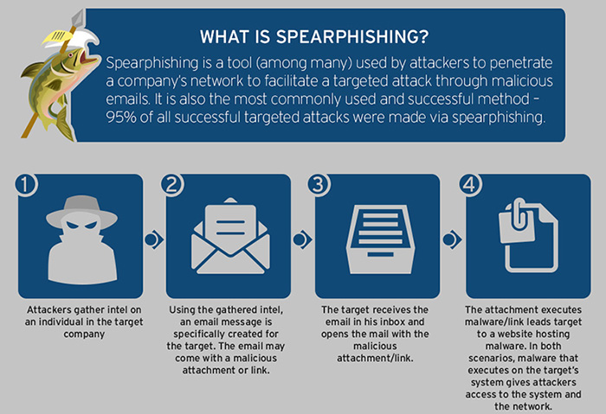
Phishing: Social engineering techniques to steal confidential information, usually username(s), passwords, financial account details and or other credentials.
Whaling: A spearfishing attack targeting specific executives

Slide 13
Protection: Phishing & Social Engineering
Be aware!
Do not respond to requests for information via phone or e-mail
  “This is Microsoft Services. We’ve detected a ransomware attack on your computer, and you need to give us immediate access to fix it!”
  Never open or download a file from an unsolicited email, even from someone you know
  If you get a request, call the person to confirm that it actually came from them
  Your bank, your veterinarian, the IRS, etc. will NEVER call you for this info!
Keep your operating system & applications, especially plug-ins, updated
Use a robust security program
Enable two factor authentication whenever available
Confirm the authenticity of a website prior to entering login credentials by looking for a reputable security trust mark
Look for HTTPS in the address bar when you enter any sensitive personal information on a website to make sure your data will be encrypted

Slide 14
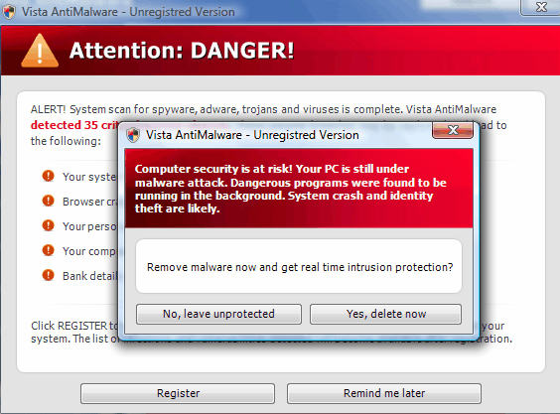
Protection: Rogue Software or “Scareware”
Masquerades as legitimate and necessary security software, that will keep your system safe
Pop-up windows and alerts look legitimate. Warn that you are at immediate risk and to download security software
Clicking either “yes” or “no,” downloads the rogue software to your computer!
Protect by
  Do not click, just close the window
  Use a good firewall keep it updated, and use a good security program

Slide 15
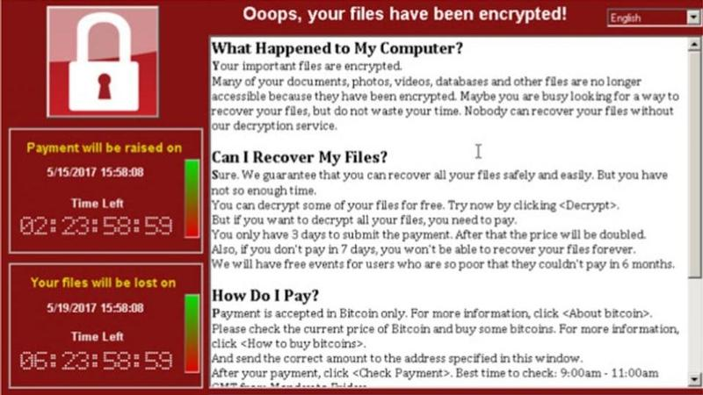

Slide 16
“Help! My Computer’s Been Taken Hostage!!”
Typically a "Trojan horse" attack: infection is secretly triggered when you open an unexpected e-mail attachment, visit a malicious website or install rogue software downloaded from the Internet
Ransomware blocks user access to data and demands payment to restore access
Once infected, the victim often has no choice but to pay the "ransom"
Initially affected only Windows computers, but has spread to Android devices and even Macs

Slide 17
Two Types of Ransomware
Locker Ransomware
  Originated in Russia around 2010, spread to the West within 2 years
  Freezes the user interface; keyboard and mouse inputs will not work
  Screen will display a banner informing you that the computer has been "locked" or "seized," often by the FBI or another law-enforcement agency
Crypto Ransomware
  First appeared in 1989, widely distributed versions appeared around 2005
  The current wave of crypto ransomware uses very strong encryption; user can still access other files, but the ransomed files are encrypted
  Latest attacks initially appeared in Russia in 2012, with wider distribution in late 2013
  Runs in the background searching your hard drive for common file types such as images, documents, and financial files;
  Then encrypts those files with a very strong key;
  Then presents a ransom note.

Slide 18
Paying the Ransom
In North America, ransom demand is usually between $250 - $1,000 for individuals and small businesses
On the screen or in a message, Bad Guys send details on how and where to send payments – usually in the form of Bitcoin
May give deadlines for paying the ransom, accompanied by a threat of deleting files at regular intervals (typically every 30 minutes).
After payment, the victim will be sent a numerical key to unlock the screen or encrypted files, or a serial key for activating a decryption program found on the scammer's website.
Payment is almost always honored: the Bad Guys have a reputation to maintain; they depend on victims trusting that they're good for their word to unlock the computer

Slide 19
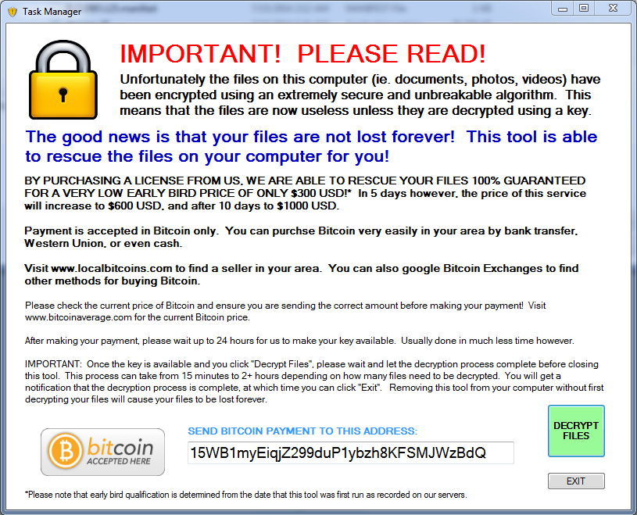
Protection: Ransomware
Keep your operating system updated
Keep your other software fully updated
Use a robust, self-updating antivirus software
No security software or firewalls can stop you from opening email attachments or clicking on links

Slide 20
Mobile Security

Slide 21
Mobile Discussion Framework
“Mobile devices” for our discussion includes any device that can wirelessly connect to a network.
Topic Areas:
Mobile Devices, Then and Now
Mobile Device Security Overview
General Security Recommendations
Bluetooth Security Recommendations

Slide 22
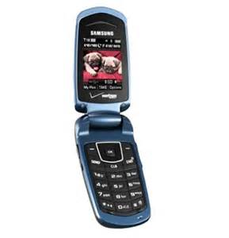
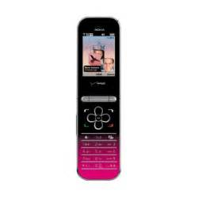
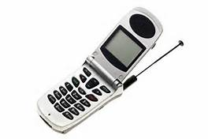
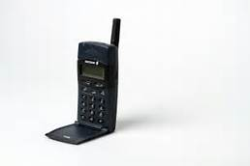
The Good Ol’ Days of Flip Phones
Primitive Internet capabilities
  Simple text messaging
  Limited web browser (text-based)
  Only use cell phone network
  Usually no sensitive data stored on phones
Few threats against these phones
  Primary threat is someone stealing phone and selling it or making calls from it
  Malware to attack these phones exists but is not commonly encountered

Slide 23
Mobile Devices Then…
Ten years ago…
  Mostly laptop computers issued by organizations to their employees
  Dial-up, some ISDN
Five years ago…
  A mix of organization-issued and personally-owned laptop computers
  Broadband
Today…
  BYOD (Bring Your Own Device) … to work, school, home, vacation, Starbucks… happens even if the employer/organization says not to
  Source of significant security issues!

Slide 24
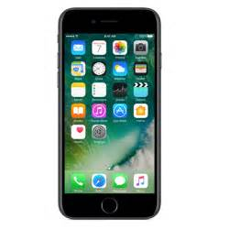

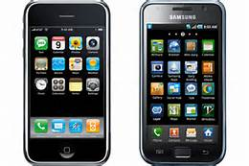
Smart Phones
Have reached PC technology capabilities
  Wide range of sophisticated client applications (email, social networking, shopping, online ordering, interactive gaming, etc.)
  Robust web browsers
  Use additional networking technologies, including Wi-Fi and Bluetooth
  Passwords and other sensitive data often stored on phones
Threats against smart phones increasing
  Phone theft and sale/use still a major threat
  Threats becoming more similar to PC threats

Slide 25
Mobile Devices Today… Are Everywhere
TVs
Fitness Monitors
Digital Cameras
Medical Equipment
Laptops
Alexa
Siri
Cellphones
Motorcycles
Tablets
Wireless Router
Cars
Game
Systems
Baby Monitors
The Internet
Audio / Music
Kitchen Appliances
E-Book Readers
Home Security Systems

Slide 26
Mobile Software Updates
For all devices
  Configure software to update itself automatically
  Perform manual updates for any major applications without automated update features; may need to regularly connect device to your computer
  Most important software to keep updated:
    Operating system
    Applications, especially apps that receive data from the Internet: Web browsers, email clients, instant messaging clients, etc.
    Security software (e.g., antivirus software, antispyware software, personal firewalls)

Slide 27
Mobile Networking Configuration
Reduce your network footprint
  Helps to prevent others from misusing your phone
  Saves battery power
Disable networking features you rarely or never use (Wi-Fi, Bluetooth)
Configure mobile devices not to join any detected wireless network automatically
Enable networking only when you need it and disable it when done
Use mobile security software

Slide 28
Mobile Application Configuration (cont.)
Be wary of applications from unknown, untrusted sources and high-threat applications, especially for children & teenagers
  Peer-to-peer software, file sharing programs, Voice over IP software, social networking web sites
Be cautious of storing passwords in applications
  May allow malware or people to steal passwords or to impersonate you
Use application security capabilities when available
Some applications allow users to set passwords/PINs just to access those applications

Slide 29
User Accounts & Sessions
Require authentication to use the phone
  Always lock the device before leaving it unattended around people who shouldn’t have access to it
  Manually lock or set lock timeout (the shorter timeout, the better!)
  Use password, PIN or screen design that is hard for someone else to guess but easy for you to remember and enter
If device is lost, or too many consecutive failed attempts
  May cause the phone to deactivate itself or wipe out all data
  ”Mom, your phone doesn’t work anymore!” (AKA, beware of kids picking up your phone!)
  You can locate it or wipe it remotely
Change passwords or PINs occasionally

Slide 30
Bluetooth Security Recommendations
Shut off Bluetooth whenever it is not needed
  Reduces your exposure
  Saves energy
Only place a device in discoverable mode when necessary (generally, for device pairing)
Perform Bluetooth device pairing securely
  As infrequently as possible
  In an area where others cannot observe key entry and eavesdrop on pairing
Avoid transmitting sensitive data over Bluetooth when within physical range of possible attackers

Slide 31
Some Smartphone Encryption Apps
Apple and Android come with built-in encryption as part of your passcode set up
There are a number of very good smartphone encryption apps on the market
Support functionality includes
  Secure Voice & Messaging
  Full device functionality/encryption
  File transfer
  Video Calling
  Conference calling for multiple callers
  Other encryption providers:
  Signal https://www.signal.org
  Silent Circle https://www.silentcircle.com
  CryptoCat https://crypto.cat (chat)
  For the latest info, head to the Electronic Frontier Foundation, www.EFF.org Secure Messaging Scorecard

Slide 32
General Cyber Protection

Slide 33
Protection: Home Network
Routers provided by your Internet provider
  Most routers are still shipped and installed as
    Username: admin
    Password: password
  Most new high-speed routers provided by your cable company are very good
  Generally have fewer security features
  Generally range is more limited
Your own router allows you to configure and control access to your network and firewall
  Allows multiple devices without suffering from buffering or lag
  Allows 2.4 & 5GHz band specifications for different devices
Many now allow you to add a single or multiple “guest networks”
  Allows your guests to have Wi-Fi access
  Controls access to the rest of your network, including all of your other devices
  Remember, once you give a guest access to your network, they have access to everything on your network – so if they’re infected, so are you
Check that yours isn’t!

Slide 34
Integrated Security Software Packages Today
Anti-virus & Threat Protection
  Viruses, spyware, malware, ransomware, phishing, trojan horses & other online threats
  Checks that e-mails & links actually come from trusted sources
VPN
Automatic, real-time updates are pushed to you as soon as they are available
Manage everything from a single portal
Multi-user, multi-platform protection
Compatible with PCs, Macs, Andriods & iOS Smartphones & Tablets
Password management
Parental controls
Social media privacy
Automatic Cloud backups
Maintains security events logs

Slide 35
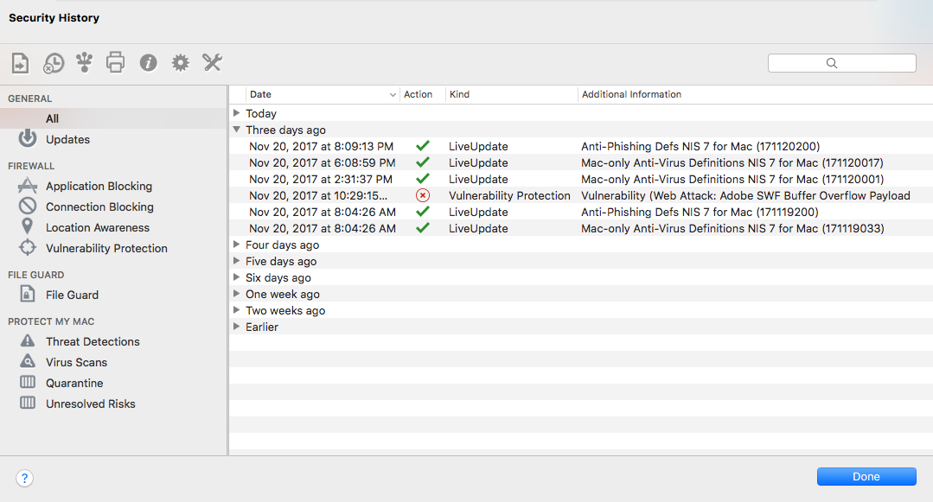
Remember this one…?

Slide 36
Protection: Passwords
If you can password protect it, do it!
Use strong passwords -- mix of upper & lowercase letters, numbers, and special characters, minimum of 8-12 characters
Do not use words that can be found in the dictionary
Creative words and passphrases: 3at@$mithz for EatAtSmiths
Don’t share your passwords
Consider using a password manager
  Create your own passwords, or generate strong passwords
  Safely encrypts and stores your passwords

Slide 37
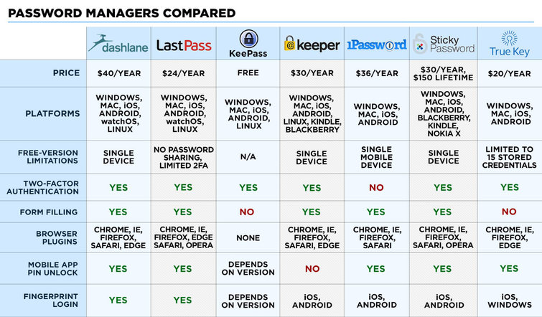
Password Managers
Source: tomsguide.com

Slide 38
Protecting Personally Identifiable Information (PII)
PII is not simply sensitive information about you, it is information that can be combined with other information and used to identify and attack you
Use physical security controls for mobile devices and removable media
Set device passwords or PINs
Encrypt files stored on mobile devices and removable media
Destroy information when it is no longer needed
Erase information from missing cell phones and other mobile devices
Don’t just “hit delete,” securely erase files from old devices

Slide 39
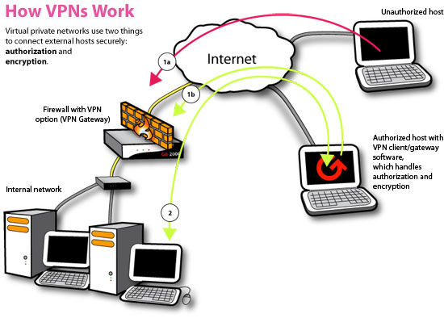
VPN
Virtual Private Network - A network used on another network
Used to connect computer-to-network or network-to-network
Can be created with hardware, software or in combination
Employs both authorization and usually also encrypts data; not required but recommended

Slide 40
Example: Attempt On Me This Week

Slide 41
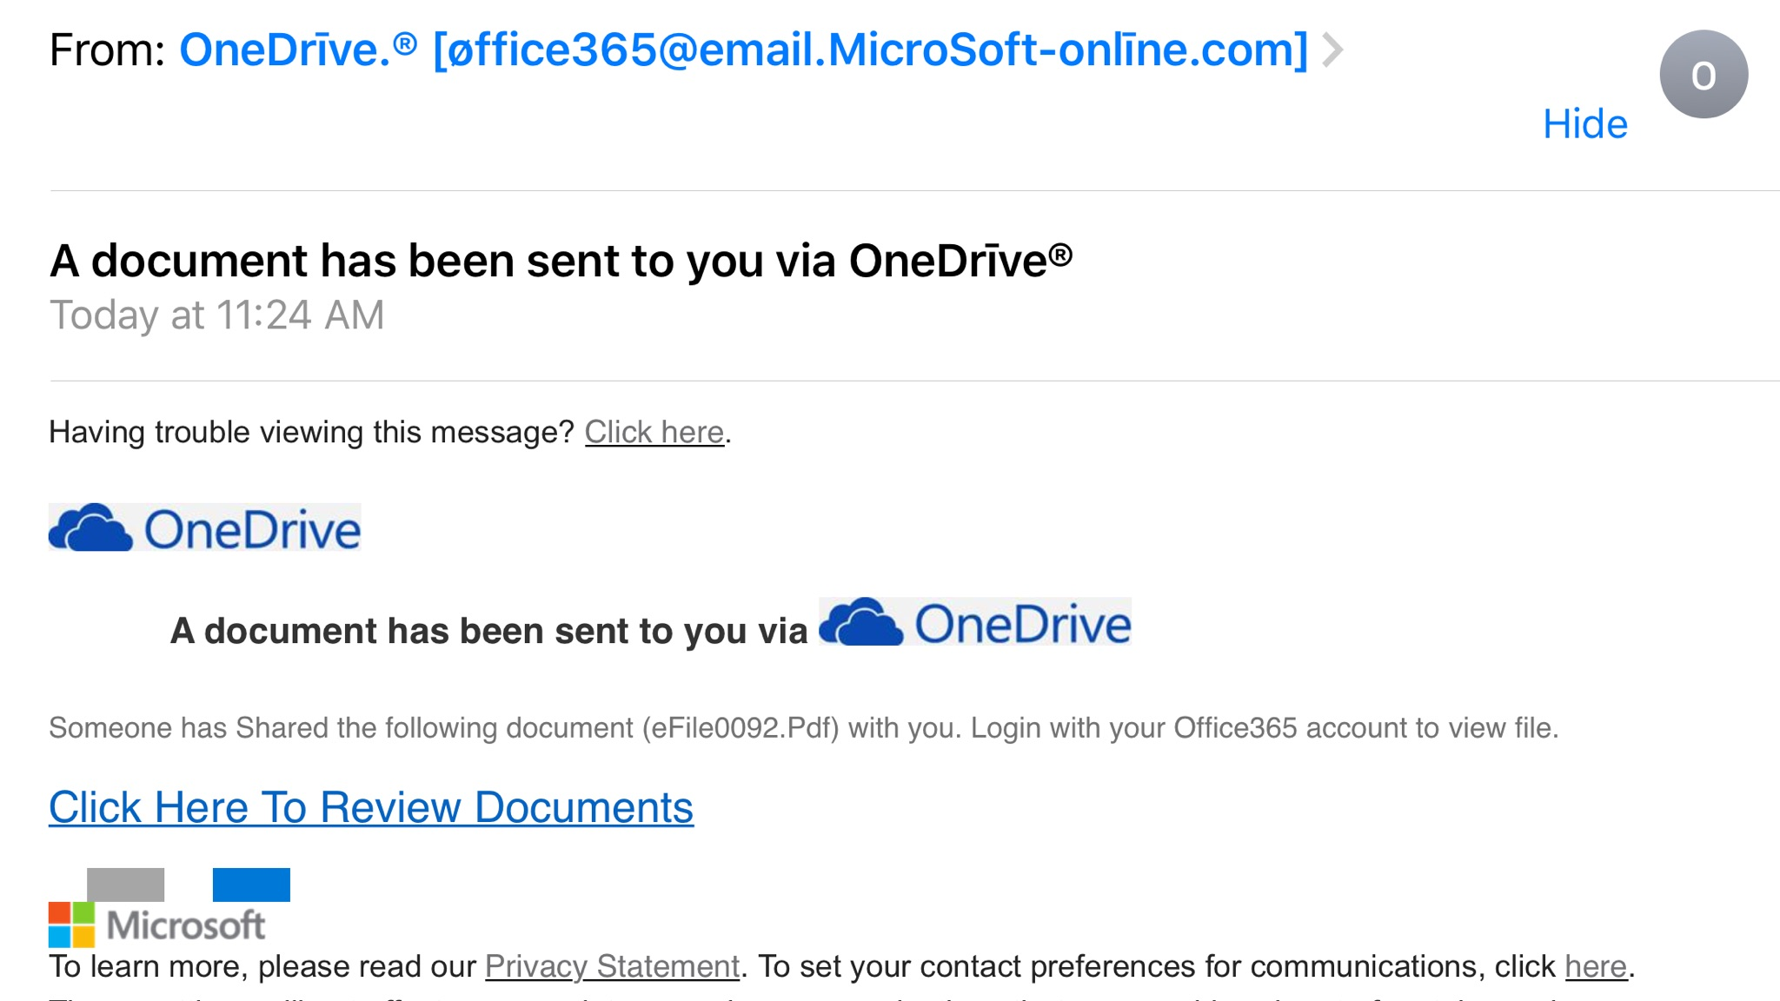
Phishing for Ray
Received on
Monday 11/20/2017…

Slide 42
Why They Missed…
HIDE
HOVER

Slide 43
Recap
General Security Guidelines

Slide 44
General Security Guidelines
The best ways to avoid any kind of attacks or infections are to
  Keep your operating system fully updated and patched
  Keep your other software fully updated and patched
  Use a robust, integrated, and multi-platform security software package
Remember
  Firewalls don't always protect against infiltration
  No software can stop you from opening email attachments or clicking on links
Don’t get caught limping around the waterhole with the predators
  People who don't patch their systems and don't run antivirus software get infected first
  Most attacks and infections are recognized and blocked by antivirus programs, and most exploit software vulnerabilities that were fixed long ago

Slide 45
General Security Guidelines (cont-1)
Social Engineering Awareness
  It’s not just OK, it’s GOOD to be skeptical!
  “If it sounds too good to be true…”
If possible, set all devices to automatically update and install software daily
Change all of your passwords regularly – set calendar reminders
Run full system security scans at least once a week
Prepare yourself and your organization by taking the time to secure and backup your systems
Make your personal cybersecurity a priority

Slide 46
General Security Guidelines (cont-2)
Fingerprint touch ID is very cool
  Understand that if you use it and are arrested, the police can force you to use your fingerprint to unlock your phone
  Once it’s unlocked, everything on your phone is subject to a legal search and seizure
  Expect that facial recognition will go the same way, when it gets to court
To automatically update your OS, and many applications
  In Windows, go to Windows Update in the Control Panel, or Update & Security in the Settings menu, and make sure that updates are set to install automatically
  On a Mac, go to Settings, then App Store, and make sure "Automatically check for updates" and "Install system data files and security updates" are checked

Slide 47
Save Yourself!
If you haven’t been infected yet, you will be…
Backup your data!!
  Preferably at least every 24 hours, hourly when you’re working
  Both Windows and Mac have automatic backup settings
Backup Options
  External hard drive
    Easy to set up and use
    Doesn’t require a network connection
    Can be stolen or lost
    It WILL eventually fail
  In the Cloud
    Easy to set up and use
    Requires a network connection for backup, but you can still work offline
    Cannot be stolen, lost and WILL NOT eventually fail
    Very low chance of data being lost or hacked
Cloud Storage
OneDrive (Windows product that works for Apple)
iCloud (Apple product that works for Windows)
Both of the following have end-to-end (data-in-transit)and in-storage (data-at-rest) encryption
SpiderOak
Carbonite

Slide 48
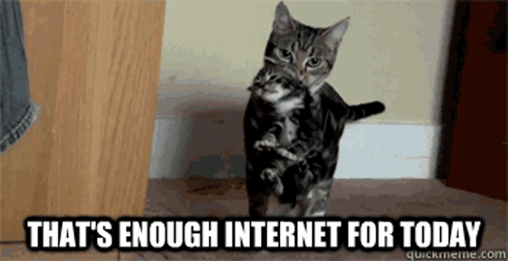

Slide 49
Speaker Bio: Ray Tye
Ray Tye is the president of 3 Forks Consulting, a boutique strategy and management consulting firm based in Dallas. He brings over 30 years of progressive leadership experience in leadership development, strategy development, organizational planning and operations, IT integration and cybersecurity, and business development.
Ray works with organizations and individuals on creating a compelling strategy, building a clearly-defined identity and captivating company culture, and developing the leadership and management teams that makes it all work.
Ray’s career has overlapped the private sector and federal government. In the private sector, executive leadership positions have ranged from Fortune 100 companies to start-ups. Federal government service has included positions as an employee and as a contractor supporting Executive, Department of Defense, and Intelligence agencies.
Ray is a retired Marine, with over 20 years of service. He holds a Bachelor’s degree in Business Administration from the University of Texas at Austin Business Honors Program, and a Master’s degree in Business Administration from Texas State University.

Slide 50

Thank You!
Ray Tye
703-624-1995
www.3ForksConsulting.com
raytye@3ForksConsulting.com
Twitter: @3ForksConsults
and @raytye
If you would like a copy of today’s presentation, please e-mail me or download from 3ForksConsulting.com…
and I promise
Special thanks to Karen (Kent) Scarfone @kscarfone for her inputs on mobile security. Karen is the Cybersecurity Writer for Scarfone Cybersecurity in Clifton, Virginia. She provides security writing and editing services to media outlets, Federal agencies, and other organizations.

