Slide 1

Don’t Get Scammed!
SCAM
SCAM
SCAM
SCAM
SCAM
SCAM
SCAM
Red Flags to Look For

Slide 2

Fraudsters play off human error and rely on convincing you to believe that something made up is actually true.
Several red flags and recurring patterns are common to most fraudulent schemes. Being vigilant about these indicators can help you spot and avoid scams.

Slide 3
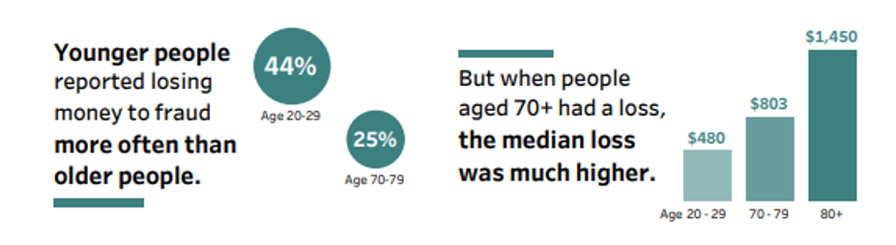
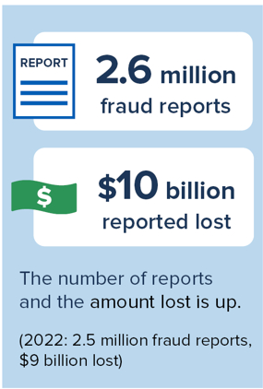
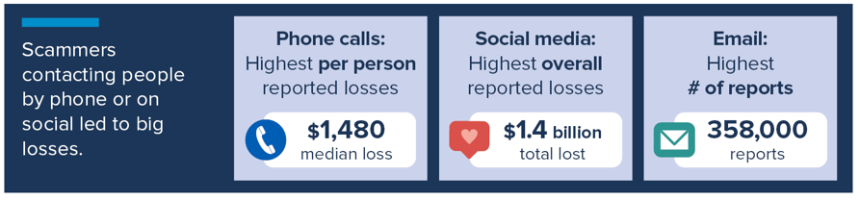
Some interesting statistics:

Slide 4
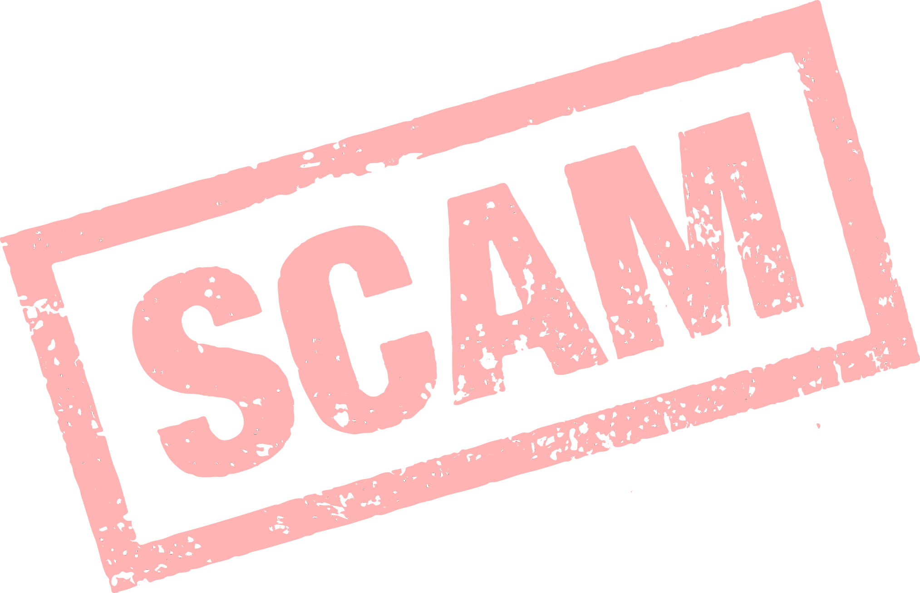
1. Authority
Online scammers often allege that they are reaching out on behalf of well-known businesses, brands, or organizations that you recognize and trust.
It's crucial to maintain a healthy skepticism toward individuals who contact you under the guise of representing these entities, particularly if they claim to be from the Social Security Administration, or the Internal Revenue Service.

Slide 5

2. A Sense of Urgency
Fraudsters’ claims often wilt under sustained scrutiny, which means that it’s in their best interests to pressure you into taking action before you can think twice. Beware of anyone who attempts to rush or push you into making a decision without first giving you time to verify and thoughtfully consider their requests. Here are a few examples:
o Claim that transaction must happen ASAP or the deal is off
o Claim you must take a check and no other payment method will work
o They want to send you a check for more than what is owed and have you remit the excess to someone else
o Death of a family member is impacting the deal somehow
o You will be arrested if you don’t send money now
o Someone in your family is hurt, arrested, or detained and so you need to send money

Slide 6

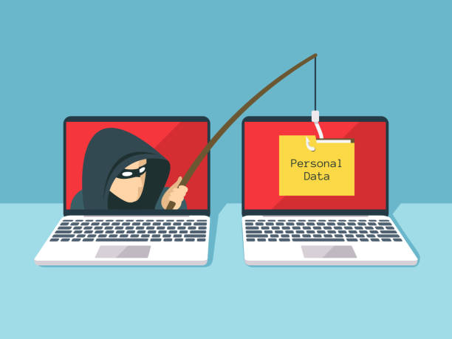
3. Misspelled Words or Grammatical Errors
Scan any emails, messages or online chats you receive for misspellings, grammatical errors, strange subject lines or other discrepancies. Be sure to check the domain of an email address too—for example, instead of Amazon.com, an email may be from Amazon.net, a dead giveaway that the communication isn’t from the online retailing giant
4. Won’t Appear on Camera or Meet You in Person
Examples of these types of scams are:
love bombing
Catfishing
for some reason, just can’t speak to you on the phone (or take a picture showing today’s date on a newspaper)
  If you’re suspicious that your so-called love interest may be impersonating another party, you can do a reverse image search of their profile picture on Google. If you find other names attached to the photo, or it appears on a stock image site, alarm bells should ring.

Slide 7


5. A Price That’s Too Good to Be True
With the rise of Facebook Marketplace, eBay, Amazon, and Instagram scams, it's crucial to shop smart and safeguard your wallet.
On social media platforms and counterfeit online stores designed to mimic authentic retailers, it's not rare to encounter steeply discounted products.
Trust your instincts and be aware that if a price seems too good to be true, it's probably a scam. Even with a receipt, you might never receive the item you paid for, or if you do, it could substantially differ in appearance or condition from what you expected.
REMEMBER – IF IT SOUNDS TOO GOOD TO BE TRUE – IT USUALLY IS!
6. A Promise of Easy Money
Remember: No legitimate financial investment opportunity is sure to ever pay off 100% of the time—and cannot legally be advertised as “guaranteed” income—so be very leery of anyone promising such. Don’t purchase a business, franchise or sales system that asks you to invest in pricey training or equipment upfront.
Similarly, remember that a favorite trick of sweepstakes and lottery scammers is to let you know you’ve won a prize but there’s a catch: you need to pay an (illegitimate) fee in advance to collect it.

Slide 8


7. Requests an Unusual Payment Option/Practices
Here are a few of the flags to look out for:
  They offer to let you pay in gift cards
  Adamant you must use their Escrow Person for payment
  Adamant you must send them YOUR banking or identity details to get payment
  Adamant they WILL NOT use an online services mandatory payment service or use a specific payment practice only (Bitcoin for example)
  They want to send YOU a check for more than what is owed and have you remit the excess to someone else
  Pretending to be your grandchild or other family member in need of money for bond or other “emergencies”.

Slide 9
New Scams – This info is current as of today – tomorrow it will be different
Check Washing/Cooking –
  Washing was erasing entries on existing checks and alerting payee and amount
  Cooking is the electronic version – taking a photo of check and then using software to alter
Fake Rx Scams- As people get older they are more apt to use prescriptions and also worried about cost so Seniors are especially vulnerable to offers of LOW LOW prices on Rx.
Fake Anti-Aging Products – Again as we get older our vanity may cloud our judgement – so only purchase anti aging products from reputable sources. Or better yet embrace your “experience”!!!!
Charity Scams and Funeral Frauds – I know, I know people who would use those two items are really the scum of the earth – Seniors are very charitable, and scammers will definitely play to that character trait…. Just don’t let ANYONE GUILT YOU INTO contributing.. And the Funeral Frauds play to Seniors especially – wanting to take care of the arrangements, fear of burdening the survivors with the arrangements – AGAIN DON’T LET ANYONE PRESSURE YOU into making an emotional decision.

Slide 10

So I’ve Been Scammed!!!
Now What Do I Do???
If you do fall victim to a scammer, don’t be embarrassed, as the stats show, it happens all too frequently.
The most important thing to do is report it to the Federal Trade Commission at ReportFraud.ftc.gov and your Local Police Department.

