Slide 1
GreenLinks
Linking Investors To a Healthier Portfolio

Slide 2
Give It To Me Straight
If you could invest in 5 or more top real estate markets in the U.S, would you?
If you had help deciding which release strategy would yield the highest ROI in the shortest amount of time, would your portfolio be stronger?
If you could build wealth by allowing your money to work for you, would you?

Slide 3
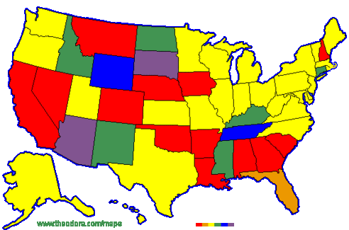
How We Do It
GreenLinks uses inside Real Estate market knowledge of the top cities in the U.S as a guide to building successful portfolios.
We show investor’s how to build wealth by dominating failing or undesirable neighborhoods, as well as flourishing neighborhoods and “city centers”.
Our goal is to maximize investor’s ROI by examining ALL release strategies such as Seller Financing, and Land Contracts which could potentially double or triple expected proceeds; then choosing the one that not only yields the highest ROI but is soundly the best asset allocation for that particular investors investment goals.

Slide 4
Insert Bills Here
Location Location Location!! Identifying your investment goals will lead you to YOUR market. A beginner investor should focus on areas such as Michigan or Georgia. More financially established investor’s should focus on areas such as New York and California. However, if the established investor is looking for a long term investment he may also focus on Michigan in respects to the stable rental market.
Michigan:
Georgia:
Las Vegas:
California:
Texas:
Florida:
Colorado:
New York:

Slide 5
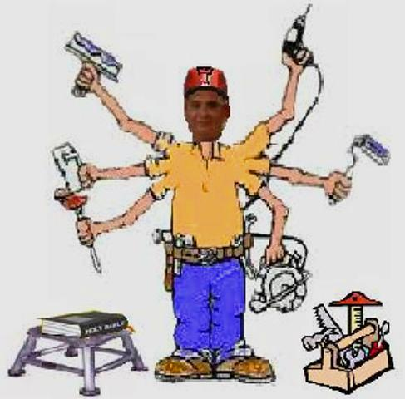
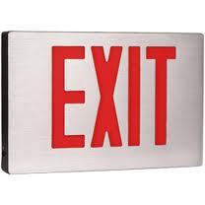
Get It Done
Property Search
Market Analysis
Property Purchase
City Inspections/Repair Evaluation
Contractor Assignment
Rehab
Re Market Analysis
Confirm Release Strategy(Flip, lease, etc)
Marketing
Negotiations

Slide 6
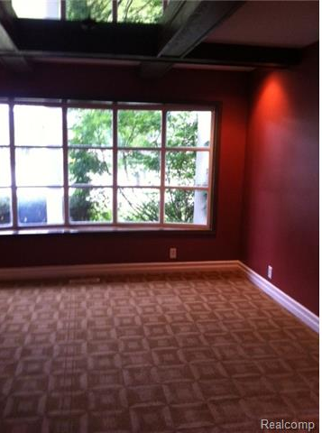
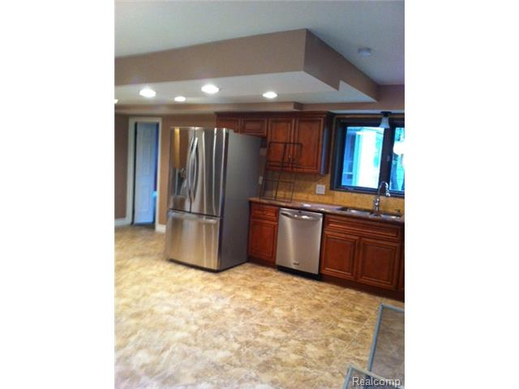
Glenmorra st. Southfield MI, 48076
Sale price: $104k Operating Cost: $700
Closing costs: $2,000 Resale price: $199,000
Rehab: $30,000 Gross Profit: $ 47,300

Slide 7
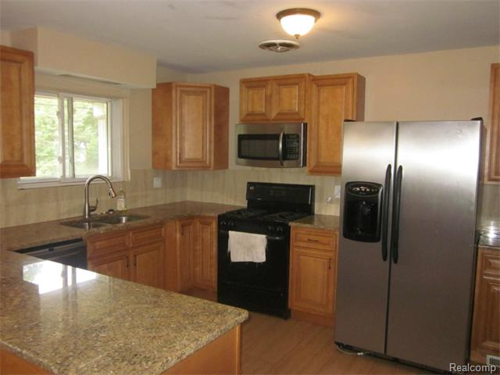
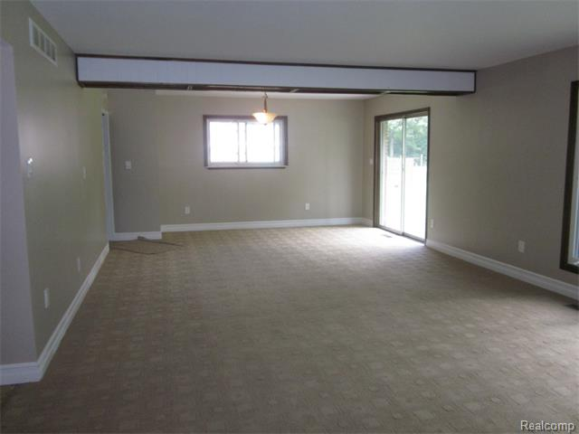
Philip Dr, Southfield MI 48075
Purchase Price: $58,300 Resale Price: $125,000
Closing costs: $1,400 Operating cost: $700
Rehab: $20,000 Net Return: $ 35,600

Slide 8
GreenLinks
CONNECTING INVESTORS TO PROFITABLE REAL ESTATE PROJECTS ACROSS THE U.S.
(greenlinkcorp@gmail.com)

