Slide 1





What are the harms caused by vaping?
Scaffolded Starter:
Despite never smoking, Estelle and her friends all vape. It’s getting expensive, but no one has suggested quitting – until recently.
Estelle started getting a weird pain in her chest, it felt a bit like there was some water stuck somewhere, which she just couldn’t cough up. Her dad is very worried and has taken her to the doctor.
Discuss: Why are Estelle and her friends vaping in the first place, do you think?
Explain briefly why you think vapes were created in the first place.
I think the reason vapes were
created in the first place is….
Notes:
Image attribution https://www.flickr.com/photos/oddharmonic/11004812794

Slide 2
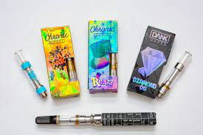

What are the harms caused by vaping?
Learning outcomes:
Describe the different health problems caused by vaping and the link between addiction, nicotine and dopamine.
Explain why vaping is not a safe long-term activity and should be seen primarily as a smoking cessation aid, using new terminology.
Key terms:
Vaping – breathing in a steam-like fume designed as a replacement for tobacco smoking, still containing nicotine in many cases.

Slide 3
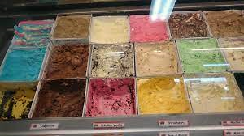



Many young people who vape haven’t even tried smoking cigarettes, let alone having the need for a smoking cessation aid. So why do so many young people vape?
Complete the mind map using the image clues and we’ll review together as a class in five minutes.
Task One:
.
One reason people might vape even though they never smoked is because…
Why would a person vape if they weren’t trying to give up smoking?

Slide 4
What did we think? Let’s collect our ideas before we reveal the answers and see if there is anything we’ve missed.
ANSWERS BEHIND THIS BOX, MOVE BOX TO REVEAL
Lots of different and enticing flavours makes vaping appealing
Peer pressure – or not wanting to look like the odd one out in a group
They genuinely think it makes you look ‘cool’ in some way
They have tried it once, enjoyed it and so carried on.
ANSWERS:
.
One reason people might vape even though they never smoked is because…
Why would a person vape if they weren’t trying to give up smoking?

Slide 5
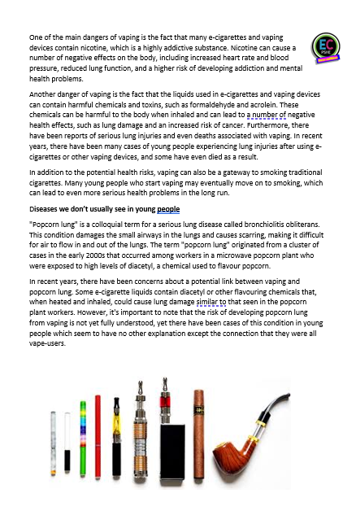
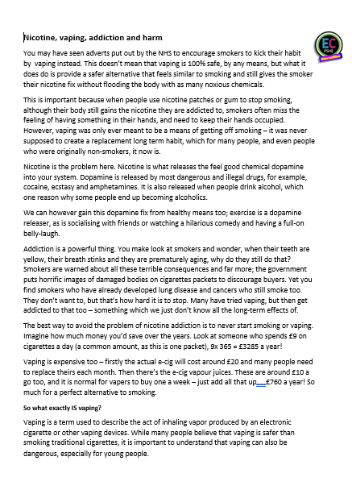


What are the harms caused by vaping?
Task Two:
We will now find out more about why vaping has taken off in the first place, why so many people vape and the real-life harms it can do which aren’t widely publicised.
POPCORN READING!
We will take it in turns to read. When you have
finished reading a paragraph, say the name of the
next person in the class you would like to read.
Listen carefully, in case your name is next.

Slide 6

Task Three:
Vaping – why such a big issue?
https://www.youtube.com/watch?v=IaVaoja2Uk4
(note: clip shows real life damage done by vaping to a cadaver’s organs)
What were e-cigarettes originally designed to do?
What have hospitals noticed in the last few years?
What are the symptoms of hospital patients?
What are GI symptoms?
What is the addictive component which could cause GI issues?
What metal has been found in vape juices?
Why was the vitamin E acetate found in patients’ lungs so harmful?
Watch the clips and complete your questions on your task sheet. We will then go through the answers together so you can fill in any you’ve missed.

Slide 7
ANSWERS:
Vaping – why such a big issue?
https://www.youtube.com/watch?v=IaVaoja2Uk4
What were e-cigarettes originally designed to do?
Mimic real life cigarettes in a safer way
What have hospitals noticed in the last few years?
An increase in lung damage – due to vaping
What are the symptoms of hospital patients?
Fever, coughing, chills, coughing up blood, racing heart
What are GI symptoms?
Abdominal pain – nausea, tummy aches
What is the addictive component which could cause GI issues?
Nicotine
What metal has been found in vape juices?
Arsenic (a deadly poison), tin, manganese, chromium
Why was the vitamin E acetate found in patients’ lungs so harmful?
2807 people were hospitalised and 2.4% of those died. There is no cure, just therapy and breathing aids to eventually help recovery.

Slide 8

Task Four:
Let’s not lose sight of reality. Vaping IS much safer than smoking. BUT (and it’s a big but), there are still significant dangers. Here is an information comparison chart – at the moment, it’s all mixed up.
Vaping | Smoking cigarettes | Smoking cannabis
Can ruin your singing voice
Major cause of lung disease
Linked to ‘popcorn lung’
Used to wean people off cigarettes
Comes in many different flavours
Has been linked to schizophrenia
Expensive habit
Is illegal in the UK
Becoming more popular with teenagers
Turns your teeth yellow
Increases risk of a wide variety of cancers and heart disease
Can make you lose all motivation
Decide whether the statements are talking about cigarette smoking, vaping or cannabis smoking – some may be applicable to more than one. Explain your decision for each choice in your books.
Then answer in your books: Why do people still vape, smoke cannabis and smoke cigarettes fully knowing these dangers? Be prepared to feedback your answer to the class.

Slide 9

ANSWERS:
Vaping | Smoking cigarettes | Smoking cannabis
Comes in many different flavours
Major cause of lung disease
Expensive habit
Used to wean people off cigarettes
Expensive habit
Has been linked to schizophrenia
Turns your teeth yellow
Expensive habit
Is illegal in the UK
Becoming more popular with teenagers
Turns your teeth yellow
Can make you lose all motivation
Linked to ‘popcorn lung’
Turns your teeth yellow
Can ruin your singing voice
Can ruin your singing voice
Increases risk of a wide variety of cancers and heart disease
Can ruin your singing voice

Slide 10



PLENARY:
Create a warning label for vapes
We’ve seen them on packets of cigarettes, those gruesome images to put off buyers, those terrible statistics which make you glad you don’t smoke – but currently there are no warning labels on vapes.
Draw out the shape of a vape (or use the template) in your book and create your own warning label.
You could create an image, if you feel confident, or just a short paragraph detailing the most important points people need to know.
Ask your teacher for an app template if you wish and there is a literacy through PSHE template too which you may find helpful.

Slide 11
Scaffolding for PSHE specific literacy:
Starting sentences about importance:
It’s essential that we…
It’s always important to realise…
Essentially, we must all take note of…
Critically….
Starting sentences for
two-sided arguments:
We must consider both sides when…
On the one hand…
One point of view might be..
There are two opposing viewpoints on this subject..
Starting
sentences about opinion:
My personal opinion on this matter is…
It may be controversial,
but I believe…
My opinion is based on two factors….
Useful conjunctives:
Additionally
Furthermore
Subsequently
Similarly
In contrast
Nonetheless
However
©EC Publishing 2022/23
Concluding extended writing:
In conclusion…
When all has been considered..
Therefore as expressed…
In consideration of all the above..
Finally, when all has been considered…
Overall I would state…
Complete second part of argument, or second paragraph of PSHE extended writing piece.

Slide 12
What are the harms caused by vaping?
Signposting support:
Useful helplines and charities
https://www.nhs.uk/better-health/quit-smoking/vaping-to-quit-smoking/
NHS site with up to date info on using vaping appropriately to quit smoking.
Young Minds. Child and adolescent mental health charity. Call: 0808 802 5544 (parents’ helpline)
Teen Line | Teens Support hotline - Connect, talk, get help! Teen Line's highly trained teen listeners provide support, resources and hope to any teen who is struggling.
https://www.royalwolverhampton.nhs.uk/about-us/smoke-free-rwt/the-facts-on-vaping/
Free vaping and health facts guide

Slide 13







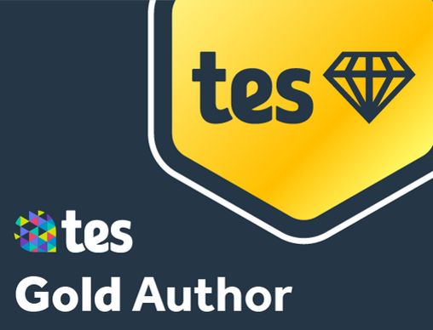
Top UK PSHE, Citizenship and RS complete package and lesson provider, serving thousands of schools since 2017.
Email:
info@ecpublishing.co.uk
Website:
www.ecpublishing.co.uk
This product, or any part of it, is not to be distributed, or resold under any circumstances, including through any websites, groups or organisations, without written permission from the author. Group and whole school licenses are available at the publisher’s request.
Thanks for choosing EC Resources
©EC Publishing 2022/23
All products on our website, unless stated, are sold with a Single User License. This means that one purchase of one product means only one person is permitted to use that product. Multi-teacher licenses are available upon request, just email us info@ecpublishing.co.uk.
Every product, and any part of any product on this website, may not be resold or distributed under any circumstances, including through any website, newsletters, unauthorized groups or organizations, without express written permission from EC Publishing.
EC Publishing are not responsible for the content of any external sites we link to. All suggested external content, clip links or information for further reading is used at the teachers' discretion.
All rights to all products remain with EC Publishing.

