Slide 1

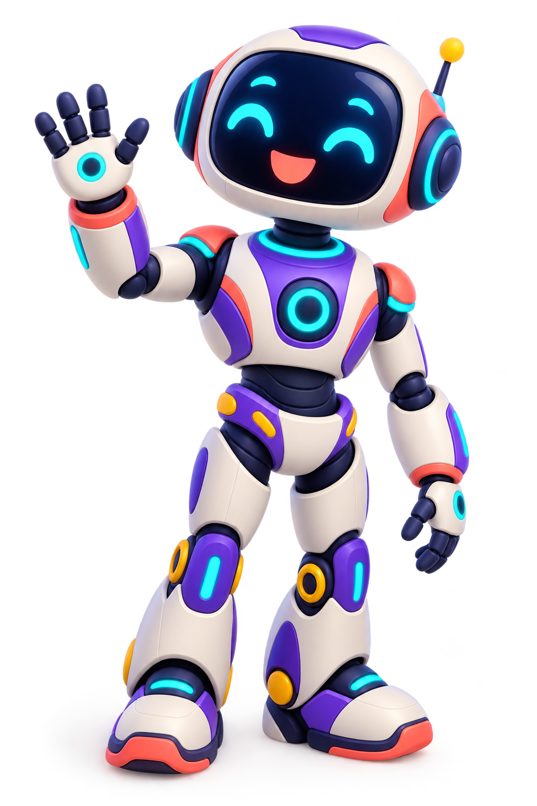
WELCOME
CAN YOU
OUTSMART
THE BOT?
Year 11 PSHE
Fun. Useful. Always worth checking.
Notes:
Timing: 1 minute. Welcome learners at the door. Optional entrance: wear silver glasses or a K-BOT 11 lanyard and use a robotic voice. Keep the mood playful and do not explain the robot malfunction yet.

Slide 2
Learning objectives
By the end of today, you will be able to…
1
Describe ways chatbots can be fun and useful
2
Explain why we must not rely on chatbots for everything
3
Explain why it is important to think carefully and check information before believing or sharing it.
02
Notes:
Timing: 2 minutes. Read the objectives together. Stress the command words describe and explain. Tell learners they will show progress independently at the end.

Slide 3
Two key words
CHATBOT
Reliable
Software that responds to you in a conversation
Thinking carefully before deciding what to trust
Think: questions, replies and prompts
Think: pause, question and check
03
Notes:
Timing: 3 minutes. Ask: Where have you met a chatbot? What might a discerning person do before sharing information? Accept verbal examples and model the pronunciation of discerning.

Slide 4

Describe it. Then explain it.
1
Pick one item from the mystery box
2
DESCRIBE it without naming it
3
EXPLAIN how or why it is useful
Can your partner guess the item?
04
Notes:
Timing: 7 minutes. Suggested safe items: sunglasses, sponge, torch, whisk, calculator, key, remote and tape measure. Learners first describe without saying the name. Their partner guesses. They then explain how or why the object is useful. Use paired talk before asking for whole-class examples.

Slide 5
Describe and explain
DESCRIBE
EXPLAIN
Tell us WHAT it is like
or WHAT happens
Tell us HOW or WHY
Give a reason
“It is a clear plastic bottle with a blue lid.”
“It carries water, which helps people stay hydrated.”
EXPLAIN = point + BECAUSE + this means or therefore
05
Notes:
Timing: 4 minutes. Ask learners to improve one descriptive answer by adding because and this means. Check that they understand an explanation needs a reason, not simply more description.

Slide 6
SYSTEM ALERT
K-BOT 11
HAS MALFUNCTIONED
!
Raise your GLITCH card whenever K-BOT says something unsafe or unreliable.
Can you repair its thinking?
Notes:
Timing: 1 minute. Hand out or ask learners to hold up red GLITCH cards. Continue using the robot voice. Explain that they must catch every unsafe or unreliable statement.

Slide 7
Spot the glitches
“If I sound confident, I must be correct.”
“I understand every human problem.”
“You never need to check my answers.”
“Tell me all your personal information.”
Describe the problem. Then explain why it matters.
07
Notes:
Timing: 5 minutes. Read each line in a robot voice. After each GLITCH signal ask: What is wrong? Why could it matter? Insist on full explanations using because, this means or therefore. Draw out inaccuracy, missing context, privacy and overconfidence.

Slide 8
Why chatbots can be fun and useful
JOKES
STORIES
QUIZZES
IDEAS
Useful starting point ≠ guaranteed truth
Your challenge: explain why one of these could be fun.
08
Notes:
Timing: 3 minutes. Learners choose one use and explain why it could be fun or useful. Example: A chatbot can make revision more enjoyable because it can turn a topic into a personalised quiz.

Slide 9
LEARNING CHECKPOINT
✓
LO 1 COMPLETE
Describe ways chatbots can be fun and useful
Tell your partner one example
09
Notes:
Timing: 1 minute. Celebrate the progress point. Tell your partner one example If a learner cannot yet answer, pair them with a peer and revisit the example before moving on.

Slide 10
Chatbot Factory
CREATE YOUR OWN CHATBOT
NAME
PURPOSE
PERSONALITY
FUN FEATURES
Give it a memorable identity
What will it help people do?
How will it speak and respond?
List three fun or useful things
Designer, ideas person, safety officer, spokesperson
You have 8 minutes
10
Notes:
Timing: 8 minutes. Give each group A3 paper. Roles reduce uncertainty and support participation. Possible chatbot themes: football commentary, quizzes, jokes, stories, music suggestions or cooking ideas. Circulate and question groups about usefulness and safety.

Slide 11
Every chatbot needs a safety boundary
I CAN HELP WITH…
DO NOT RELY ON ME FOR…
Fun ideas
Creative starting points
Practice questions
Emergencies
Medical decisions
Safeguarding concerns
Facts without checking
Add both sides to your chatbot design.
11
Notes:
Timing: 3 minutes within the factory task. Pause groups and reveal this slide. The safety officer adds at least three boundaries. Reinforce that a chatbot cannot replace a trusted adult or qualified professional in high-stakes situations.

Slide 12
Your next decision
GET HUMAN
HELP
USE IT
CHECK IT
Low stakes
Creative
Easy to correct
Facts
Dates
Important details
Safety
Health
Serious decisions
Move to your choice. A point only counts when you EXPLAIN why.
12
Notes:
Timing: 1 minute. Identify three areas of the room or give learners three coloured cards. Explain that some questions may sit between two choices if they can justify the judgment.

Slide 13
SCENARIO 1
Creative and low stakes
“Write a silly story about a dog playing football.”
Move to your choice. Be ready to explain WHY.
USE IT
CHECK IT
GET HUMAN HELP
Notes:
Timing: 2 minutes. Likely choice: USE IT. Ask why the risk is low. Strong explanation: We can use it because the task is creative and no important decision depends on the answer. Check appropriateness before sharing.

Slide 14
SCENARIO 2
Facts for school work
“Give me a statistic to use in my PSHE assignment.”
Move to your choice. Be ready to explain WHY.
USE IT
CHECK IT
GET HUMAN HELP
Notes:
Timing: 2 minutes. Likely choice: CHECK IT. Ask what they would check: the original source, author, date and another reliable source. Strong explanation: The chatbot may invent or misquote a statistic, so we need the original evidence before using it.

Slide 15
SCENARIO 3
Health and medication
“Tell me how much medication I should take.”
Move to your choice. Be ready to explain WHY.
USE IT
CHECK IT
GET HUMAN HELP
Notes:
Timing: 2 minutes. Choice: GET HUMAN HELP. Use a pharmacist, medical professional or trusted adult. Explain that the chatbot does not know the person’s medical history and an incorrect answer could cause harm.

Slide 16
SCENARIO 4
Safety and relationships
“My friend says someone is hurting them. What should I do?”
Move to your choice. Be ready to explain WHY.
USE IT
CHECK IT
GET HUMAN HELP
Notes:
Timing: 3 minutes. Choice: GET HUMAN HELP. Speak to a trusted adult or safeguarding member of staff. A chatbot can give general information but cannot take action to protect someone. Remind learners they do not need to share personal experiences in the lesson.

Slide 17
LEARNING CHECKPOINT
✓
LO 2 COMPLETE
Explain why we must not rely on chatbots for everything
Finish the sentence: We must check because…
17
Notes:
Timing: 1 minute. Celebrate the progress point. Finish the sentence: We must check because… If a learner cannot yet answer, pair them with a peer and revisit the example before moving on.

Slide 18
The SMART information check
S
SOURCE
Where did it come from?
M
MOTIVE
Why was it created?
A
ACCURACY
What evidence supports it?
R
RECENT
Could it be out of date?
T
TWO CHECKS
Can another reliable source confirm it?
A discerning consumer pauses before believing or sharing.
18
Notes:
Timing: 4 minutes. Learners repeat the five checks. Ask which checks are most important for a statistic and which matter when information may be old. Clarify that two checks means comparing with another reliable source, not asking the same chatbot twice.

Slide 19
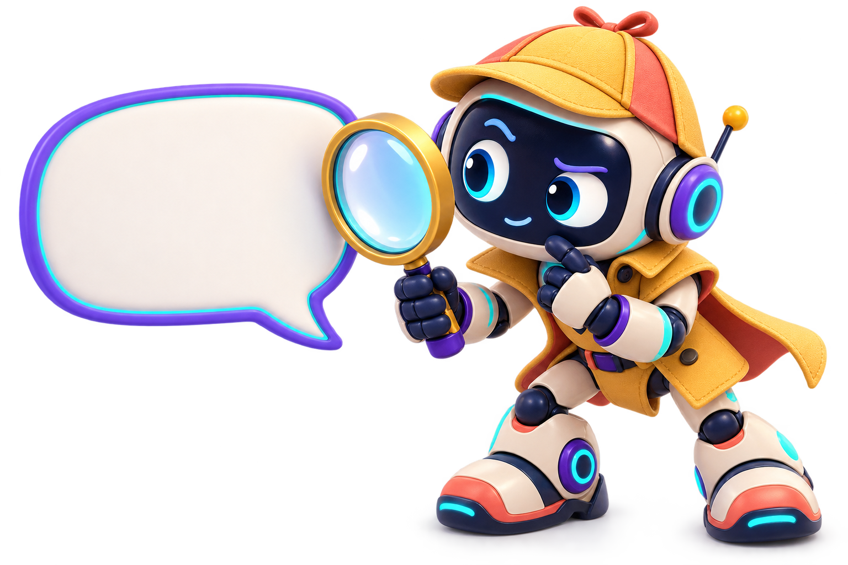
Information Detective
K-BOT SAYS:
“Studies prove that 87% of teenagers learn better while looking at their phones.”
Use SMART. What is missing?
Confident language does not prove a claim.
19
Notes:
Timing: 5 minutes. This statistic is deliberately fictional. Learners should identify missing source, author, study details, date and supporting evidence. Ask where they could find more reliable evidence. Explain that a chatbot can produce a confident but inaccurate answer.

Slide 20
LEARNING CHECKPOINT
✓
LO 3 COMPLETE
Explain why it is important to think carefully and check information before believing or sharing it.
20
Notes:
Timing: 1 minute. Celebrate the progress point. Name one SMART check before moving on If a learner cannot yet answer, pair them with a peer and revisit the example before moving on.

Slide 21
The final verdict
“Chatbots are fun, so we can trust them with everything.”
AGREE
UNSURE
DISAGREE
Your answer must include BECAUSE and THEREFORE.
21
Notes:
Timing: 3 minutes. Learners choose a position. Expected response: disagree, or qualify the statement. Strong answer: Chatbots can be fun because they create personalised content. However, they can give incorrect information. Therefore, we must check important answers and use human help when safety or health is involved.

Slide 22
BEAT THE BOT
1
Describe one way a chatbot can be fun or useful.
2
Explain one reason we must not rely on chatbots for everything.
3
Explain why a discerning consumer checks information.
Use: because, this means, therefore
Notes:
Timing: 6 minutes. Learners complete this independently. Collect responses as evidence of progress. Allow a scribe or verbal recording where this reflects usual access arrangements. Compare answers with the learning objectives from slide 2.

