Slide 1





Mental health: stigma and the language we use
Scaffolded Starter:
Since Narla was involved in a car crash, she has been suffering from severe anxiety. It’s been so bad, Narla’s been off school for a week.
‘When do you think she’ll be back?’ Her friend asked another girl in form time.
‘I dunno,’ the girl replied. ‘She’s turned into a right fruit-loop, so could be off for a while.’
Discuss: How does the response of the girl in Narla’s form make you feel? Why?
Explain what you think the word ‘stigma’ means.
I think the word stigma means…
Notes:
Image attribution https://www.flickr.com/photos/oddharmonic/11004812794

Slide 2
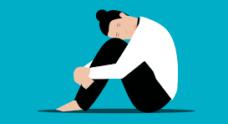

Mental health: stigma and the language we use
Learning outcomes:
Describe the link between language and mental health stigma and develop strategies
to challenge stigma and misconceptions associated with help-seeking and mental
health concerns.
https://www.youtube.com/watch?v=9vkUMXaJDM4
Key term:
Stigma – a set of negative and unfair beliefs that a society or group of people have about something.

Slide 3

Mental health: stigma and the language we use
Task One:
Different cultures and countries attach stigma to different things. Stigma can
come from religious views too. Stigma comes with a set of unfair expectations, a bit like stereotypes, but always negative. Stigma makes people judge someone unfairly.
In pairs, match up the common but unfair judgments which can arise from stigma.
Issue causing stigma | Draw a line to match up: | Judgement coming from the stigma
Being homeless. |  | ‘This person has disgraced and bought shame on their family.’
Being a single-parent. |  | ‘The person is probably a drug addict or alcoholic. They probably never wash either.’
Marrying someone outside of your strict religion, without your family’s blessing. |  | ‘This person is crazy. Best avoid them, they could be dangerous and unpredictable. Who knows what they’ll do.’
Having a severe mental health issue. |  | ‘This person probably doesn’t plan properly or doesn’t work hard on their relationships. I feel sorry for them, their life is probably a struggle. I bet their kids are sad.’
Being on benefits. |  | ‘This person is probably lazy and never bothers even applying for jobs. They just want to live off tax-payers money.’

Slide 4
Mental health: stigma and the language we use
ANSWERS:
Issue causing stigma | Draw a line to match up: | Judgement coming from the stigma
Being homeless. |  | ‘This person has disgraced and bought shame on their family.’
Being a single-parent. |  | ‘The person is probably a drug addict or alcoholic. They probably never wash either.’
Marrying someone outside of your strict religion, without your family’s blessing. |  | ‘This person is crazy. Best avoid them, they could be dangerous and unpredictable. Who knows what they’ll do.’
Having a severe mental health issue. |  | ‘This person probably doesn’t plan properly or doesn’t work hard on their relationships. I feel sorry for them, their life is probably a struggle. I bet their kids are sad.’
Being on benefits. |  | ‘This person is probably lazy and never bothers even applying for jobs. They just want to live off tax-payers money.’
Class discuss: What other issues or situations do people find themselves in which have stigma attached to them? Why do you think this is?

Slide 5
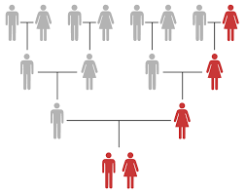



Often, people who attach stigma to mental illness are people who either have never suffered mental illness themselves, or people who have never had a loved-one who is close to them suffer from mental illness either. Fortunately, there is far less stigma surrounding mental illness today, but why would there ever be? Using the clues, hypothesise why there has traditionally been stigma attached to mental illness.
Task Two:
.
One reason people might have traditionally attached stigma to mental illness is…
Why would anyone attach stigma to mental health issues in the first place?

Slide 6
What did we think? Let’s collect our ideas before we reveal the answers and see if there is anything we’ve missed.
ANSWERS BEHIND THIS BOX, MOVE BOX TO REVEAL
Often people with severe symptoms cannot work
People inherit negative views from their family/friends
The way the mentally ill have been traditionally presented in films and media
The common discriminatory language which is used
ANSWERS:
.
One reason people might have traditionally attached stigma to mental illness is…
Why would anyone attach stigma to mental health issues in the first place?

Slide 7
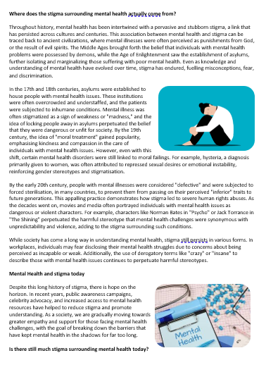
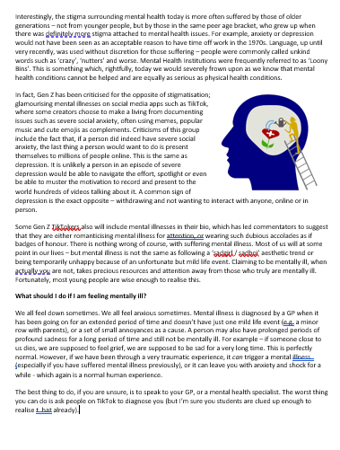


Mental health: stigma and the language we use
Task Three:
We will now find out more about why there has been a level of stigma attached to having mental health issues throughout different cultures, throughout history.
POPCORN READING!
We will take it in turns to read. When you have
finished reading a paragraph, say the name of the
next person in the class you would like to read.
Listen carefully, in case your name is next.

Slide 8
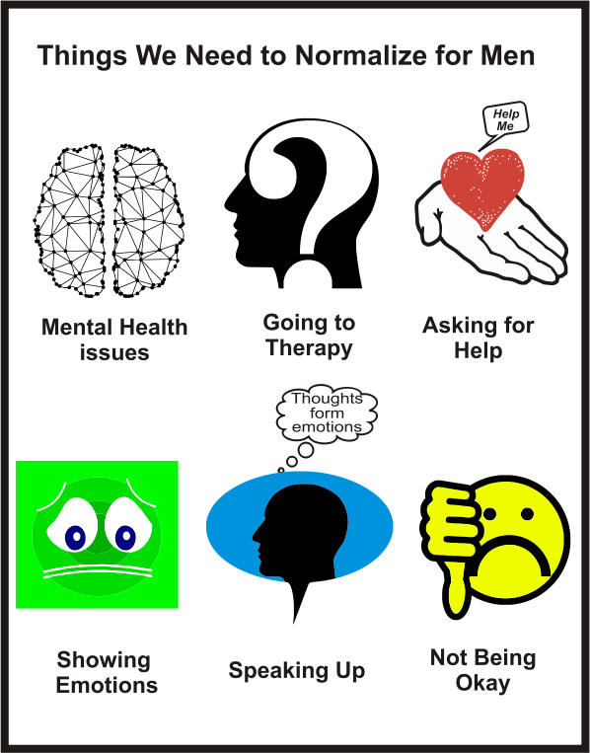
Task Four:
As we’ve just discovered, the amount of stigma attached to mental illness differs between the generations.
However, it also differs between the sexes too, with recent statistics showing that 40% of men will not talk to others about their mental health issues.
DISCUSS: Study the icons on the left and discuss with a partner why males in particular may struggle with each of these aspects of support.
Be prepared to feedback your ideas to the class shortly.

Slide 9

Task Five:
The link between stigma and language
https://www.youtube.com/watch?v=eVv21d8Z4e8
What is self-stigma?
What happens to people who are told the odds are stacked against them
and they’ll never succeed?
How are people working to de-stigmatise mental health?
How is language perpetuating stigma around mental health?
How can we help with the destigmatisation?
How is conversation the key?
Watch the clips and complete your questions on your task sheet. We will then go through the answers together so you can fill in any you’ve missed.

Slide 10
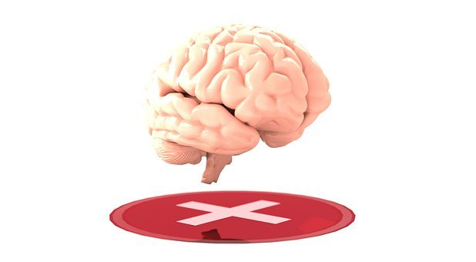
ANSWERS:
The link between stigma and language
https://www.youtube.com/watch?v=eVv21d8Z4e8
What is self-stigma?
A sub-category of stigma, when you judge yourself for a condition
you are suffering. You blame yourself and feel it's your own fault.
What happens to people who are told the odds are stacked against them
and they’ll never succeed?
Many people then don’t bother trying.
How are people working to de-stigmatise mental health?
By being open and sharing their stories, not hiding it.
How is language perpetuating stigma around mental health?
Over time, medical language can become slurs, depending on how
they are used, such as ‘insane’, which is now used as an insult.
How can we help with the destigmatisation?
By not using mental health terms inappropriately.
How is conversation the key?
It helps normalise the fact we all have problems at some point and helps promote learning and understanding.

Slide 11

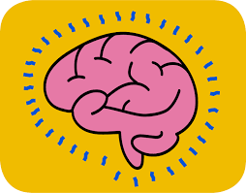
Mental health: stigma and the language we use
Creative Plenary:
TikTok Top-Tips…
You now have five minutes to create a 30 second TikTok with a partner (in real life not on your phone), explaining either: the link between mental health stigma and language, or, why mental health issues are sometimes still stigmatized.
You can be as creative as you like with this – a rap, a dance (if there’s room), changing the words to a song you like or just a 30-second info-blast of the main points is all great.
We’ll see some of them in a few minutes ☺

Slide 12
Scaffolding for PSHE specific literacy:
Starting sentences about importance:
It’s essential that we…
It’s always important to realise…
Essentially, we must all take note of…
Critically….
Starting sentences for
two-sided arguments:
We must consider both sides when…
On the one hand…
One point of view might be..
There are two opposing viewpoints on this subject..
Starting
sentences about opinion:
My personal opinion on this matter is…
It may be controversial,
but I believe…
My opinion is based on two factors….
Useful conjunctives:
Additionally
Furthermore
Subsequently
Similarly
In contrast
Nonetheless
However
©EC Publishing 2022/23
Concluding extended writing:
In conclusion…
When all has been considered..
Therefore as expressed…
In consideration of all the above..
Finally, when all has been considered…
Overall I would state…
Complete second part of argument, or second paragraph of PSHE extended writing piece.

Slide 13
Mental health: stigma and the language we use
Signposting support:
Useful helplines and charities
Samaritans. Samaritans provide 24-hour online and phone support to people in distress. Call: 116 123.
Mind. Mind is a charity that provides advice and support for people experiencing a mental health problem in England and Wales. Call: 0300 123 3393 (Mon to Fri, 9am to 6pm)
Rethink Mental Illness. Support and advice for people living with mental health problems. Call: 0300 5000 927 (Mon to Fri, 9.30am to 4pm)
SANE. National out-of hours mental health charity offering emotional support, guidance and information. Call: 0300 304 7000 (4.30pm to 10.30pm)
Mental Health Foundation. Information and support for anyone with mental health problems or learning disabilities.
Childline. Support for people under 19 in the UK. Call: 0800 11 11
Young Minds. Child and adolescent mental health charity. Call: 0808 802 5544 (parents’ helpline)

Slide 14








Top UK PSHE, Citizenship and RS complete package and lesson provider, serving thousands of schools since 2017.
Email:
info@ecpublishing.co.uk
Website:
www.ecpublishing.co.uk
This product, or any part of it, is not to be distributed, or resold under any circumstances, including through any websites, groups or organisations, without written permission from the author. Group and whole school licenses are available at the publisher’s request.
Thanks for choosing EC Resources
©EC Publishing 2025/26
All products on our website, unless stated, are sold with a Single User License. This means that one purchase of one product means only one person is permitted to use that product. Multi-teacher licenses are available upon request, just email us info@ecpublishing.co.uk.
Every product, and any part of any product on this website, may not be resold or distributed under any circumstances, including through any website, newsletters, unauthorized groups or organizations, without express written permission from EC Publishing.
EC Publishing are not responsible for the content of any external sites we link to. All suggested external content, clip links or information for further reading is used at the teachers' discretion.
All rights to all products remain with EC Publishing.

