Slide 1
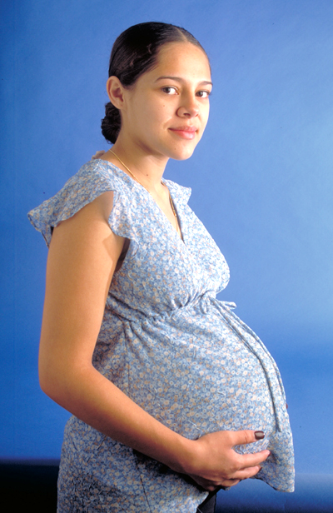
What do we need to know about unplanned pregnancies and miscarriage?
Rachel didn’t plan her pregnancy – however, as
she had suffered three miscarriages with her
last partner, she decided she to keep the baby.
STARTER:
Challenge:
What do we mean by a ‘miscarriage’ and an ‘unplanned pregnancy’?
More challenging:
What options are available for those who discover they have an unplanned pregnancy?
Mega challenge:
Explain how an unplanned pregnancy might happen, how they can be prevented and why they can cause emotional distress.
Notes:
With thanks to: https://www.flickr.com/photos/gazeronly/4139824123 labelled as creative commons 2.0 on 4 / 2 /20

Slide 2
What do we need to know about unplanned pregnancies and miscarriage?
KEY WORDS:
Unplanned pregnancy – A pregnancy that was not planned for.
Miscarriage - the spontaneous or unplanned expulsion of a foetus from the womb before it is able to survive independently.
Today’s LOs:
Challenge: Describe how both unplanned pregnancies and miscarriages can occur, and options available for unplanned pregnancies. Identify where people can go for further advice and support.
More challenging: Describe in detail all of the factors that can cause a miscarriage and the options for unplanned pregnancies as well as how the abortion process works.
Mega Challenge: Explain the symptoms of miscarriage and why they may be hard to spot as well as the symptoms in the different stages of pregnancy and where further support can be found. Explain both the abortion and adoption process in detail as well as a person’s legal rights and financial entitlements.

Slide 3
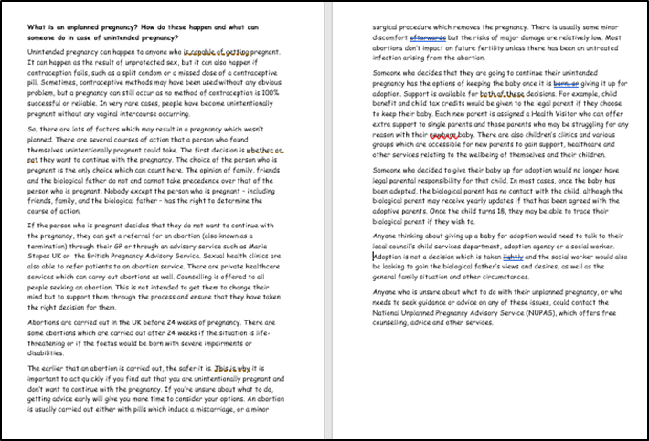
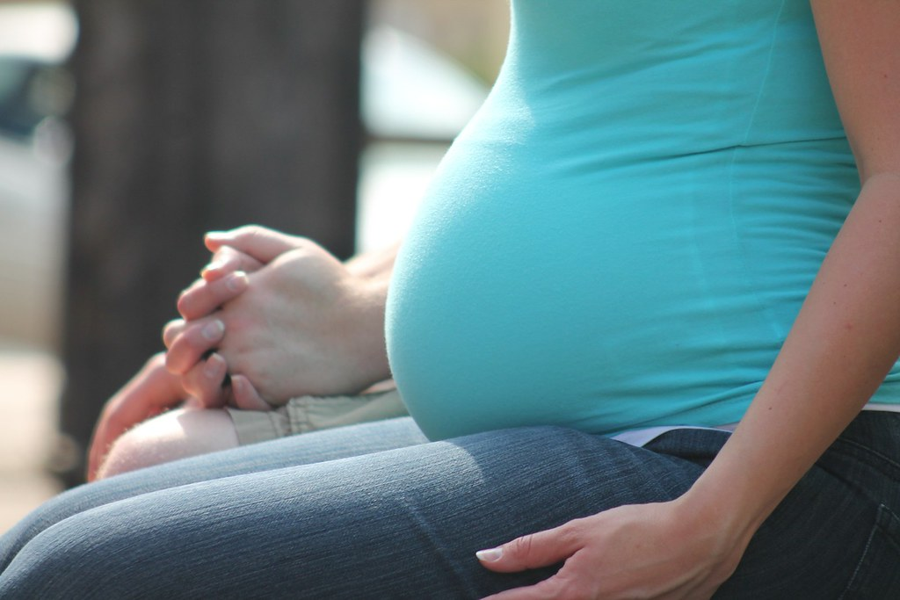
Task One:
We will now find out more
about unplanned pregnancies,
and the options available to
those who find themselves with an
unplanned pregnancy, as well
as where we can go for further
support.
FOCUSED READING OPPORTUNITY
Spend five minutes now, reading this
quietly on your own. You can then have
a minute breather to discuss the
content with the friend next to you
if you wish to.
You will then complete the next task at your challenge level.

Slide 4
Task Two:
Your friend, Aimee, has just sent you a message. She sounds worried. Read her message carefully and write her one back, using your information sheets.
‘Hey, I didn’t want to wake you up by ringing but I wanted to get my feelings down in a message because I feel so scared. I thought me and Brett were being so careful we always used condoms – there was that one time when it came off though – but that was just it – one time! So now I’m pregnant. I don’t want to tell him – he’ll want to keep it – and I really don’t.
What can I do? I don’t even know what the process is for getting an abortion – or even if I could really go through with it. I’m far too young to look after a baby, I don’t think I could even afford to - and I want to go to Uni! I haven’t a clue where to start with all this. Please help!
Additional challenges!
Challenge: Describe to Aimee how she might have become pregnant and advise her of her options and where she can go for further help.
More challenging: Explain to Aimee how the abortion process works, who needs to know about her plans, who doesn’t and why.
Mega challenge: Explain both the abortion and adoption process to Aimee in detail. Let her know her legal rights and financial entitlements.

Slide 5
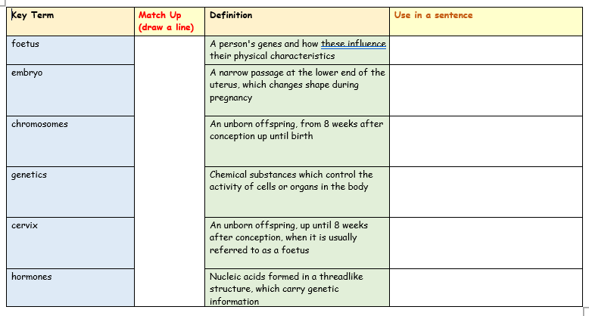
Task Three:
We have already heard a lot of new key terms today.
We’ll now be examining miscarriage in detail, so let’s see how many key terms about this topic we know already.
Let’s explore these now. You have a copy each but you can help each other in pairs too.
Don’t forget to complete the final column!
We will go through the answers together in ten minutes.

Slide 6

Task 4 – What is miscarriage? What do we need to know about it?
Watch the clip and answer your choice of challenge questions on your worksheet.
https://www.youtube.com/watch?v=j9peQFwW7T4&t=24s
Challenge:
What percentage of pregnancies will end in miscarriage?
Generally speaking, is there anything than a woman can do to stop a miscarriage from occurring?
Describe some of the most common miscarriage symptoms.
More challenging:
Name one factor that increases the risk of miscarriage.
How might issues with the placenta cause a miscarriage?
How might a miscarriage be diagnosed?
Mega Challenge:
What is meant by an ‘incomplete miscarriage’?
Describe two of the risk factors that increase the likelihood of miscarriage.
What are some things a woman can do to reduce her risk of miscarriage?

Slide 7

Task Five:
We will now find out more
about miscarriage, what
exactly this is, the different
forms and how it can happen in
any pregnancy.
FOCUSED READING OPPORTUNITY
Spend five minutes now, reading this
quietly on your own. You can then have
a minute breather to discuss the
content with the friend next to you
if you wish to.
You will then complete the next task at your challenge level.

Slide 8


Task Six:
Using the information in your hand-out, create an eye-catching noticeboard for Dr Smith’s clinic. Ensure you complete your challenge level task (think carefully about how you can present the issues raised today in a way that informs people about miscarriages in a sensitive and informative way).
Describe five reasons why miscarriages can happen and how they happen and where further support can be found.
As above, but explaining each reason in detail as well as the effect this can have on the pregnant person, depending on the stage of pregnancy and where further support can be found.
Explain in detail the reasons why miscarriage occurs, as well as the symptoms and why they may be hard to spot. Explain the symptoms in the different stages of pregnancy and where further support can be found.

Slide 9
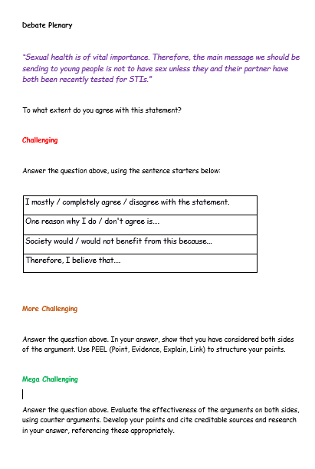

PLENARY -DEBATE TIME!
“Fathers should be able to have an equal say about whether a pregnancy is terminated or not, this should be taken into account before the decision is made by a doctor.”
Do you agree or disagree? Maybe you can
see both sides of this argument.
ALL –
You have five minutes now to prepare your
own opinion on this statement.
Today’s LOs:
Challenge: Describe how both unplanned pregnancies and miscarriages can occur, and options available for unplanned pregnancies. Identify where people can go for further advice and support.
More challenging: Describe in detail all of the factors that can cause a miscarriage and the options for unplanned pregnancies as well as how the abortion process works.
Mega Challenge: Explain the symptoms of miscarriage and why they may be hard to spot as well as the symptoms in the different stages of pregnancy and where further support can be found. Explain both the abortion and adoption process in detail as well as a person’s legal rights and financial entitlements.

Slide 10





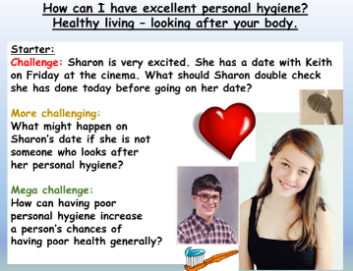
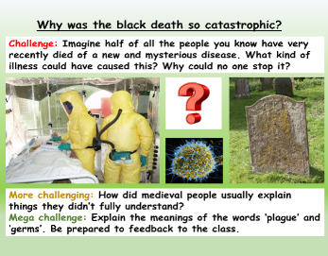






Most popular author on Tes
Email:
info@ecpublishing.co.uk
Website:
www.ecpublishing.co.uk
This product, or any part of it, is not to be distributed, or resold under any circumstances, including through any websites, groups or organisations, without written permission from the author. Group and whole school licenses are available at the publisher’s request.
Thanks for choosing EC Resources
©EC Publishing Ltd 2019
©Lead Practitioner English 2019
We aim to always provide high quality, fully resourced teaching packages for the cost of a cup of coffee or two. Our mission is to save teachers time and make them happy.
Check out our website for offers and freebies. Right click here, follow the link.
English
PSHE
History
Citizenship
RE
Whole School
Follow us on twitter: @ec_publishing or facebook

