Slide 1

Composting Your Organics
www.leducregionallandfill.ca
Notes:
Introduce Yourself

Slide 2
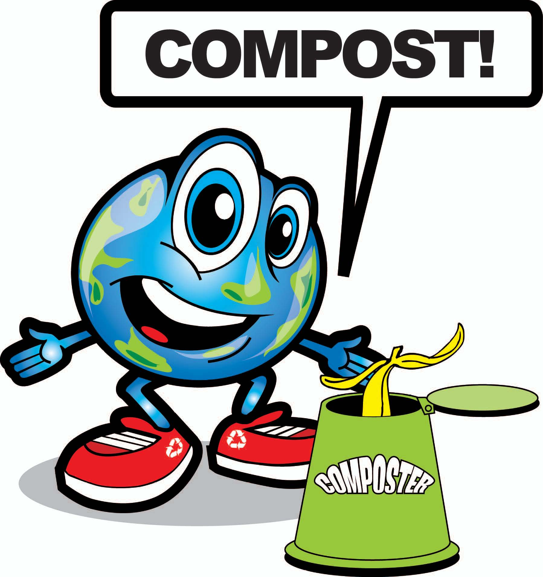
Composting Organic Waste:
Nature’s Recycling Program
Notes:
Today we will be talking about composting and why it’s important. Composting is nature’s way of recycling organic waste.
Does anyone know what composting is?
Why is composting important?
Do you compost at home? How do you do it?

Slide 3
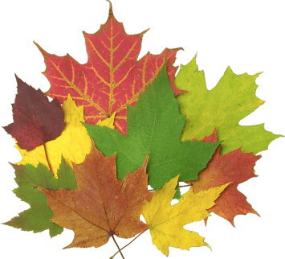
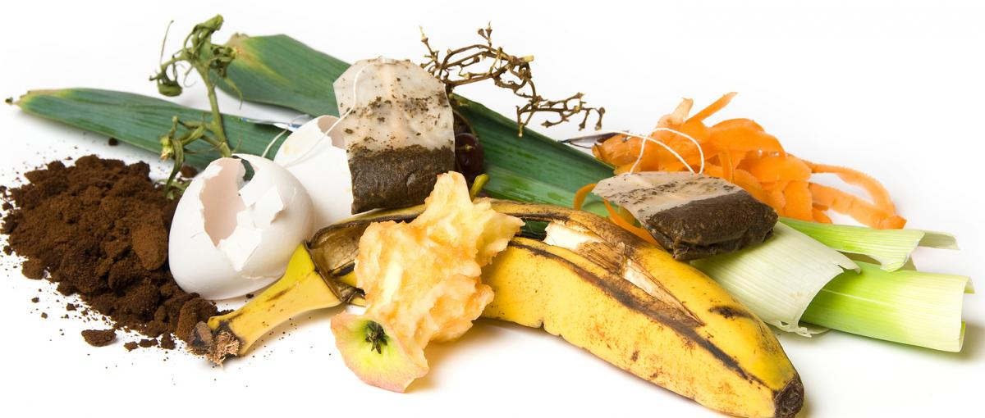

What is Organic Waste?
Materials that are biodegradable
Which materials are biodegradable?
  Plants, like grass and leaves
  Food scraps, like fruits and vegetables
  Things made from plants, like wood and paper
Notes:
Organic waste are materials that are biodegradable. Biodegradable means that they come from the earth and will break down and become part of the earth. These materials even help fertilize the soil and nourish plants.
What is biodegradable? Can you name any? Food scraps: fruits and vegetables, Plants: grass and leaves, Paper

Slide 4
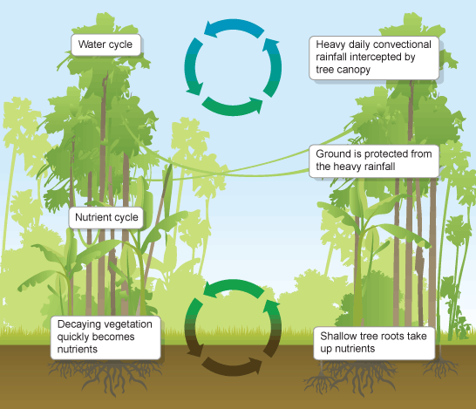
What is Composting?
Composting is nature’s way of recycling organic waste
In a forest, dead plants and leaves form a mulch
Over time they decompose into nutrients that feed the forest plants
We can help the environment by recycling our organic waste through composting!
Notes:
In a forest, leaves fall and form a mulch that is home to a number of critters, like microorganisms, worms, and insects. Over time these critters help the leaves decompose into nutrients that feed the forest plants. We can recycle our biodegradable materials that we use everyday by composting at home.

Slide 5
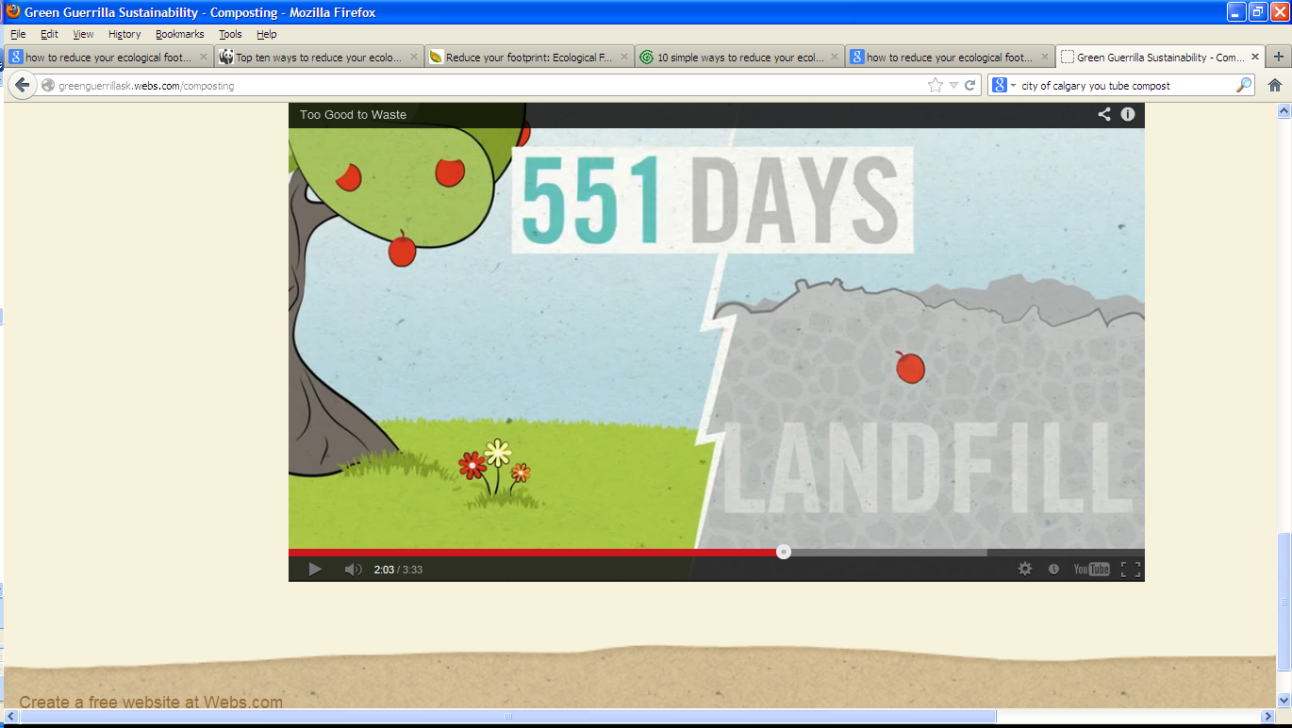
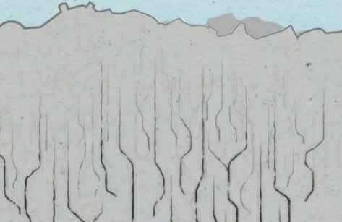
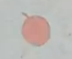
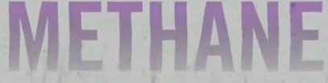

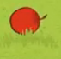
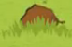
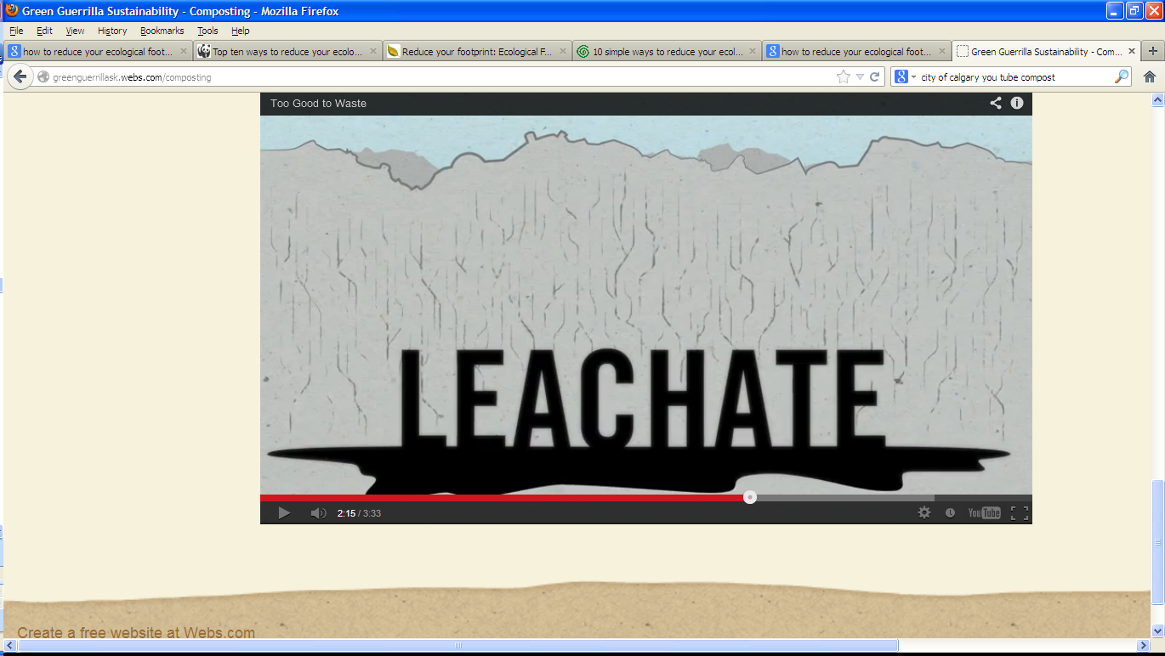
Organic Waste in a Landfill
Organic Breakdown vs Landfill Breakdown
LEACHATE
Notes:
OPTIONAL
When an apple falls to the ground, it breaks down and turns into soil, but that’s not what happens when an apple ends up in a landfill. Food and yard waste don’t break down into soil, compost or anything useful because there is no oxygen under a pile of garbage at the landfill. Meaning it can’t break down properly.
A landfill isn't designed for materials to biodegrade. It just compacts more than it breaks down. Have you ever seen an apple get squishy and brown? That’s decomposition! This creates liquid leachate that oozes through the garbage. If not collected and treated, leachate could contaminate the soil around the landfill and ground water. As the food and yard waste slowly decomposes, it also produces methane, a greenhouse gas that is 21 times stronger than carbon dioxide when it comes to causing climate change. Fortunately, there is a simple solution – compost!

Slide 6
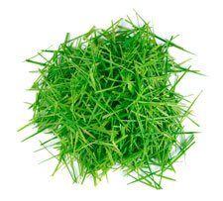
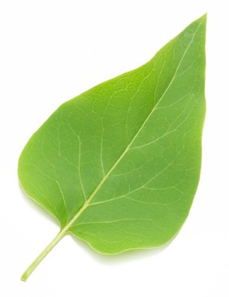
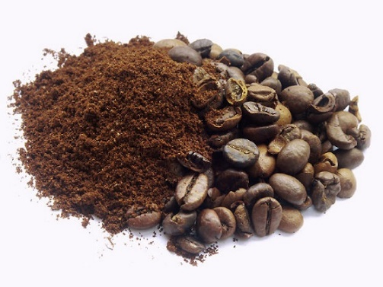
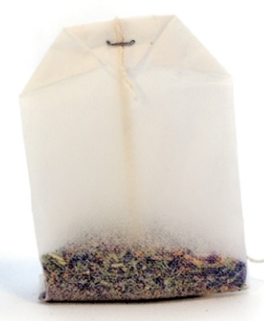
Compost Materials
Greens
(Nitrogen-rich)
Fresh yard waste
Fruit and veggie scraps
Egg shells
Coffee grounds
Tea bags
Notes:
Here are items you can put in your compost. We call these green materials.
List items.

Slide 7
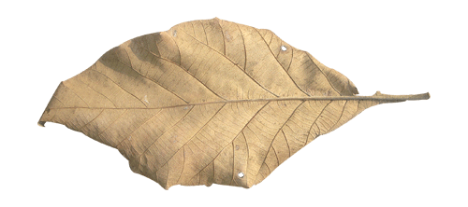
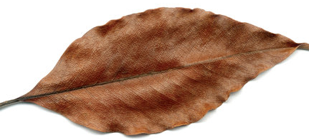
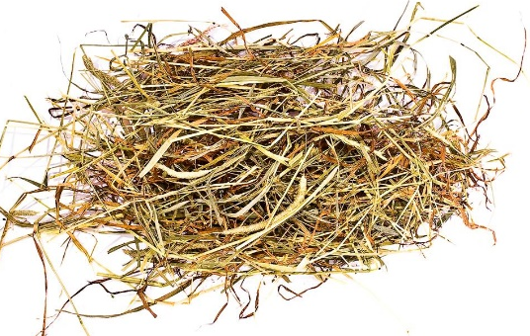
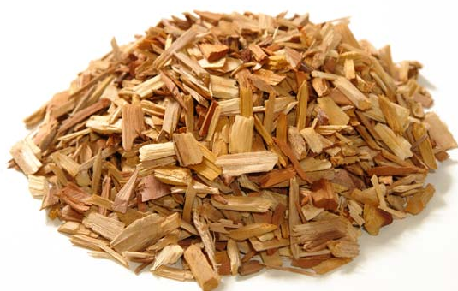
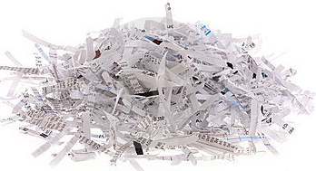
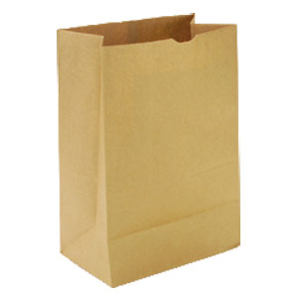
Compost Materials
Browns
(Carbon-rich)
Dead leaves
Dry grass
Wood chips
Paper products
Notes:
Here are more items you can put in your compost. We call these brown materials.
List items.

Slide 8
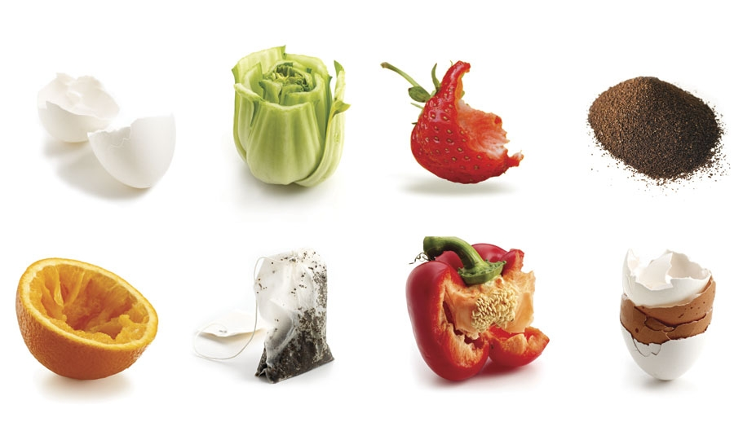
Any Organic Material is Compostable
Fruit and vegetable peels
Coffee grounds and filters
Tea bags
Ground egg shells
Napkins and paper towels
Plant clippings
Notes:
Any organic material is compostable.
Which materials do you see?
Can you name me items you put in your compost bin?
Can you put a pumpkin in the compost?
Can you put in a used pizza box? What is it made of?
Can you put in a plastic bottle?

Slide 9
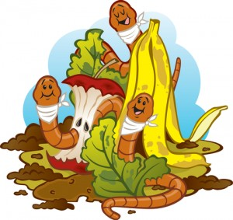
Composting with Worms!
Did you know?
Vermi is the Latin word for worm
Vermicomposting is the composting of food scraps using worms
In the soil, microbes and fungi break down the food scraps
Then red wiggler worms eat the microbes to make castings or worm ‘poop’
The worms work with fungi and microbes to help breakdown food
Notes:
OPTIONAL
Vermicomposting is one way to speed up your compost pile. This is composting of food scraps using worms. Normally, microbes and fungi break down the food scraps. With vermicompost, red wiggler worms eat the microbes to make castings or worm ‘poop’. The worms work with fungi and microbes to help breakdown food.

Slide 10
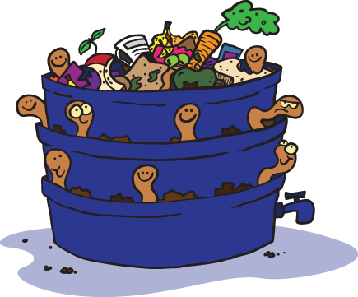
How to make a worm bin
What you will need:
  Food scrap bucket
  Shallow container
  Garden spade & gloves
  Bedding material
  Worm food
  Red wiggler worms!
Notes:
OPTIONAL
You can build your own vermicomposter. You can acquire red wiggler worms at a pet store, or fishing store (fisherman use them as bait). You can then fill a bucket with some bedding material (wood chips or paper or cardboard). Add worm food (healthy veggies and fruit! Try to avoid acidic ones, like kiwis and lemons.) Your worms will start making compost right away by chowing down on the material provided.

Slide 11
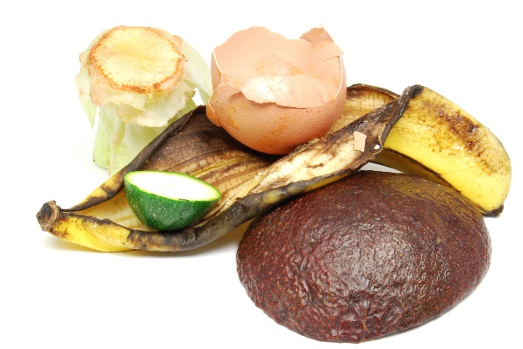
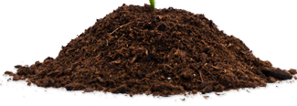
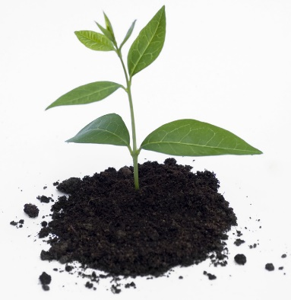

Harvesting Compost
After 6 to 12 months you will have finished compost
BEFORE
AFTER
You can use it for:
  Fertilizer
  Flower beds & gardens
  Mulch
  Houseplants
  Compost tea
Notes:
It will take 6 to 12 months to create finished compost in a normal compost pile. It will be dark, crumbly and moist soil. Now you can harvest your compost!
Compost becomes nutrient rich soil that is best used for gardening. It acts as a great fertilizer and can be used outdoors or even in the house with houseplatns. You can also make compost tea. This is compost that you leave soaked in a jug of water. The nutrients in the compost spread throughout the water, making it perfect to use to water your plants.

Slide 12
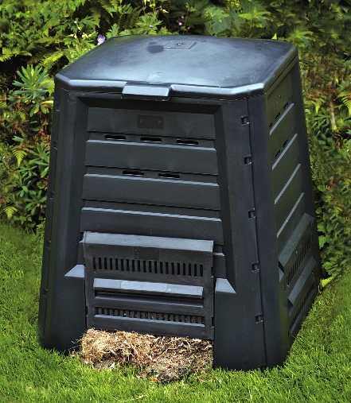
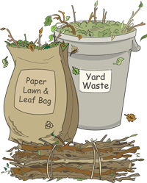
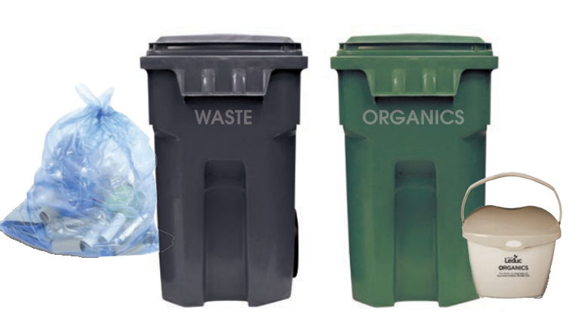
Ways to Compost
Leaf and Yard Waste Depots
Green curbside carts
Home compost piles
Bring yard waste in paper bags or reusable containers
Notes:
There are many ways to collect your compost.
You can use Leaf and Yard Waste Depots, these are good if you are helping with yardwork.
You may have green curbside cart collection. Usually organics go in your green cart.
Or you can have your own compost pile and make your own.

Slide 13
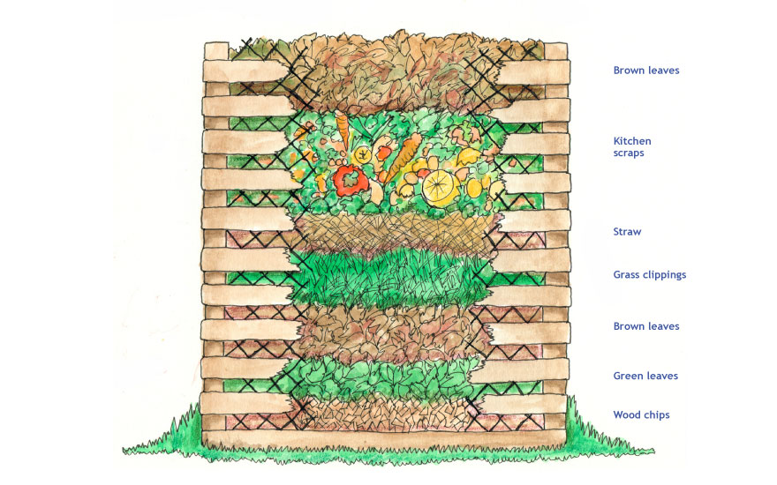
Backyard Composting
Compost bins can be made of wood, wire or plastic
Steps:
  Choose the right area
  Add organic material
  Add water
  Mix pile
  Finished compost
Notes:
Backyard composting is a great option you can do at home.
Choose an area and bin
Choose an area with good drainage and some sun.
Your compost area should be at least 1m x 1m x 1m.
Choose a type of compost bin (wood or plastic are the best).
Adding materials
When you begin, layer some branches or twigs on the bottom of your compost pile to allow for air flow and drainage. Then add a thin layer of soil to provide soil microbes that will do the work of breaking down your organic material.
Then begin to add your materials as you have them. The smaller the pieces you put into your compost heap, the faster they will decompose.
Add equal parts green and brown material to build a balanced compost heap.
Add water
Add water when you first start your compost pile and each time you turn your pile.
The compost pile should be moist.
Maintaining your compost bin
Turn your pile with a shovel every couple of weeks during the summer to provide enough air.
You will know that your compost pile is working when the material starts to heat up.
In the winter, your compost pile may freeze solidly. Just keep adding your green and brown material as usual.
In the spring, when it thaws, the pile will pick up the composting process just where it left off the previous winter.
Finished compost
Your composted material is ready to use when it has an "earthy" smell, is dark in colour, cold and most of the materials are unrecognizable.
The composting process can take from two months to two years, depending on the materials used and the effort involved.

Slide 14
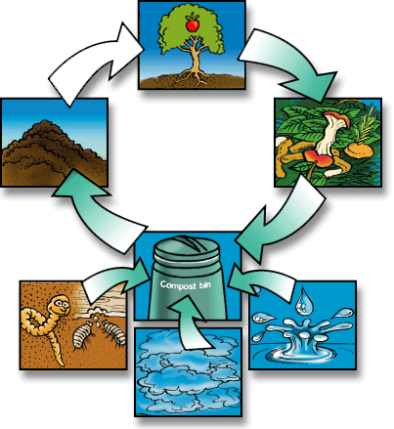
Benefits of Composting
Great way to help the environment
Add compost to your plants and help them grow
It recycles waste and helps reduce the amount of garbage in our landfill
Notes:
There are many benefits to composting:
Easy and fun way to be environmentally friendly
Cuts your weekly garbage almost in half
Recycles a valuable natural resource
Produces free compost soil for your gardens
Reduces air pollution
Saves landfill space
Helps reduce greenhouse gas production at landfills

Slide 15
Thank You
Any Questions?
Notes:
Thank you, any questions?

