Slide 1
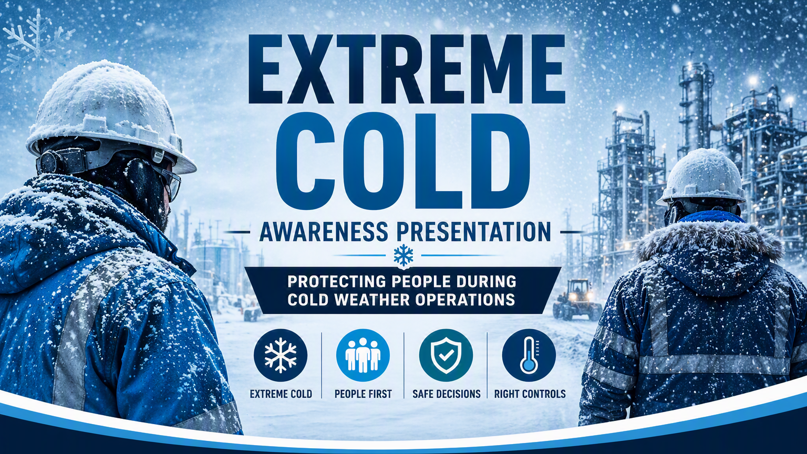

Notes:
Slide 1 — Opening / purpose
Key message: extreme cold is a foreseeable operational risk, not just a comfort issue.
Use this opening to set the tone: this session is about recognising cold-weather risk early, making sensible decisions before exposure becomes unsafe, and protecting people while keeping operations controlled.
Reference the Bridges principle: plan early, control risk, protect people. Explain that the wider policy also covers heat and adverse weather, but this briefing focuses on cold weather and winter conditions.
Transition: “Let’s start with why cold-weather awareness matters in day-to-day operations.”

Slide 2
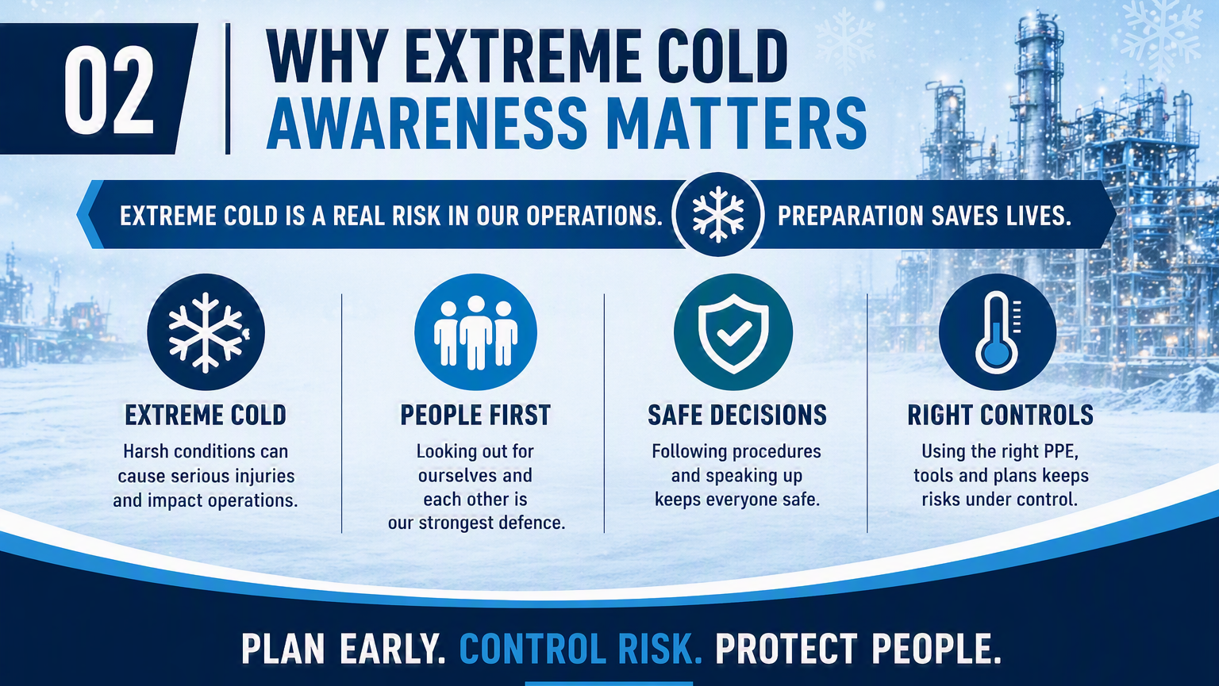
Notes:
Slide 2 — Why awareness matters
Key message: cold weather affects people, decisions, equipment and the way work is carried out.
Cold stress can develop gradually, especially when wet clothing, wind chill, long exposure or physical fatigue are involved. It can reduce concentration, manual dexterity and decision-making, which increases the likelihood of errors and incidents.
Emphasise that the policy expects work to be planned and controlled, not simply reacted to. Good cold-weather management means using forecasts, site observations, briefings and supervision before conditions deteriorate.
Transition: “To manage this properly, we need to understand the risks — not just the temperature.”

Slide 3
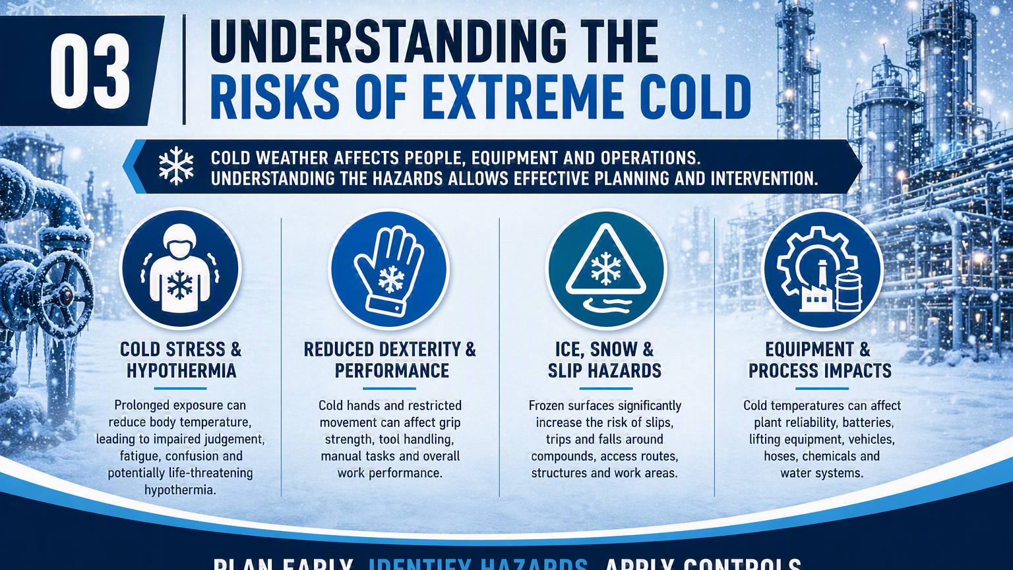
Notes:
Slide 3 — Understanding the risks
Key message: risk is created by the interaction of the weather, the task, the person and the controls in place.
Make clear that no single temperature determines risk. A wet, windy day just above freezing may be more hazardous than a dry, calm day below zero. Wind chill, snow, ice, rainfall, ground conditions, duration of exposure and available welfare all change the risk level.
Highlight four practical impacts: cold stress and hypothermia, reduced dexterity and performance, slips from ice and snow, and the effect of cold on equipment, materials and emergency arrangements.
Transition: “Once we understand the risk factors, preparation becomes the most important control.”

Slide 4
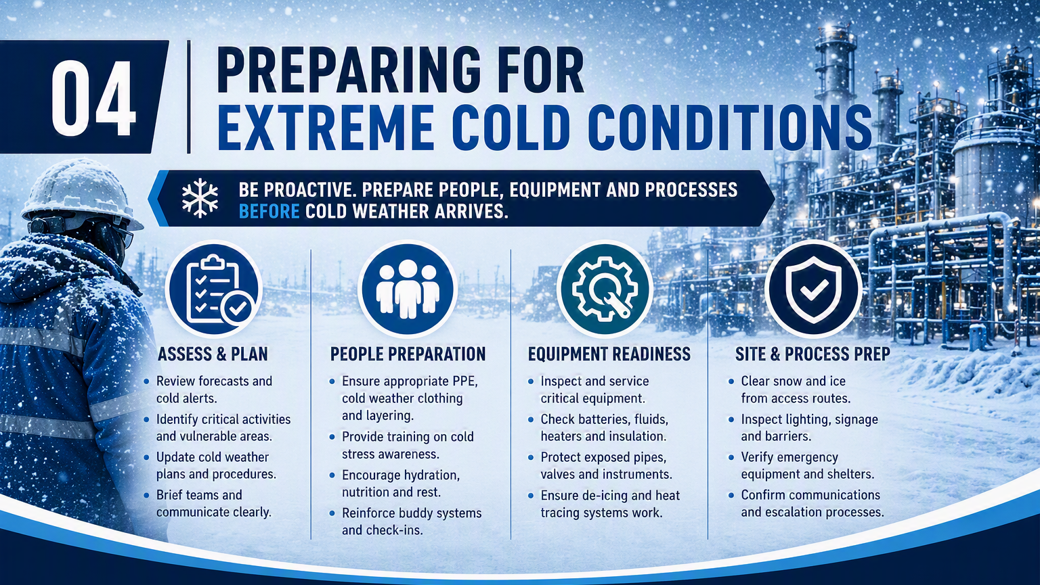
Notes:
Slide 4 — Preparing for extreme cold
Key message: preparation must happen before the shift, not after people are already exposed.
Talk through the preparation steps: check forecasts and alerts, review RAMS, consider site-specific conditions, brief the team, confirm welfare and heating arrangements, check access and egress, and ensure plant, vehicles and equipment are suitable for the conditions.
Managers and supervisors should consider worker vulnerability, new starters, fatigue, lone working, task duration, PPE, rescue capability and whether work should continue, be modified, delayed or stopped.
Transition: “Preparation only works if it is backed up by practical controls on site.”

Slide 5
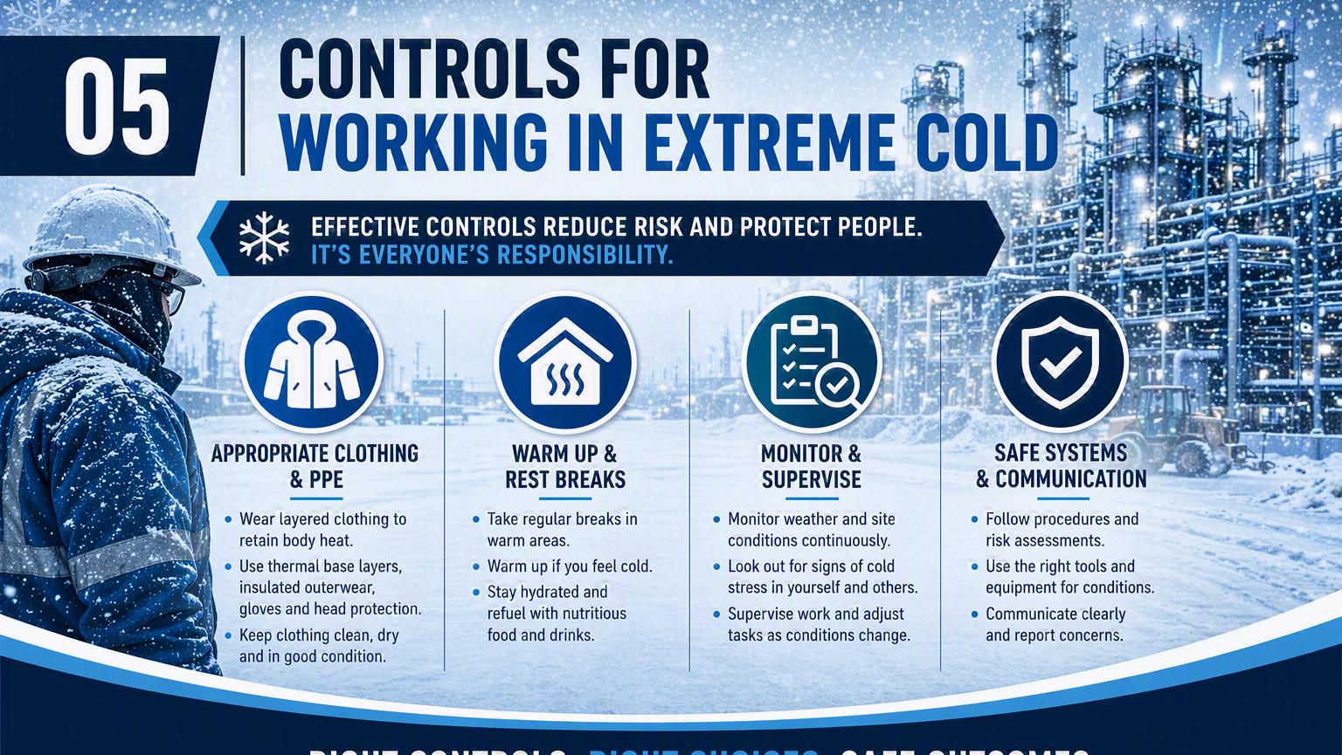
Notes:
Slide 5 — Controls for working in extreme cold
Key message: controls must reduce exposure and give people the chance to recover.
Reinforce welfare as a critical control: heated rest areas, warm drinks, drying facilities, suitable toilets and first aid arrangements must be proportionate to the level of risk. Welfare is not optional or secondary.
Typical controls include layered clothing, windproof and waterproof protection, suitable gloves and footwear, gritting and clearance, safe access routes, task rotation, shorter exposure periods, buddy checks, increased supervision and clear communication.
If controls are not adequate, work must be modified, restricted or suspended until the risk is controlled.
Transition: “Even with controls in place, we still need people to spot the early warning signs.”

Slide 6
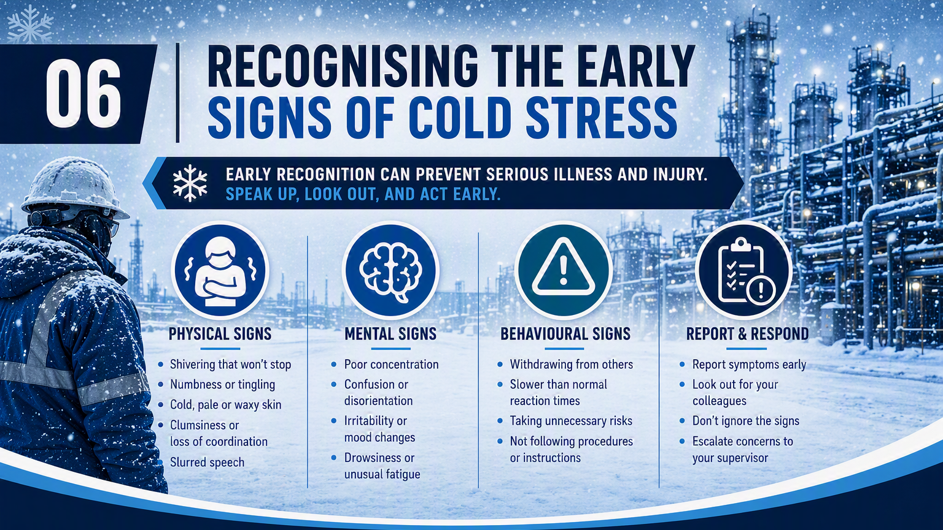
Notes:
Slide 6 — Recognising early signs
Key message: early recognition prevents cold stress becoming a serious incident.
Ask the audience to watch for physical, mental and behavioural changes: shivering, numbness, pale or cold skin, loss of coordination, confusion, slowed responses, unusual behaviour or reluctance to speak up.
Stress that workers should report symptoms early and supervisors should intervene promptly. The escalation guide confirms that any employee, subcontractor, supervisor or manager can stop work where there is an immediate and uncontrolled risk.
No one should be criticised for stopping work in good faith. Reassessment and suitable controls are required before work restarts.
Transition: “The next slide shows why early intervention matters.”

Slide 7
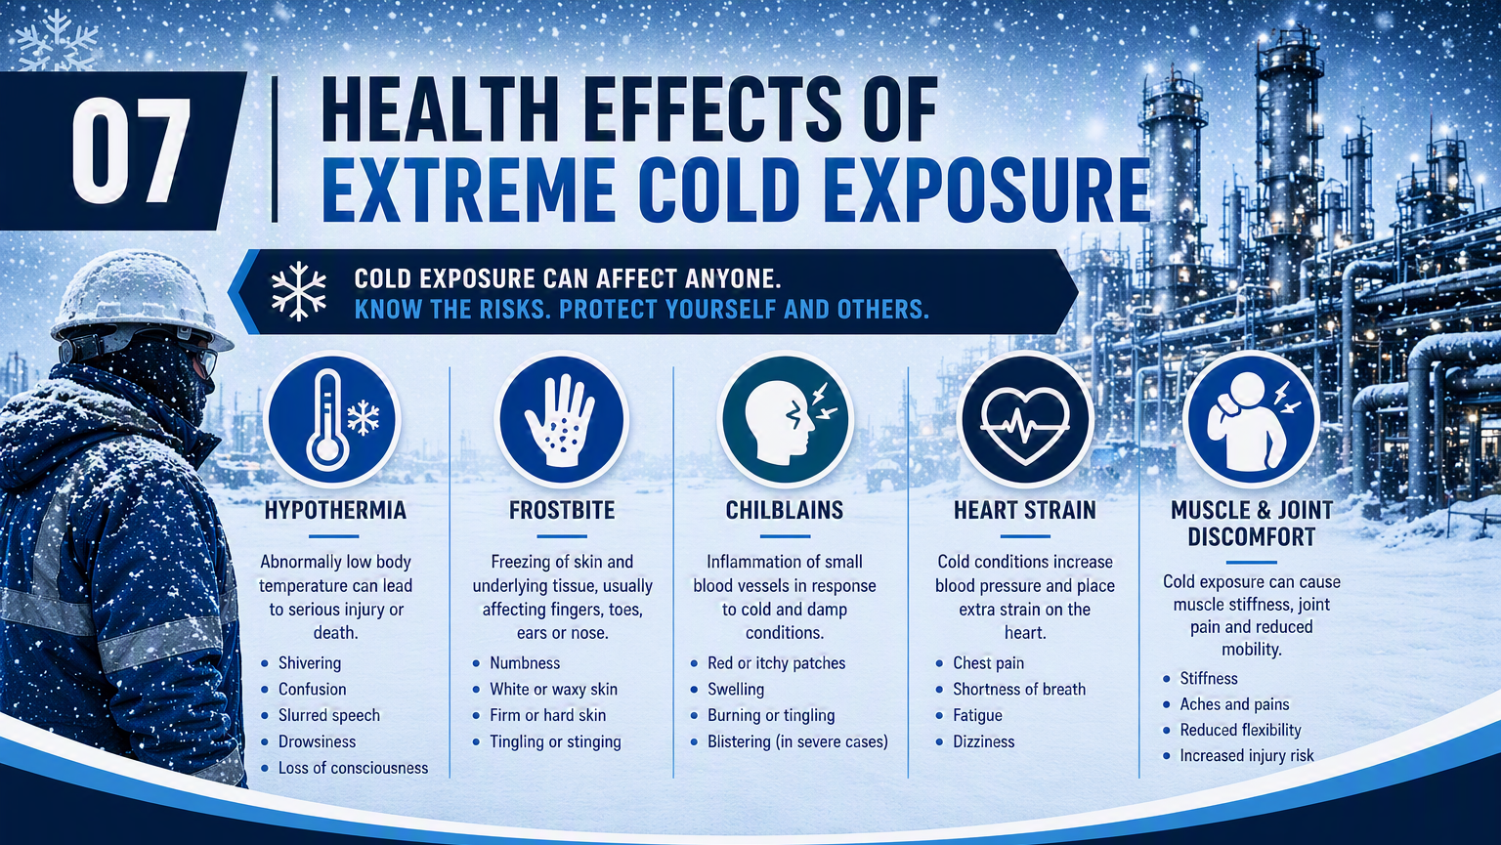
Notes:
Slide 7 — Health effects of extreme cold exposure
Key message: cold exposure can lead to serious health effects, not just discomfort.
Briefly explain the main effects: hypothermia affects the body’s core temperature and can impair judgement; frostbite damages exposed skin and extremities; reduced dexterity makes tools and controls harder to use; and cold can place additional strain on the heart and muscles.
Pay particular attention to vulnerable workers, fatigue, recent illness, existing medical conditions and anyone working alone or in remote locations. Workers do not need to disclose private medical information to colleagues, but known occupational health restrictions must be followed.
Transition: “Prevention is built from simple habits repeated consistently.”

Slide 8
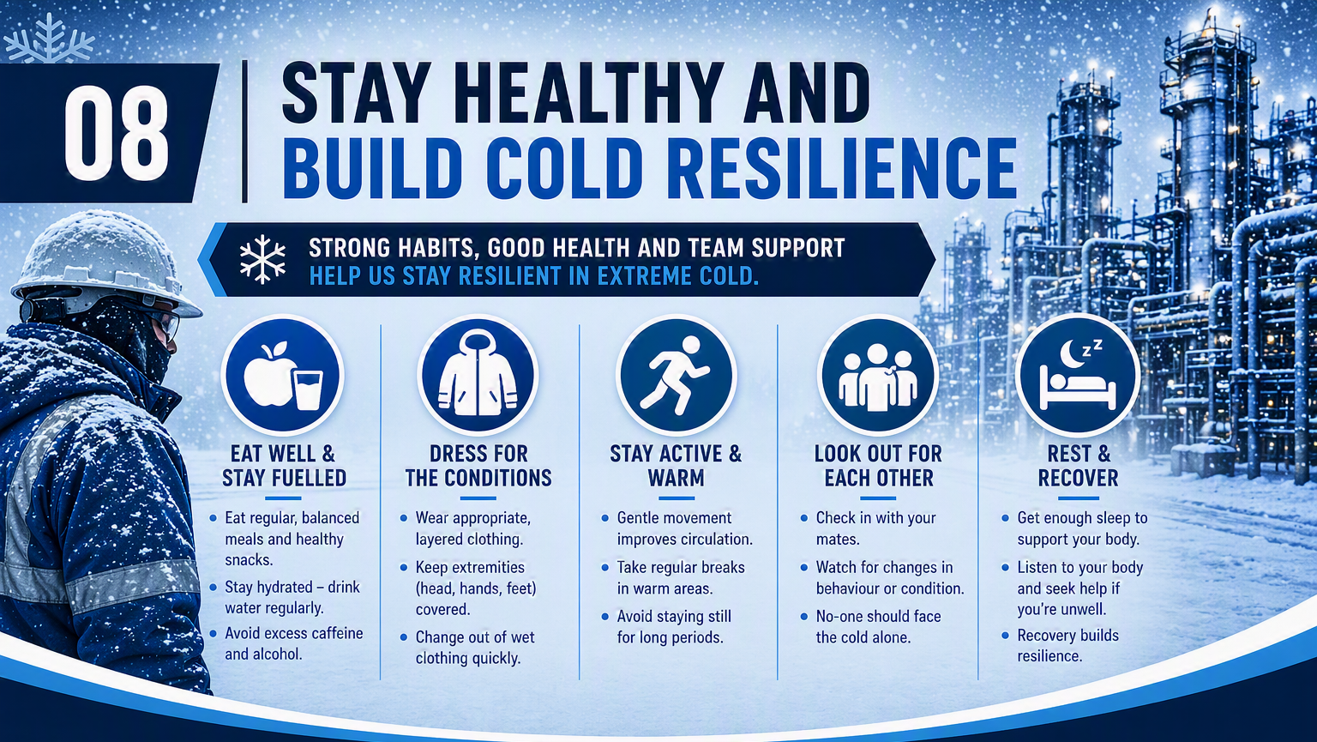
Notes:
Slide 8 — Staying healthy and building cold resilience
Key message: good personal habits support the site controls.
Encourage practical behaviours: eat properly, stay hydrated, wear appropriate layered clothing, keep spare dry items available where possible, move and stretch during safe opportunities, use warming breaks, and report wet clothing or loss of feeling in hands and feet.
Emphasise “watch each other” — buddy checks are especially important because cold stress can affect judgement and people may not recognise their own symptoms.
Resilience is not about pushing through; it is about using controls early, recovering properly and escalating concerns before conditions become unsafe.
Transition: “To close, let’s bring this back to the Bridges operating principle.”

Slide 9
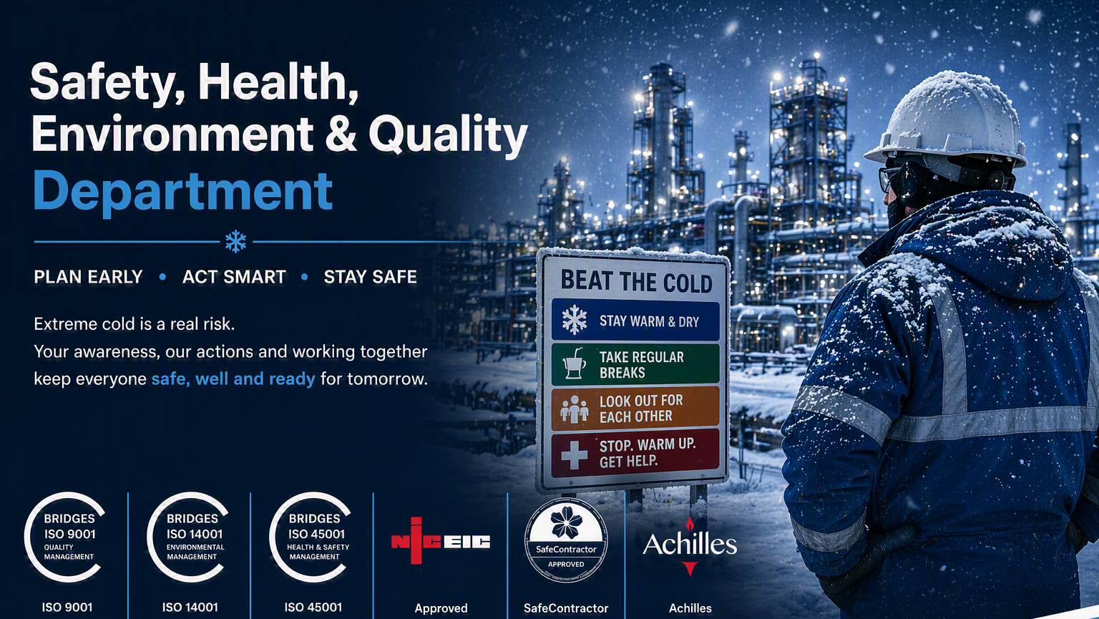
Notes:
Slide 9 — Close / call to action
Key message: plan early, act smart and stay safe.
Summarise the session in three points: monitor weather and site conditions, apply the correct controls before exposure, and escalate or stop work where risk is not controlled.
Remind presenters to link this briefing to the supporting documents: the Extreme Temperature & Adverse Conditions Policy, the Weather Alert Monitoring & Escalation Guide, the Risk Assessment & Control Matrix, RAMS, toolbox talks and dynamic risk assessment arrangements.
Close with the expectation: decisions must be visible, communicated and documented where Amber or Red alerts, or equivalent site conditions, influence whether work continues, changes or stops.

