Slide 1


SHEQ Department
22/06/2026
Notes:
INTRODUCTION:
This is not just a heat-awareness message, it is part of Bridges' wider approach to extreme temperature and adverse conditions management.
Bridges recognises extreme heat, extreme cold and severe weather as foreseeable risks to health, safety, welfare and operational performance. These conditions are not simply matters of discomfort, they can affect concentration, decision-making, travel, emergency arrangements and the ability to work safely.
The key message for the session is simple: plan early, act smart and stay safe. We want teams to make good decisions before exposure occurs, not after conditions have already deteriorated.
Our expectation is that no task or programme pressure overrides health, safety and welfare. If the risk cannot be adequately controlled, the work must be modified, postponed, restricted or stopped.

Slide 2
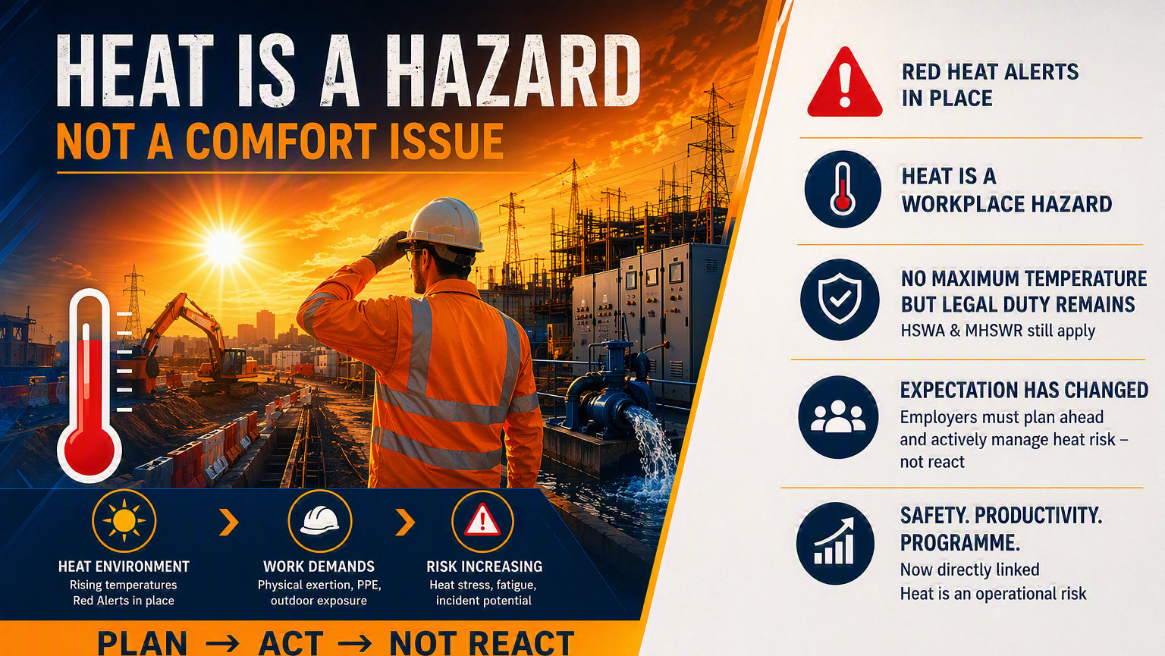
Notes:
HOT WEATHER IS A WORKPLACE HAZARD
Heat can lead to dehydration, heat exhaustion, heat stroke, fatigue, loss of concentration and impaired judgement all of which increase the likelihood of mistakes and incidents.
Make the point that the absence of a fixed maximum workplace temperature does not remove the duty to assess and control risk. The legal expectation remains that foreseeable risks are identified and reduced so far as is reasonably practicable.
The assessment must look beyond temperature alone. Humidity, direct sunlight, PPE burden, physical workload, duration of exposure, recovery breaks, welfare provision and individual vulnerability all change the level of risk.
It is imperative that early symptoms and concerns are reported. Supervisors should intervene promptly, and work should stop where symptoms are identified or controls are no longer effective.

Slide 3
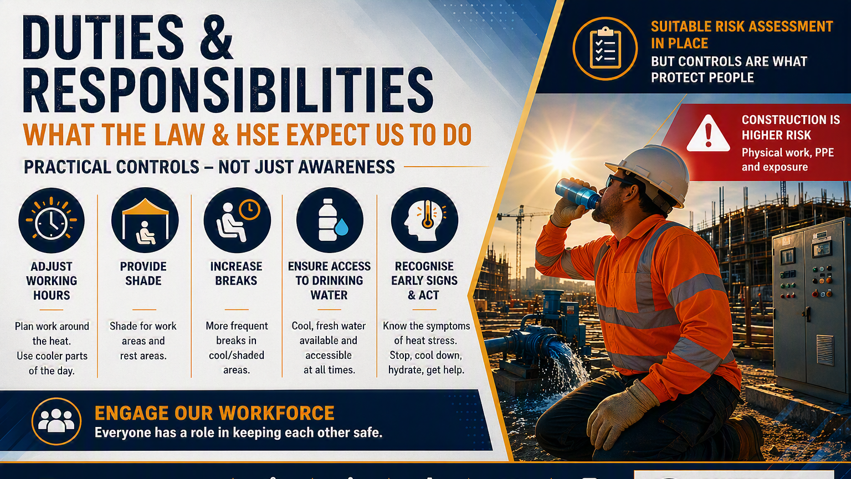
Notes:
PRACTICAL DUTY-HOLDING RATHER THAN PAPERWORK.
The policy is built around clear responsibilities: leaders set the standard, managers plan and make decisions, supervisors control the work on site, SHEQ provides competent support, and employees and subcontractors follow controls and speak up.
This all links back to the statutory legal framework: HSWA, Management Regulations and Workplace Welfare Regulations require suitable and sufficient assessment, effective control measures, supervision, communication and welfare.
RAMS must consider the combined effect of forecast conditions, actual site conditions, task demands, PPE, duration, worker vulnerability, access and egress, travel risk, emergency response and welfare.
Engagement matters. Workers are often the first to notice deteriorating conditions, fatigue or symptoms. Anyone who believes conditions present an immediate and uncontrolled risk is authorised to stop work and escalate in good faith.

Slide 4
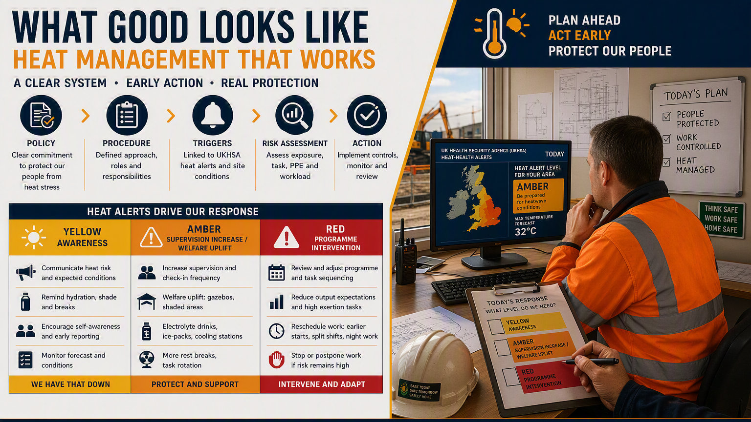
Notes:
Project Managers, Site Managers and Supervisors should monitor credible sources such as Met Office warnings, UKHSA Weather-Health Alerts, site observations, local forecasts, client communications and emerging conditions on site.
Weather alerts do not automatically stop work, but they are management triggers. Amber means pause, review and confirm enhanced controls before affected work proceeds. Red means senior management scrutiny, with a presumption that non-essential activities will be suspended, postponed or significantly modified unless it can be clearly demonstrated that work can continue safely.
Typical controls include adjusted working hours, task rotation, reduced exposure periods, enhanced briefings, additional supervision, hydration monitoring, welfare checks and restrictions on higher-risk activities.
The important output needs to be visible and documented. For decisions made we need to know what has changed, what controls are relied upon, who is accountable, how the workforce has been briefed and when the decision will be reviewed.

Slide 5
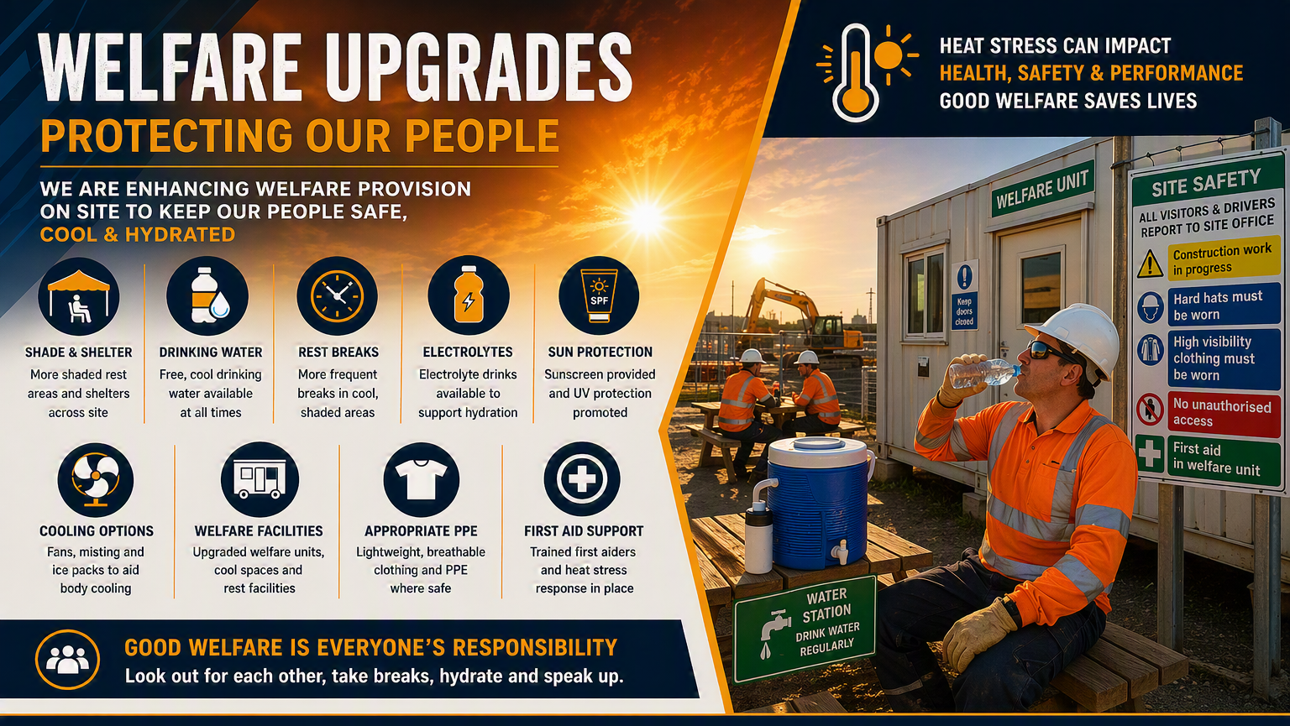
Notes:
WELFARE.
In heat, welfare means cool drinking water, shaded or cooled rest areas, planned recovery breaks, hydration monitoring, suitable clothing/PPE choices, first aid readiness and early recognition of heat stress. But that is not going to happen by accident, extremes of heat for example require planning for cooling and keeping water cool and more importantly safe.
In cold or adverse weather, welfare means heated shelters, warm drinks, drying facilities, suitable layered clothing, waterproof and windproof protection, safe access routes, gritting or clearance where needed, and arrangements for safe travel and emergency response.
Supervisors should verify welfare before work starts and continue checking it as conditions change. A welfare arrangement that was adequate at 08:00 may not be adequate later in the day as temperature, workload or weather changes.
Welfare is more than a nice to have, it is a legal requirement and must be maintained in an appropriate condition. If provision fails or cannot match the level of risk, that is a trigger for escalation, work modification or in worst cases suspension.

Slide 6
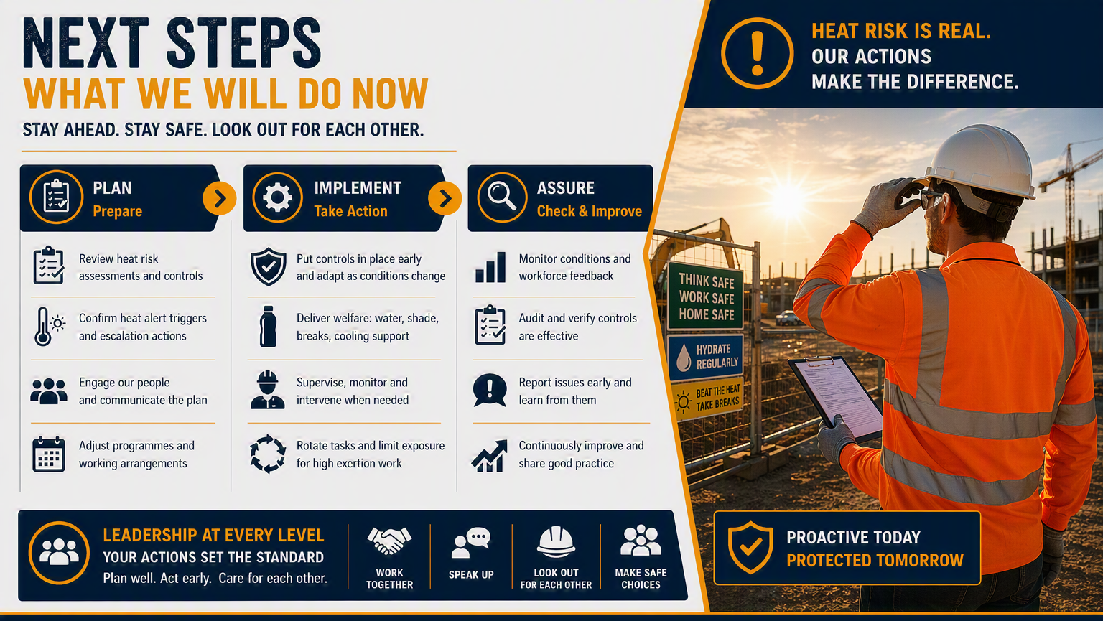
Notes:
SIMPLE OPERATING RHYTHM: PLAN, ASSESS, IMPLEMENT AND ASSURE.
Plan ahead by checking forecasts, alerts, work activities, travel implications, exposed locations, PPE requirements, vulnerable workers and welfare availability. Do this before the shift, not once people are already exposed.
Assess properly by reviewing RAMS and using dynamic risk assessment when conditions change. Consider environment, task, people, duration, supervision, rescue capability and welfare, not temperature alone.
Controls Must be Implemented Visibly: Brief the workforce, adjust work/rest arrangements, rotate tasks, increase supervision, confirm hydration or warming arrangements, restrict high-risk work where necessary and agree escalation routes.
Assure through welfare inspections, supervisor checks, Management Decision Records and review points. Reassess whenever alerts change, tasks change, personnel change, controls prove ineffective, concerns are raised, or an incident or near miss occurs.

Slide 7
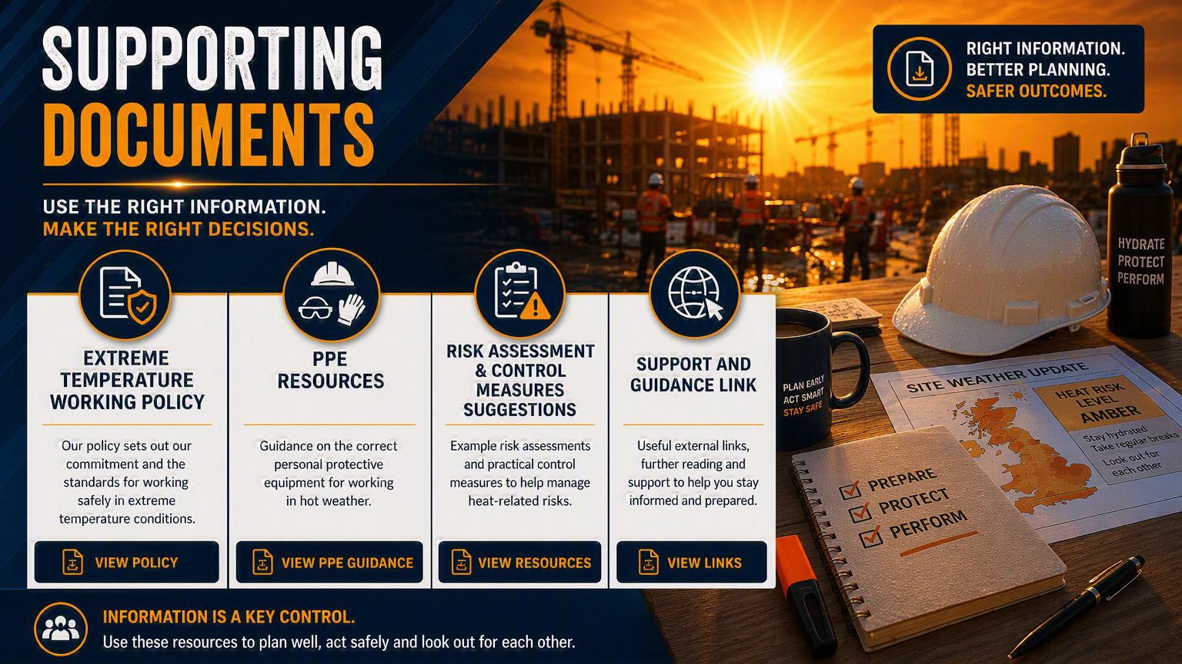
Notes:
SUPPORTING DOCUMENTS
Extremes of temperature is something we have identified as needing to fit together as one management system.
The System Index shows the full suite of tools being developed.
The Policy sets the company expectation and legal duty.
The Weather Alert Monitoring & Escalation Guide explains triggers, Amber and Red response requirements, stop-work authority and decision-making routes.
The Risk Assessment & Control Matrix helps teams assess environmental factors, activity risk, individual vulnerability, heat controls, cold controls and residual risk.
RAMS guidance, model assessments, checklists, toolbox talks, communication templates, infographics and decision records then translate the policy into practical site action.
The purpose is consistency.
We should not have one project treating an Amber alert as business as usual while another stops everything without review. The documents give managers and supervisors a structured way to make proportionate, defensible decisions.
The tools provided support the exercise of good judgement, they do not replace local assessment of actual site conditions.

Slide 8
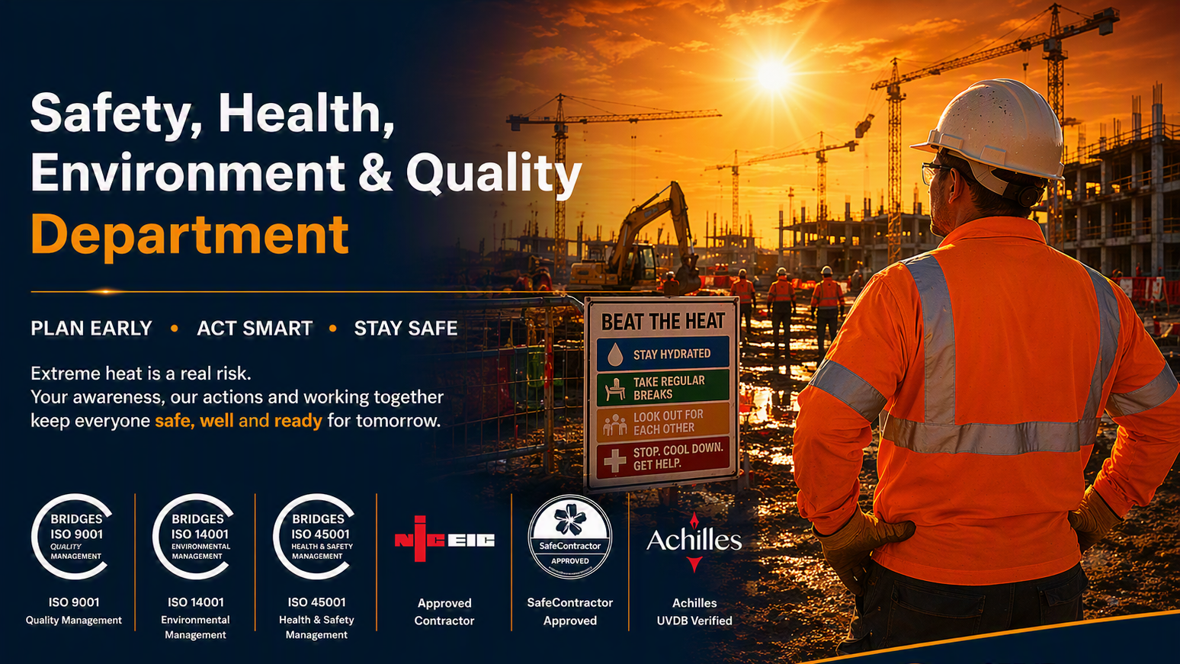
Notes:
That’s all for today, In closing just remember to plan early, assess properly, implement effective controls, monitor continuously and act decisively before harm occurs.
The outcome we want is simple: people go home safe, the business makes consistent decisions, and teams feel confident to raise concerns early rather than waiting for conditions to become an emergency.
Reinforce the stop-work message. If anyone believes environmental conditions present an immediate and uncontrolled risk, they should stop, make the area safe where possible, and escalate through the Site Manager, SHEQ support and senior management route as required.
“see it, assess it, act on it” use the supporting documents so decisions are recorded, communicated and reviewed.

