Slide 1
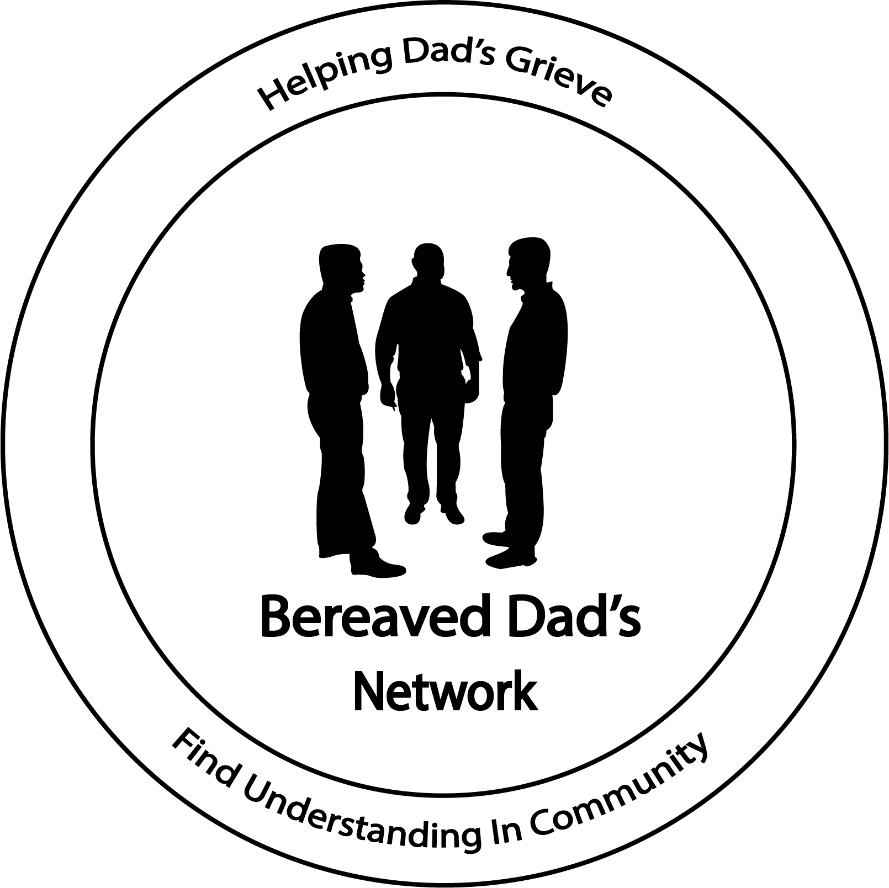

Slide 2
Rules & Disclaimer
How to be a good group member
Keep what is said in the group confidential
2. Ask others dad’s if they want advice or a suggestion before you give it
3. Know that some people can be very intense and goal-oriented
4. Neglect, malpractice or abuse
5. Understand that dad’s in the group will be at different stages
7. Realize that people do not have to like everyone else in the group
8. Realize that peer support groups cannot solve all personal problems
Disclosure: The information, suggestions or recommendations you receive from participating within this group should NOT be used as a substitute for seeking professional care of a trained counselor or medical expert. Our information is designed to be used for peer support and we highly suggest it to be used in conjunction with professional care. We are not licensed or trained professional therapists and/or counselors and provide no claim of such services.

Slide 3
Introductions

Slide 4
Integration of the Shadow
“The shadow goes by many familiar names: the disowned self, the lower self, the dark twin or brother in bible and myth, the double, repressed self, alter ego, id. When we come face-to-face with our darker side, we use metaphors to describe these shadow encounters: meeting our demons, wrestling with the devil, descent to the underworld, dark night of the soul, midlife crisis.”
We must consider that perhaps there are unconscious aspects of ourselves driving our behavior “behind the scenes”. We must look down into our depths and realize that our conscious ego is not always in control, but is often overtaken by the power of our shadow.
Sources: Carl Jung - Swiss psychiatrist, Academy Of Ideas Course , Scott Jeffery

Slide 5
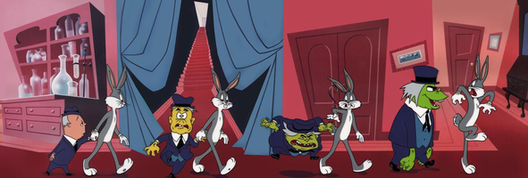
Integration of the Shadow
It’s always standing right behind us, just out of view. In any direct light, we cast a shadow.
The shadow is a psychological term for everything we can’t see in ourselves.
“There is no light without shadow and no psychic wholeness without imperfection.” Carl Jung

Slide 6
Safe People
“I Can Be Myself With Him”
What is a safe person?
They don’t try to fix.
They don’t judge or belittle.
They don’t give adv ice we haven’t asked for.
They don’t have an agenda for how we should progress.
They don’t need us to be a certain way.
They don’t see us as some kind of project.
They aren’t shocked by emotion or chased away by pain.
They allow us to be ourselves & accept us for who we are.
“I’m not alone. There are others willing to walk this road with me.”
Source: Gary Roe – Shattered, Surviving the loss of a child

Slide 7
SPEAKER SERIES
Have You Registered?

