Slide 1
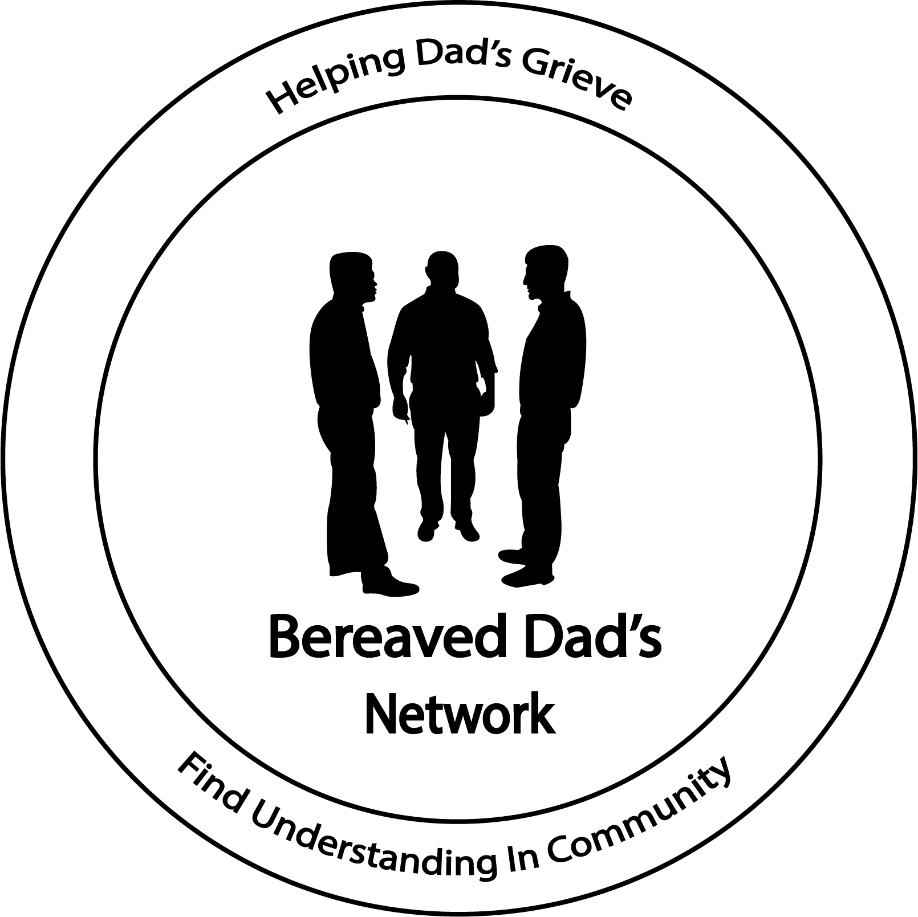

Slide 2
New Year What’s Different
Holidays have come & went…
The New Year has begun!
How was your Christmas & News Years?
What went better than expected?
Any thing you wish you had did different?

Slide 3
Resilience
What is Resilience?
The American Psychological Assoc defines it as
“the process of adapting well in the face of adversity, trauma, tragedy, [and] threats.”
Most people have capacity for resilience
Resilience requires very ordinary processes
These process can be taught & learned

Slide 4
Three habits of resilient thinking
How you respond to situations reflect something called thinking style.
Realistic Optimism aka Optimistic Thinking
Redefining Hope? What are you hoping for now?
Mindfulness – Being fully present in the moment
Notes:
Optimism = hopefulness and confidence about the future or the successful outcome of something.
Hope -

Slide 5
Tools to build resilience
Adopt a positive attitude
Think Flexibility
Embrace a personal moral compass
Find a resilient role model
Face your fears
Develop active coping skills
Establish & nurture a support social network
Physical exercise
Notes:
Optimism = hopefulness and confidence about the future or the successful outcome of something.
Hope -

Slide 6
Boost your self resilience
Understand suffering is part of life
Tune into the Good
As yourself, is this helping or harming me
Notes:
Optimism = hopefulness and confidence about the future or the successful outcome of something.
Hope -

Slide 7
Grief Finger Print
Notes:
Optimism = hopefulness and confidence about the future or the successful outcome of something.
Hope -

Slide 8
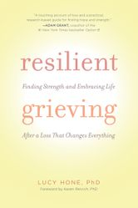
Learn More
Notes:
Optimism = hopefulness and confidence about the future or the successful outcome of something.
Hope -

