Slide 1
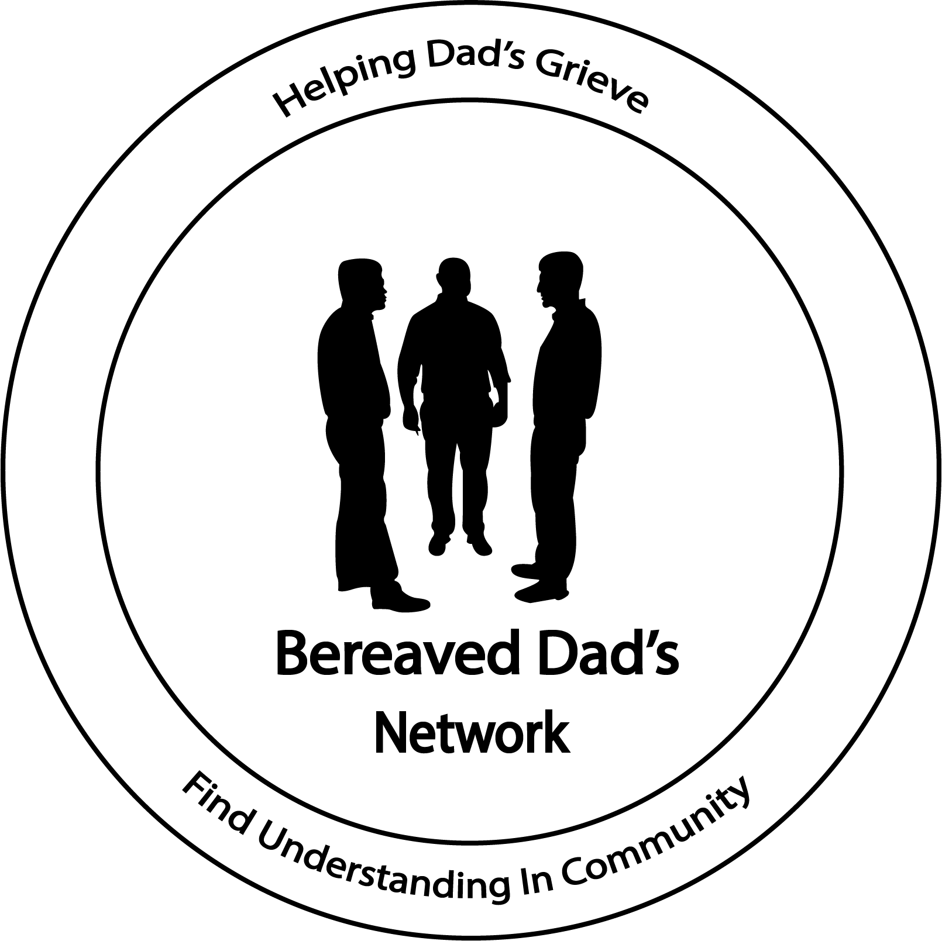

Slide 2
Guilt & Forgiveness
Do you harbor guilt?
    Do you blame yourself…
    Do you feel like you should have prevented it…
    Do wish you had done more…
These are all considered normal thoughts and the only true way to escape the feeling of guilt is to ask for forgiveness and to forgive.

Slide 3
No Guarantees
Death provides us with a painfully blunt reminder that life has no guarantees & we can’t necessarily count on tomorrow.
Thomas Attig is the author of How We Grieve: Relearning the world describes how bereavement uproots our souls and shakes our spirits.
How, ultimately, it is a process of relearning the world. “We do eventually have to find the courage, faith, and hope we need to reengage in the world, take tentative first steps, try fail, try again, fail better, and eventually relearn how to be and act in the world that loss changed so profoundly.”
He continues: “The next chapters cannot unfold just as we expected hoped, or dreamed they would.” Life and meaning are shattered, Welcome to your new unexpected world.

Slide 4
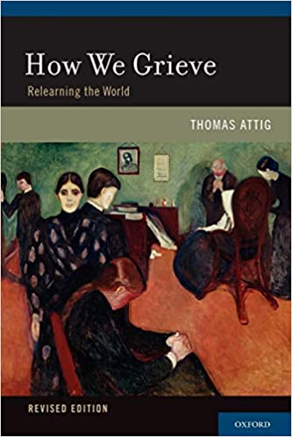
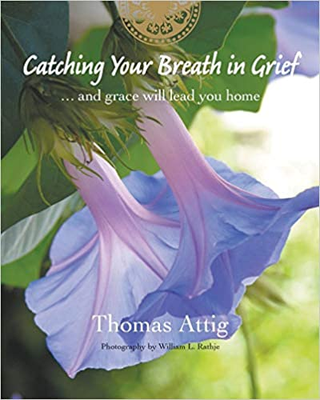

Slide 6
Ernest Hemingway
“The world breaks everyone and afterward many are strong at the broken places.”

