Slide 1
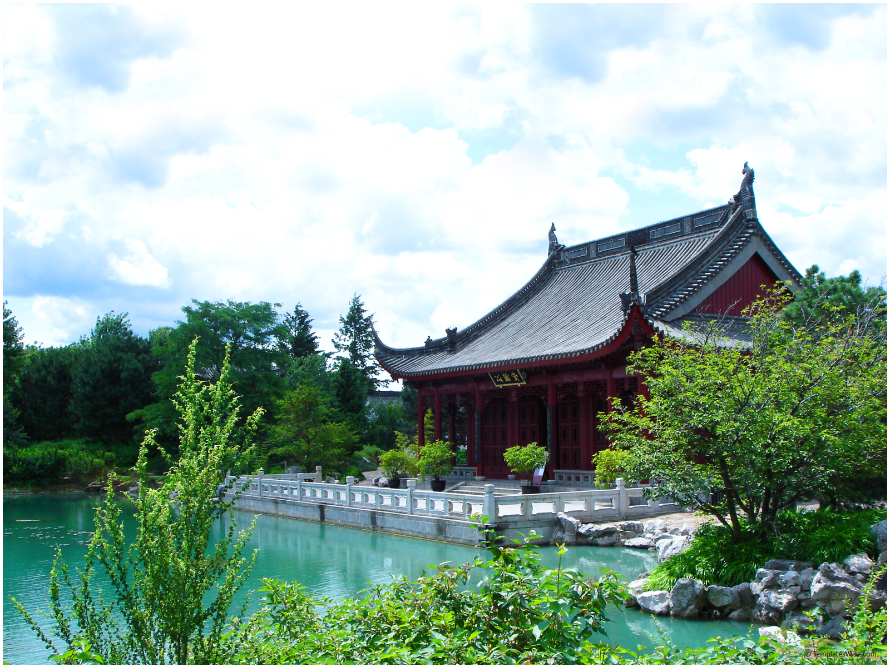
Eastern Meditation Techniques for Stress Reduction
Presented by: Thomas Metzinger

Slide 2
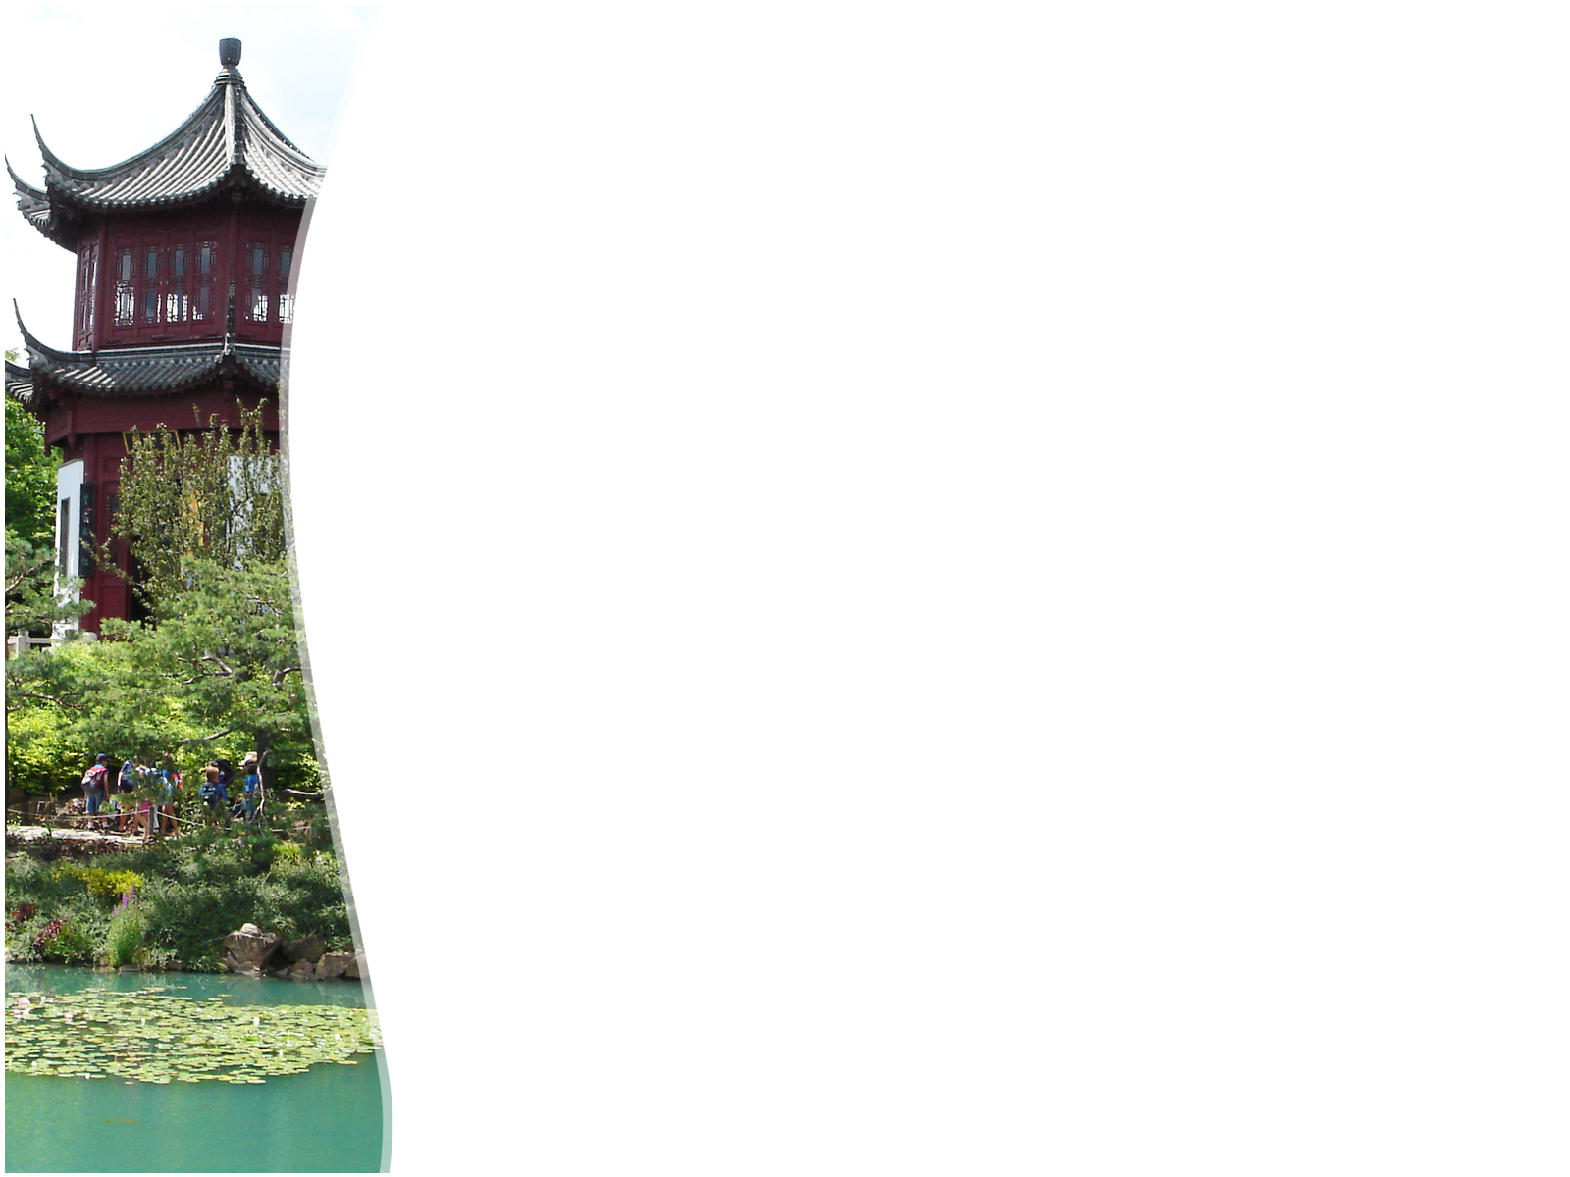
Managing Stress: An Eastern Perspective
The following presentation will discuss how stress can be reduced in order to refocus, use time efficiently, and make healthy choices. Eastern philosophy, medicine, and health takes a more proactive approach.
Health and wellness can best be described as being on a continuum and those, from an Eastern perspective, practice techniques, such as yoga, meditation, tai chi etc., in order to maintain health and prevent disease. Alternatively, Westerner’s appear to take a reactive approach to health, meaning that, when illness occurs, a response is necessary.

Slide 3

Stress
Stress affects our health and wellbeing, sometimes in a positive way (eustress), but mostly negative (distress). Adversely, stress can become debilitating and cause a person to lose focus and make poor decisions.

Slide 4
Signs & Symptoms of Stress
http://www.stress.org/stress-effects/
The American Institute of Stress

Slide 5
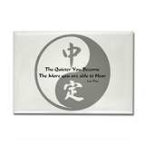
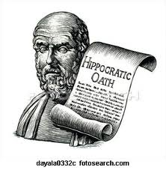
East vs. West
Western Philosophy
Eastern Philosophy
Proactive approach to wellness
Reactive approach toward health

Slide 6
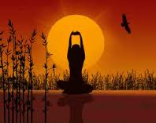
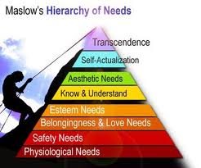
East vs. West
Western Philosophy
Eastern Philosophy
Seeks harmony with the universe
Self as part of the whole
Seeks to master the universe
Self-actualization

Slide 7
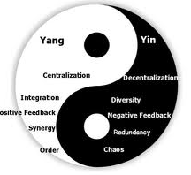
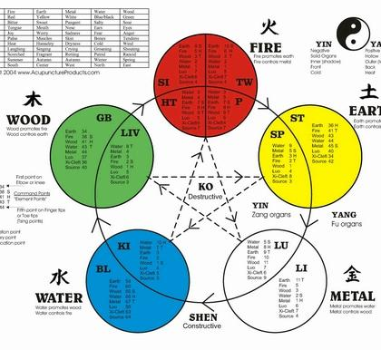
Chinese Medicine
Chi (energy): Yin & Yang
Five Elements

Slide 8
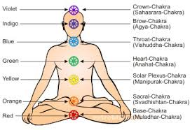
Auryveda, Chakras & Yoga
Indian health and wellness model using energy known as prana (energy). Made popular in American Society through Yoga.

Slide 9
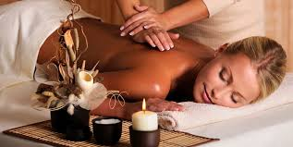
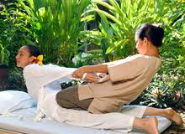
Massage & Bodywork
Profession massage and bodywork can be a great benefit in promoting relaxation.
Massage can also alleviate physical pain, encourage emotional release, and reduce stress.

Slide 10
Meditation
Traditionally, meditation was used as a sacred connection between the physical and spiritual realm.
Today, we can use meditation to connect our minds and bodies.
Meditation can take many forms: tai chi, yoga, guided imagery, introspection, etc.
Meditation, for a few minutes a day, can have a profound effect on stress reduction, as well as, physical and emotional wellbeing.

Slide 11
Progressive Muscle Relaxation
This technique uses contraction and relaxation of major muscle groups in order to promote overall relaxation and stress reduction.
Get in a comfortable position: sitting or laying on the floor with eyes closed. Use circular breathing.
Starting with the toes, slowly tighten and relax muscles, holding for 5 seconds then releasing.
Work your way up: ankles, legs, abdomen, chest, shoulders, arms, hands, neck, face, etc.

Slide 12
Guided Imagery
This meditation technique offers a way to relax by focusing the mind on a guided journey.
Practitioners can use this technique with clients to help center and ground themselves.
Class Experiential:
  Get into a comfortable position
  Close your eyes and use circular breathing
  Open your mind

Slide 13
Quiz
1) Identify the term for negative stress.
eustress
negtress
Sustress
Distress

Slide 14
Quiz
2) Stress can…
a) Increase blood pressure
b) Trigger a sympathetic (fight or flight) response
c) Increase cortisol levels
d) All of the above

Slide 15
Quiz
3) The Traditional Chinese Medical term for energy is…
a) Prana
b) Chi/ qi
c) Meridian
d) Chakra

Slide 16
Quiz
4) The meditation technique of tensing and releasing muscles is called…
Pervasive Muscle Relaxation
Preventative Muscle Relaxation
Purposeful Muscle Relaxation
Progressive Muscle Relaxation

Slide 17
Quiz
5) The process of taking a client through a meditation process by painting visual pictures better known as…
Gradient images
Imagination Therapy
Guided Imagery
Internal imagery

Slide 18
References
Coogan, M. D., & Narayanan, V. (2005). Eastern religions: Origins, beliefs, practices, holy texts, sacred places. Oxford: Oxford University Press.
Fisher, M. P., & Adler, J. A. (2011). Living religions. Upper Saddle River, N.J: Pearson Prentice Hall.

Slide 19
Namaste
Thank you for allowing me to take you on this journey.
I hope that this presentation was helpful.
Does anyone have any:
  Questions?
  Comments?
  Thank you and be well!

