Slide 1
Motivational Interviewing
Training for the healthcare provider
Presented by Thomas R. Metzinger, MSW

Slide 2
What is Motivational Interviewing
A person centered goal orientated approach for facilitating change by exploring & resolving ambivalence (Miller 2006)
A method of communication rather than a set of techniques. It is not a bag of tricks for getting people to do what they don’t want to do; rather, it is a fundamental way of being with & for people – a facilitative approach to communication that evokes change” (Miller & Rollnick 2002)

Slide 3
Risk Factors for Adolescents and Young Adults
Poor self-management
Familial and Relationship Conflict
Risk-taking behaviors (unprotected sex, substance abuse, etc.)
Struggle for Independence
Emotional and mental stressors
Difficulty regulating emtions
Development

Slide 4
Socrates
Ancient Greek Philosopher
“Know Thyself”
Socratic Dialogue/ Socratic Method

Slide 5
Carl Rogers
American Psychologist
Humanistic/ Client-Centered Approach
All humans have a desire to grow in a positive direction, if given the opportunity.
Tenets
  1) Unconditional Positive Regard
  2) Empathy
  3) Non-judgment

Slide 6
William R. Miller and Stephen Rollnick
Clinical Psychologists and academic professors
Creators of Motivational Interviewing
Based upon working with the substance abuser
Foster/ elicit change while overcoming ambivalence
Enhance and engage intrinsic motivation

Slide 7
Tenets
Manage the dynamics of difference: MI is non-judgmental, respects client autonomy, reduces or makes explicit power differentials
Acquire and incorporate cultural knowledge: Identify and mobilize client’s intrinsic values, beliefs and goals
Adapt to diversity and the cultural contexts of the individuals they serve: partnership/utilization of existing resources, amount of direction is adjusted based on client input -SAMHSA

Slide 8
The Spirit of MI: A.C.E.
Autonomy (only they have the power to change their lives)
Collaboration (work together rather than just dishing out unsolicited advice)
Evocation (evoke and elicit reasons for and concerns about change).

Slide 9
Processes of MI
Engaging – Establish a mutually trusting and respectful helping relationship.
Focusing – Clarify a particular goal or direction for change.
Evoking – Elicit the person’s own motivation for a particular change.
Planning –Developing a specific change plan that the client is willing to implement.

Slide 10
The Spirit of Motivational Interviewing vs. Its Mirror Image
COLLABORATION VS. CONFRONTATION
EVOCATION VS. EDUCATING
AUTONOMY VS. AUTHORITY

Slide 11
Ambivalence:
The Dilemma of Change
“I want to, and I don’t want to”
Ambivalence is a normal aspect of human nature.
Passing through ambivalence is a natural phase in the process of change.
Ambivalence is a reasonable place to visit but you wouldn’t want to live there.

Slide 12
The Righting Reflex
The desire to set things right often leads to: Acting on the inclination to
  advise,
  teach,
  persuade,
  counsel or
  argue for a particular resolution to a patient’s ambivalence

Slide 13
Reactions to Righting Reflex
Angry, agitated Oppositional
Discounting Defensive
Justifying Helpless
Overwhelmed Ashamed
Trapped Disengaged
Not come back-avoid Uncomfortable
Not understood Not heard
Procrastination Afraid

Slide 14
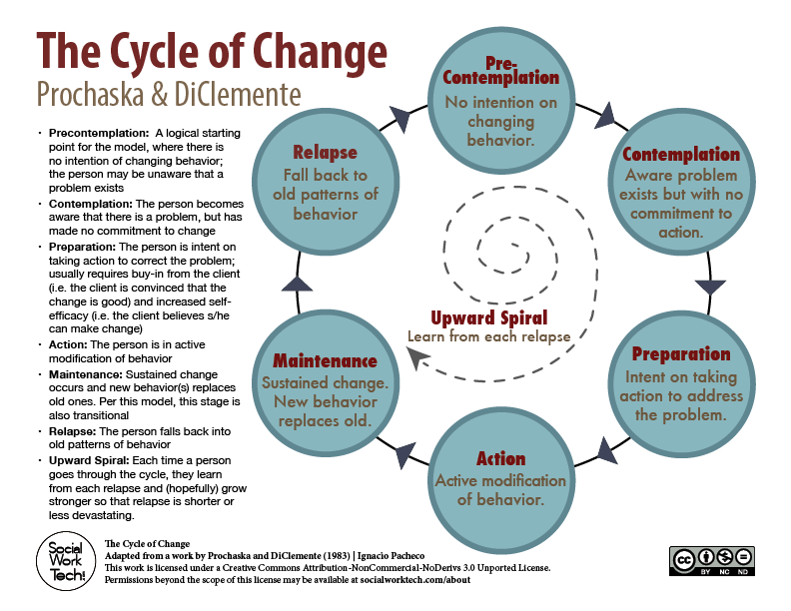

Slide 15
In Motivational Interviewing:
Direct persuasion is not very useful for resolving ambivalence
Motivation is elicited from the patient and not imposed from without
The patient is supported in identifying and resolving ambivalence
Patient values and autonomy respected
“Change talk” recognized & responded to
Resistance is treated constructively

Slide 16
Four General Principles of
Motivational Interviewing
1. Express Empathy
2. Develop discrepancy
3. Support self-efficacy
4. Roll with resistance

Slide 17
Principle 1: Express Empathy
Listen actively with the goal of understanding
Skillful reflective listening is fundamental
Acceptance facilitates change
Ambivalence is normal.

Slide 18
Principle 2: Develop Discrepancy
Motivation for change occurs when people perceive a discrepancy between where they are and where they want to be.
Values and beliefs are key factors
The person rather than the practitioner should make the arguments for change

Slide 19
Principle 3: Support Self-Efficacy
A person's belief in the possibility of change is an important motivator.
The patient, not the practitioner, is responsible for choosing and carrying out change.
The practitioner's own belief in the person’s ability to change becomes a self-fulfilling prophecy.

Slide 20
Principle 4: Roll with Resistance
Avoid arguing for change.
Resistance is not directly opposed.
New perspectives are invited and not opposed.
The patient is the primary resource in finding answers and solutions.
Resistance is a signal to respond differently.

Slide 21
Roll with Resistance
Reluctance and ambivalence are to be acknowledged (and even respected) and not confronted directly
Questions and problems may be turned back to the patient for solution
Explicit permission is given to disregard what the interviewer is saying
Resistance supplies energy which can be used therapeutically

Slide 22
Motivational Interviewing Tools: OARS
O - Open Questions
A – Affirm
R – Reflect
S - Summarize

Slide 23
O= Open-ended Questions
Patients should do most of the talking (avoid “yes/no” questions)
Useful early in session to build rapport & provide direction
Ask for “both sides of the coin”
The general pattern in MI is to ask an open question, setting the topic of exploration, and then follow with reflective listening.

Slide 24
A= Affirming
Compliments or statements of appreciation and understanding
Notice and appropriately affirm the patient’s strengths and efforts
Genuineness is critical Appreciation vs. approval

Slide 25
R= Reflect
Demonstrates a desire for mutual understanding
Start with simplest levels of reflection and move forward as rapport builds
Good follow up to open-ended question “Listen more than tell”
Being selective as we hold up a mirror for the people we work with
Simple Reflection (focused on feelings; e.g., “You’re angry about
being sent here.”)
Amplified Reflection (overstating feelings; e.g., “You’re furious about being sent here.”)
Double-Sided Reflection ("On one hand you like the way things are; and on the other hand there’s part of you that would like to make a change.")

Slide 26
S= Summarizing
Periodic summaries reinforce what has been said, show that you have been listening carefully, and prepare the patient to elaborate further.
It’s like collecting flowers one at a time and then giving them to a person in a bouquet.

Slide 27
Readiness to Change:
Assessing Importance & Confidence
Likert scale: 1-10
Top three goals
How have you been successful in the past?

Slide 28
DEALING WITH RESISTANCE
S imple Reflections
A mplified Reflections
D ouble-sided Reflections
S hifting Focus
C oming Along Side
A greement w/ a Twist
R eframing
E mphasizing Personal Control
D isclosing Feelings

Slide 29
Guidelines for the Medical Providers
R - Resist the righting reflex (avoid instructing the patient in an authoritarian manner)
U - Understand the patient (use open-ended questions)
L - Listen to the patient (use reflections to convey understanding and empathy)
E – Build self-efficacy (convey support and confidence in patient’s ability to make changes)

Slide 30
More MI Language & Acronyms
Change Talk – Any client speech that favors movement toward a particular change goal.
D.A.R.N. – Subtypes of client preparatory change talk: Desire, Ability, Reason and Need.
C.A.T. – Subtypes of client mobilizing change talk: Commitment, Activation, and Taking Steps.

Slide 31
Resources
Copeland, M. (2005). Socratic circles: Fostering critical and creative thinking in middle and high school. Portland, ME: Stenhouse Publishers.
Miller, W.R. & Rollnick, S. (2013). Motivational interviewing: Helping people change (Third Edition). New York, NY: The Guilford Press.
Naar-King, S., & Suarez, M. (2011). Motivational interviewing with adolescents and young adults. New York, NY: Guilford Press.
Prochaska, J. O., Di, C. C., & Norcross, J. C. (2002). Changing for good: A revolutionary six-stage program for overcoming bad habits and moving your life positively forward. New York, NY: Avon Books.

Slide 32
Resources
Rogers, C. R. (1995). On becoming a person: A therapist's view of psychotherapy. Boston, MA: Houghton Mifflin.
SAMHSA TIP 35: Enhancing motivation to Change in Substance Abuse Treatment and other documents on Motivational Interviewing: http://store.samhsa.gov/facet/Treatment- Prevention- Recovery/term/Motivational-Interventions
Thorpe, C. W. (2015). Motivational interviewing training for health professionals. CreateSpace Independent Publishing Platform.

