Slide 2
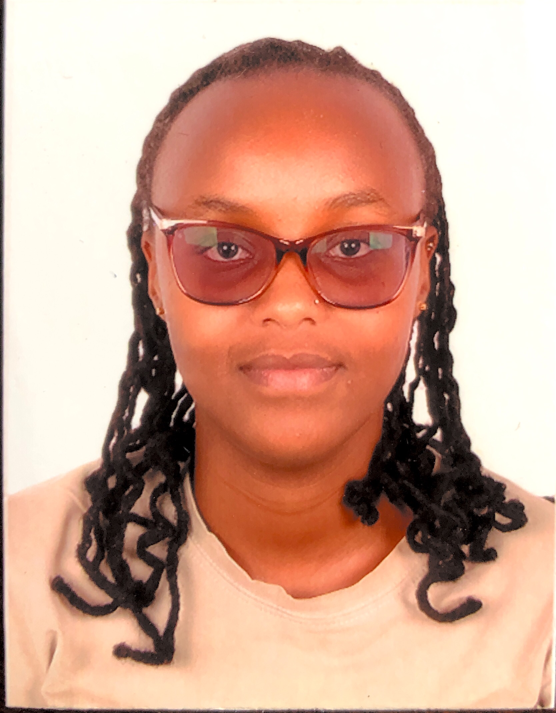
Angela Wangari Gathuri
BSc. Environmental Science.
Cover profile
A passionate environmentalist with an objective of strategically and sustainably support environmental development through creative utilization of gained knowledge and skills in environment issues pertaining to sustainability, leadership and management. Endeavoring to make positive impacts on environment matters through adherence to set quality standards both locally and internationally as per set environmental goals and objectives.
KEY ACHIEVEMENTS
Participation in Africa For Sustainable Development Fellowship.
Actively participate in volunteer activities in a couple of volunteer programs. One of them being being Greenpeace Africa, where I am part of three main groups;
•Biodiversity and research
•Open and street campaign
•Greenpeace Volunteers-Security Training.
Also I am part of Youth for Our Planet (YFOP) which is the global youth movement calling for urgent action on the nature crisis and climate action.

