Slide 1
Africa for sustainable development Fellowship
Introduction
COHORT 3 Profiles

Slide 2
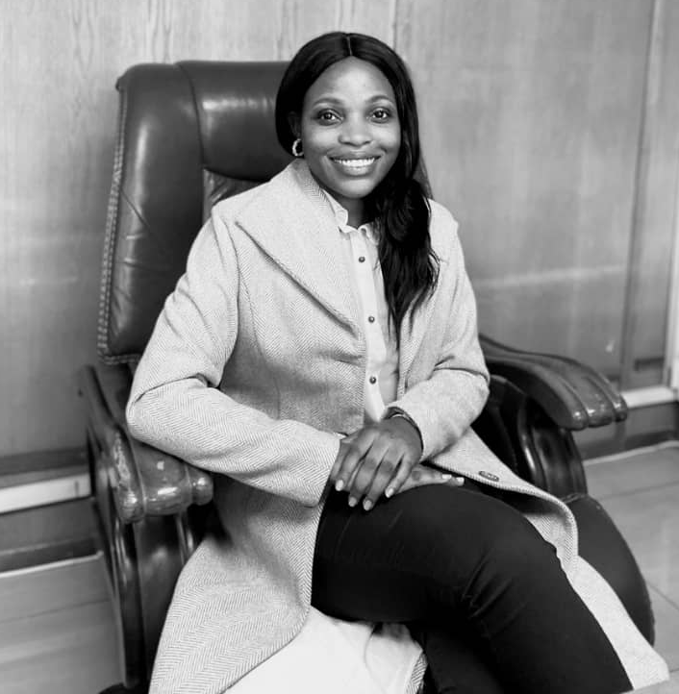
Audrey Milcah Madzudzo
Sustainable Infrastructure Development
Audrey Milcah Madzudzo works for the Infrastructure Development Bank of Zimbabwe (IDBZ), where she is a Principal Technical Officer in the Infrastructure Projects Department. Her role involves identifying, evaluating, and implementing various projects. Trained as a Quantity Surveyor, she has a strong background in managing construction costs and overseeing project progress. Audrey is also advancing her skills by completing a Master's degree in Development Finance, which adds to her ability to assess and manage investment projects. As IDBZ's Sustainability Standards Certification Support person, she champions environmentally and socially responsible development projects, ensuring alignment with global best practices. Her combined expertise in finance and sustainability is essential for the bank's efforts in funding and executing development projects that contribute to the country's economic growth in a sustainable way.
Key Achievements:
BSc Honours Degree in Quantity Surveying
Principal Technical Officer for the Infrastructure Development Bank of Zimbabwe
Appointed Sustainability Standards Certification Initiative Support Person
Macroeconomics of Climate Change - Science, Economics, and Policies with the International Monetary Fund

