Slide 1
Africa for sustainable development Fellowship
Introduction
COHORT 3 Profiles

Slide 2
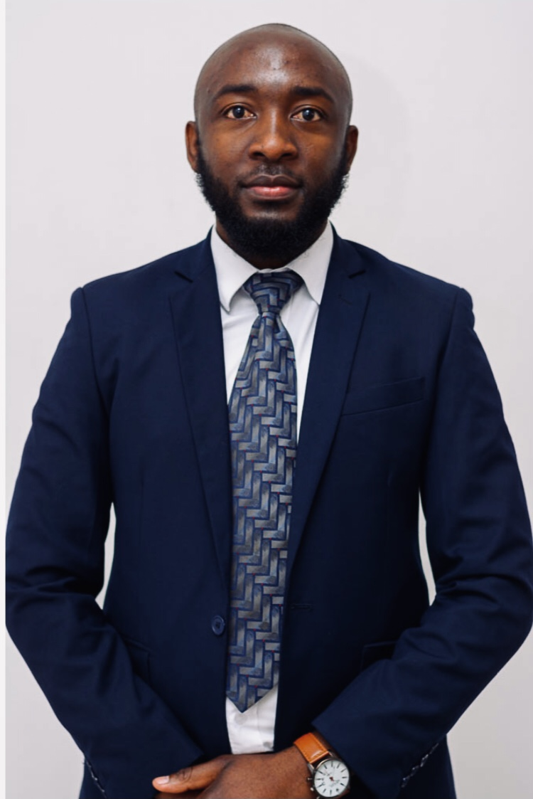
CHEWE NKAMBA
PUBLIC HEALTH
Chewe Nkamba is a highly accomplished professional in the field of project portfolio and program management, boasting four years of extensive experience in areas such as HIV/Sexual and Reproductive Health Rights (SRHR), youth engagement, and mental health advocacy. Currently holding the position of School-Based Prevention Interventions Officer at Copper Rose Zambia, I have a track record of successfully creating and executing creative programs that align with the organization's strategic goals. I am a dedicated public health specialist deeply committed to advancing the Sustainable Development Goals, with a particular focus on promoting gender equality and improving health and well-being. I excel in crafting and implementing innovative public health initiatives that address health disparities, champion gender equity, and enhance community health. My passion lies in effecting positive change through evidence-based strategies and advocacy.
Key Achievements:
Bachelor’s Degree in Adult Education
Master of Public Health Candidate
USAID Youth Lead Alumni
Provided consulting services to government agencies and NGOs, offering expertise in Team Building
Coordinated and mobilized over 1000 young people at the first-ever youth Rise Up summit

