Slide 1

Africa for sustainable development Fellowship
Introduction
COHORT 3 Profiles

Slide 2

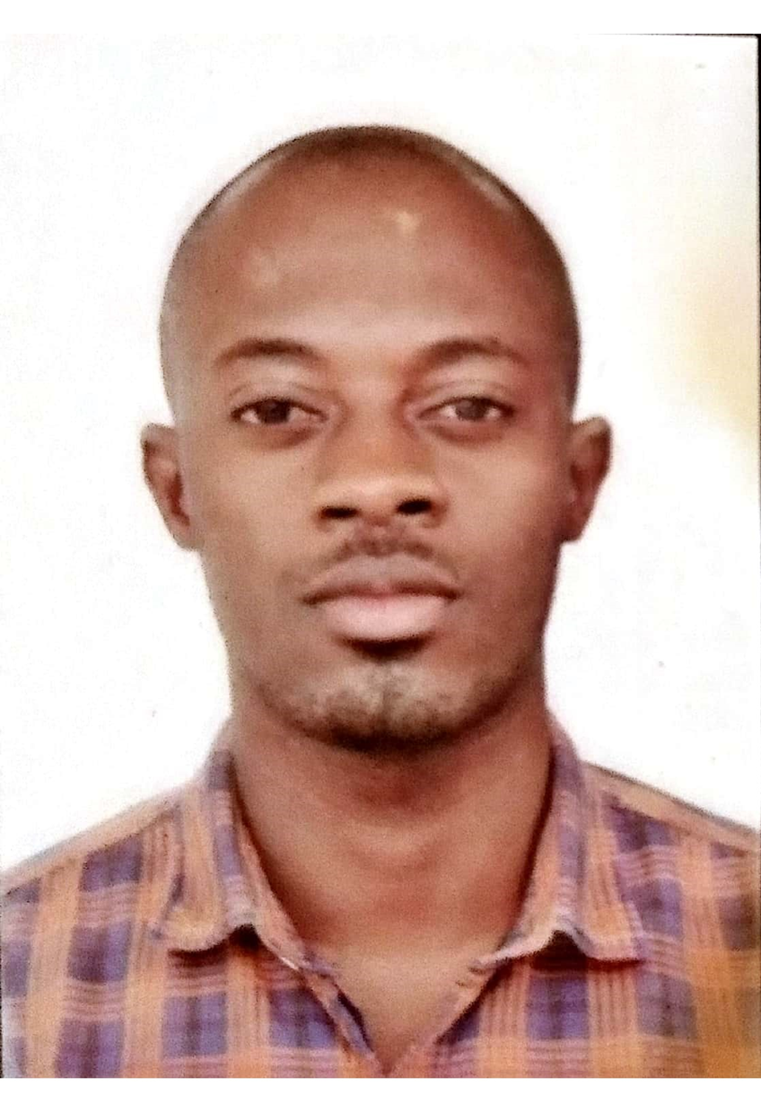

Chimfwembe Mutale
Renewable Energy /Climate Change
Chimfwembe Mutale is a Sustainable Development Goals champion whose focus is on offering consultancy services as a qualified solutions expert(energy and climate) at Onfrontiers platform strategic, multi-disciplinary services to public and private sector stakeholders seeking to assess the risks of climate factors and to mitigate those risks and their potential consequences. His broad expertise across numerous engineering disciplines, public health, ecological and renewable energy, environmental sciences, hydrology, natural resource damage assessment, and restoration and mitigation analysis gives clients access to an unparalleled wealth of skills and resources that can help any industry build unique solutions to unprecedented challenges. He is also a managing director at Yaaka Investments Limited- an ecoprenuer start-up company solving community & global climate challenges. He also offers mentorship classes for young boys below 20 years old.
Program Milestones:
Raised $15742 in seed funding
100+ Clients for mentorship
Key Achievements:
Top 10 innovations in WASH($14k grant-UNDP)
Digital Hamburg logistics Top 3 WASH innovations
Featured in the top 50 African Climate Innovators magazine by UNDP & CTCN 2022
Seed starter top 10 energy and climate innovations

