Slide 1
Africa for sustainable development Fellowship
Introduction
COHORT 3 Profiles

Slide 2
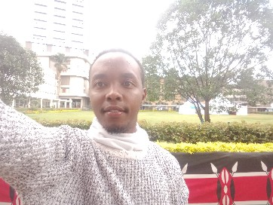
Dennis Njiru Mwarange
Sustainable cities and communities/ Zero carbon impact warrior
Dennis Njiru Mwarange is an economist, statistician and dedicated researcher whose goal is to pursue a career in a dynamic working environment to learn and add substantive value by applying my knowledge skills and experience in order to become a valuable asset. Dennis continues to research extensively on technology, poverty, inequality and consumer behavior with an eye on sustainable development. As a technology enthusiast, I advocate for the adoption of breakthrough technology to transform lives and green growth. Dennis is a member of a project Youth For Change Carbon Zero Warriors where our goal is to empower and educate youth on the urgent need for sustainable practices in combating climate change while mobilizing meaningful action towards achieving a zero carbon future. Dennis is also a member of a group of fellows in the planning stages of developing a start up that bridges the gap between project participants and service providers as well as a one stop shop for data on affordable housing that contains a library for training resources on how to build climate friendly housing.
Key Achievements:
Founder and member Youth For Change Carbon Zero Warriors.
Fellow Africa For Sustainable development.
Fellow Zero Carbon Impact Fellowship
Participant in repliCATS research project.
Program Milestones:
Trained over 200 youths on topics related to climate science, change impacts and strategies for achieving net zero carbon emissions.
Design and execution of targeted awareness campaigns using social media, email and other online channel to reach and engage youths.

