Slide 1
Africa for sustainable development Fellowship
Introduction
COHORT 3 Profiles

Slide 2
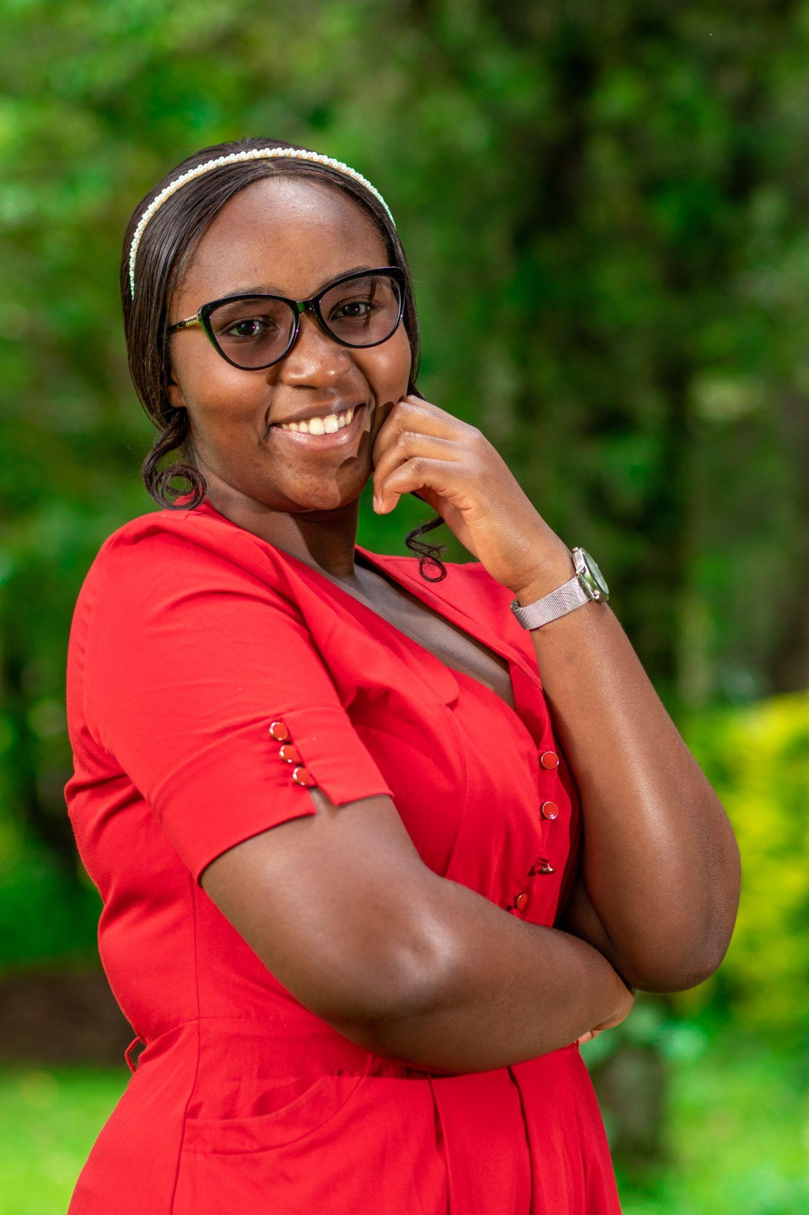
Grace Muthoni Kaimburi
Young Climate Change Leader
Grace Muthoni Kaimburi is a female Kenyan young lady, aged 22 who is dedicated to foster youth empowerment and advocate for the Climate Change. She is a Software Engineer with exceptional leadership, and policy advocacy skills. She has devoted over 2 years to NGOs steering community projects in SRHR, governance, gender equality and human rights. Currently working with the she spearheads SRHR advocacy initiatives at local, national and international levels. Her unwavering commitment radiates through her advocacy, volunteerism and youth empowerment to challenge systemic inequalities for a fairer world. Her service in the WHO Youth Council, is a commitment to contributing towards lasting change on global health. She Holds a Bachelor’s Degree of Social Science with a major in Development Studies and currently pursuing a Master of Arts in International Relations and Diplomacy.
Key Achievements:
BSc in Software Engineering
Founder of the Maji Yetu Foundation
Serve as a Young Climate Change Leader
Youngest Presenter ai the Pre-COP 28 African Group of Negotiators Experts and Support
Momentum Tiyeni youth innovation Challenge
Young women Leadership Programme fellow
National Climate Change Negotiator
Africa for Sustainable Development Fellow

