Slide 1
Africa for sustainable development Fellowship
Introduction
COHORT 3 Profiles

Slide 2
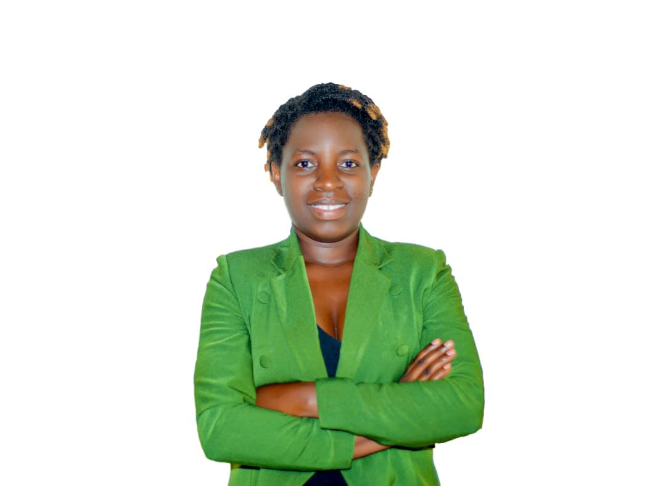
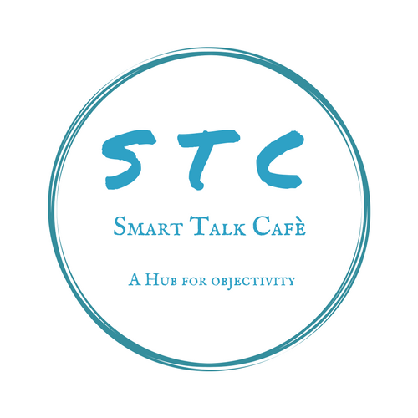
Hyacinthe Mizero Ahingeneye
AGYWs mentor/program manager and resource mobilization officer
Hyacinthe Mizero Ahingeneye is sustainable development champion who focus on gender and women empowerment and driven guidance mentor with 3+ years experience educating women SRHR (sexual reproductive health and rights), life skills and financial. She works as mentor for adolescent girls and young women by carrying out comprehensive sexuality education and fight against gender based violence. Hyacinthe's expertise stems from her participation in various impactful programs, including the YALI program, Training of Trainers, Young Citizen Training, and the Intwari Women program. As a founding member of Women GAIN Rwanda, she holds the position of program manager, contributing significantly to the organization's objectives. Her training covers a broad spectrum of essential areas, including women's leadership, financial literacy, gender-based violence, SRHR, psychosocial support, and mental health. Furthemore, Hyacinthe serve as a resource mobilization officer for Grown to help organization and volunteer as AGYWs mentor within DUHAMIC ADRI.
Key Achievements:
Formed and sustained 24 saving group for AGYWs in my community
Facilitated 30 AGYWs accessissing vocational training
Represented Davis college in Global Social Innovation Challenge (GSIC) competition to Sandiego in 2020
Serve as ICPD 25 young champion
Founding member of women GAIN Rwanda
Recognition:
YALI alumni, YCTP alumni, ICPD 25 young champions in the context of sustainable development using the framework of SRHR and rights, and Davis college representative in Global Social Innovation Challenge (GSIC) competition to San Diego in 2020.

