Slide 1
Africa for sustainable development Fellowship
Introduction
COHORT 3 Profiles

Slide 2
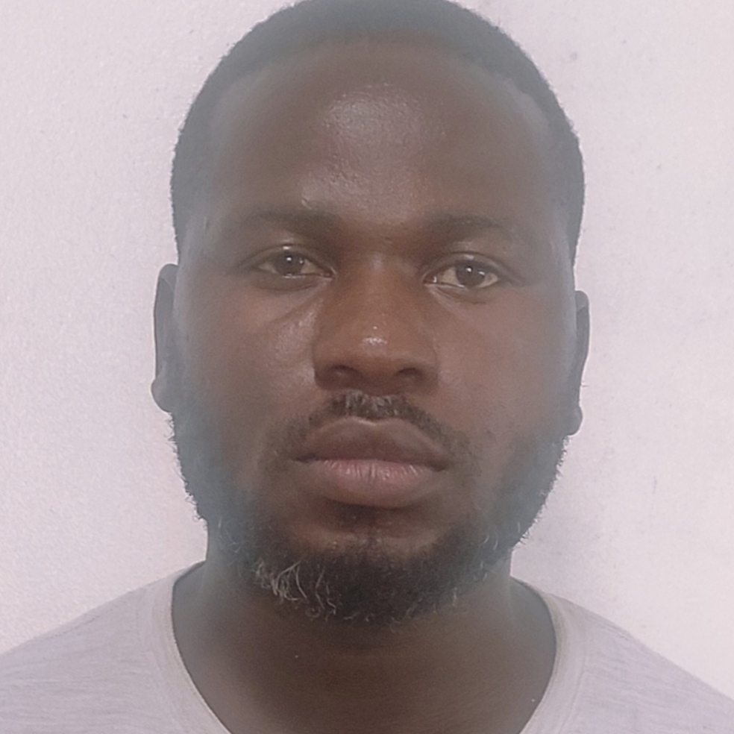
CHANCY TSONGA
Affordable housing and Green cities | Living Extra
Chancy Tsonga is a highly skilled Sustainable Development Specialist with a strong background in Digital Media and Strategic Planning & Communication. His expertise extends to software design and management. He has a direct and deep connection with the Construction and Infrastructure Development industry. Chancy is a hands-on Co-founder of the innovative startup, “Live Extra.” This company is on a mission to revolutionize the construction industry by focusing on sustainable housing and green cities. Chancy and his team advocate for a paradigm shift in the way we build, with a commitment to creating sustainable, affordable, and climate-responsive housing units across African cities. His pivotal role within Live Extra extends to technology research, where he stays on the cutting edge of advancements. Chancy also takes charge of marketing and branding for the project portfolio.
Key Achievements:
The project is a start-up, currently under product assessments
Conducted technology assessment in both software and construction industry materials
Designing and planning a webinar for stakeholder engagement and resource mobilization

